Slide 1
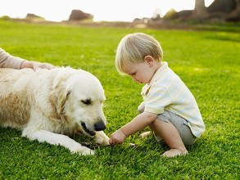
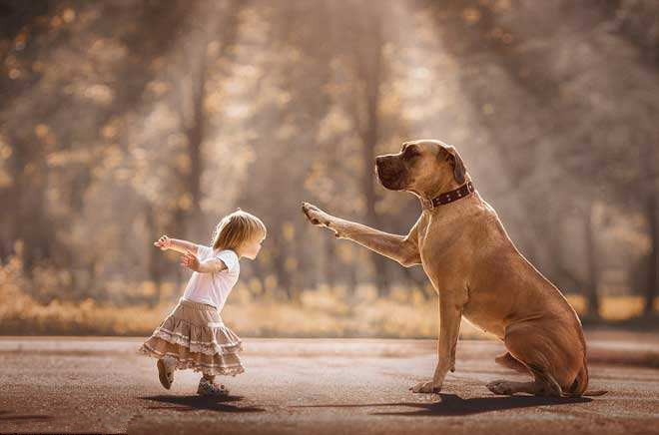
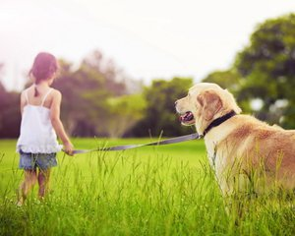
Unit 6 Pets
Grammar

Slide 2
目录
Lead-in
1
While-Learning
2
3
Post-Learning
Review
4

Slide 3
Part I Lead-in

Slide 4
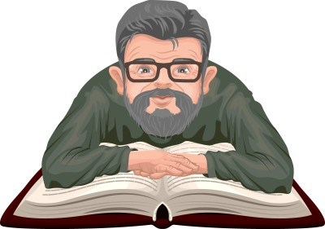
read
widely
The old man read______.

Slide 5
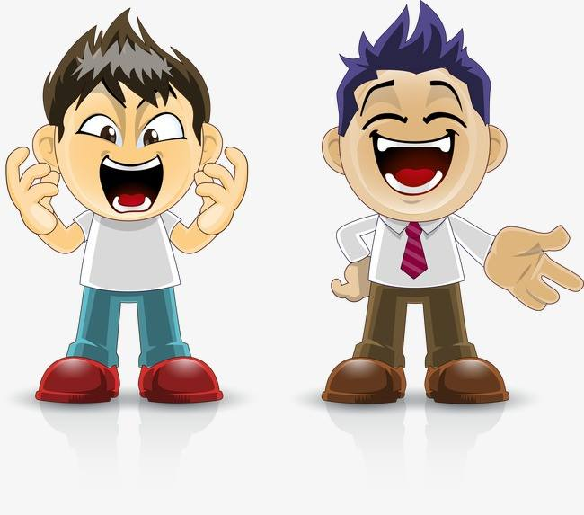
play
happy
The boys are _______.
They play ________.
happily

Slide 6
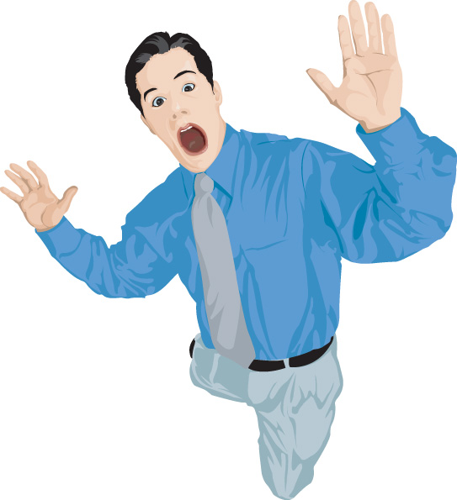
shout
loudly
The man shouts _______.

Slide 7
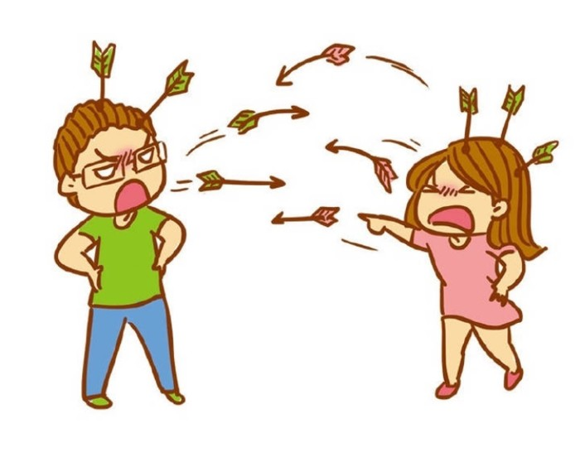
quarrel
They quarrels _______.
rudely

Slide 8
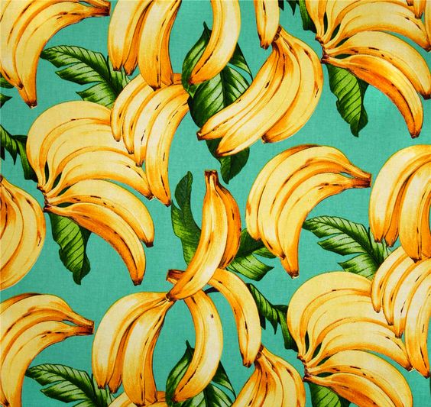
What kind of words are they?
widely
The old man read_______.
They play ________.
rudely
They quarrels _______.
Adverb
adv.
happily
The man shouts _______.
loudly

Slide 9
Part II While-Learning

Slide 10
adverbs 副词
副词的基本形式：（形容词+）ly结尾
副词的主要作用：用来修饰动词、形容词、其他副词或整个句子，说明时间、地点、程度、方式等。

Slide 11
Find out the adv. and what do they use for?
The boy can run quickly.
The girl looks really beautiful.
She sings very well.
Luckily, the lost girl was found.
修饰动词
修饰形容词
修饰副词
修饰整个句子

Slide 12
A Using adverbs with verbs
We can use adverbs to talk about how something happens or is done.
The cat is sleeping peacefully.
The girl is talking with her mum happily.
A dog will love you faithfully and bring you lots of happiness for many years.
副词通常在主要动词
或宾语的后面
Work out the rule
We usually put the adverb (after/before) the main verb or the object.

Slide 13
Many adverbs are formed by adding –ly to adjectives:
Adjectives | Changes | Examples
Most adjectives | +ly | quick---quickly
Adjectives ending in –y | y + ily | easy---easily
Adjectives ending in a consonant + -le | e + y | simple---simply
Adjectives ending in -ll | + y | full---fully

Slide 14
副词的构成
1.许多副词是由形容词加-ly 构成的。
形容词变副词的一般规律如下表:
形容词 | 构成相应副 词的方法 | 举例
大多数形容词 | 在词尾加-ly | careful-carefully slow-slowly
以辅音字母加-y结尾的形容词 | 先将y改为i, 再加-ly | heavy-heavily easy-easily
绝大多数以-e结尾的形容词 | 在词尾加-ly | polite-politely wide-widely
少数以-e结尾的形容词 | 先去e再加-ly | true-truly
以-ll结尾的形容词 | 在词尾加-y | full-fully

Slide 15


Things to remember
2. 有些词既可以作形容词，也可以作副词。常见的有：early, fast, late, hard, high等。
hard, fast, late
These adverbs have the same form as adjectives.
He is a hard worker. He works hard.
She is a fast runner. She can run fast.
Do you like late dinners? No, I do not like to eat late.

Slide 16
Things to remember
3. good是形容词，well是副词。
good, well
Good is an adjective; well is an adverb.
Is she a good singer? Yes, she sings well.

Slide 17
Practice
1. Don’t eat so ___(quick/quickly).
It’s not good for you.
2. Why are you ___(angry/ angrily)?
I haven’t done anything.
3. Can you speak ___(slow/ slowly)?
4. Bill is a very ___(careful/carefully) driver.
5. Jane is studying ___(hard/ hardly).
6. Those oranges look ___(nice/nicely). Can I
have one?

Slide 18
7. Please be ___(quiet/quietly). I’m studying.
8. ---Where is Diane?
--- She was here but she left___(sudden/
suddenly)
9. He insisted on being paid __(immediate/
immediately).
10. It is ___(impossible/ impossibly) for lost
time to be made up.

Slide 19
请用括号中单词的适当形式完成Happy所说的话。
It is a month since Happy spoke to his workers. All the customers are coming back to Happy’s pet shop. Happy wants to speak to his staff again.
You are all behaving ______(good). Everyone is dressing ______(neat) and serves the customers _______(quick). Rose always speaks ______(polite) to everyone. Terence smiles _______(cheerful) all the time. All of you listen to the customers _______(patient). The bills are added up ________(accurate). The customers leave the shop _______(happy). The business is increasing ______(fast). Next month I shall ________(definite) raise your pay.
well
neatly
quickly
politely
cheerfully
patiently
accurately
happily
fast
definitely

Slide 20
A man called Happy keeps a pet shop, but today Happy is not happy! He is speaking to his workers. Complete the sentences with the correct form of the words in the box. Use each word only once.
bad correct happy quick cheerful good patient
My customers are leaving me because You act (1)__________.
In the future, I want you all to smile (2)_______
at our customers. I want you to listen to them (3)_________. I want you to work(4)________ and add up all the amounts (5)___________.
Finally, I want you all to dress (6)_____.Do all these things, and I’m sure we’ll work (7) _______ together.
badly
cheerfully
patiently
quickly
correctly
well
happily

Slide 21
Read the sentences below. What kind of sentence are they?
Tom runs as quickly as Jim.
Tom runs more quickly than Peter.
Ted runs (the) most quickly of the four.
副词的比较级 与 形容词比较级 类似。
副词的最高级 也与 形容词最高级 类似。

Slide 22
B The comparative and superlative of adverbs
We have learnt how to compare people or things with adjectives. We can use adverbs to compare how something happens or is done.
We can take care of pet dogs more easily in
large open spaces than in small spaces.
Of all her friends, Emma looked after her pet
dog (the) most carefully.

Slide 23
Adverbs | Comparatives | Superlatives
quickly | more quickly | (the) most quickly
slowly | more slowly | (the) most slowly
hard | harder | (the) hardest
fast | faster | (the) fastest
late | later | (the) latest

Slide 24
Work out the rule
To form the comparative and superlative of adverbs ending in –ly, we add __________ and ____________ before them.
For adverbs that do not end in –ly and have the same form as the adjectives, we often add_______ and _______ to them.
more
(the) most
-er
-est

Slide 25

Things to remember
The comparative and superlative forms of badly, for, little, much and well and irregular:
badly----worse----worst much----more----most
far----farther/further---farthest/furthest
well---better---best
little----less----least

Slide 26
副词比较级和最高级的构成
1. 规则变化
构成方法 |  | 原级 | 比较级 | 最高级
与形容词同形的副词、不以 ⁃ly结尾的副词 | 在词尾 加⁃er， ⁃est | fast hard | faster harder | (the) fastest (the) hardest
以⁃ly结尾的 副词 | 在其前 面加 more， most | quickly | More quickly | (the) most quickly

Slide 27
副词比较级和最高级的构成
2. 不规则变化
well-better-(the) best
badly-worse-(the)worst
much-more-(the) most
little-less-(the) least
far-farther / further-(the) farthest /furthest
注：副词最高级前面的the可以省略。

Slide 28
副词比较级和最高级的用法
等 级 | 比较程度 | 表达方式 和意义 | 例句 | 备注
比 较 级 | 不同程度 （两者比较） | 副词比较级+ than (比……) | He works harder than his sister. | 比较级前面可以用much, a little, even, still, a lot 等词修饰。
最 高 级 | 不同程度 （三者或三 者以上比较） | (the) + 最 高级+ in (of) ... (最……) | He works (the) hardest in his class.

Slide 29
Emma interviewed 40 people to find out which pet centre is the most popular. Help her complete her report with the information from the table below. Use the comparative and superlative of the adverbs in brackets.
Pet centre | Good animal doctors | Good helpers | Number of visits
TEP | //// //// //// | //// //// // | //// //// //
LOVE | //// / | //// // | ////
Ken’s | /// | // | /
Heart | //// //// //// // | //// //// //// //// | //// //// //// //// //

Slide 30
I interviewed 40 people who keep pets at home. They think the animal doctors at TEP check pets (1)
___________ (carefully) and the helpers help look after pets (2)___________ (patiently) than those at LOVE and Ken’s. However, among the four pet centres, people go to Heart (3)_______________(regularly). They think the animal doctors and helpers there did their jobs (4)_______(well). They seldom go to Ken’s because the animal doctors there usually work (5)_________(slowly) than those in the other centres. Of all these four pet centres, Ken’s helpers care (6)___________(little) about pets.
more carefully
more patiently
(the)most regularly
the best
more slowly
(the)least

Slide 31
Exercises
A
– Would you please drive _____?
My plane is taking off.
-- I’d like to, but safety comes first.
faster
B. better
C. more carefully
D. more slowly

Slide 32
D
2. Of all the teams in NBA, I think the Los Angeles Lakers played _____ this year.
most successfully
B. the more successfully
C. very successfully
D. much more successfully

Slide 33
B
3. She is very good at painting. She can paint ___ her teachers.
as better as B. as well as
C. as good as D. so well as
4. This maths problem is ___ that one.
not so easy as B. more easily than
C. as easier as D. easy than
A

Slide 34
Part III Post-Learning

Slide 35
Summary
副词
副词的基本形式：（形容词+）ly结尾
副词的主要作用：用来修饰动词、形容词、其他副词或整个句子，说明时间、地点、程度、方式等。

Slide 36
副词的构成
1.许多副词是由形容词加-ly 构成的。
形容词变副词的一般规律如下表:
形容词 | 构成相应副 词的方法 | 举例
大多数形容词 | 在词尾加-ly | careful-carefully slow-slowly
以辅音字母加-y结尾的形容词 | 先将y改为i, 再加-ly | heavy-heavily easy-easily
绝大多数以-e结尾的形容词 | 在词尾加-ly | polite-politely wide-widely
少数以-e结尾的形容词 | 先去e再加-ly | true-truly
以-ll结尾的形容词 | 在词尾加-y | full-fully

Slide 37
Things to remember
2. 有些词既可以作形容词，也可以作副词。常见的有：early, fast, late, hard, high等。
hard, fast, late
These adverbs have the same form as adjectives.
He is a hard worker. He works hard.
She is a fast runner. She can run fast.
Do you like late dinners? No, I do not like to eat late.

Slide 38
Things to remember
3. good是形容词，well是副词。
good, well
Good is an adjective; well is an adverb.
Is she a good singer? Yes, she sings well.

Slide 39
副词比较级和最高级的构成
1. 规则变化
构成方法 |  | 原级 | 比较级 | 最高级
与形容词同形的副词、不以 ⁃ly结尾的副词 | 在词尾 加⁃er， ⁃est | fast hard | faster harder | (the) fastest (the) hardest
以⁃ly结尾的 副词 | 在其前 面加 more， most | quickly | More quickly | (the) most quickly

Slide 40
副词比较级和最高级的构成
2. 不规则变化
well-better-(the) best
badly-worse-(the)worst
much-more-(the) most
little-less-(the) least
far-farther / further-(the) farthest /furthest
注：副词最高级前面的the可以省略。

Slide 41
副词比较级和最高级的用法
等 级 | 比较程度 | 表达方式 和意义 | 例句 | 备注
比 较 级 | 不同程度 （两者比较） | 副词比较级+ than (比……) | He works harder than his sister. | 比较级前面可以用much, a little, even, still, a lot 等词修饰。
最 高 级 | 不同程度 （三者或三 者以上比较） | (the) + 最 高级+ in (of) ... (最……) | He works (the) hardest in his class.

Slide 42
Part IV Review

Slide 43
一、用括号内所给单词的正确形式填空。（每空限
填一词）
1. ________(lucky), he passed the exam at last.
2. Of all these pictures, I like this one ________ (well).
3. ________(certain), he is a clever and brave man.
4. She got to school ________ (early) of the whole class today.
5. Who did ________ (badly) in the 100-metre race, Jim or Peter?
Luckily
best
Certainly
earliest
worse

Slide 44
二、选择最佳答案填空。
( )1. Li Ming did his homework ____, so he went to bed
late last night.
A. slow B. slowly
C. more slowly D. most slowly
( )2. Lily always listens to the teacher ____ in class and
gets high marks in exams.
A. careful B. carefully
C. more careful D. carefulier
( )3. His wife often talks ____ than he does.
A. seriously B. seriouslier
C. more seriously D. most seriously
( )4. Tim runs ____ of them all.
A. fast B. faster C. fastest D. more faster
B
B
C
C

Slide 45
三、根据中文意思完成句子。
1. 我认为你应该少说一点多听一点。
I think you should speak ______ and listen ______.
2. 这些女孩子玩得多开心啊！
How ______ the girls are ______!
3. 你下次可以早点来吗？
Can you come ______ next time?
4. 他今天很晚才回到家。
He came home very ______ today.
less more
happily playing
earlier
late

Slide 46
Thank you!

