Slide 1
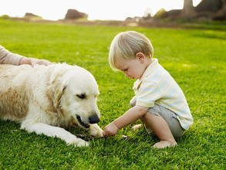
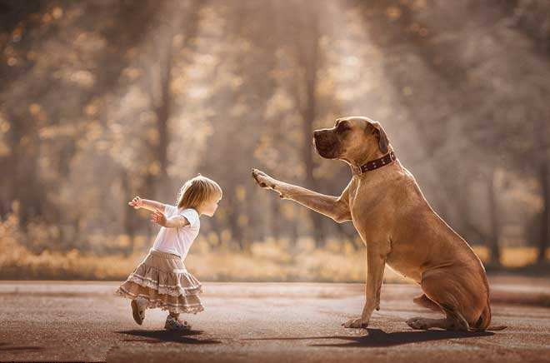
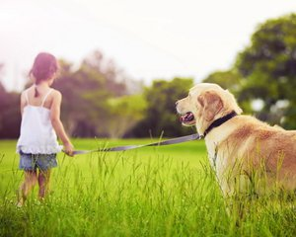
Unit 6 Pets
Writing

Slide 2
目录
Lead-in
1
Pre-Learning
2
3
While-Learning
Post-Learning
4
5
Review

Slide 3
Part I Lead-in

Slide 4
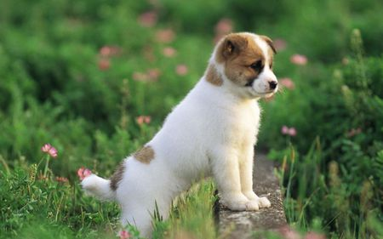
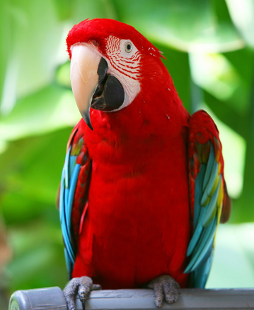
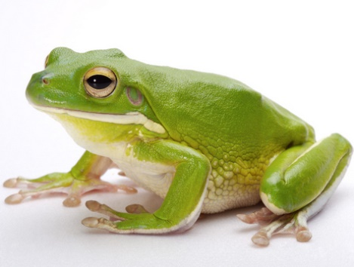
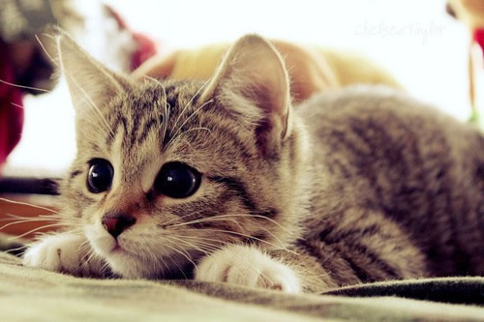
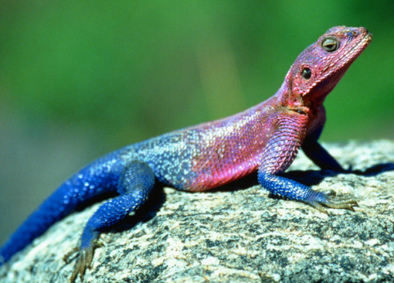
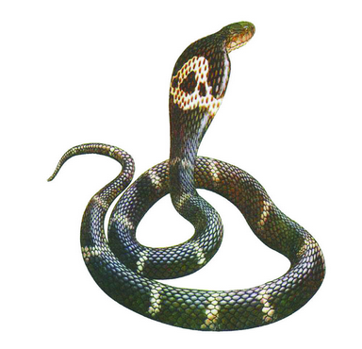
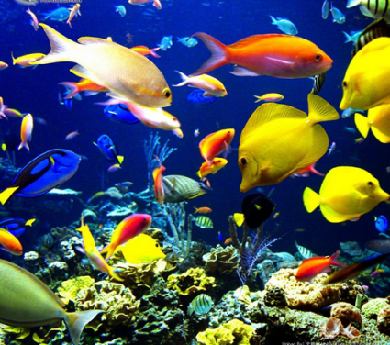
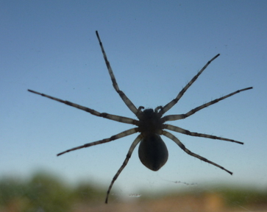
Which animal would you like to pet as a pet? Which animal is the best pet?
Please give your reasons.
dog 狗
frog青蛙
cat 猫
lizard蜥蜴
parrot鹦鹉
spider蜘蛛
fish鱼

Slide 5
Part II Pre-Learning

Slide 6
Think and write
Do you remember how to give opinions?
Complete the table.

Slide 7
Emma
Opinion | Reasons | Supporting details
Dogs are really cute.
It’s nice to hold them in your arms.
It’s wonderful to see them grow up.
Keeping pet dogs
is a good idea.
We can learn responsibility from keeping dogs.
We have to feed, train and play with dogs.
Young people can learn how to care for others.
A dog will love you faithfully and bring you lots of happiness for many years.

Slide 8
Matt
Opinion | Reasons | Supporting details
Pet dogs are dirty.
They leave hair on the floor, on beds and on sofas.
They need to be washed often.
It’s not a good idea to keep pet dogs.
Nearly all dogs bark at strangers.
A few dogs bark at night and this stops people from getting any sleep.
Dogs are noisy.
Owning dogs can be expensive.
Dogs need fresh air and large open spaces to run free. But many people live in flats so their dogs are kept in small spaces.

Slide 9
Argumentation
opinion
reasons
facts/ supporting details
conclusion

Slide 10
Part III While-Learning

Slide 11
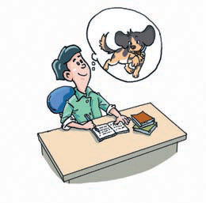
What animal makes the best pet?
A In pairs, discuss what animal makes the best pet. Write down your opinion and reasons. Use the example below to help you.
I think that dogs make the best pets.
Reasons:
Dogs are lovely.
Dogs are faithful to their owners.
Walking a dog can help the owner stay healthy.

Slide 12
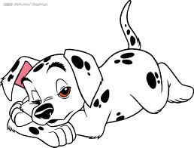
B Use your notes from A, the expressions from the box below and the example on page 92 to help you write a short article.
According to… Secondly,…
For these reasons,…
In my opinion, … What’s more,…
I (do not) believe that…
Firstly, … Finally,…
I (do not) think that…

Slide 13
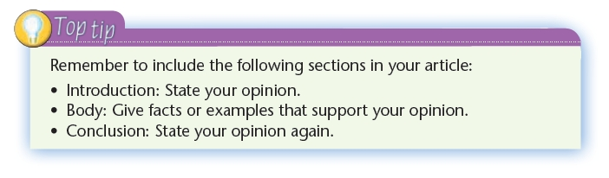

Slide 14
Structure and expressions
Introduction | Opinion | According to … In my opinion, … I think that …
Body | Reasons | Firstly, … Secondly, … Thirdly, … What’s more, … Finally, …
Conclusion |  | So ... For these reasons, … I (do not) believe that … I (do not) think that …

Slide 15
Make a table about the animal you think makes the best pet.
Introduction | Opinion
Body | Reasons | Supporting details
Conclusion

Slide 16
Write your article
Write your own article about the best pet using information from your table.
__________ make the best pets

Slide 17
Dogs make the best pets
I think that dogs make the best pets.
Firstly, dogs are lovely. I enjoy playing with them. It’s pleasant to hold them in our arms.
Secondly, dogs are faithful. There was once a faithful dog in Japan. One day, his owner died suddenly of a heart attack. The dog did not know it and kept on waiting for his owner every day for many years, until he died.
Thirdly, if you keep a pet dog, you need to walk it every day. When you are walking your dog, you are doing exercise.
For these reasons, I believe that dogs make the best pets.

Slide 18
Discussion
What is the writer’s opinion?
Dogs make the best pets.
How many reasons does the writer give?
Three.
How do you know?
From the words firstly, secondly and thirdly.
Does the writer give any example to show that dogs are faithful?
Yes, he/ she does.
What is the example?
It is a story about a faithful dog in Japan.

Slide 19
 |  | •
Opinion
Reasons
Supporting details
I think that dogs make the best pets.
Dogs are lovely.
enjoy playing with them
pleasant to hold them in our arms
a story about a faithful dog in Japan
Dogs are faithful.
Walking a dog can help the owner stay healthy.

Slide 20

Let’s learn the new words and expressions.

Slide 21
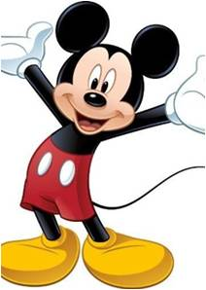
New words and expressions
P91-92
(be) faithful to…对……忠诚的 p. 91
believe v. 相信 p. 91
die of 死于 p. 92
heart n. 心；心脏 p. 92
heart attack n. 心脏病发作p. 92
keep on 继续 p. 92
until conj. 到⋯⋯ 时；直到⋯⋯ 为 止 p. 92

Slide 22
Notes P91-92
1. (be) faithful to… 对……忠诚的
你应该忠于自己内心的感觉。
You should be faithful to your own feelings.

Slide 23
2. believe v. 相信
believe后跟宾语从句，当主语是I或we时，将宾语从句变成否定句时，要进行否定转移。
她说什么我都不相信。
I don't believe what she says.
believe sb. 相信某人所为
believe in sb. 相信某人的为人
我相信他的话，但我不相信他的为人。
I believe him, but I don't believe in him.

Slide 24
3. die of 死于
表示死的原因，通常是指疾病、饥饿或衰老等自身的原因。例如：
那个婴儿死于发烧。
The baby died of a fever.

Slide 25
【拓展】die from 意为“死于”，也表示死因，通常指事故或意外等造成的外部原因。若死因由外部影响到体内，即两方面共有的原因，则用of 或from 均可。如：
die of / from thirst( a wound, cold, etc)
死于口渴（受伤、寒冷等）。例如：
那个老人死于一起交通事故。
The old man died from a traffic accident.
那只可怜的小老虎渴死了。
The poor little tiger died of / from thirst.

Slide 26
Practice
根据中文意思完成句子。
1. 到目前为止，已经有20个人死于流感。
So far, twenty persons have _____ _____ flu.
选用of或from填空。
2. Many people died _____ the earthquake in Yushu, Qinghai.
3. The driver died _____ a heart attack. Before he died, he stopped the bus safely.
4. She died _______ a wound.
died of
from
of
of / from

Slide 27
4. heart n. 心；心脏
heart attack n. 心脏病发作
learn sth. by heart 用心记忆某事
heart and soul 全心全意地
lose heart 灰心，丧失信心
我们的英语老师让我们用心学习这篇文章。
Our English teacher asked us to learn the
passage by heart.

Slide 28
5. The dog did not know it and kept on waitingfor his owner every day for many years, until he died.
这条狗不知道这件事，继续每天等待主人，
等了许多年，直到死。
①keep on 继续（后面常接动词-ing形式）
keep on doing sth 可与keep doing sth互换使用。
那个男孩一直在课堂上问一些滑稽的问题。
The boy kept (on) asking some funny questions
in class.

Slide 29
②until conj. 到⋯⋯ 时；直到⋯⋯ 为止
当until用在肯定句中时，表示主句的动作一
直持续到从句动作发生或状态出现时为止。
主句的谓语动词必须是延续性动词，如live,
last, stay, wait等。例如：
他们一直聊天直到老师进来。
They talked on until the teacher came in.
我看书一直到我妈妈回来。
I read a book until my mother came back.

Slide 30
Practice
根据中文意思完成句子。
1. 那个推销员不停地给我打电话，但我不想买他的产品。
The salesman ________ ________ __________ me but I didn’t want to buy his products.
2. 你最好待在这儿直到雨停
You’d better stay here _____ the rain stops.
kept / went on phoning / calling
until

Slide 31
Part IV Post-Learning

Slide 32

假如你们班要举行一场题为“养宠物是否好”的辩论赛，你是正方辩手，请根据下面的内容提示表明你的观点并阐述你的理由。词数80左右，开头已给出，不计入总词数。

Slide 33
【内容提示】
1. 可以跟宠物一起做运动；
2. 和宠物玩可以帮助我们放松自己；
3. 可以通过养宠物学会如何照顾他人；
4. 有宠物的陪伴，我们不会感觉孤独；
5. 根据一些研究显示，照顾宠物甚至有助于我们活得更久；
6. 你自己的观点。

Slide 34
Step 1: 激活词汇
你能想起与短文有关的学过的词汇吗？试一下吧！
1. 和……一起玩
2. 带……去散步
3. 锻炼；做运动
4. 照顾
5. 根据……
6. 更为重要的是
7. 依我看
play with
2. take ... for walks
3. do exercise /sports
4. take care of / care for / look after
5. according to
6. what’s more
7. in my opinion

Slide 35
Step 2: 精彩结构
1. learn how to do sth意为“学习如何做某事”。
【例】我们可以从这本书上学习如何折纸飞机。
【译】我们可以通过养宠物学会如何照顾他人。
We can learn how to make paper planes
from this book.
We can learn how to take care of others by keeping pets.

Slide 36
2. be faithful to ...意为“对……忠诚的”。
【例】我的宠物猫对我很忠诚。
My pet cat is very faithful to me.
【译】宠物会一直对我们忠诚。
Pets are always faithful to us.

Slide 37
3. help sb (to) do sth意为“帮助某人做某事”。
【例】妈妈，让我来帮你打扫卫生吧。
Let me help you do the cleaning, Mum.
【译】照顾宠物甚至有助于我们活得更久。
Caring for pets even helps us live longer.

Slide 38
4. learn ... from ...意为“从……中学习……”。
【例】你可以从看英文电影中学习英语。
You can learn English from watching
English movies.
【译】我们确实可以从养宠物中学到很多东西。
We can really learn a lot of things from keeping
pets.

Slide 39
Step 3: 谋篇布局
本篇短文属于议论文，时态应用 ___________ 。在阐述理由时应使用 _______ ，second 等序数词和what’s more 等来进行过渡，表示个人观点时可用in my opinion 来引导。构建文章内容时要注意运用所学过的单词、短语和句型。
一般现在时
first

Slide 40
Step 4: 小试身手
I think it is a good idea to keep pets. First, we can play with pets, take them for walks or do sports with them. In this way, we can also do some exercise.
Second, playing with pets can help us relax ourselves. Third, we can learn how to take care of others by keeping pets. What’s more, pets are always faithful to us. They offer us love so we won’t feel lonely. Finally, according to some studies, caring for pets even helps us live longer.
In my opinion, we can really learn a lot of things from keeping pets.

Slide 41
Part V Review

Slide 42
根据中文意思完成句子。
1. 吉姆对他的老板很忠诚。
Jim _______ _____ _____ his boss.
2. 那个老人一年之后死于高烧。
The old man _____ _____ a high fever one year later.
3. 如果你们继续等下去，你们可能会见到他。
You may see him if you _____ _____ waiting.
4. 更重要的是，这些课程是免费的。
_______ _____, these courses are free.
is / was faithful to
died of
keep / go on
What’s more

Slide 43
Thank you!

