Slide 1

Unit 7 The unknown world
Speaking

Slide 2
目录
Lead-in
1
Pre-Learning
2
3
While-Learning

Slide 3
Part I Lead-in

Slide 4
John: Tiffany, do you know the news about the UFO?
Tiffany: UFO?____ I think it is just an April Fool’s day’s joke.
John: But the local newspaper and TV reported it.
Tiffany: ____. People have never seen it before.
John: ____. UFO does not really exist.
Tiffany: It is irresponsible for the media to tell such a lie.
D
C
A
I agree with you.
So do I.
I think they are joking.
I don’t believe it.
I disagree.

Slide 5
Part II Pre-Learning

Slide 6

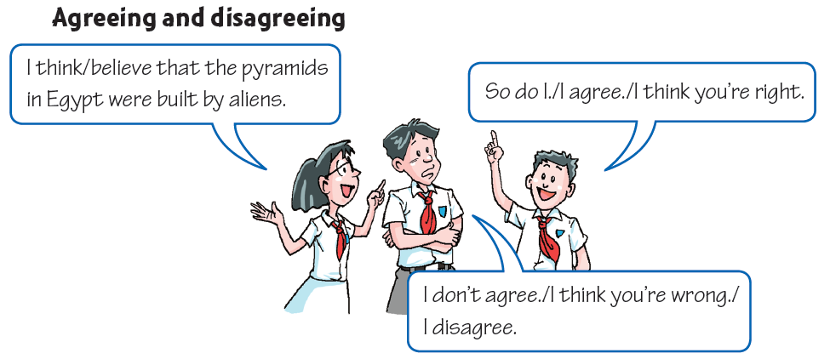
Talk time

Slide 7
Part III While-Learning

Slide 8

In pairs, make a conversation like the example above. Choose one of the following topics.
Aliens are a danger to us .
Aliens will become our friends.
Aliens are cleverer than us.
We will fight aliens in the future.

Slide 9
What can we say to express agreement?
  Yes, indeed.
  Yes, (that’s) exactly what I think.
  I agree totally/one hundred per cent
  /completely.
  That’s just what I was going to say.
  I think so.
  Yes, that’s right.
  How true!

Slide 10
What can we say to express disagreement?
  I’m not so sure about that.
  Do you really think so?
  I’m a bit surprised you said that.
  Well, that’s a matter of opinion.
  I wouldn’t say that.

Slide 11

In pairs, make a conversation like the example above. Choose one of the following topics.
I think/believe that …

Slide 12

Group Discussion
Discuss the topic “Have aliens ever visited the Earth?”
Come up with at least three reasons for and against.

Slide 13

Have aliens ever visited the Earth?
Aliens have visited the Earth. We know this because…
1.
2.
3.
Aliens have visited the Earth. We know this because…
1.
2.
3.

Slide 14
Write a report
Use the results of the discussion above to write your opinion on this topic.
I believe aliens have/ haven’t visited the Earth. There are three reasons for my opinion.
To begin with,____________________________
In addition,_____________________________
What’s more,____________________________
In a word, there just is a lot of / isn’t really any evidence of alien visits to the Earth.

Slide 15

Speak up
Look at B on page 102 again. The two astronauts must get to their mother ship as soon as possible. They have the following things, but they can only take five of them.
a camera 一部照相机
a tent 一个帐篷 10 bottles of water 十瓶水
a knife 一把刀
matches 火柴
25 gold coins 25块金币
a map of Planet X 行星X的地图
medicine 药
6 lunch boxed 6个午餐盒

Slide 16
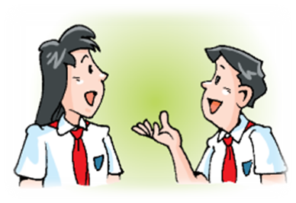
Work in pairs . Imagine you and your classmate are Liz and Gus.
Choose five things to take with you.
Explain why you need these things and
why you agree or disagree with your
classmate;
Tell the class your list and give your
reasons.

Slide 17
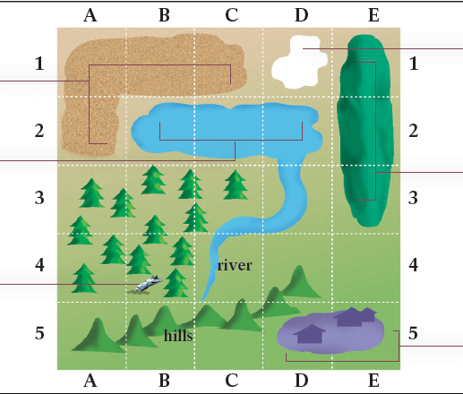
You can use the following expressions for reference.
Offering suggestions:
Let’s …
I suggest that …
Why don’t we …?
What about …?
Accepting suggestions:
Yes, that’s a good idea.
We need … because we must …
Rejecting suggestions:
No, we don’t need to take that.
We don’t need … because …

Slide 18
Discuss the things you will take and complete the table below.
 | Thing | Reason | Agree/Disagree
Liz
Gus

Slide 19

Make a report about the five things you want to take with you and give reasons. Use the expressions below to help you.
Fellow students,
We have decided to carry these five things. Firstly, we will carry … because … Secondly, …
Thirdly, … Then, … Lastly, … Have you got any questions?

Slide 20

Let’s learn the new words and expressions.

Slide 21

New words and expressions
P106
as soon as possible 尽快 p. 106
tent n. 帐篷 p. 106
knife n. 刀 p. 106
explain v. 解释；说明 p. 106
agree with 同意；赞成 p. 106
disagree with 不同意；持不同意见； 有分歧 p. 106

Slide 22
Notes P106
1. — I think / believe that the pyramids in Egypt
were built by aliens.
— So do I.
——我认为埃及的金字塔是外星人建造的。
——我也是（这样认为的）。
So do I. 我也是。
1）“ So +助动词/ be 动词/情态动词+主语”结构表示
前面所述的肯定情况同样适用于后面的人或物。该
结构中的助动词、be 动词或情态动词的时态要与前
一句保持一致，单复数形式则由后面的主语决定。

Slide 23
例如：
——露西唱歌很好听。
——我也是。/ 莉莉也是。
— Lucy sings beautifully.
— So do I. / So does Lily.
——汤姆昨天去体育馆看足球赛了。
——我也去了。/ 彼得也去了。
— Tom went to the gym to watch the football
match yesterday.
— So did I. / So did Peter.

Slide 24
2）“Neither +助动词/be 动词/情态动词+主语”
意为“……也不……”，表示前面所述的否定情
况同样适用于后面的人或物。例如：
——我不喜欢这种音乐。
——我也不喜欢。
— I don’t like this kind of music.
— Neither do I.
——他们昨晚没去参加那个聚会。
——我也没去。
— They didn ’t go to the party last night.
— Neither did I.

Slide 25
Practice
选择最佳答案填空。
( )1. — I like watching cartoon films.
— ____.
A. So do I B. So I do
C. Neither do I D. Neither I do
( )2. — Tom speaks English well.
— ____.
A. So do Lily B. So does Lily
C. Neither does Lily D. Neither Lily does
( )3. — The food was very delicious. I ate too much.
— ____.
A. So do I B. So did I
C. Neither did I D. Neither I did
( )4. — It’s raining. I don’t want to go out.
— ____.
A. So do I B. So I do
C. Neither do I D. Neither I do
A
B
B
C

Slide 26
2. I disagree. 我不同意。
1）disagree 意为“不同意”，是由动词agree加前缀“dis⁃”变化而来的。
前缀“dis⁃”加在某些动词、名词或形容词前
可构成其反义词。
例如：dislike“不喜欢”，dishonest “不诚实”
2）disagree 常用于句型“disagree with sb”，可与“don’t agree with sb”互换使用。例如：
他不同意我（的看法）。
He disagreed with me.
= He didn’t agree with me.

Slide 27
Practice
写出下列单词的反义词，并写出其中文意思。
1. cover _____________
2. appear _____________
3. order _____________
4. interested _____________
discover; 发现
disappear; 消失
disorder; 混乱
disinterested; 不感兴趣的

Slide 28
3. The two astronauts must get to their mother
ship as soon as possible.
这两个宇航员必须尽快到达他们的母舰。
as soon as possible 意为“尽可能快地”，相
当于as soon as sb can / could。例如：
已经是早上7 :40了，我们必须尽快到达学校。
It’s already 7:40 a.m. We must get to school as
soon as possible.
= It’s already 7:40 a.m. We must get to school as
soon as we can.

Slide 29
Practice
根据中文意思完成句子。
请你尽快给我回信。
Please write to me _____ _____ _____ ______.
Please write to me ___ ___ ___ ___ ___.
as soon as possible
as soon as you can

Slide 30

4. tent n. 帐篷
我们在营地上搭起了帐蓬。
We put up our tent in the camp site.

Slide 31
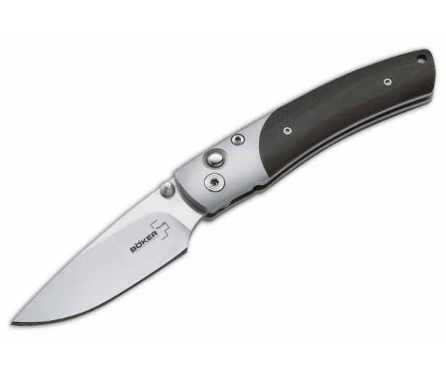
5. knife n. 刀
以f或fe结尾的名词变复数时把f或fe变为v，
再加-es，如：
wife-wives妻子，life-lives生命，
leaf-leaves叶子，thief-thieves小偷，
wolf-wolves狼，shelf-shelves架子。
这把刀是干什么用的？
What is the knife used for?

Slide 32
6. explain v. 解释；说明
explain sth. to sb. / explain to sb. sth.
向某人解释某事
你应该解释一下你不反对他看电视。
You should explain that you don't mind him
watching TV.
他向我说明这个机器怎样使用。
He explained to me how the machine was used.

Slide 33

7. agree with 同意；赞成
disagree with 不同意；持不同意见； 有分歧
辨析：agree with, agree to与agree on

Slide 34
辨析：agree with, agree to与agree on
agree with | 后面接“人”或“意见；看法”。表示同意某人的观点 | 我们同意你所说的话。 We agree with what you said.
agree to | 后面接“计划、建议、安排、决定等” 。表示同意某一计划、建议或决定等 | 他同意了我的计划。He agreed to my plan.
agree on | 表示双方通过协商就某事达成一致，主语一般用表示复数的词 | 他们同意了这些条款。 They agreed on these terms.

Slide 35
Practice
根据中文意思完成句子。
对于这件事，我爸爸和妈妈的意见不一致。所以他
们问我是怎么想的。
My father ________ _______ my mother about this matter.
So they asked me what I thought of it.
disagreed with

Slide 36
Thank you!

