Slide 1

Unit 8 Life in the future
Grammar

Slide 2
目录
Lead-in
1
While-Learning
2
Post-Learning
3
Review
4

Slide 3
Part I Lead-in

Slide 4
观察这些句子
1. We were having supper when the phone rang.
2. I was watching TV at home last night.
3. This time yesterday Jack was not watching TV. He was repairing his bike.
4. --Were you playing basketball at four
yesterday afternoon?
--Yes, I was./ No, I wasn’t
5.Jenny was reading while Danny was writing.
过去进行时

Slide 5
Part II While-Learning

Slide 6
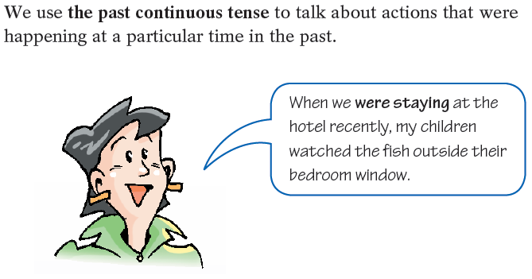
The past continuous tense
我们用过去进行时来表示在过去特定的时间正在发生的动作。

Slide 7
I/He/She/It | was(not) | watching | TV at eight o'clock last night.
You/We/They | were(not)
Was | I/he/she/it | having | dinner at eight o'clock last night?
Were | you/we/they
Yes, | I/he/she/it | was.
 | you/we/they | were.
No, | I/he/she/it | Was not/wasn’t.
 | you/we/they | Were not/weren’t.

Slide 8
Work out the rule
Work out the rule
We form the past continuous tense with __________ or __________+ the -ing form of the main verb.
was
were

Slide 9
一、过去进行时的句子结构
1. 肯定句：
主语+ was / were +动词现在分词+其他 如：
My mother was cooking dinner at 6 p.m. yesterday.
2. 否定句：
主语+ was / were + not+动词现在分词+其他 如：
I was not sleeping at home from 7:00 to 9:00
yesterday evening.

Slide 10
3. 一般疑问句：
Was / Were +主语+动词现在分词+其他
肯定回答：Yes, 主语+ was / were.
否定回答：No, 主语+ was / were + not. 如：
— Were you playing football at that time?
— Yes, I was. / No, I wasn’t.

Slide 11
A1 Linda was helping at a charity event last Saturday. Read her schedule and complete the sentences below using the past continuous tense.
Time Activity
7:00-8:00 get ready to go out
8:00-9:00 travel on the underground
9:00-10:00 buy food in the market with some friends
10:00-12:00 make lunch for 30 people
12:00-13:00 have lunch
13:00-15:00 tidy up and wash the dishes
15:00-17:00 meet a friend at a tea shop
17:00-18:00 go home on the underground

Slide 12
At 7:30, Linda
2 At 8:30, she
At 9:30, she and some friends
At 12:30, they
5 At 16:30, she
6 At 17:30, she
was getting ready to go out.
was travelling on the underground.
were buying food in the market.
were having lunch.
was meeting a friend at a tea shop.
was going home on the underground.

Slide 13
Answer the following questions.
What were you doing last Sunday?
What were you doing at midnight yesterday?
What were you doing at 7:30 this morning?
What were you doing on the morning of 1
January?
What were you doing at this time a week ago?
Where were you living ten years ago?

Slide 14
Things to remember
We can also use the past continuous tense to talk about two actions happening at the same time in the past.
While I was driving my old car, I was polluting the city.
通常我们用while谈论过去两个持续进行的动作。
Usually we use while to talk about two continuing actions in the past.

Slide 15
二、过去进行时的用法
1. 过去进行时表示过去某一时刻正在发生的
动作，常与at that time / moment, then, at 9:00
p.m., yesterday等时间状语连用。
2. 过去进行时表示过去某一段时间内持续的
动作，常与those days, the whole morning,
from 7:00 to 9:00 yesterday evening 等时间状
语连用。
3. 过去进行时表示在过去某一个动作发生时，
另一个动作正在发生。

Slide 16
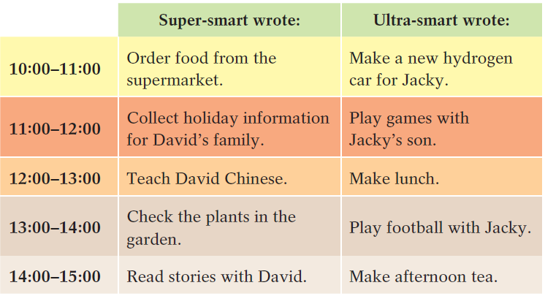
B Super-smart is a smart computer and Ultra-smart is a smart robot. Look at their notes about what they did on Wednesday and complete the paragraph below.

Slide 17
While Super-smart (1)_______________ from the supermarket, Ultra-smart (2)___________________________ for Jacky. While Super-smart (3)_____________________________for David's family, Ultra-smart(4)________________ with Jacky's son. While Super-smart(5)_________________ Chinese, Ultra-smart(6)________________. While Super-smart (7)______________________in the garden, Ultra-smart and Jacky(8)________________.
While(9)___________________________ with David, (10)____________________ afternoon tea.
was ordering food
was making a new hydrogen car
was collecting holiday information
was playing games
was teaching David
was making lunch
was checking the plants
were playing football
Super-smart was reading stories
Ultra-smart was making

Slide 18
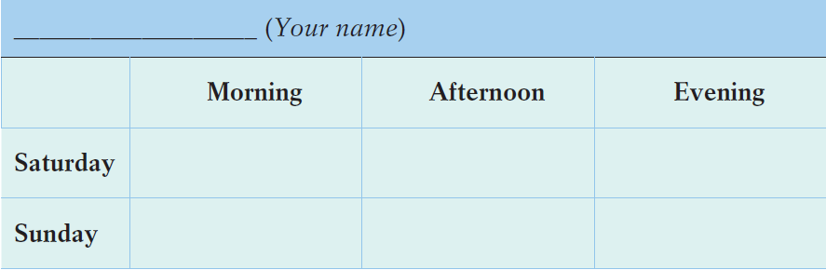
C In pairs, talk about what you were doing last weekend. Use the table below to help you.
do my homework visit my friends read some books
play computer go shopping chat wirh my games parents

Slide 19
Last weekend, I was busy and happy. On Saturday, I got up at 7:00. And I was having breakfast at 8:00. Then, I was doing my homework. At 12:00, I was eating lunch. At 7
p.m., I was having my supper. And at 10:00, I was sleeping on my bed.
On Sunday, I got up at 7:30. I was playing computer games from 10:00 to 11:30. And then I had lunch. In the afternoon, I was doing some shopping with my mother from 2:00 3:00. At 10:00, I slept. I felt happy.

Slide 20

Let’s learn the useful expressions.

Slide 21
Notes P119-121
1. on / in +限定词+交通工具
travel on the underground 乘地铁出行
on the underground表示乘地铁。
on / in +限定词+交通工具表示乘坐具体的交
通工具，在句中作状语，限定词一般用a(n)、
the、形容词性物主代词或形容词等。例如：
周末我经常坐地铁去广州图书馆。
At weekends, I often go to Guangzhou Library on
the underground.

Slide 22
【拓展】
on the underground 与by underground意思相同
类似用法还有：
by plane = on ... plane
by bus = on ... bus
by bike = on ... bike
bycar = in ... car
by taxi = in ... taxi 例如：
她将乘飞机去上海。
She will go to Shanghai by plane / on a plane.

Slide 23
Practice
同义句转换。
(1) Mary goes to work by bus every day.
Mary goes to work _____ _____ _____ every day.
(2) We’re in a hurry. We’d better go there by taxi.
We’re in a hurry.
We’d better go there _____ _____ _____ .
根据中文意思完成句子。
(3) 汤姆每天骑他的自行车去上学。
Tom goes to school _____ _____ _____ every day.
(4) 我有时坐我爸爸的汽车去上学。
Sometimes I go to school _____ _____ _____ _____ .
on a bus
in a taxi
on his bike
in my father’s / dad’s car

Slide 24
Part III Post-Learning

Slide 25
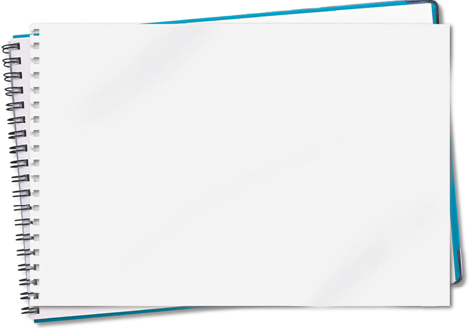
Use the past continuous tense to make a story.
When Tom came home, his mother was cooking dinner.
Later, Tom was doing
his homework when dinner was ready. When his mother called him, Tom was thinking about a very difficult Maths problem. He was working on it when his mother suddenly stopped him. …

Slide 26
Part IV Review

Slide 27
一、选择最佳答案填空。
( )1. We ____ the classroom at half past two yesterday
afternoon.
A. clean B. cleaned
C. have cleaned D. were cleaning
( )2. When I saw him, he ____ a letter in his room.
A. writes B. wrote
C. was writing D. has written
( )3. While I was cleaning the windows, Sally ____ water.
A. was carrying B. carries
C. carried D. was carried
( )4. I was washing my clothes when the telephone ____.
A. rang B. has rung
C. was rang D. was ringing
D
C
A
A

Slide 28
二、用括号内所给动词的适当形式填空。
1. The children were not __________(dance) in the garden then.
2. What was your brother __________ (do) when you were watching TV?
3. When I saw them, they __________ (have) dinner.
4. Lily was reading a book while Lucy __________ (listen) to music.
5. When it _____ (begin) to rain, I __________ (walk) in the street.
dancing
doing
were having
was listening
began was walking

Slide 29
Thank you!

