Slide 1
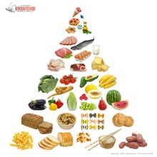
Unit 2 Healthy Eating

Slide 2
What kinds of food do we often eat?
Food group:
meat
vegetable
seafood
fruit
snacks（零食小吃）
staple ['steɪpl] food (主食)

Slide 3
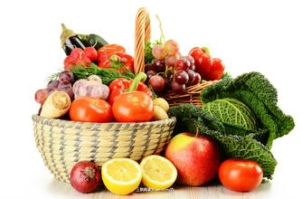
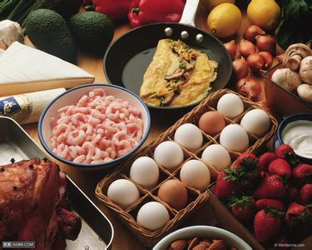
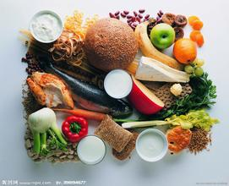
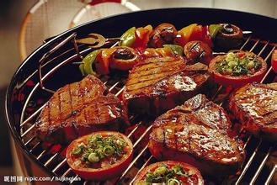
Can you guess what they are?

Slide 4
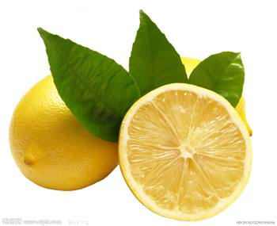
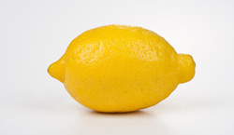
I am a kind of fruit and I am yellow.
I look like an egg sometimes.
When people eat me, I am always cut into pieces and added into the water.
I taste sour(酸的).
Who am I ?
lemon
['lemən]

Slide 5
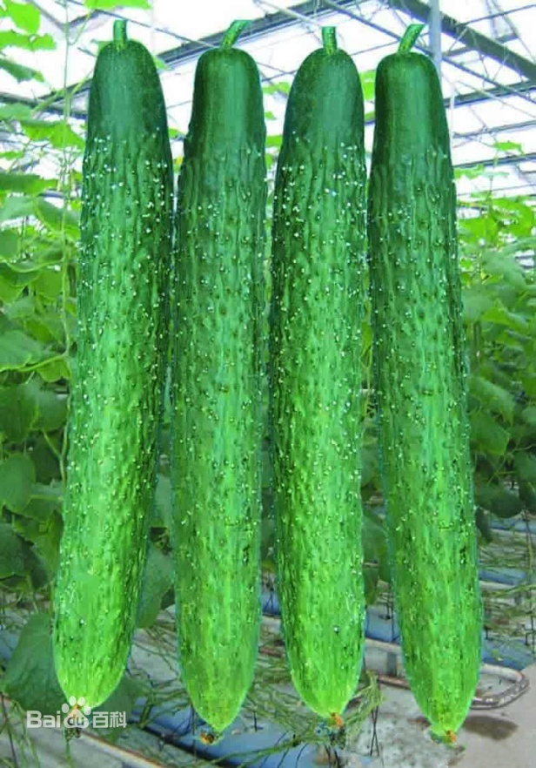
I am a kind of vegetable and I am green.
I am very long.
I can be eaten and I can be used to
make people beautiful.
cucumber
['kjuːkʌmbə]

Slide 6
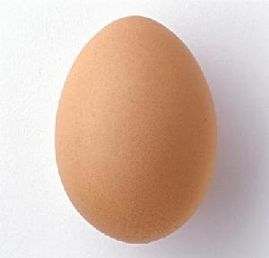
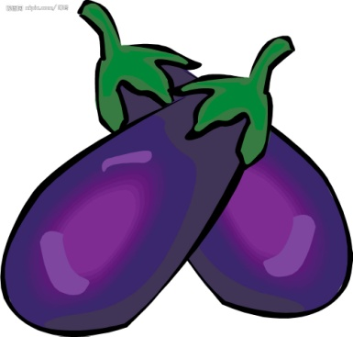
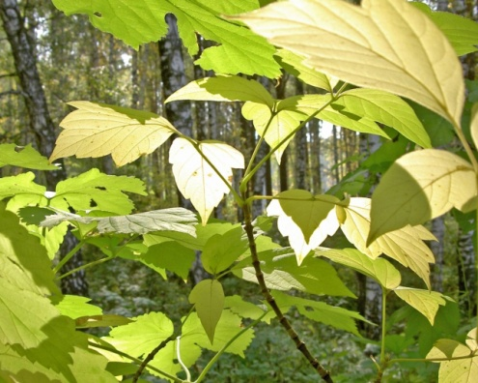
I am a kind of vegetable and I am purple.
I have a green hat.
My name is made up with egg and plant.
〓
eggplant
['egplɑːnt]
egg
plant

Slide 7
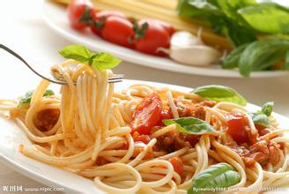
I am a kind of stable food.
I am made from powder.
I am long and I am famous in Italy.
Who am I ?
spaghetti
[spə'getɪ]

Slide 8
Functions of food
Supply energy
Satisfy hunger
Prevent diseases
Keep healthy
Why do we have
to eat every day?
Maintain life

Slide 9
A healthy diet 健康膳食
=
energy-giving food
能量食物
Food that provides energy
(60% or so)
protective
food
保健食品
Food that helps the body fight diseases
(30% or so)
body-building
food
健身食品
Food that helps grow bones and muscles
(10% or so)
+
+

Slide 10
Ⅱ词语派生

Slide 11
1.health n. 健康 _________ adj. 健康的 ________adv. 健康地
2. sugar n. 糖 __________ adj. 甜的， 含糖的
3.__________n. 好奇心 curious adj. 好奇的 _________ adv.好奇地
4. ______ n. 虚弱，弱点 weak 虚弱的，差的 ________v.变弱
6. strong adj.强壮的，牢固的 __________ n. 力气，长处__________ vt.加强，巩固
7. protect vt.保护 __________ n.保护，防护 _________ adj. 保护的，给予保护的
8. balance n. 天平，平衡 vt.平衡，权衡 ________ adj.平衡的
9. limit n. 界限，限度vt.限制，限定 ________ adj.有限的
10. benefit n. 利益，好处 vi & vt 有益于，有助于 _______ adj.有益的，受益的
11. host n. 男主人，男主持人 ________n.女主人,女主持人
12. digest vi & vt. 消化，____________n.消化作用
13. combine vi & vt 联合，结合 ____________ n. 联合
14. fry v. 油炸 _______ adj 油煎的；油炸的

Slide 12
Ⅱ词语派生
healthily
1.health n. 健康 _________ adj. 健康的 ________adv. 健康地
2. sugar n. 糖 __________ adj. 甜的， 含糖的
3.__________n. 好奇心 curious adj. 好奇的 _________ adv.好奇地
4. __________ n. 虚弱，弱点 weak 虚弱的，差的
__________v.变弱
6. strong adj.强壮的，牢固的 __________ n. 力气，长处__________ vt.加强，巩固
7. protect vt.保护 __________ n.保护，防护 _________ adj. 保护的，给予保护的
8. balance n. 天平，平衡 vt.平衡，权衡 ________ adj.平衡的
healthy
sugary
curiosity
curiously
weakness
weaken
strength
strengthen
protection
protective
balanced

Slide 13
Ⅱ词语派生
9. limit n. 界限，限度vt.限制，限定 ________ adj.有限的
10. benefit n. 利益，好处 vi & vt 有益于，有助于 __________ adj.有益的，受益的
11. host n. 男主人，男主持人 ________n.女主人,女主持人
12. digest vi & vt. 消化，____________n.消化作用
13. combine vi & vt 联合，结合 ____________ n. 联合
14. fry v. 油炸 _______ adj 油煎的；油炸的
limited
i
beneficial
_______
hostess
digestion
combination
fried

Slide 14


练习：用括号中所给词的适当形式填空。
1 Just to satisfy my _______（curious） , how much did you pay for your car ?
2. To succeed, we must ________(combination) talent and work
3. I haven’t the __________ ( strong) to lift this stone.
4. My ability is ____________ ( limit).
5. Early to bed and early to rise makes a man live ___________ ( health).
curiosity
combine
strength
limited
healthily

Slide 15
6. The food is easy to ______________ ( digestion).
7. Exercise is ____________ ( benefit ) to our health.
8. You shouldn’t eat too much __________ ( sugar) food.
9. With the help of the doctor, he recovered from her ____________ ( weak).
10. She will be the _________(host) in the show.
11. I like _______(fry)chicken and beer very much.
digest
beneficial
sugary
weakness
hostess
fried

Slide 16
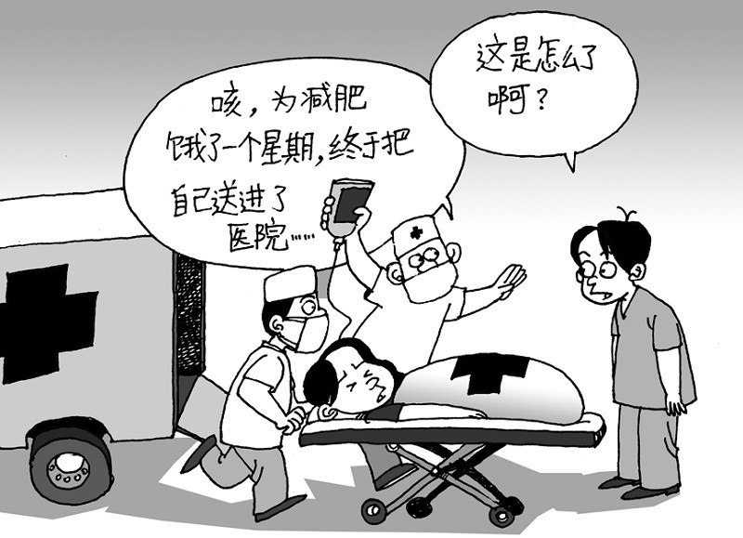
1.diet [‘daɪət] vi. 节食 be/go on a diet 节食, 控制饮食
been on a diet
She has （节食）for a week, so she is very weak now.
n. 日常饮食
a balanced diet
均衡的饮食

Slide 17

balance平衡
play
study
Every one of us should try our best to achieve/ gain a better balance between study and play.

Slide 18
1. 题目
2. 到午饭时分
3. 在没有比这更好的
4. 匆匆走过
5. 一定发生了很重要的事
6. 跟着
7. 厌烦
8. 驱使某人走进
9. 两周内
10. 感到吃惊
11. 不能相信他的眼睛
12. 扔下菜谱
13. 在回家路上
14. 做调查
15. 惊讶地发现
16. 保持健康又精力旺盛

Slide 19
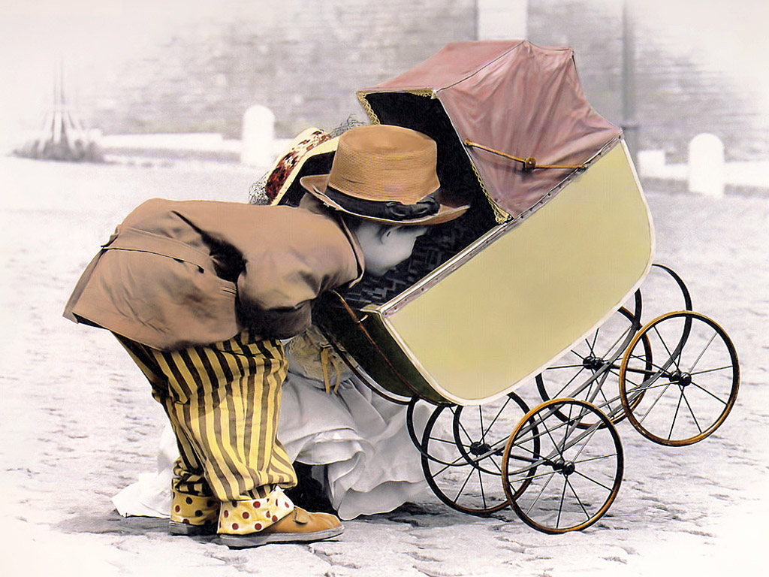
curiosity [kjʊərɪ‘ɒsɪtɪ] n.好奇心
The two kids showed great curiosity about what was in the pram(婴儿车).
What can be put inside?
curious (adj.)
curiously (adv.)

Slide 20
get away with
not be punished for sth.(做了某事)而不受惩
steal sth. and escape with it 携带……跑掉
1. 他们把车毁坏后逃跑了.
They _______________ damaging the car.
2. 强盗们抢劫了银行然后携带大量钱款逃跑了.
Thieves robbed the bank and_______________________.
3. 我不能容忍你们考试作弊而不受惩罚。
I won’t have you getting away with cheating in the exam.
got away with
got away with a lot of money

Slide 21
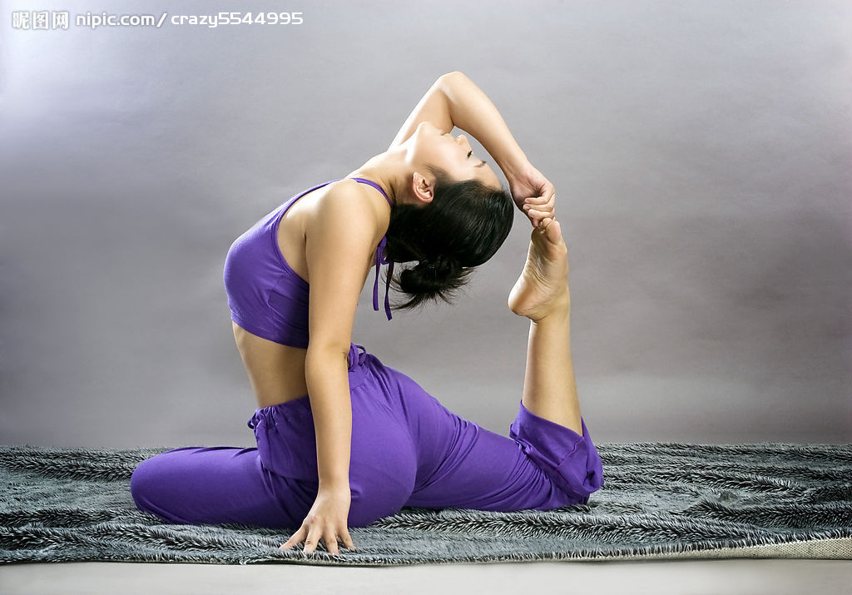
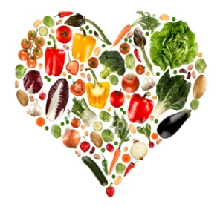
benefit
n. 利益; 好处
v. 得益于……
据说瑜伽对人体的健康大有好处。
_______________________________________________________
2. 我们都得益于读书。
_______________________________________________________
It is said that Yoga is of great benefit to human health.
We all benefit from learning.
adj.
beneficial
新鲜空气非常有利于身体健康。
Fresh air is greatly beneficial to our health.
Fresh air is of great benefit to our health.

Slide 22

She used to smoke heavily, but now, she managed to _______ _______ smoking which does great harm to her health.
cut
down
Cut down
削减，删节
cut off 切断；中断；使死亡；剥夺继承权
cut in 插嘴；超车；插入
cut up 切碎；抨击
cut out 切断；删去；停止；关掉

Slide 23
combine A with B 使A与B结合
We should combine book learning with social practice.
我们应当将书本知识与社会实践结合起来。
It is said that the new teaching method combines education with pleasure.
据说这种新的教学法寓教于乐。

