Slide 1

课件编辑说明
1. 本课件需用office2010及以上版本打开，如果您的电脑是office2007及以下版本或者WPS软件，可能会出现不可编辑的文档，建议您安装office2010及以上版本。
2. 因为课件中存在一些特殊符号，所以个别幻灯片在制作时插入了文档。如您需要修改课件，请双击插入的文档，即可进入编辑状态。如您在使用过程中遇到公式不显示或者乱码的情况，可能是因为您的电脑缺少字体，请打开网页www.canpointgz.cn/faq下载。
3. 本课件显示比例为16:9，如您的电脑显示器分辨率为4:3，课件显示效果可能比较差，建议您将电脑显示器分辨率更改为16:9。如您不知如何更改，请 360搜索“全品文教高中”或直接打开网页www.canpointgz.cn/faq，点击“常见问题” 。
4. 如您遇到有关课件技术方面的问题，请打开网页www.canpointgz.cn/faq，点击“常见问题”，或致电010-58818058；有关内容方面的问题，请致电010-58818084。

Slide 2


Slide 3

专题二
短文改错
PART 02
专题二
第1讲 词法错误
第2讲 句法错误
第3讲 行文逻辑错误

Slide 4
考情分析
【考纲解读】
高考短文改错题是给出一篇约100词的短文,文中有10处错误,要求考生对每个句子进行判断,如有错误将其改正。错误类型包括词法、句法、行文逻辑等方面的错误。每句中最多有两处错误,每处错误仅涉及一个单词的增加、删除或修改。
高考短文改错着重考查考生的语言基本功和正确使用英语进行表达的能力。此题型不仅要求考生牢固掌握一定的词汇和语法知识,还要求考生具有一定的阅读理解和逻辑推理能力。它是为针对考生平时学习英语过程中,尤其是在写作中常犯的错误而设计的。考生在平时写作中常出现的错误是短文改错考查的重点。

Slide 5
考情分析
【命题透视】
2017—2019年高考全国卷短文改错试题分析表
年份 | 卷别/体裁 | 词数 | 错误类型 |  |  | 考点分布
 |  |  | 错词 | 多词 | 缺词 | 名词 | 冠词 数词 | 动词 | 代词 | 形容词 副词 | 介词 | 连词 | 关系 词 | 小品 词 | 非谓语 | 固定 句式

Slide 6
考情分析
2017—2019年高考全国卷短文改错试题分析表
2019 | Ⅰ记叙文 | 95 | 8 | 1 | 1 | 2 | 1 |  | 1 | 3 |  | 1 | 1 |  | 1
 | Ⅱ记叙文 | 105 | 8 | 1 | 1 | 1 | 1 | 1 |  | 5 | 1 | 1
 | Ⅲ说明文 | 108 | 8 | 1 | 1 | 1 | 1 | 2 | 1 | 1 | 1 |  | 1 | 1 | 1

Slide 7
考情分析
2017—2019年高考全国卷短文改错试题分析表
2018 | Ⅰ记叙文 | 112 | 8 | 1 | 1 | 1 | 1 | 1 |  | 3 | 1 | 1 | 1 |  | 1
 | Ⅱ记叙文 | 97 | 8 | 1 | 1 | 2 | 1 | 3 | 1 |  | 1 |  | 1 | 1
 | Ⅲ记叙文 | 102 | 8 | 1 | 1 | 1 |  | 2 | 1 | 2 |  | 1 |  |  | 2 | 1

Slide 8
考情分析
2017—2019年高考全国卷短文改错试题分析表
2017 | Ⅰ记叙文 | 108 | 8 | 1 | 1 | 1 | 2 | 1 |  | 2 | 1 | 1 |  |  | 1 | 1
 | Ⅱ记叙文 | 92 | 8 | 1 | 1 | 1 | 1 | 1 | 1 | 3 | 1 |  | 1 |  | 1
 | Ⅲ记叙文 | 109 | 8 | 1 | 1 |  | 1 | 3 | 1 | 2 | 1 | 1 | 1
命题 规律 | 1. 选材特点:以记叙文为主,词数在90~120词之间;话题是关于学生日常学习和生活的; 2. 设错特点:为学生平时写作中常犯的错误;错误类型:多词(1个)、少词(1个)和错词(8个)。

Slide 9

第1讲
词法错误
专题导读
真题典例
模拟演练

Slide 10
专题导读
词法的测试包括:定冠词和不定冠词;名词的单复数和名词所有格;动词的时态、语态和非谓语动词;人称代词的格、物主代词、指示代词、连接代词、不定代词;介词(短语) 及其和名词、形容词、动词的搭配;形容词、副词的区别及其比较级和最高级;固定搭配和习惯用法等。

Slide 11

专题导读
考点一 冠词的误用
【高考体验】
1.[2019·全国卷Ⅲ] Each of my cafes will have a different theme and an unique style.
[答案]an改为a
[解析]考查冠词的用法。an用在元音音素前,a用在辅音因素前。unique是以辅音音素开头的单词,所以前面用a。故把an改为a。

Slide 12
专题导读
2.[2018·全国卷I] During my last winter holiday, I went to countryside with my father to visit my grandparents.
[答案]countryside前加the
[解析]考查冠词。句意:去年寒假期间,“我”和父亲去乡下拜访爷爷奶奶。此处特指去的是乡下,故加定冠词the。

Slide 13
专题导读
3.[2017·全国卷II] They live far from the school, and it takes them about a hour and a half to go to work every day.
[答案]第一个a改为an或one
[解析]考查冠词的用法。名词hour虽然以辅音字母开头,但首字母的发音为元音,故此处用an或one均可。

Slide 14
专题导读
【易错考点归纳】
①不定冠词a和an的混用;②可数名词单数前遗漏不定冠词;③不可数名词或表示类别的复数名词前加不定冠词;④定冠词和不定冠词的混用;⑤某些习语或固定搭配中冠词的误用。

Slide 15
专题导读
考点二 代词的误用
【高考体验】
1.[2018·全国卷II] They would say to us that playing card games would help my brain.
[答案]us改为me
[解析]考查代词。根据后面的help my brain可知,玩扑克牌游戏有助于“我”的大脑得到锻炼,因此这里的意思是“对我说”,故将us改为me。

Slide 16
专题导读
2.[2018·全国卷III] I had done myself homework, but I was shy.
[答案]myself改为my或the
[解析]考查代词/冠词。此处表示“我”已经完成了(“我”的) 作业,故用形容词性物主代词my修饰homework,作定语。此题也可以把myself改为定冠词the,修饰homework。

Slide 17
专题导读
3.It was the first time I had lived far away from my home, so I found difficult to fit in.
[答案]found后加it
[解析]考查代词。此处是“find+it+形容词+to do”结构,其中it作形式宾语。

Slide 18
专题导读
【易错考点归纳】
①代词指代的人或事物前后不一致;②代词的单复数误用;③“it” 一词使用不当(包括用于从句中作形式主语或形式宾语);④不定代词或反身代词的误用。

Slide 19
专题导读
考点三 介词(短语) 的误用
【高考体验】
1.[2016·浙江卷] While they chatted, my father would lift my sister and me up to sit in the top of the fridge.
[答案]in改为on
[解析]固定词组:on the top of…在……的上面。

Slide 20
专题导读
2.[2016·全国卷III] Now I am leaving home to college.
[答案]to改为for
[解析]固定词组:leave…for…离开……去……。

Slide 21
专题导读
3.A big storm destroyed two villages in South Africa on last Friday, causing 4 deaths.
[答案]去掉on
[解析]考查固定用法。last Friday是一个完整的时间状语,前面不需要介词,故删除on。

Slide 22
专题导读
【易错考点归纳】
①介词与其他各类词的搭配错误;②涉及动词时,如果动词是及物动词,其后直接接宾语,不需要介词,如果其后有介词,那这个介词就是多余的;③不及物动词不可以直接接宾语,如果接宾语需借助恰当的介词,如果缺少了这个介词,就会出现错误。

Slide 23
专题导读
考点四 连词的误用
【高考体验】
1.[2019·全国卷II] When I studied chemistry in high school, I reconsidered my goal or decided to be a doctor.
[答案]or改为and
[解析]考查连词。句意:在高中学化学的时候,我重新考虑了自己的目标并决定成为一名医生。 “重新考虑目标”与“决定成为一名医生”之间是顺承关系,不是选择关系,故将or改为and。

Slide 24
专题导读
2.[2018·全国卷I] At the end of our trip, I told my father that I planned to return every two years, but he agreed.
[答案]but改成and
[解析]考查并列连词的用法。“我”计划每两年回来一次,父亲同意了。此处是顺承关系,故将but改成and。

Slide 25
专题导读
3.Besides,it’s common that the young or middle-aged sit on the bus when the elderly have to stand.
[答案]when改成while
[解析]考查连词的用法。此处用while表示前后分句的对比,故把when改成while。

Slide 26
专题导读
【易错考点归纳】
并列连词错误主要有三种情况:①混淆并列、选择、转折等逻辑关系。②受汉语影响而引起的连词的多余,如英语中although/though不能与but连用,because不能与so 连用。③注意常考句式be doing/be about to do…when…中when的应用;“祈使句+and/or+陈述句”中and/or的应用。

Slide 27
专题导读
考点五 名词/数词的误用
【高考体验】
1.[2019·全国卷II] Since I was a kid, I’ve considered different job I would like to do.
[答案]job改为jobs
[解析]考查名词复数。“job(工作;职业)”为可数名词,用different(不同的)修饰时意思为“不同种类的工作”,应该用名词的复数形式,故将job改为jobs。

Slide 28
专题导读
2.[2018·全国卷III] The classroom is a place for learning and that includes learning from textbooks, and mistake as well.
[答案]mistake改为mistakes
[解析]考查名词复数。与前面的textbooks并列,故用复数形式。

Slide 29
专题导读
3.[2018·全国卷II] When I was little, Friday’s night was our family game night.
[答案]Friday’s改为Friday
[解析]考查名词。根据句意可知这里指“周五晚上”, Friday属于无生命的事物,不需要使用所有格,故将Friday’s改为Friday。

Slide 30
专题导读
4.[2019·全国卷II] Then, when I was in the five grade, I wanted to be a teacher because I liked my English teacher so much.
[答案]five改为fifth
[解析]考查序数词。年级、班级是按数字顺序排列的,所以“在几年级”中的数词需要用序数词。故将five改为fifth。

Slide 31
专题导读
【易错考点归纳】
名词错误主要有三种情况:①名词数的错用:该用单数时错用复数或相反;误把不可数名词用作复数;②词性的错用:该用所有格时错用普通格;③该用名词时错用动词或形容词。
数词错误有两种情况:①该用序数词时错用基数词;②该用复数时错用单数或相反。

Slide 32
专题导读
考点六 形容词和副词的功能及其比较级和最高级的误用
【高考体验】
1.[2019·全国卷I] I became interesting in playing football thanks to a small accident.
[答案]interesting改为interested
[解析]考查形容词用法。句意:多亏一个偶然的小事件,我对踢足球产生了兴趣。主语是I,故将interesting改为interested。

Slide 33
专题导读
2.[2019·全国卷I] I stopped the ball and kicked it hardly back to the playground.
[答案]hardly改为hard
[解析]考查副词。hard努力地,费力地;hardly几乎不,几乎没有。句意:我挡住足球,并使劲将它踢回操场。故将hardly改为hard。

Slide 34
专题导读
3.[2019·全国卷II] First, I wanted to be a fireman, whose uniform looked so coolly.
[答案]coolly改为cool
[解析]考查形容词的用法。句中的“looked(看起来)”为系动词,系动词后需用形容词作表语,故将coolly改为cool。

Slide 35
专题导读
4.[2019·全国卷III] What I want is not just an ordinarily cafe but a very special one.
[答案]ordinarily改为ordinary
[解析]考查形容词的用法。修饰名词cafe,应用形容词。ordinarily 是副词,故把ordinarily改为ordinary。

Slide 36
专题导读
5.[2016·全国卷III] They were also the best and worse years in my life.
[答案] worse改为worst
[解析]考查形容词的最高级。由the best可知此处也应该用最高级形式worst。

Slide 37
专题导读
【易错考点归纳】
形容词、副词错误主要有四种情况:①形容词之间或副词之间的错用:由于词形或词义的接近而引起的错误;v.-ing形容词与v.-ed形容词的错用。②比较级的错用:除了原级、比较级、最高级互相之间的错用,还要注意比较级的重复。③形容词与副词错用:作定语、表语时应用形容词,作状语时一般用副词,作伴随状语时用形容词。④形容词与名词的错用:该用形容词时错用名词。

Slide 38
真题典例
A
[2019·全国卷I]
I became interesting in playing football thanks to a small accident. One afternoon where I was in primary school, I was walking by the school playground. Suddenly football fell just in front of me but almost hit me. I stopped the ball and kicked it hardly back to the playground. To everyone’s surprising, the ball went into the net. All the football player on the playground cheered loudly, say that I had a talent for football. From now on, I started to play my football with classmates after school. I am a good player now.

Slide 39
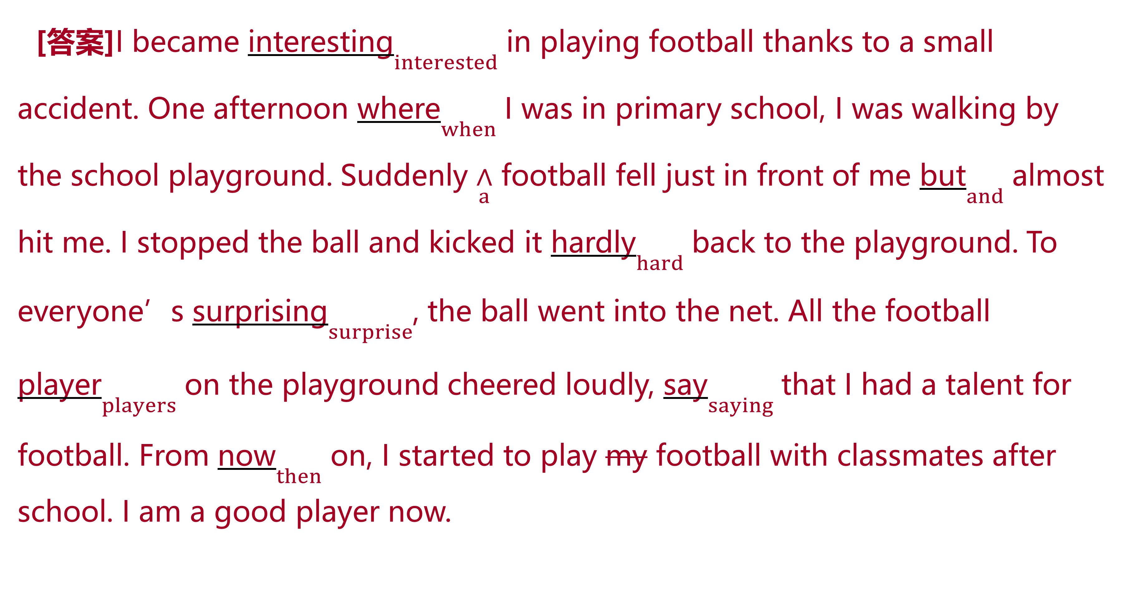
真题典例
[答案]I became interesting$\underset{interested}{}$ in playing football thanks to a small accident. One afternoon where$\underset{when}{}$ I was in primary school, I was walking by the school playground. Suddenly $\underset{a}{∧}$ football fell just in front of me but$\underset{and}{}$ almost hit me. I stopped the ball and kicked it hardly$\underset{hard}{}$ back to the playground. To everyone’s surprising$\underset{surprise}{}$, the ball went into the net. All the football player$\underset{players}{}$ on the playground cheered loudly, say$\underset{saying}{}$ that I had a talent for football. From now$\underset{then}{}$ on, I started to play my football with classmates after school. I am a good player now.

Slide 40
真题典例
[解析][文章大意] 本文是一篇记叙文。由于一次偶然的经历,“我”喜欢上了踢足球,后来经过自己努力,“我”成了一名优秀的球员。
1.interesting改为interested 考查形容词。“interest(使感兴趣;使关注)”的形容词有interesting(有趣的),常修饰物;而interested(感兴趣的)常修饰人。本句的意思为:多亏一个偶然的小事件,我对踢足球产生了兴趣。主语是I,故将interesting改为interested。
2.where改为when 考查定语从句。先行词one afternoon在定语从句中作时间状语,所以关系词使用when。故将where改为when。
3.在football前加a 考查冠词。名词football为可数名词,前边需要有限定词。这里football第一次出现,故在football前加a。

Slide 41
真题典例
4.but改为and 考查连词。句意:突然一个足球落在我前边并且差点打到我。“足球落下来”与“打到我”两个动作是顺承关系,不是转折关系。故将but改为and。
5.hardly改为hard 考查副词。hard(努力地;费力地)与hardly(几乎不;几乎没有)都为副词,但是词义不同。文中表示“我”挡住足球,并费力地将它踢回操场,故将hardly改为hard。
6.surprising改为surprise 考查固定搭配。“to one’s+名词”意为“令某人……”。此处为to one’s surprise意为“让某人惊讶的是”。故将surprising改为surprise。
7.player改为players 考查名词的数。player为可数名词,此处all(所有的)后需要用player的复数形式。故将player改为players。

Slide 42
真题典例
8.say改为saying 考查非谓语动词。句中谓语动词为cheered,say在这里作伴随状语,与主语players是主动关系,故将say改为saying。
9.now改为then 考查上下文逻辑。结合语境可知,文中指从那时开始,“我”放学后跟同学们一起踢足球。表示“从那时起”需用from then on,故将now改为then。
10.将my去掉 考查固定搭配。踢足球的英语表达为“play football”,中间不能加冠词或代词。故将my去掉。

Slide 43
B
[2018·全国卷I]
During my last winter holiday, I went to countryside with my father to visit my grandparents. I find a big change there. The first time I went there, they were living in a small house with dogs, ducks, and another animals. Last winter when I went here again, they had a big separate house to raise dozens of chicken. They also had a small pond which they raised fish. My grandpa said last summer they earned quite a lot by sell the fish. I felt happily that their life had improved. At the end of our trip, I told my father that I planned to return for every two years, but he agreed.
真题典例

Slide 44
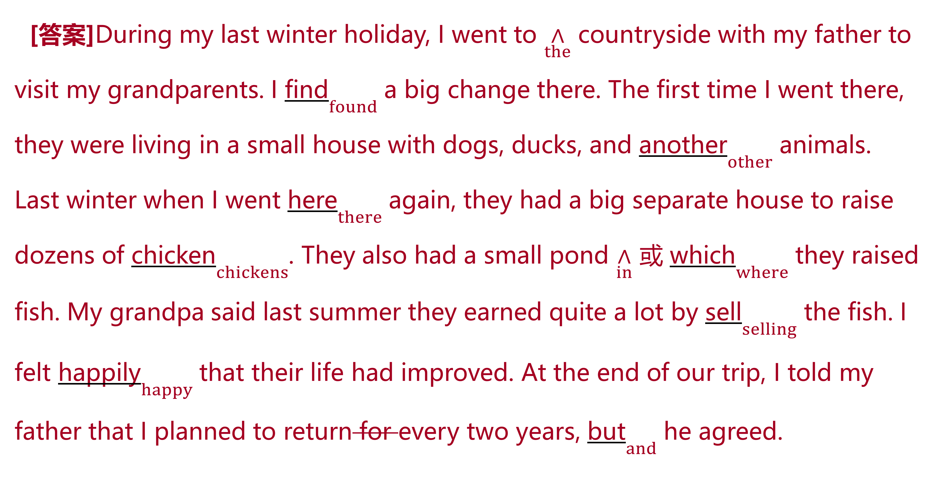
真题典例
[答案]During my last winter holiday, I went to $\underset{the}{∧}$ countryside with my father to visit my grandparents. I find$\underset{found}{}$ a big change there. The first time I went there, they were living in a small house with dogs, ducks, and another$\underset{other}{}$ animals. Last winter when I went here$\underset{there}{}$ again, they had a big separate house to raise dozens of chicken$\underset{chickens}{}$. They also had a small pond $\underset{in}{∧}$ 或 which$\underset{where}{}$ they raised fish. My grandpa said last summer they earned quite a lot by sell$\underset{selling}{}$ the fish. I felt happily$\underset{happy}{}$ that their life had improved. At the end of our trip, I told my father that I planned to return for every two years, but$\underset{and}{}$ he agreed.

Slide 45
真题典例
[解析][文章大意] 本文是一篇记叙文。文章主要讲述了作者在去年寒假期间和父亲去乡下拜访爷爷奶奶过程中的所见所闻,由此讲述了乡下的巨大变化。
1.countryside前加the 考查冠词。去年寒假,“我”和父亲去乡下拜访爷爷奶奶。此处特指去的是乡下,故加定冠词the。
2.find改成found 考查动词的时态。根据文章中的during my last winter holiday可知,事件发生在过去,故用一般过去时。故将find改成found。
3.another改成other 考查形容词的用法。他们住在一个小房子里,院子里有狗、鸭子和其他动物。根据句意可知,将another改成other。

Slide 46
真题典例
4.here改成there 考查副词及语意理解。去年冬天“我”又一次去了那里。故将here改成there。
5.chicken改成chickens 考查名词复数。他们在一个大的独立的房子里养了许多只鸡。根据前文的dozens of可知,其后用名词复数形式。
6.which改成in which或where 考查定语从句的关系词。他们还有一个小池塘,里面养着鱼。此处a small pond是先行词,其在后面的定语从句中作地点状语,故用in which或where。
7.sell改成selling 考查动名词。“我”爷爷说去年夏天他们通过卖鱼挣了一大笔钱。此处介词by后用动名词,故用selling。

Slide 47
真题典例
8.happily改成happy 考查形容词作表语。他们的生活有了很大提高,“我”感到很高兴。此处形容词作表语,故将happily改成happy。
9.删除for 考查介词的用法。时间名词由every,each,last等词修饰时,其前不用介词。故删除for。
10.but改成and 考查并列连词的用法。“我”计划每两年回来一次,父亲同意了。此处是顺承关系,故将but改成and。

Slide 48
模拟演练
Ⅰ.单句改错
1.After a hour or so we began to feel very frightened.
[答案]a 改为 an
[解析]因为hour的读音是以元音音素开头的,所以将a改为an。

Slide 49
模拟演练
2.Some people read the books or watch television while others have sports.
[答案]去掉 the
[解析]因为这里的 books 表泛指,不表特指。

Slide 50
模拟演练
3.There is public library in every town in Britain.
[答案]public library 前加 a
[解析]因为这里的 public library 是单数可数名词,表泛指,故在其前加a。

Slide 51
模拟演练
4.Suddenly,I caught a sight of my English teacher in the crowd.
[答案]去掉 a
[解析]catch sight of看见,瞥见。

Slide 52
模拟演练
5.Each player must obey captain, who is the leader of the team.
[答案]captain 前加 the
[解析]captain 在此处表示特指,故加定冠词。

Slide 53
模拟演练
6.We stopped to rest for a while and to drink some waters from a stream.
[答案]waters 改为water
[解析]water当“水”讲时为不可数名词。

Slide 54
模拟演练
7.They were eager to know everything about China and asked me lots of question.
[答案]question 改为 questions
[解析]因其前有表示复数意义的修饰语 lots of,且question为可数名词,故应用复数形式。

Slide 55
模拟演练
8.Nowadays millions of people of all ages take pleasure in a hobby which is both interested and fun.
[答案]interested 改为 interesting
[解析]指某事物是“有趣的,有吸引力的”,用interesting,而表示某人“对……感兴趣”时,用interested。

Slide 56
模拟演练
9.You can find all kinds of information in just a few minute on the Internet.
[答案]minute改为minutes
[解析]a few后面的名词应用复数形式。

Slide 57
模拟演练
10.Without enough knowledges, you can never teach well.
[答案]knowledges改为knowledge
[解析]knowledge是不可数名词,没有复数形式。

Slide 58
模拟演练
Ⅱ.短文改错
A
词数:116 话题:志愿者活动 文体:记叙文
Last month, I took part in a volunteer activity in a village. We start off by bus at 9 o’clock. After a three-hour drive, we saw the village surrounded by hills. It was very difficulty to drive on the rocky road, so we got on the bus and walked there. The villagers standing by road welcomed us warm.

Slide 59
模拟演练
Cooked with those vegetable grown by the villagers, the lunch was tasted delicious. After lunch, we played games with the village children. Then, we visited an old man live alone on the hillside. We sang a few songs, what made him really happy.
I think when doing volunteer work, you help others and you gain happy in return.

Slide 60
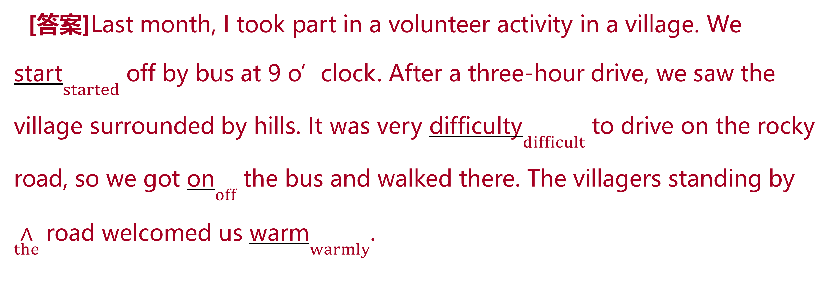
模拟演练
[答案]Last month, I took part in a volunteer activity in a village. We start$\underset{started}{}$ off by bus at 9 o’clock. After a three-hour drive, we saw the village surrounded by hills. It was very difficulty$\underset{difficult}{}$ to drive on the rocky road, so we got on$\underset{off}{}$ the bus and walked there. The villagers standing by $\underset{the}{∧}$ road welcomed us warm$\underset{warmly}{}$.

Slide 61
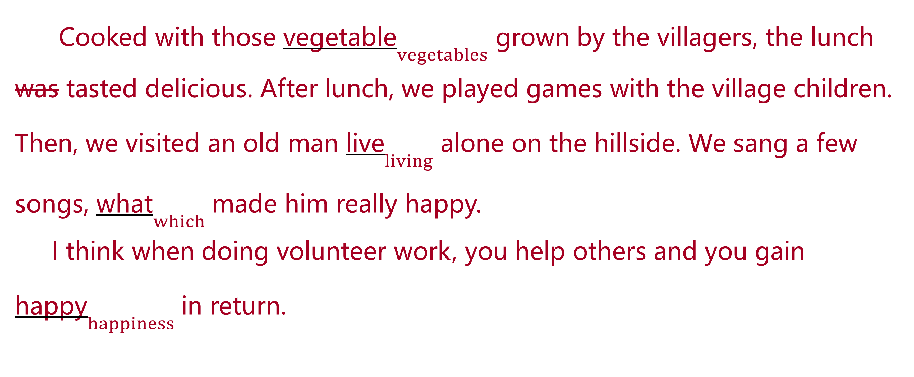
模拟演练
Cooked with those vegetable$\underset{vegetables}{}$ grown by the villagers, the lunch was tasted delicious. After lunch, we played games with the village children. Then, we visited an old man live$\underset{living}{}$ alone on the hillside. We sang a few songs, what$\underset{which}{}$ made him really happy.
I think when doing volunteer work, you help others and you gain happy$\underset{happiness}{}$ in return.

Slide 62
模拟演练
B
词数:104 话题:童年趣事 文体:记叙文
When I was six years old, I was a innocent and lovely girl. One day, my father asked me, “How can fish only live in water?” I thought about it with cautions and then replied, “That’s because there is some cats on the bank.” My father said, “Although your answer sounds a little ridiculous, but I think you are smart.” I was happy to hear them then. Maybe it seemed an amused answer then. But now, I think it is benefit to me. And now I am smart. I dare said I could have a happy childhood just owing my parents’ love for me.

Slide 63
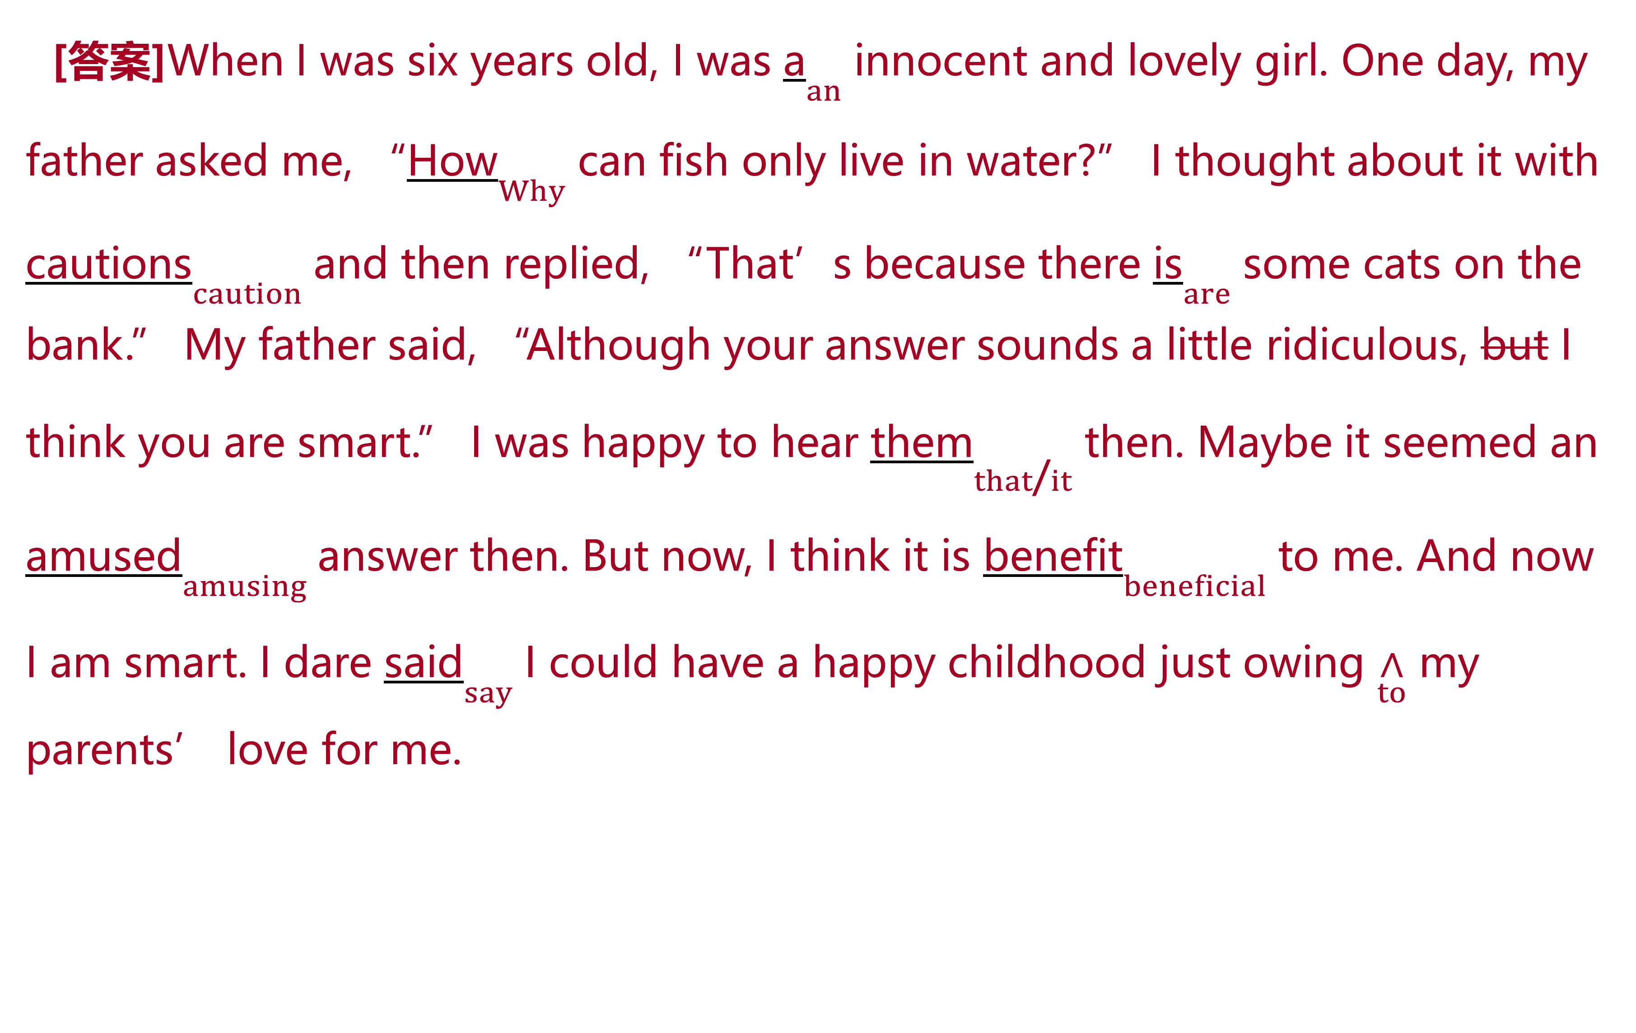
模拟演练
[答案]When I was six years old, I was a$\underset{an}{}$ innocent and lovely girl. One day, my father asked me, “How$\underset{Why}{}$ can fish only live in water?” I thought about it with cautions$\underset{caution}{}$ and then replied, “That’s because there is$\underset{are}{}$ some cats on the bank.” My father said, “Although your answer sounds a little ridiculous, but I think you are smart.” I was happy to hear them$\underset{that\text{/}it}{}$ then. Maybe it seemed an amused$\underset{amusing}{}$ answer then. But now, I think it is benefit$\underset{beneficial}{}$ to me. And now I am smart. I dare said$\underset{say}{}$ I could have a happy childhood just owing $\underset{to}{∧}$ my parents’ love for me.

