Slide 1

课件编辑说明
1. 本课件需用office2010及以上版本打开，如果您的电脑是office2007及以下版本或者WPS软件，可能会出现不可编辑的文档，建议您安装office2010及以上版本。
2. 因为课件中存在一些特殊符号，所以个别幻灯片在制作时插入了文档。如您需要修改课件，请双击插入的文档，即可进入编辑状态。如您在使用过程中遇到公式不显示或者乱码的情况，可能是因为您的电脑缺少字体，请打开网页www.canpointgz.cn/faq下载。
3. 本课件显示比例为16:9，如您的电脑显示器分辨率为4:3，课件显示效果可能比较差，建议您将电脑显示器分辨率更改为16:9。如您不知如何更改，请 360搜索“全品文教高中”或直接打开网页www.canpointgz.cn/faq，点击“常见问题” 。
4. 如您遇到有关课件技术方面的问题，请打开网页www.canpointgz.cn/faq，点击“常见问题”，或致电010-58818058；有关内容方面的问题，请致电010-58818084。

Slide 2


Slide 3

专题二
短文改错
PART 02
专题二
第1讲 词法错误
第2讲 句法错误
第3讲 行文逻辑错误

Slide 4

第2讲
句法错误
专题导读
真题典例
模拟演练

Slide 5
专题导读
句法的测试包括:动词的时态、语态错误,非谓语动词使用错误,主谓一致错误,名词性从句、定语从句和状语从句三大从句出现的错误以及句子成分的赘余等。语气的误用主要体现在虚拟语气的误用、主从句语气不一致等。

Slide 6

专题导读
考点一 时态、语态的误用
【高考体验】
1.[2019·全国卷II] And the other is that I wanted to help people in need.
[答案]is改为was
[解析]考查时态。本篇文章使用的全是一般过去时,且此处也是在讲述过去的事。故将is改为was。

Slide 7
专题导读
2.[2019·全国卷III] Though it may appear simple, it required a lot of ideas and efforts.
[答案]required改为 requires
[解析]考查动词的时态。文章的主体时态是一般现在时。故把 required改为 requires。

Slide 8
专题导读
3.[2018·全国卷II] I didn’t realize how right my parents are until I entered high school.
[答案]are改为were
[解析]考查动词时态。文中didn’t realize,entered的时态是一般过去时,根据时态的一致性原则可知,be动词应为一般过去时,故将are改为were。

Slide 9
专题导读
4.[2018·全国卷III] It was Monday morning, and the writing class had just begin.
[答案]begin改为begun
[解析]考查过去分词。 根据句中的had可知,其后用过去分词,故将begin改为begun。

Slide 10
专题导读
【易错考点归纳】
时态、语态错误主要有三种情况:①混淆时态、语态的构成形式;②未能依据时间状语判定适当的时态;③未能依据前后的逻辑关系判定适当的语态。

Slide 11
专题导读
考点二 非谓语动词的误用
【高考体验】
1.[2019·全国卷I] All the football players on the playground cheered loudly, say that I had a talent for football.
[答案]say改为saying
[解析]考查现在分词。本句句意:操场上所有的足球运动员大声欢呼,说我有踢足球的天赋。句中谓语动词为cheered,say在这里作伴随状语,与主语players是主动关系,故将say改为saying。

Slide 12
专题导读
2.[2019·全国卷III] If I succeed in manage one, I will open more.
[答案]manage 改为managing
[解析]考查非谓语动词。succeed in doing sth意为“成功做了某事”。故把manage 改为managing。

Slide 13
专题导读
3.[2018·全国卷II] …but no matter how many times I asked to watching them, my parents would not let me.
[答案]watching改为watch
[解析]考查不定式。由前面的不定式符号to可知,其后的动词应用原形,故将watching改为watch。

Slide 14
专题导读
4.[2018·全国卷III] Everyone was silent, wait to see who would be called upon to read his or her paragraph aloud.
[答案]wait改为waiting
[解析]考查现在分词。此句是非谓语动词作状语,因为wait与everyone是主动关系,故用现在分词waiting作伴随状语, 指学生们等待的状态。

Slide 15
专题导读
【易错考点归纳】
非谓语动词错误主要有三种情况:①非谓语动词错用:应根据非谓语动词的功能及所作成分来判断用哪种非谓语动词;一般来说,不定式表示尚未发生,动词-ing形式表示主动或进行,过去分词表示被动或完成;②介词后一般用动词-ing形式;③误将非谓语动词用作谓语动词或相反。

Slide 16
专题导读
考点三 复合句引导词的多用、少用或误用
【高考体验】
1.[2019·全国卷III] In the cafe, customers will enjoy themselves in the historical environment what is created for them.
[答案]what改为that/which
[解析]考查定语从句。先行词environment 在从句中作主语,指物,关系代词用that/which。故把what改为that/which。

Slide 17
专题导读
2.[2019·全国卷I] One afternoon where I was in primary school, I was walking by the school playground.
[答案]where改为when
[解析]考查定语从句。先行词one afternoon表示时间,在定语从句中作状语,所以关系词使用when。故将where改为when。

Slide 18
专题导读
3.[2018·全国卷II] The games my parents taught me where I was a child turned out to be very useful later in my life.
[答案]where改为when
[解析]考查时间状语从句。根据后面的“…I was a child…”可知,这是一个时间状语从句,故将where改为when。

Slide 19
专题导读
4.[2016·全国卷I] My uncle is the owner of a restaurant close to that I live.
[答案]that改为where
[解析]考查宾语从句。介词to后面的宾语从句缺少表示地点的状语,故用where引导宾语从句并在从句中作状语。

Slide 20
专题导读
【易错考点归纳】
复合句错误主要有三种情况:①状语从句的引导词错误或重复;②定语从句关系词的错用或缺失;③名词性从句中连接词的错用或重复,尤其是what与that,that与which,where与that的误用。

Slide 21
专题导读
考点四 特殊句式和功能词误用
特殊句式包括强调句、倒装句、祈使句等;功能词是指it用作形式主语和宾语及小品词to的运用。
【高考体验】
1.[2019·全国卷II] They were two reasons for the decision.
[答案]They改为There
[解析]考查there be句型。句意:(我)做这个决定有两个原因。they在句子中找不到指代的事物,此处应为there be句型。故将They改为There。

Slide 22
专题导读
2.Not only do readers find the book useful, but it also helped Jiang to learn more.
[答案]do 改为did
[解析]考查倒装句。not only 置于句首时应用倒装结构,根据not only…but also…连接两个平行结构find 和help,且help为一般过去时可知助动词do应改为did。

Slide 23
专题导读
3.It was not until I met you before I knew real happiness.
[答案]before改为that
[解析]考查强调句。分析句式可知此句是强调句型,根据“It is/was+被强调部分+that/who+其他.”可知before应改为that。

Slide 24
专题导读
4.[2017·全国卷I] The instructor kept repeating the words, “Speed up!” “Slow down!” “Turning left!”
[答案]Turning改为Turn
[解析]考查平行结构。根据前文“Speed up!” “Slow down!”可知,教练的话“加速”“减速”“左转”都是祈使句,祈使句以动词原形开头,故将Turning改为Turn。

Slide 25
专题导读
【易错考点归纳】
①强调句的基本结构以及运用do/does/did对动词的强调;②祈使句和感叹句的基本构成;③倒装句中be动词/情态动词/助动词do和have在时态中变化;④it句型和there的混用以及it的形式功能等。

Slide 26
真题典例
A
[2019·全国卷II]
Since I was a kid, I’ve considered different job I would like to do. First, I wanted to be a fireman, whose uniform looked so coolly. Then, when I was in the five grade, I wanted to be a teacher because I liked my English teacher too much. When I studied chemistry high school, I reconsidered my goal or decided to be a doctor. They were two reasons for the decision. One was that I was amazing at the fact that a sick person could feel much more better after seeing a doctor. And the other is that I wanted to help people in need.

Slide 27
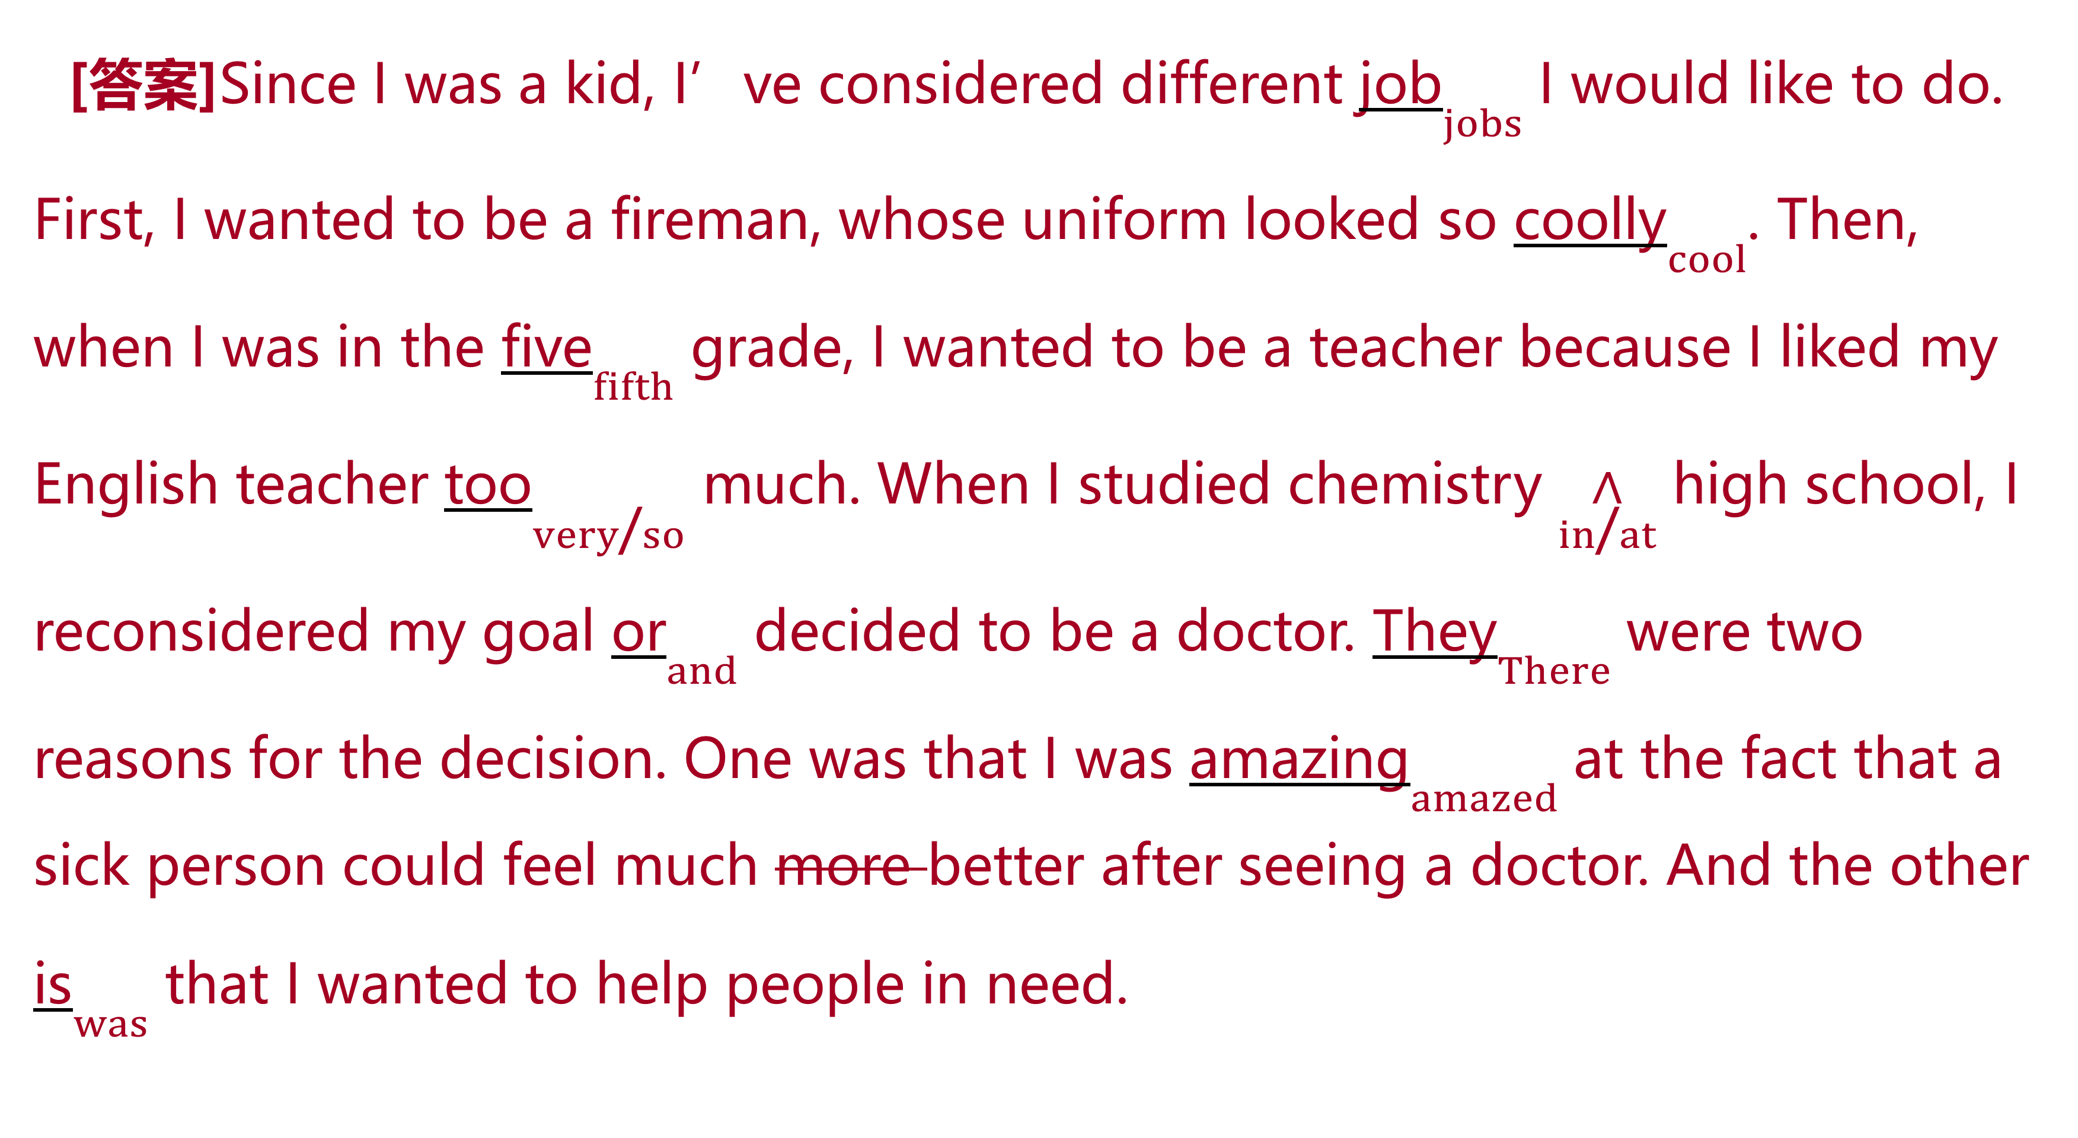
真题典例
[答案]Since I was a kid, I’ve considered different job$\underset{jobs}{}$ I would like to do. First, I wanted to be a fireman, whose uniform looked so coolly$\underset{cool}{}$. Then, when I was in the five$\underset{fifth}{}$ grade, I wanted to be a teacher because I liked my English teacher too$\underset{very\text{/}so}{}$ much. When I studied chemistry $\underset{in\text{/}at}{∧}$ high school, I reconsidered my goal or$\underset{and}{}$ decided to be a doctor. They$\underset{There}{}$ were two reasons for the decision. One was that I was amazing$\underset{amazed}{}$ at the fact that a sick person could feel much more better after seeing a doctor. And the other is$\underset{was}{}$ that I wanted to help people in need.

Slide 28
真题典例
[解析][文章大意] 本文是一篇记叙文,讲述了“我”随着年龄的变化对未来职业的选择也发生了变化。
1.job改为jobs 考查名词复数。本句中的different表示“不同的”,后面的名词job应该使用复数形式,故job改为jobs。
2.coolly改为cool 考查形容词。looked是系动词,表示“看起来”,后面使用形容词作表语,故coolly改为cool。
3.five改为fifth 考查序数词。“在五年级”有两种表达方式:in the+序数词+grade,或者使用in Grade 5的形式。故five改为fifth。
4.too改为very/so 考查副词。too much表示“太多”,而very/so much表示“非常”,故too改为very/so。

Slide 29
真题典例
5.在high前面加in/at 考查介词。“在高中”为in/at high school。故在high前面加in/at。
6.or改为and 考查连词。本句中的reconsidered和decided这两个谓语的动作是递进关系,故or改为and。
7.They改为There 考查固定句型。此处应该是there be句型,故将They改为There。
8.amazing改为amazed 考查非谓语动词。根据前面的主语I可知,后面应该使用amazed,表示“感到惊奇的”。

Slide 30
真题典例
9.删除more 考查形容词比较级。本句中better本身已经是比较级,前面只需要much来修饰,more是多余的。故删除more。
10.is改为was 考查时态。综合分析全文可知,作者在描述过去发生的事情,因此将is改为was。

Slide 31
真题典例
B
[2018·全国卷II]
When I was little, Friday’s night was our family game night. After supper, we would play card games of all sort in the sitting room. As the kid, I loved to watch cartoons, but no matter how many times I asked to watching them, my parents would not to let me. They would say to us that playing card games would help my brain. Still I unwilling to play the games for them sometimes. I didn’t realize how right my parents are until I entered high school. The games my parents taught me where I was a child turned out to be very useful later in my life.

Slide 32
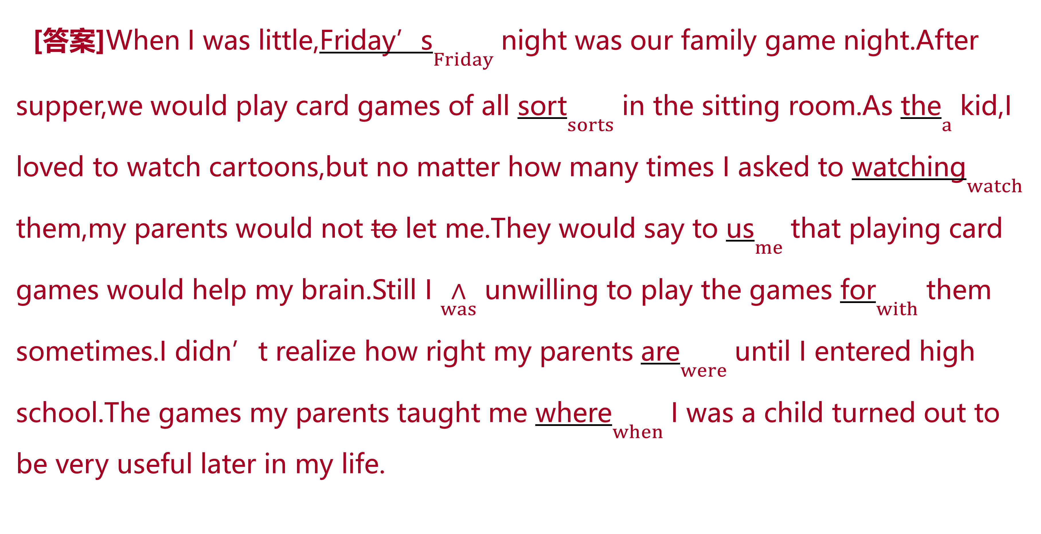
真题典例
[答案]When I was little,Friday’s$\underset{Friday}{}$ night was our family game night.After supper,we would play card games of all sort$\underset{sorts}{}$ in the sitting room.As the$\underset{a}{}$ kid,I loved to watch cartoons,but no matter how many times I asked to watching$\underset{watch}{}$ them,my parents would not to let me.They would say to us$\underset{me}{}$ that playing card games would help my brain.Still I $\underset{was}{∧}$ unwilling to play the games for$\underset{with}{}$ them sometimes.I didn’t realize how right my parents are$\underset{were}{}$ until I entered high school.The games my parents taught me where$\underset{when}{}$ I was a child turned out to be very useful later in my life.

Slide 33
真题典例
[解析][文章大意] 本文是一篇记叙文,主要介绍了作者小的时候,不理解父母让他玩扑克游戏的原因。作者刚开始不明白这种游戏可以促进他的智力,但是到后来终于明白父母是对的。
1.Friday’s改为Friday 考查名词。根据句意可知这里指“周五晚上”, Friday属于无生命的事物,不需要使用所有格,故将Friday’s改为Friday。
2.sort改为sorts 考查名词。根据前面的all可知,表示“各种各样的游戏”,后面的名词使用复数形式。
3.the改为a 考查冠词。此处泛指“一个”,表示数量,意为“作为一个小孩”,因此将the改为a。

Slide 34
真题典例
4.watching改为watch 考查不定式。由前面的不定式符号to可知填原形,故将watching改为watch。
5.去掉not后面的to 考查情态动词的用法。情态动词后面跟动词原形,不能跟不定式,故去掉to。
6.us改为me 考查代词。根据后面的help my brain可知,玩扑克牌游戏有助于“我”的大脑得到锻炼,因此这里的意思是“对我说”,故将us改为me。
7.在I 后面加was 考查动词。unwilling是一个形容词,前面需要加系动词构成谓语,故在I后面加was。

Slide 35
真题典例
8.for改为with 考查介词。根据语境,此处表示play sth with sb(和某人一起玩……),故将for改为with。
9.are改为were 考查时态。根据前后时态一致性和全文描述过去的事情可知, are改为were。
10.where改为when 考查时间状语从句。根据后面的“…I was a child…”可知,这是一个时间状语从句,故将where改为when。

Slide 36
模拟演练
Ⅰ.单句改错
1.They offered me coffee and other drinks. We have a good time talking and laughing together.
[答案]have 改为 had
[解析]此处应与前句谓语offered的时态保持一致。

Slide 37
模拟演练
2.Anyone may borrow books, and it cost nothing to borrow them.
[答案]cost 改为 costs
[解析]与主语it保持一致。

Slide 38
模拟演练
3.My school is organizing a basketball team and there’s just a chance which I can join it.
[答案]which改为that
[解析]chance后面的从句是同位语从句,要用that引导,故将which改为that。

Slide 39
模拟演练
4.On the way up I was busy taking pictures since the scenery was so beautiful. The time passes quickly.
[答案]passes 改为 passed
[解析]此处应与语境时态was保持一致。

Slide 40
模拟演练
5.She stopped to look out of the window and find a cloud of smoke coming out of her neighbour’s house.
[答案]find改为 found
[解析]此处应与谓语stopped保持时态一致。

Slide 41
模拟演练
6.Bill was standing at the side of the car, talking to two men who was helping him to repair it.
[答案]第二个was 改为 were
[解析]此处应与先行词 two men 的数保持主谓一致。

Slide 42
模拟演练
7.Playing football not only makes us grow up tall and strong but also give us a sense of fair play and team spirit.
[答案]give 改为 gives
[解析]主语为playing football,为单数,且此处与makes构成平行结构。

Slide 43
模拟演练
8.One evening she told me that something happened when their parents was out.
[答案]was改为were
[解析]此处应与主语their parents的数保持一致。

Slide 44
模拟演练
9.I want to thank you again for have me in your home for the summer holidays.
[答案]have改为having
[解析]介词后接动名词作宾语。

Slide 45
模拟演练
10.The World Health Organization and other organizations are working improve health all over the world.
[答案]improve前加to
[解析]不定式在此处表示目的。

Slide 46
模拟演练
Ⅱ.短文改错
A
词数: 129 话题: 保持健康 文体:说明文
It’s true that everyone want to be in good health. I’m very glad to give you some advices on how to keep healthy.
First of all, we need to keep a healthy and balance diet. Various kinds of foods can provide us for different nutrients which our bodies need. Secondly, we should also take exercise regular. As the saying goes, life lies of movement. Thirdly, we ought to get enough rest and sleep. Have you hear that early to bed and early to rise makes a man healthy, wealthy and wise? Last but not least,

Slide 47
模拟演练
we’d better to keep a healthy mind. That is to say, we should look at everything in a positive way.
Don’t forget to laugh much and cry less. You know, laughter is best medicine.

Slide 48
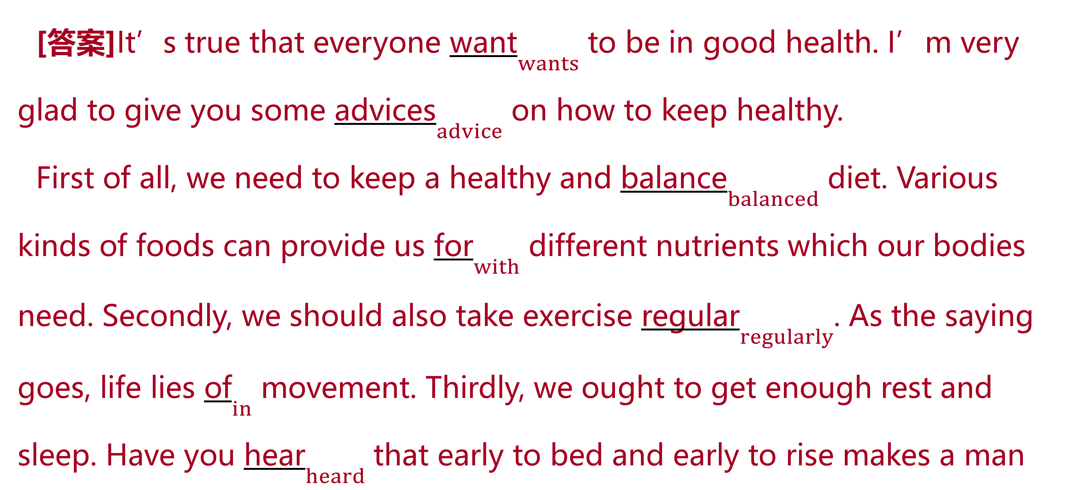
模拟演练
[答案]It’s true that everyone want$\underset{wants}{}$ to be in good health. I’m very glad to give you some advices$\underset{advice}{}$ on how to keep healthy.
First of all, we need to keep a healthy and balance$\underset{balanced}{}$ diet. Various kinds of foods can provide us for$\underset{with}{}$ different nutrients which our bodies need. Secondly, we should also take exercise regular$\underset{regularly}{}$. As the saying goes, life lies of$\underset{in}{}$ movement. Thirdly, we ought to get enough rest and sleep. Have you hear$\underset{heard}{}$ that early to bed and early to rise makes a man

Slide 49
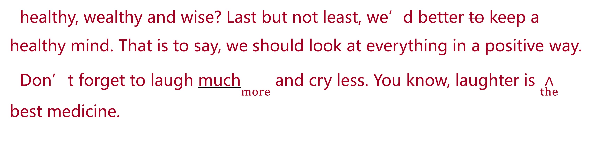
模拟演练
healthy, wealthy and wise? Last but not least, we’d better to keep a healthy mind. That is to say, we should look at everything in a positive way.
Don’t forget to laugh much$\underset{more}{}$ and cry less. You know, laughter is $\underset{the}{∧}$ best medicine.

Slide 50
模拟演练
B
词数:130 话题:16公里徒步 文体:记叙文
Life is full of various experiences, some of them are unforgettable. I still remember the hiking experiences with my classmates for 16 km a year ago. That summer day, we set off early in the morning, think it would be a great fun to walk for so long a distance. However, as the weather is getting hotter and hotter, I found their legs heavier and heavier. What’s worse, my feet began bleeding because long time pressing against the shoes. At one point, I

Slide 51
模拟演练
even wanted to give up. But I managed to dragging the rest of the way to the destination. Though not pleasant, this journey was impressive or rewarding. I have learnt that life is a long journey like this. No matter what happened, we should never give up.

Slide 52
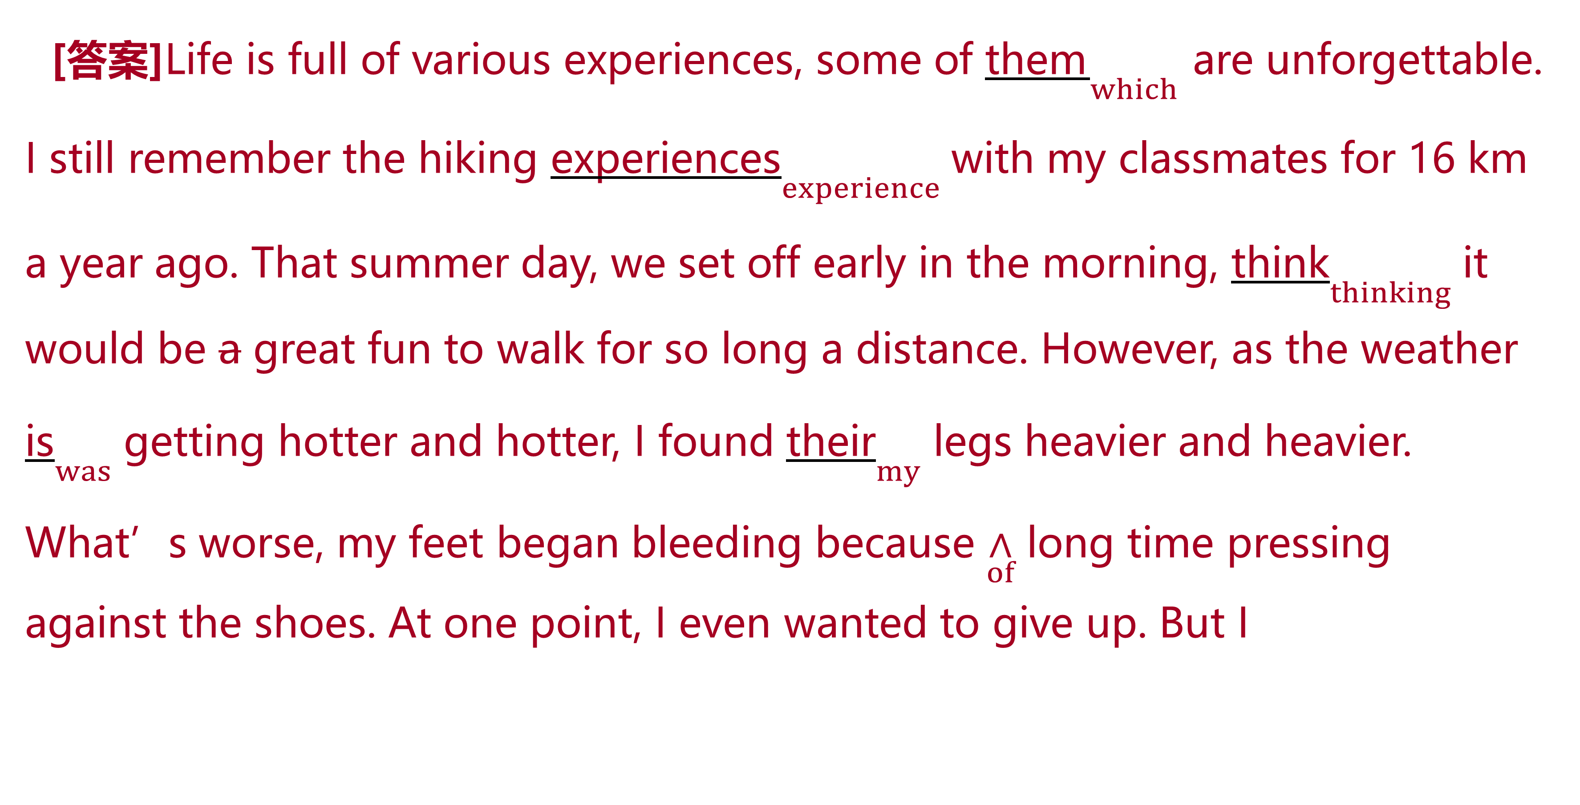
模拟演练
[答案]Life is full of various experiences, some of them$\underset{which}{}$ are unforgettable. I still remember the hiking experiences$\underset{experience}{}$ with my classmates for 16 km a year ago. That summer day, we set off early in the morning, think$\underset{thinking}{}$ it would be a great fun to walk for so long a distance. However, as the weather is$\underset{was}{}$ getting hotter and hotter, I found their$\underset{my}{}$ legs heavier and heavier. What’s worse, my feet began bleeding because $\underset{of}{∧}$ long time pressing against the shoes. At one point, I even wanted to give up. But I

Slide 53
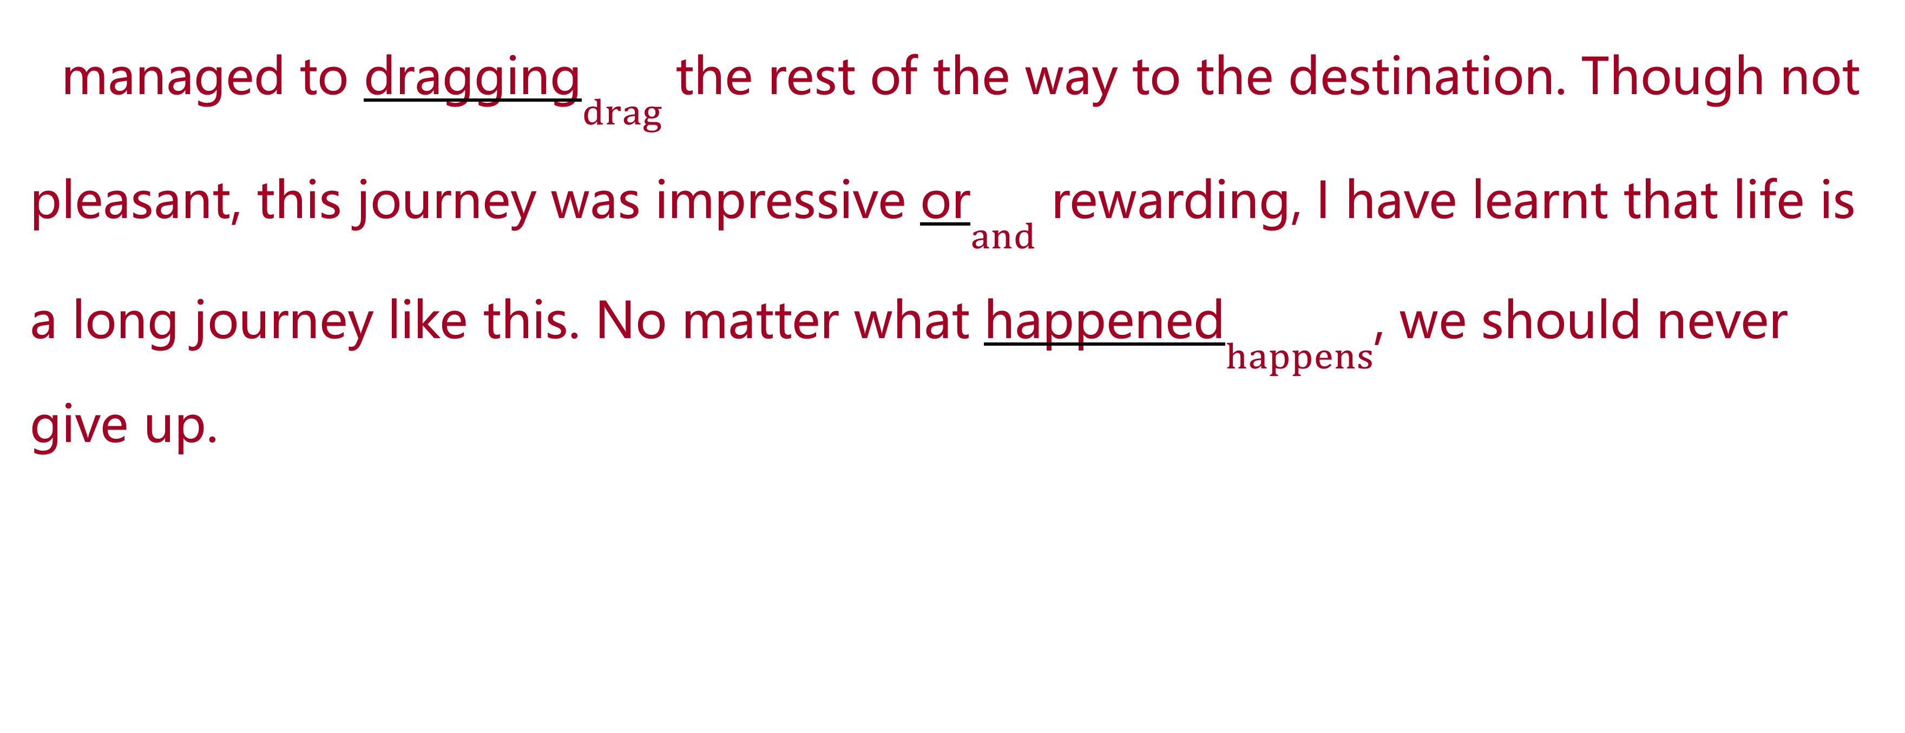
模拟演练
managed to dragging$\underset{drag}{}$ the rest of the way to the destination. Though not pleasant, this journey was impressive or$\underset{and}{}$ rewarding, I have learnt that life is a long journey like this. No matter what happened$\underset{happens}{}$, we should never give up.

