Slide 1

课件编辑说明
1. 本课件需用office2010及以上版本打开，如果您的电脑是office2007及以下版本或者WPS软件，可能会出现不可编辑的文档，建议您安装office2010及以上版本。
2. 因为课件中存在一些特殊符号，所以个别幻灯片在制作时插入了文档。如您需要修改课件，请双击插入的文档，即可进入编辑状态。如您在使用过程中遇到公式不显示或者乱码的情况，可能是因为您的电脑缺少字体，请打开网页www.canpointgz.cn/faq下载。
3. 本课件显示比例为16:9，如您的电脑显示器分辨率为4:3，课件显示效果可能比较差，建议您将电脑显示器分辨率更改为16:9。如您不知如何更改，请 360搜索“全品文教高中”或直接打开网页www.canpointgz.cn/faq，点击“常见问题” 。
4. 如您遇到有关课件技术方面的问题，请打开网页www.canpointgz.cn/faq，点击“常见问题”，或致电010-58818058；有关内容方面的问题，请致电010-58818084。

Slide 2


Slide 3

专题二
短文改错
PART 02
专题二
第1讲 词法错误
第2讲 句法错误
第3讲 行文逻辑错误

Slide 4

第3讲
行文逻辑错误
专题导读
真题典例
模拟演练
教师备用习题

Slide 5
专题导读
行文逻辑上的错误主要表现在时态不一致、指代不一致、主谓不一致和逻辑不一致等方面。此类错误是通过语篇来体现的,因此难度较大,做题时应谨记:①两种句式:并列句(并列连词) 和复合句(从属连词);②六种关系:转折关系、选择关系、递进关系、并列关系、因果关系及同位关系;③一种变化:语义的曲折变化,如:肯定与否定、方位与时空的转移等。如:语义矛盾take→bring;come→go; accept→receive; here→there;up→down等。语义重叠though→but;repeat→again;because→so;improve→better; enter→into等。

Slide 6
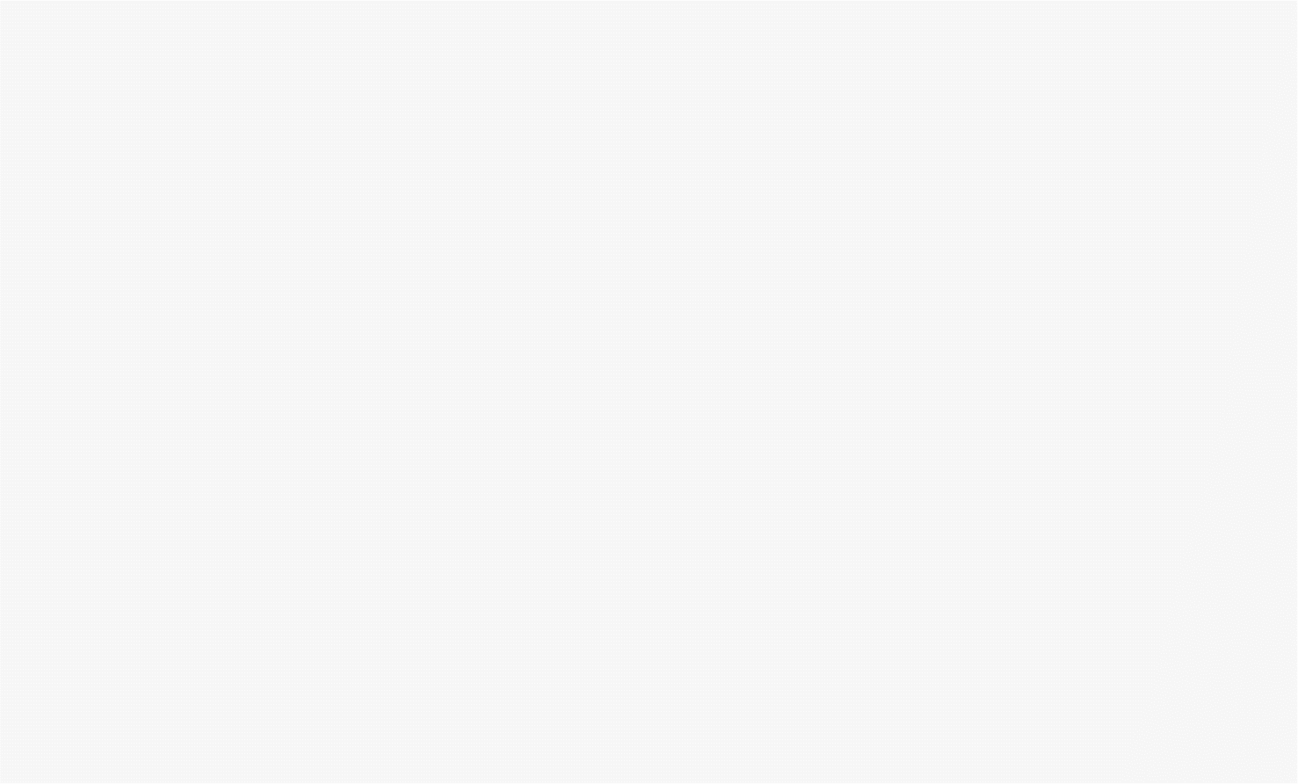
专题导读
【高考体验】
1.[2019·全国卷III] In the cafe, customers will enjoy yourselves in the historical environment that is created for them.
[答案]yourselves改为 themselves
[解析]考查代词的用法。customers是句子的主语,故把 yourselves改为 themselves。

Slide 7
专题导读
2.[2018·全国卷III] The classroom is a place for learning and that include learning from textbooks, and mistakes as well.
[答案]include改为includes
[解析]考查主谓一致。主语是that,是单数形式,根据语境时态可知谓语动词用第三人称单数形式includes。

Slide 8
专题导读
3.[2018·全国卷I] Last winter when I went here again, they had a big separate house to raise dozens of chickens.
[答案]here改成there
[解析]考查副词及语意理解。语境表达:去年冬天“我”又一次去了那里。故将here改成there。

Slide 9
专题导读
4.[2016·四川卷] Mum has a full-time job, so she has to do most of the housework.
[答案]so改为but
[解析]根据句意“母亲有一份全职的工作,但是她得做大部分的家务”可知前后分句之间是转折关系,故将so改为but。

Slide 10
专题导读
【易错考点归纳】
时态不一致错误主要有:①语境时态不一致;②并列句中的时态不一致;③主从句的时态不一致。
指代不一致错误主要有:①人称不一致;②单复数不一致;③性别不一致。
逻辑不一致错误主要有:①肯定误用否定或相反;②转折误用因果或相反。
主谓不一致错误主要有:①主谓在人称或单复数上不一致;②含有定语从句或强调结构中的主谓不一致;③非谓语动词短语作主语或主语从句作主语时主谓不一致。

Slide 11
真题典例
A
[2019·全国卷III]
I’ve had many dreams since I was a child. Now my dream is to opens a cafe. Though it may appear simple, it required a lot of ideas and efforts. What I want is not just an ordinarily cafe but a very special one. I want my cafe have a special theme such as like “Tang Dynasty”. In the cafe, customers will enjoy yourselves in the historical environment what is created for them. If I succeed in manage one, I will open more. I wish to have a chain of cafes in many different city. Each of my cafes will have a different theme and an unique style.

Slide 12
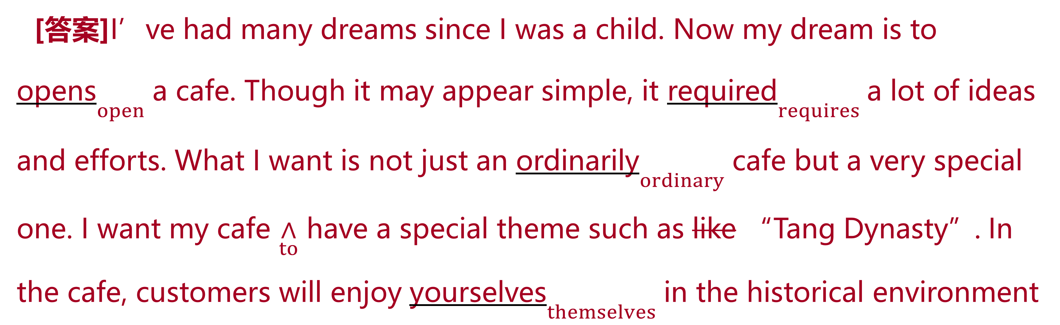
真题典例
[答案]I’ve had many dreams since I was a child. Now my dream is to opens$\underset{open}{}$ a cafe. Though it may appear simple, it required$\underset{requires}{}$ a lot of ideas and efforts. What I want is not just an ordinarily$\underset{ordinary}{}$ cafe but a very special one. I want my cafe $\underset{to}{∧}$ have a special theme such as like “Tang Dynasty”. In the cafe, customers will enjoy yourselves$\underset{themselves}{}$ in the historical environment

Slide 13
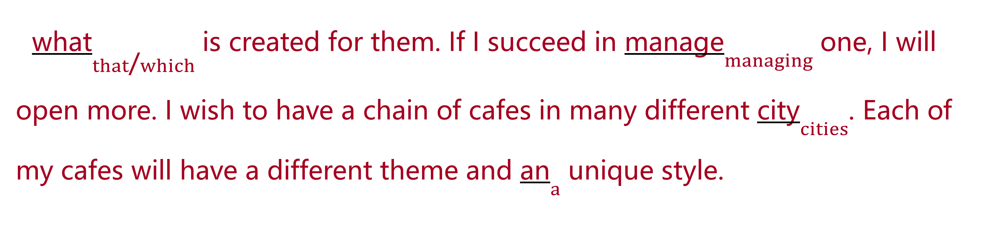
真题典例
what$\underset{that\text{/}which}{}$ is created for them. If I succeed in manage$\underset{managing}{}$ one, I will open more. I wish to have a chain of cafes in many different city$\underset{cities}{}$. Each of my cafes will have a different theme and an$\underset{a}{}$ unique style.

Slide 14
真题典例
[解析][文章大意] 本文是一篇说明文。文章讲述了“我”的梦想——开一家别有韵味的、与众不同的咖啡馆。
1.opens改为open 考查非谓语动词。此处指“我”的梦想是开一家咖啡馆。句中需用不定式to do作表语。故将opens改为open。
2.required改为requires 考查动词时态。句中需使用一般现在时,主语为it,谓语动词需用第三人称单数形式。故将required改为requires。
3.ordinarily改为ordinary 考查形容词。形容词修饰名词,作前置定语,此处表示“一家普通的咖啡馆”。故将ordinarily改为ordinary。

Slide 15
真题典例
4.在my cafe后加to 考查非谓语动词。根据短语want sb to do sth 可知需加上 to,此处为不定式作宾补。故在my cafe后加to。
5.去掉such as后的like 考查固定短语。such as意为“比方说……”,用来列举,后面无须加上like。故将like去掉。
6.yourselves改为themselves 考查反身代词。此处指顾客们在这种氛围中会很开心,需用第三人称形式的反身代词,且为复数形式。故将yourselves改为themselves。
7.what改为that/which 考查定语从句。分析句子可知先行词为environment,指物,定语从句中缺少主语,需用关系代词that/which。故将what改为that/which。

Slide 16
真题典例
8.manage改为managing 考查非谓语动词。in为介词,后接动词时需用动名词。故将manage改为managing。
9.city改为cities 考查名词复数。many修饰可数名词的复数。故将city改为cities。
10.an改为a 考查冠词。unique为以辅音音素开头的单词,用不定冠词时需用a。故将an改为a。

Slide 17
真题典例
B
[2018·全国卷III]
It was Monday morning, and the writing class had just begin. Everyone was silent, wait to see who would be called upon to read his and her paragraph aloud. Some of us were confident and eager take part in the class activity; others were nervous and anxious. I had done myself homework, but I was shy. I was afraid that to speak in front of a larger group of people. At that moment, I remembered that my father once said, “The classroom is a place for learning and that include learning from textbooks, and mistake as well.” Immediate, I raised my hand.

Slide 18
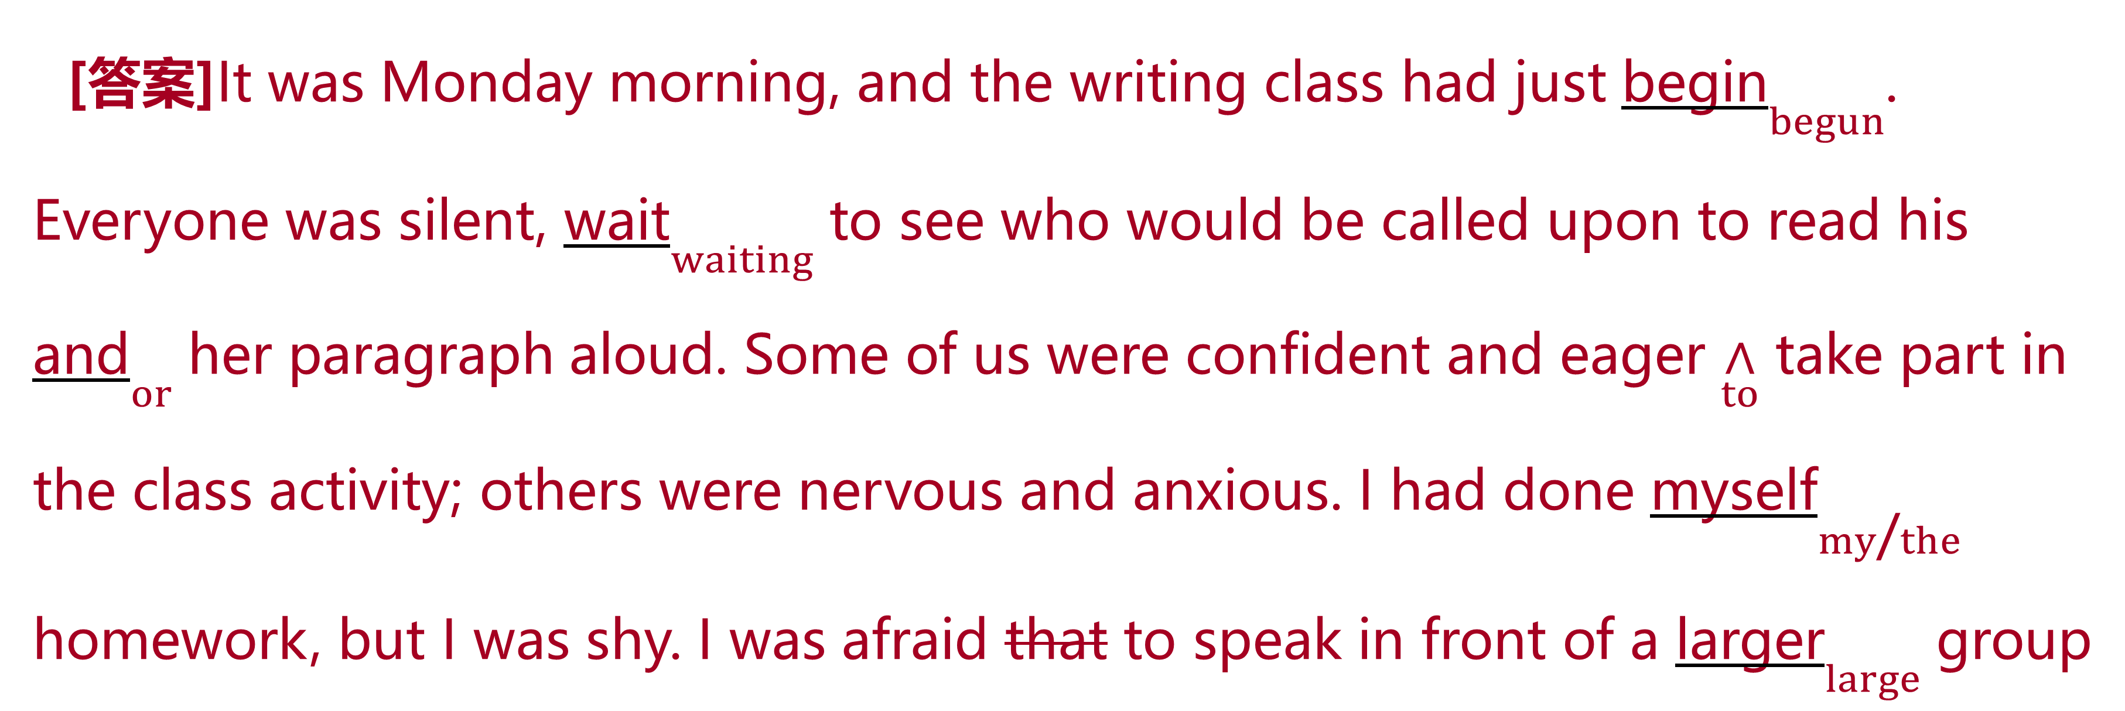
真题典例
[答案]It was Monday morning, and the writing class had just begin$\underset{begun}{}$. Everyone was silent, wait$\underset{waiting}{}$ to see who would be called upon to read his and$\underset{or}{}$ her paragraph aloud. Some of us were confident and eager $\underset{to}{∧}$ take part in the class activity; others were nervous and anxious. I had done myself$\underset{my\text{/}the}{}$ homework, but I was shy. I was afraid that to speak in front of a larger$\underset{large}{}$ group

Slide 19
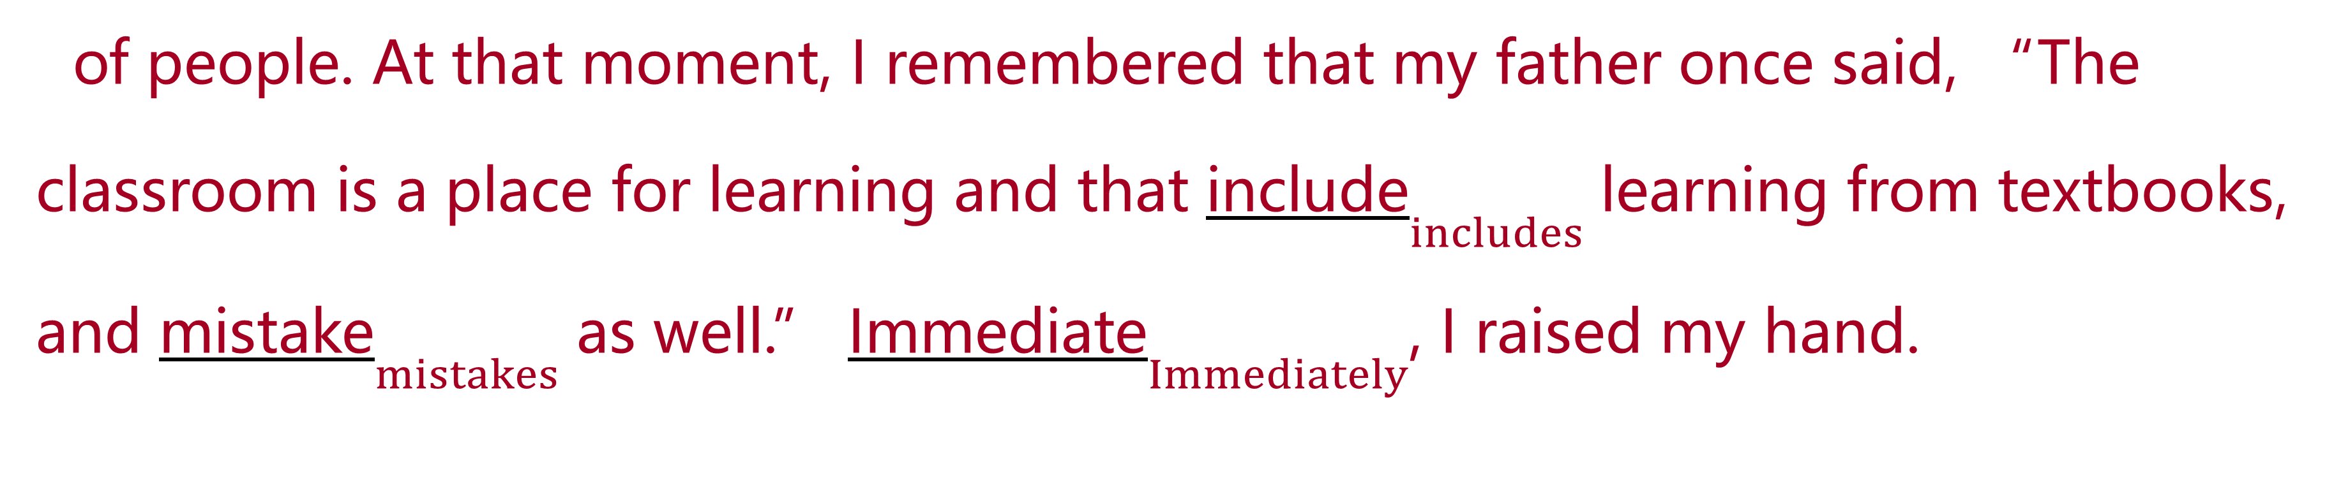
真题典例
of people. At that moment, I remembered that my father once said, “The classroom is a place for learning and that include$\underset{includes}{}$ learning from textbooks, and mistake$\underset{mistakes}{}$ as well.” Immediate$\underset{Immediately}{}$, I raised my hand.

Slide 20
真题典例
[解析][文章大意] 本文是一篇记叙文。文章主要讲述了作者在写作课上发生的故事。
1.begin改为begun 考查过去分词。 根据句中的had可知,其后用过去分词。
2.wait改为waiting 考查现在分词。wait与everyone是主动关系,用现在分词作was silent的伴随状语,指学生们等待的状态。
3.and改为or 考查连词。此处表示“他的或者她的文章”,因此属于一种选择关系,而不是并列关系。
4.在eager后加上to 考查不定式。根据短语be eager to do sth“渴望做某事”可知,要加to。

Slide 21
真题典例
5.myself改为my或the 考查代词。此处表示“我”已经完成了(“我”的)作业。此处可以改为形容词性物主代词my,作homework的定语。还可以改为定冠词the,修饰homework。
6.去掉afraid后的that 考查固定搭配。此处是be afraid to do sth“害怕做某事”,that是多余的。
7.larger改为large 考查形容词。根据句意可知作者害怕在一大群人面前讲话,这里没有比较含义,用原级。
8.include改为includes 考查主谓一致。前面的that作主语,是一个单数,由此可知谓语动词用第三人称单数形式。

Slide 22
真题典例
9.mistake改为mistakes 考查名词复数。与前面的textbooks并列,用复数形式。
10.Immediate改为Immediately 考查副词。根据语境,此处修饰整个句子,使用副词,作状语。

Slide 23
模拟演练
Ⅰ.单句改错
1.Clever as she is, but she works very hard.
[答案]去掉but
[解析]前面已有引导让步状语从句的连词 as(=though“虽然”)。此题不要受汉语句式“虽然……但是……”的影响而重复使用连词。

Slide 24
模拟演练
2.It is a very important exam but I can’t afford to fail it.
[答案]but 改为 and/so
[解析]此处是因果或并列关系,并非转折关系。

Slide 25
模拟演练
3.My grandma was the best cook in the world but she could make the most delicious dishes.
[答案]but 改为and
[解析]此处是并列关系,而不是转折。

Slide 26
模拟演练
4.We study quite a few subject, such as maths, Chinese, English and physics.
[答案]subject 改为 subjects
[解析]a few 后应接可数名词的复数形式。

Slide 27
模拟演练
5.When I got back, it were already 6:00 pm, so I hope you understand.
[答案]were改为was
[解析]主谓不一致,主语是it,故把were改为was。

Slide 28
模拟演练
6.Before her leaving, I prepared a gift to show my best wishes to him. She said it was the best gift she had ever had.
[答案]him改为her
[解析]根据句意“在她离开前,我为她准备了一个礼物来表达我对她最好的祝福”可知, 此处代词指代不一致,上文中是her leaving,故将him改为her。

Slide 29
模拟演练
7.I meant to give it back to you before four in the afternoon, and I was held up on my way back.
[答案]and改为but
[解析]根据语境可知,“我本打算在下午四点前把它还给你,但在回来的路上我被耽搁了”,此处为转折关系,故应将and改为but。

Slide 30
模拟演练
8.The air keeping the balloon up was escaping quickly and the balloon was coming up.
[答案]第二个up改为down
[解析]根据语境“因为气球中的气体跑得很快,所以气球下降了”,用up不符合逻辑,故将up改为down。

Slide 31
模拟演练
9.I helped them go to the nearest hospital and I stayed here for one and a half hours.
[答案]here改为there
[解析]依据句意“我帮助他们去了最近的一家医院,并且我在那儿待了一个半小时”,故应将here改为there。

Slide 32
模拟演练
10.Because of so much viewing, children may not be develop the habit of reading and the ability to enjoy themselves.
[答案]去掉 be
[解析]be与其后的动词 develop冲突。

Slide 33
模拟演练
Ⅱ.短文改错
A
词数:106 话题:诚实 文体:记叙文
Last weekend I go fishing with my cousins by a river, where was two miles away from my home by bike. When we were about to return for home, we found one of our bike lost. We were really nervous then. Asking about the lost bike, nobody told the truth except me. But to my surprise, my parents don’t scold me. Instead, they said I was a honest boy. I have benefited great from my family rules.

Slide 34
模拟演练
I’m not the best at schoolwork, but classmates trust me and nearly everyone is willing to making friends with me. It helps me know better about “Honesty is the best policy.”

Slide 35
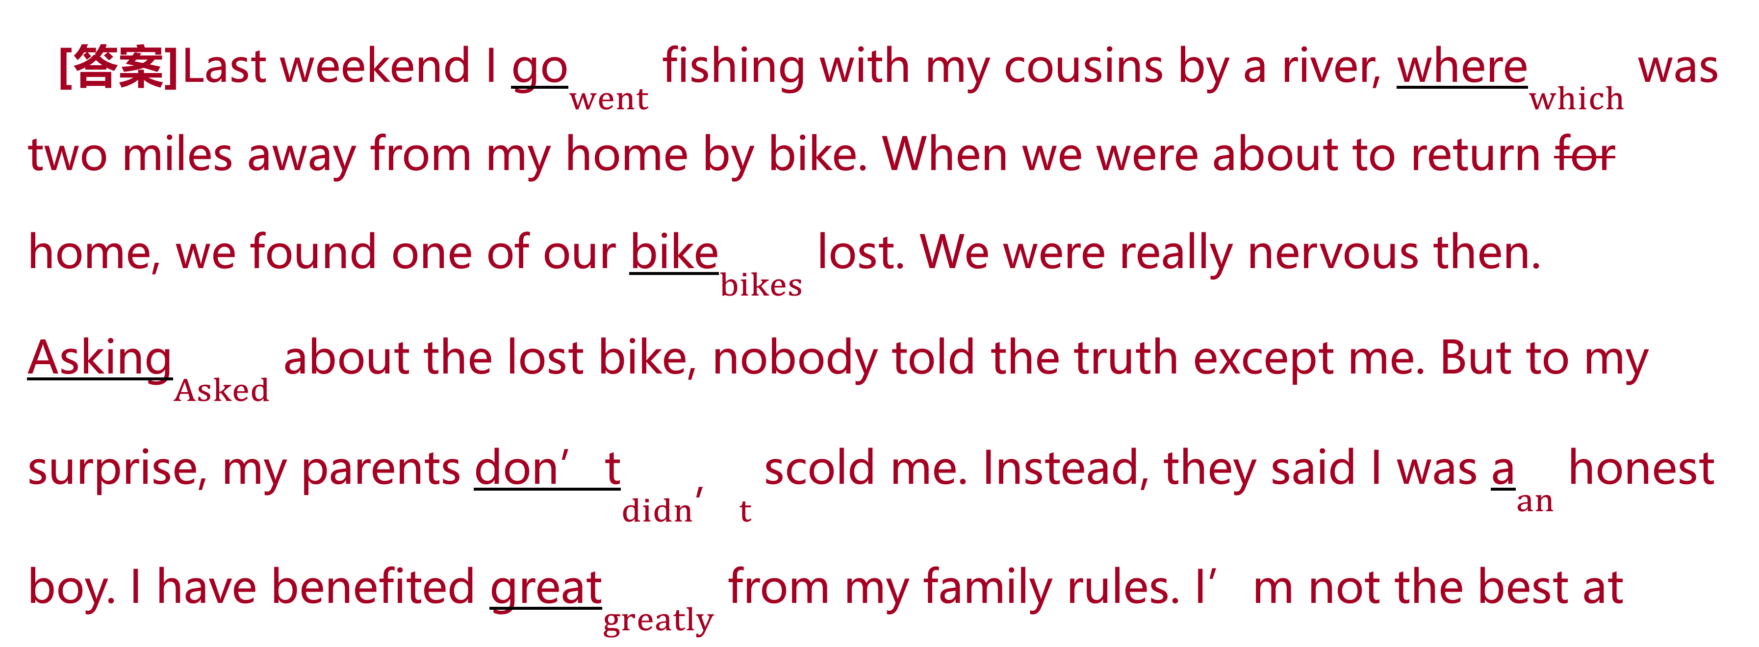
模拟演练
[答案]Last weekend I go$\underset{went}{}$ fishing with my cousins by a river, where$\underset{which}{}$ was two miles away from my home by bike. When we were about to return for home, we found one of our bike$\underset{bikes}{}$ lost. We were really nervous then. Asking$\underset{Asked}{}$ about the lost bike, nobody told the truth except me. But to my surprise, my parents don’t$\underset{didn\text{’}t}{}$ scold me. Instead, they said I was a$\underset{an}{}$ honest boy. I have benefited great$\underset{greatly}{}$ from my family rules. I’m not the best at

Slide 36
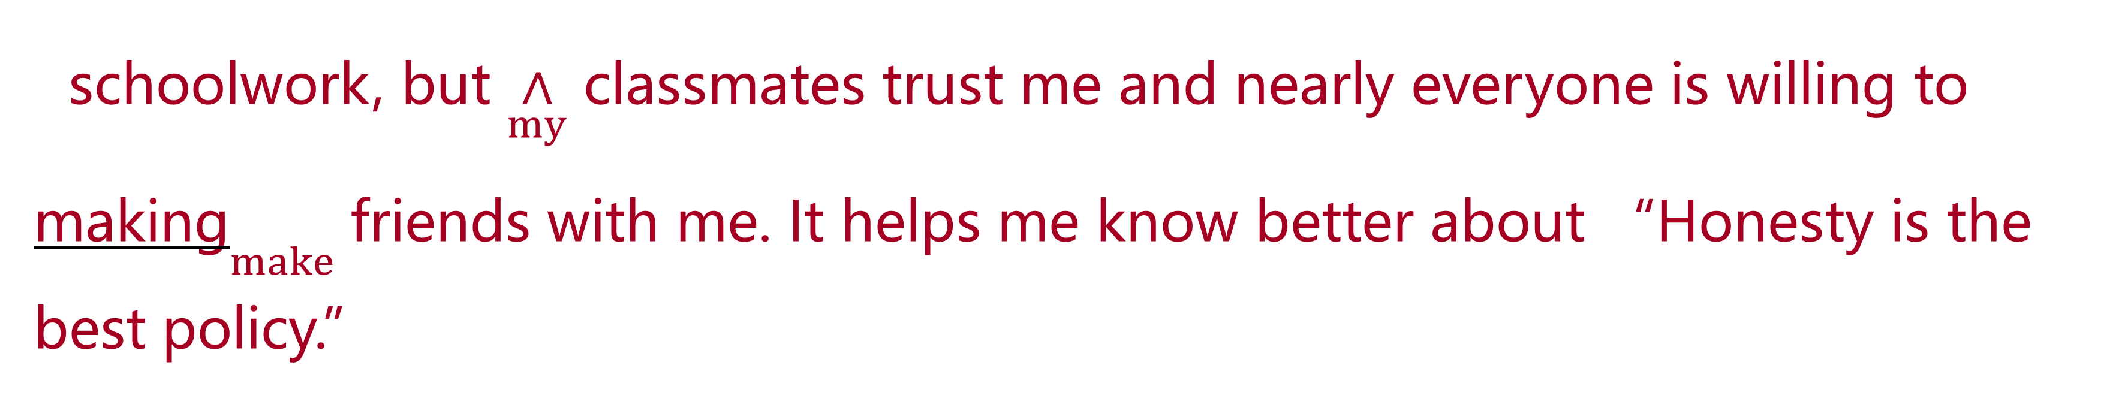
模拟演练
schoolwork, but $\underset{my}{∧}$ classmates trust me and nearly everyone is willing to making$\underset{make}{}$ friends with me. It helps me know better about “Honesty is the best policy.”

Slide 37
模拟演练
B
词数:112 话题:移动支付 文体:记叙文
My 71-year-old grandpa run a small food stand in a night market in my city, provide local snacks for people working overtime. Receiving payments has always been a problem for him before my help. He often had to feel in his pocket for changes on cold nights while keeping eye on food in the oven. After learning this I helped him set up with mobile payment apps like WeChat Pay and Alipay. My grandpa was content with which I did for him, for about 95 per cent of his customers now pay with his phones.

Slide 38
模拟演练
Mobile payment has become an essential part of our everyday life. It not only deep changes the life of young people, but also provides convenient for the elderly.

Slide 39
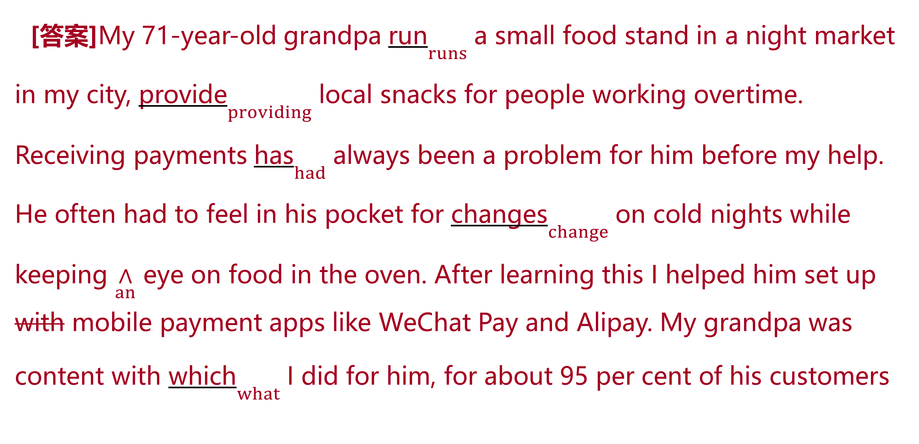
模拟演练
[答案]My 71-year-old grandpa run$\underset{runs}{}$ a small food stand in a night market in my city, provide$\underset{providing}{}$ local snacks for people working overtime. Receiving payments has$\underset{had}{}$ always been a problem for him before my help. He often had to feel in his pocket for changes$\underset{change}{}$ on cold nights while keeping $\underset{an}{∧}$ eye on food in the oven. After learning this I helped him set up with mobile payment apps like WeChat Pay and Alipay. My grandpa was content with which$\underset{what}{}$ I did for him, for about 95 per cent of his customers

Slide 40
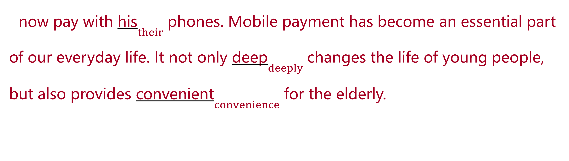
模拟演练
now pay with his$\underset{their}{}$ phones. Mobile payment has become an essential part of our everyday life. It not only deep$\underset{deeply}{}$ changes the life of young people, but also provides convenient$\underset{convenience}{}$ for the elderly.

Slide 41
教师备用习题
A
As the day June 7th and 8th is approaching, you are already on the way to the graduation ceremony. Graduating from high school is exciting time filling with both celebrations and responsibilities. Make a checklist of things that need to be done before and after graduating helps you reduce stress, but you can enjoy the last days or weeks of school with friends before life continues elsewhere. A well-planned high school graduation checklist should start from months before the actual date of graduation, they may include a graduation party, a class photo, a congratulation card and so on. In a word, it is worthwhile to make our graduation perfectly memorable and impressively.

Slide 42
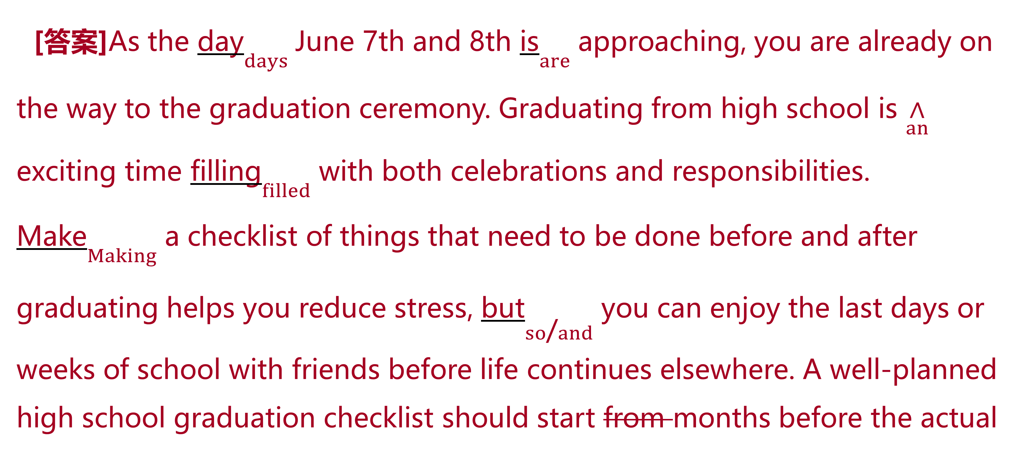
教师备用习题
[答案]As the day$\underset{days}{}$ June 7th and 8th is$\underset{are}{}$ approaching, you are already on the way to the graduation ceremony. Graduating from high school is $\underset{an}{∧}$ exciting time filling$\underset{filled}{}$ with both celebrations and responsibilities. Make$\underset{Making}{}$ a checklist of things that need to be done before and after graduating helps you reduce stress, but$\underset{so\text{/}and}{}$ you can enjoy the last days or weeks of school with friends before life continues elsewhere. A well-planned high school graduation checklist should start from months before the actual

Slide 43
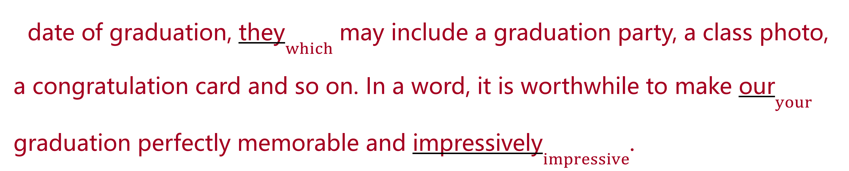
教师备用习题
date of graduation, they$\underset{which}{}$ may include a graduation party, a class photo, a congratulation card and so on. In a word, it is worthwhile to make our$\underset{your}{}$ graduation perfectly memorable and impressively$\underset{impressive}{}$.

Slide 44
教师备用习题
B
The new school year is around corner, so I need to buy something to my children and myself. Therefore, yesterday’s afternoon I took them to a shoe store to buying some new shoes. My youngest kids wanted a pair of sports shoes and thus we bought one pair. My older son needed a pair of casual shoes for school and we were found some on sale. The first pair which he tried on was a little small, so he put on other pair and they fitted him perfectly. My daughter wanted beauty dress shoes and she got some high heels. I, myself, bought some boots because my old ones were wearing out.

Slide 45
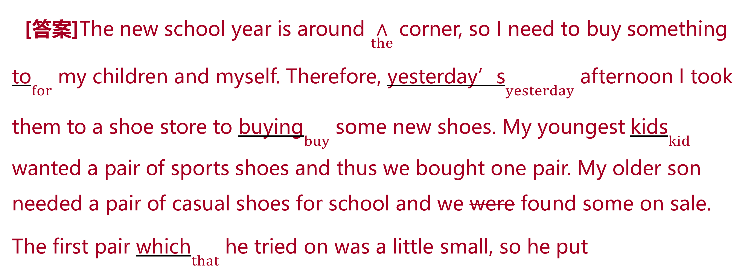
教师备用习题
[答案]The new school year is around $\underset{the}{∧}$ corner, so I need to buy something to$\underset{for}{}$ my children and myself. Therefore, yesterday’s$\underset{yesterday}{}$ afternoon I took them to a shoe store to buying$\underset{buy}{}$ some new shoes. My youngest kids$\underset{kid}{}$ wanted a pair of sports shoes and thus we bought one pair. My older son needed a pair of casual shoes for school and we were found some on sale. The first pair which$\underset{that}{}$ he tried on was a little small, so he put

Slide 46
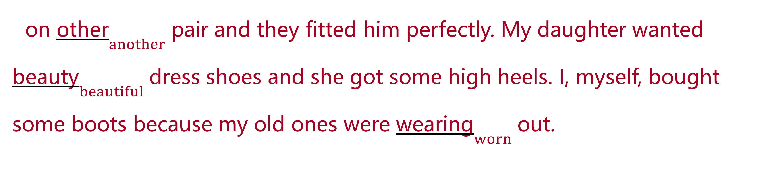
教师备用习题
on other$\underset{another}{}$ pair and they fitted him perfectly. My daughter wanted beauty$\underset{beautiful}{}$ dress shoes and she got some high heels. I, myself, bought some boots because my old ones were wearing$\underset{worn}{}$ out.

