Slide 1
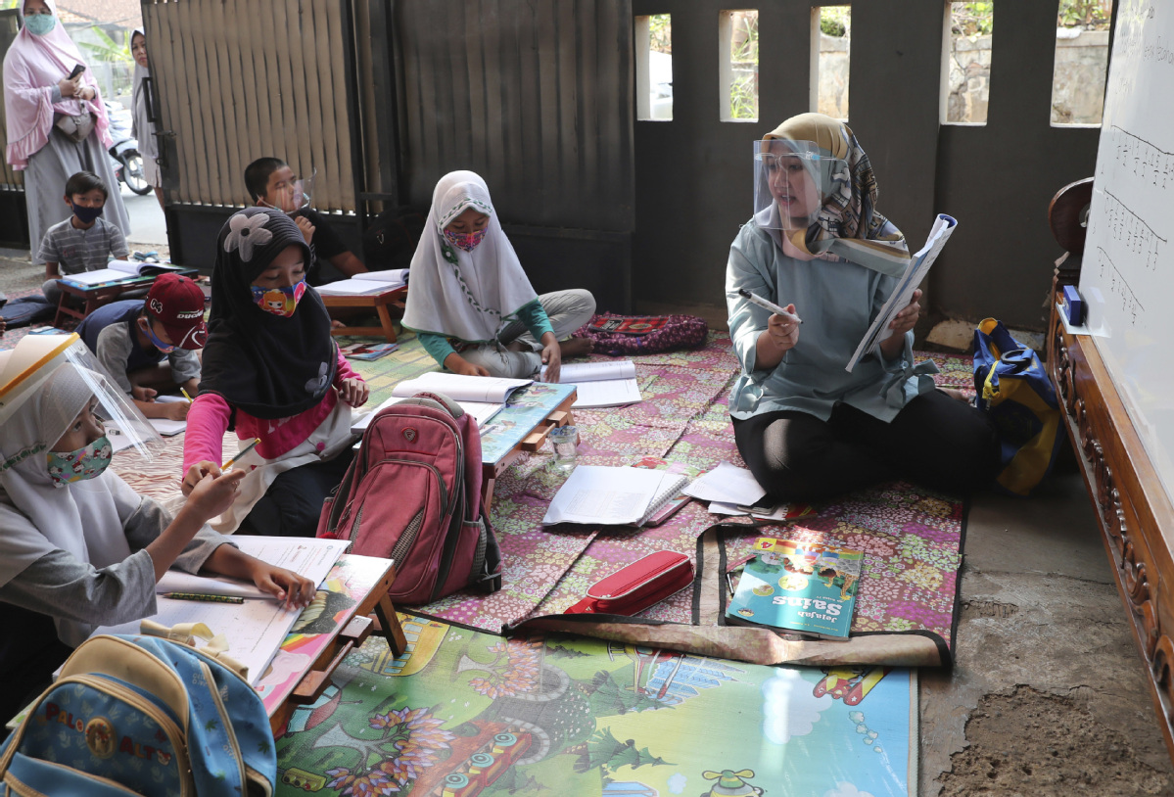
In Indonesia, shock coffin tactics策略 nail（beat） coronavirus risks
印尼防疫出狠招 不戴口罩被罚躺棺材
wearing
A teacher ______________(wear) a face shield盾 leads a class in a makeshift classroom in Tangerang, Indonesia, on Monday.

Slide 2
at
Each day in Jakarta _______ 9 am sharp, local government official Ricky Mulyana and three colleagues don full personal __________________(protect) equipment, hoist a _____________ (wood) coffin onto their shoulders, and set out on a ‘funeral’ procession down busy city streets.
在雅加达，每天上午九点整，当地政府官员瑞奇·木雅那和三名同事都会穿上全套的个人防护装备，扛起一副木棺材，沿着繁忙的城市街道出发开启“送葬”之旅。
don [dɒn]：v.穿上，披上，戴上
protective
wooden

Slide 3
The coffin, _______________(wrap) in plastic, contains only an effigy. But as Indonesia struggles to contain a surge in coronavirus cases, authorities are trying shock tactics _________________(catch) the public’s attention and drive home crucial health messages in a country that has the ______________ (high) virus death toll in Southeast Asia.
棺材用塑料包裹着，里面只有一个雕像。但在印尼努力控制新冠病例数量激增的同时，有关部门正在试图采取恫吓策略来吸引公众的注意力，并传达重要的卫生信息。印尼的新冠肺炎死亡病例数在东南亚各国居首。
effigy [ˈefɪdʒi]：n.雕像，肖像
wrapped
to catch
highest

Slide 4
The ________________(alarm) stunt is one of a string deployed amid desperate case numbers: Indonesia on Thursday recorded a record daily spike in coronavirus infections and now has more than 180,000 cases and at least 7,750 _______________(die). Jakarta has been the epicentre of Indonesia’s outbreak, accounting ________ nearly a quarter of cases in the world’s fourth most populous country.
这一惊人的防疫举措是在严重的疫情下采取的一系列措施之一：上周四（9月3日），印尼新冠肺炎确诊病例数创下单日新高，目前确诊病例总数已逾18万，死亡病例至少达7750例。雅加达是印尼疫情的中心，在这个世界人口第四大国，近四分之一的病例来自雅加达。
alarming
deaths
for

Slide 5
awareness
Elsewhere, tactics used to draw _______________(aware) to the virus have even included deploying a cast of “ghosts” to patrol streets of a village in Java, ______________(hope) an age-old superstition will keep people indoors.
在其他地方，为了引起人们对疫情的重视，采取的策略甚至包括派遣一群“鬼魂”在爪哇一个村庄的街道上巡逻，希望古老的迷信能让人们呆在家里。
hoping

