Slide 1
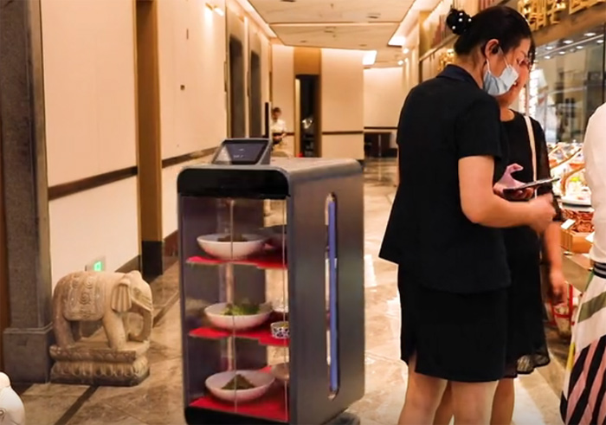
over
为减少人与人接触 韩国餐厅启用送餐机器人AI-powered robots take ____________ South Korea's restaurant to limit human contact

Slide 2
Customers at a fast-food chain in South Korea can avoid any interaction ________ a human server during the pandemic. No Brand Burger is using robots ____________ orders, prepare food and bring meals out to diners.
韩国快餐连锁店No Brand 汉堡店用机器人接单、准备食物和给顾客送餐，这样顾客就可以避免与人类服务员产生任何互动。
with
to take

Slide 3
via
Customers order and pay _________ touchscreen, then their request is sent to the kitchen ____________ a cooking machine heats up the buns and patties.
_____________ it's ready, a robot 'waiter' brings out their takeout bag.
Human workers add toppings to the burgers and wrap them _______ in takeout bags before ______________(pass) them over to serving robots.
顾客通过触摸屏下单并支付，然后订单就会送到厨房，厨房里的烹饪机器会加热小圆面包和肉饼。
准备好后，机器人“服务员”会将外卖送过来。
工作人员负责在汉堡上淋上浇头，将其用外卖袋包装好，然后“交给”机器人服务员。
where
When
up
passing

Slide 4
accounted for
Last month, takeout orders at No Brand ________________________ 58 percent total sales, up __________ 42 percent in July, according to the chain's parent company, Shinsegae Food.
根据No Brand汉堡店所属的新世界集团食品部的数据，上个月No Brand的外卖订单占了总销量的58%，相比七月份的42%上升了。
After a recent _____________(two) wave of coronavirus infections, restaurants in South Korea were only allowed to provide takeout and ________________(deliver) after 9pm - a restriction _________ was only lifted Monday.
在近期暴发第二波新冠疫情后，韩国只允许餐厅在晚上9点后提供外卖和送货服务，这一限制令刚刚于9月14日解除。
from
second
delivery
that

Slide 5
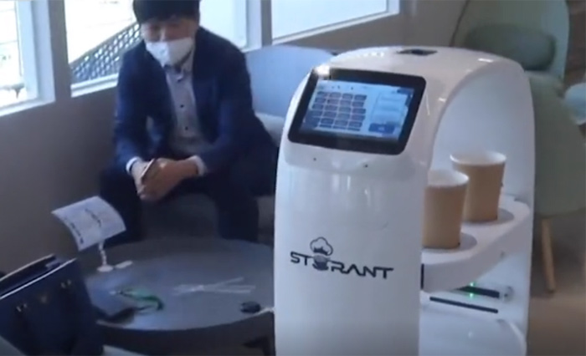

Slide 6
employing
Other eateries in Asia have started __________________（employ） robot servers during the pandemic.
亚洲的其他一些餐厅已经开始在疫情期间启用机器人服务员。
In South Korea, the Italian restaurant chain Mad for Garlic is using ________________(serve) robots even for sit-down customers.
在韩国，大蒜主题意式餐厅甚至让机器人为堂食顾客服务。
______________(Use) 3D space mapping and other technology, the electronic 'waiter,’ _____________(know) as Aglio Kim, navigates ____________ tables with up to five orders.
名为阿利奥·金的机器人服务员运用三维空间映射等技术在餐桌之间穿梭，一次最多可以接5份订单。
serving
Using
known
between

Slide 7
Mad for Garlic manager Lee Young-ho said kids especially like the robots, _____________ can carry up to 66lbs in their trays.
大蒜餐厅经理李英浩说，孩子们特别喜欢这些机器人，它们的盘子里可盛放重达66磅（约30千克）的食物。
Initially South Korea had been doing well against the virus, but in August, the number of reported infections nearly _________________, from 56 to 103, in just two days. It reached a ___________ of 441 cases on August 26 before ticking back down _________ at least 100 new infections per day.
最初韩国的抗疫局面一直不错，但八月份报告的新增病例数几乎翻了一番，两天内就从56例增至103例。8月26日韩国新增确诊病例达到了441例的高峰，之后又回落到每日新增至少100例的水平。
which
doubled
peak
to

Slide 8
banned
That month, the health ministry _______________(ban) large gatherings and shuttered nightclubs, churches and beaches _________________(turn) the tide.
为了扭转局势，八月份韩国卫生部禁止了大型聚会，关闭了夜总会、教堂和海滩。
To date, the country of 50 million has had 22,504 _________________ (report) cases of COVID-19 and 367 deaths, 42 _____________ were in Seoul.
到目前为止，拥有5000万人口的韩国新冠肺炎确诊病例累计达22504例，死亡367例，其中有42例在首尔。
to turn
reported
of which

Slide 9
知识储备
接管
与人互动
通过触摸屏支付
占了
提供送货服务
解除禁令
数量翻倍
达到高峰
take over
interact with
pay via touchscreen
account for
provide delivery
lift a restriction
number double（s）
reach a peak

Slide 10
情境运用
A：I was thinking of starting my own business.
B：What kind?
A：I know you wanted me ____________________ your restaurant business, but to be honest, I can’t stand working in the food industry.
B：Don’t worry, I knew that about you a long time ago.
Teachers have a limited amount of time __________________ each child.《牛津词典》
to take over
to interact with

