Slide 1
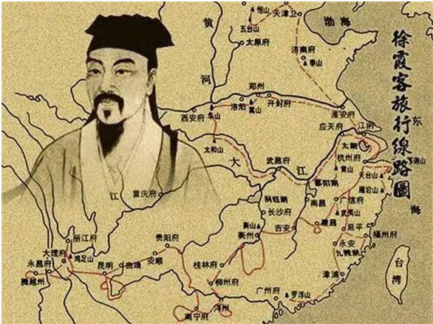
decades
Xu Xiake was one of a kind, not least because he spent three ____________(十年) on the road four centuries ago.
over

Slide 2
Extremely _________________(usual) for those times, Xu’s mother was fully literate, and she encouraged her son _______________（read） voraciously from his father’s amply stocked library. But at the age of 15, Xu failed the imperial examinations, _____________ were seen as a steppingstone to a respected position in the hierarchy. Initially _________________ (disappoint), he seemed set to follow in his father’s footsteps ________ a farmer and merchant. Then wanderlust took hold.
在那个时候很少见，徐霞客的妈妈是读过书的，她还鼓励自己的儿子多读书，读父亲藏书阁里的书。15岁的时候，徐霞客科举未中，那时候科举可是进入官宦阶层受人敬仰的道路。刚开始还很沮丧，他似乎只能走父亲的老路，开始务农和经商。不过之后，爱玩的心就占了上风。
unusually
to read
which
disappointed
as

Slide 3
taking
He strode to every province in China, _______________(take) in bustling cities such as Nanjing; the alpine scenery of Huangshan; West Lake, in Hangzhou; and Songshan Lake, in Dongguan; as well ______ Wuyishan, etc.
他踏遍了中国的每个省。眼里看过南京这样的繁华都市、黄山的高山奇景、杭州西湖、东莞松山湖、福建武夷山等等。
Xu was ______________(mug) on more than one occasion, frequently laid low by disease, swindled by unscrupulous landlords and traders, and often wandered for miles away from his route, having been ____________ (direct) or simply lost his bearings. Short _______ funds, he once traded a poetry recitation for a basket of mushrooms; _________ another occasion, he was reduced to bartering his clothes for food.
徐霞客不止一次遭到抢劫，经常因疾病卧床，被无良的地主和商人所欺骗，还常常偏离路线、被指错路或者干脆迷路。没钱的时候，他给人读诗，就为了换一篮子蘑菇；还有一次，他窘迫到拿自己的衣服来换吃的。
as
mugged
misdirected
of
on

Slide 4
to
Entrance fees ______ famous grottoes were guaranteed to put Xu in ______ foul mood, likewise charges levied for using the rope ladders or bridges that led _______ them.
有些著名的洞窟门口有人收费，徐霞客肯定会气到不行。还有的时候，爬绳梯或者过桥去这些洞窟也会被人收过路费。
His 600,000-word youji, or travelogue, which was eventually published in 1776, some 135 years after his death, _______________ (pack) with a wealth of detail. Xu’s learning and keen powers of ___________________(observe) led him to comment knowledgeably on geography, hydrology, geology and botany.
他60万字的游记最终出版于1776年，也就是大约在他去世135年后。游记里充满了丰富的细节。徐霞客的学识和敏锐的观察力使他对地理、水文学、地质学和植物学发表的评论都十分有见地。
a
to
is packed
observation

Slide 5
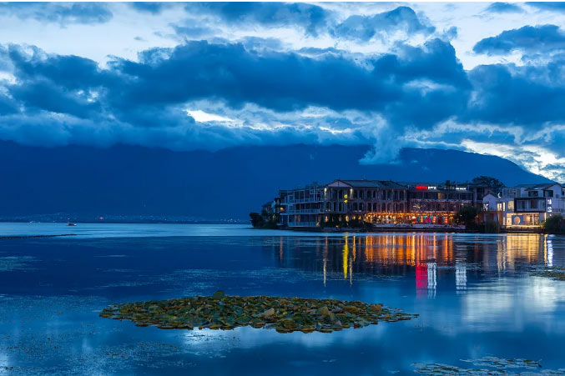
wanderer
He was the archetypal happy ________________(wander), a trenchant and witty writer, and a scientist some way ahead __________ his time.
他就是那种典型的快乐漫游者，又是一位言辞辛辣妙语连珠的作家，此外，还是一位领先时代的科学家。
of

