Slide 1
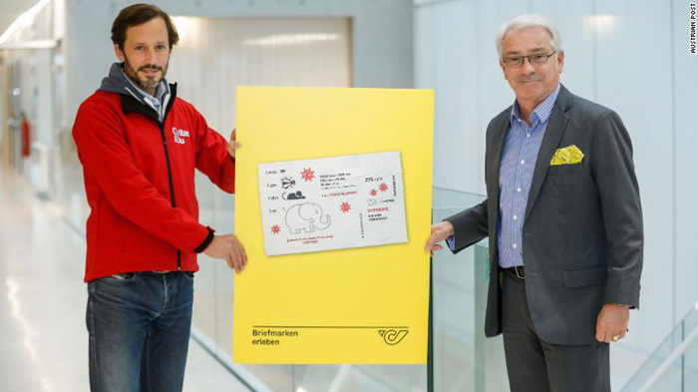
奥地利将在厕纸上印制新冠纪念邮票
Austria's postal service is printing special Covid-19 stamps -- ______ toilet paper
on

Slide 2
an
If 2020 could take the form of ______ object, it would surely be toilet paper.
如果用一个实物来代表2020年，那一定是厕纸。
Not only ______ this year been crappy, but reports of people hoarding toilet paper in large ________________ during the coronavirus pandemic will live in the memories of many.
这不仅是糟糕的一年，而且有关人们在新冠疫情期间大量囤积厕纸的报道会深植在许多人的记忆中。
has
quantities

Slide 3
Or so some in Austria seem to think: On Friday, the country's postal service announced it _______________(issue) a postage stamp made from three-ply toilet paper, to commemorate one of the year's stranger ____________________(phenomenon).
至少奥地利的某些人似乎是这么认为的。上周五（10月23日）奥地利邮政宣布，将发行一款由三层厕纸制成的邮票，来纪念今年的奇怪现象之一。
Each stamp, _______________(measure) just under four inches in ____________(long), will be the size and shape of a standard sheet of toilet paper, Austria Post said Friday.
奥地利邮政上周五称，每一枚邮票长度将近4英寸（10厘米），与标准厕纸的大小和形状一样。
is issuing
phenomena
measuring
length

Slide 4
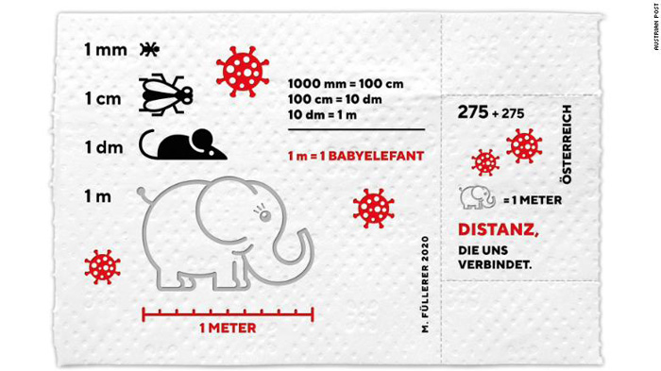
Customers can even use the stamps to enforce social distancing -- 10 stamps ___________(line) up next to each other measure one meter, the _____________________(recommend) social distance in some countries.
顾客可以用这款邮票来践行社交隔离。10枚邮票连在一起长度为1米，也就是某些国家推荐的社交距离。
lined
recommended

Slide 5
Meanwhile
_________________, the stamps are illustrated with a picture of a baby elephant -- another national ________________(remind) of the recommended one meter distance.
与此同时，邮票上印着象宝宝的图案，奥地利用一头小象的长度来提醒民众保持一米距离。
The stamps, which can _____________(tear)
off the stamp block along a perforated line
just like toilet paper, come complete with a
self adhesive foil, and retail ________ €2.75,
Austria Post said in a statement.
奥地利邮政在一份声明中称，这款邮票可以像厕纸一样沿着穿孔线撕下，还带有自粘箔纸，零售价为2.75欧元（约合人民币22元）。
reminder
be torn
at

Slide 6
The postal service will be releasing 300,000 stamps on October 30, and for each block _________(sell), €2.75 will be donated _______ charity, Austria Post said in a statement.
奥地利邮政在声明中称，邮政公司将于10月30日发行30万张新冠纪念邮票，每卖出一版，就会向慈善机构捐赠2.75欧元。
"With the Corona stamp, we not only want to issue _______ original stamp block to remember this year, but also to support those ________ have been particularly affected by this crisis," Austria Post CEO Georg Pölzl said in a statement.
奥地利邮政首席执行官格奥尔格·波尔茨尔在声明中称：“我们推出这款新冠邮票，不仅是为了发行一款纪念2020年的原创邮票，也是为了支持那些在这次危机中受创最严重的人。”
sold
to
an
who

