Slide 1
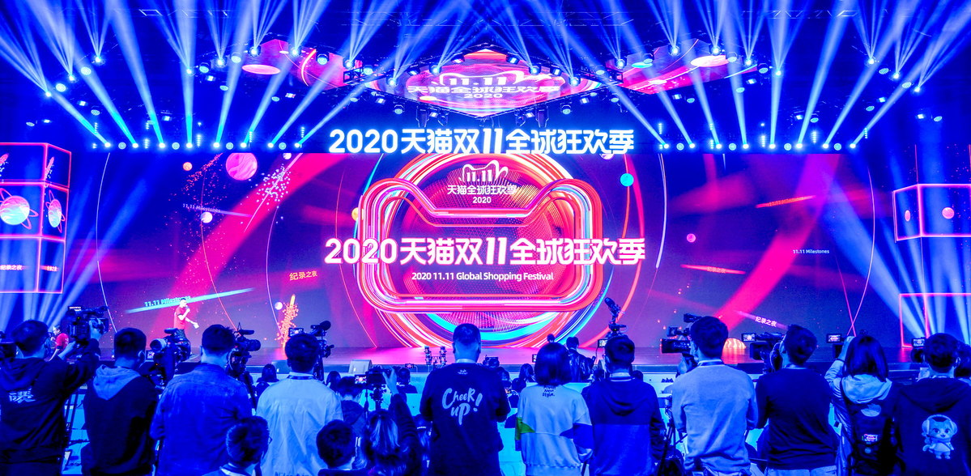
shopping
Double 11 ___________________ spree
火爆'双十一'线上消费旺

Slide 2
Chinese shoppers spent big over the Singles' Day shopping festival, __________________(show) the country's strong economic recovery ___________________(follow) the COVID-19 epidemic.
今年的"双十一"购物节火爆的消费景象反映了我国经济在新冠肺炎疫情后出现强劲复苏。
Sales on Alibaba's e-commerce platform Tmall _________(hit) 498.2 billion yuan during the annual online shopping spree ____________ started on Nov 1. At the shopping peak, 583,000 orders ______________________(make) in a single second on Tmall, setting a new online shopping record.
阿里巴巴旗下电商平台天猫双11全球狂欢季(11月1日至11日)总成交额4982亿元，订单峰值每秒58.3万笔，创下在线购物新纪录。
showing
following
hit
which
were made

Slide 3
More than 800 million shoppers, 250,000 brands and 5 million merchants participated _____________ this year's shopping spree, according to Tmall.
天猫方面表示，今年天猫"双十一"吸引了超过8亿消费者、25万品牌、500万商家共同参与。
E-commerce giant JD.com also scored big in the shopping extravaganza, with sales _________________(top) 243.1 billion yuan between Nov 1 and 2:26 pm on Wednesday, ____________________ (surpass) total sales of 204.4 billion yuan last year.
电商巨头京东也在今年"双十一"创下佳绩，自11月1日0点到11月11日14点26分，该平台成交额突破2431亿元，超过了去年"双十一"2044亿元的累计成交额。
in
topping
surpassing

Slide 4
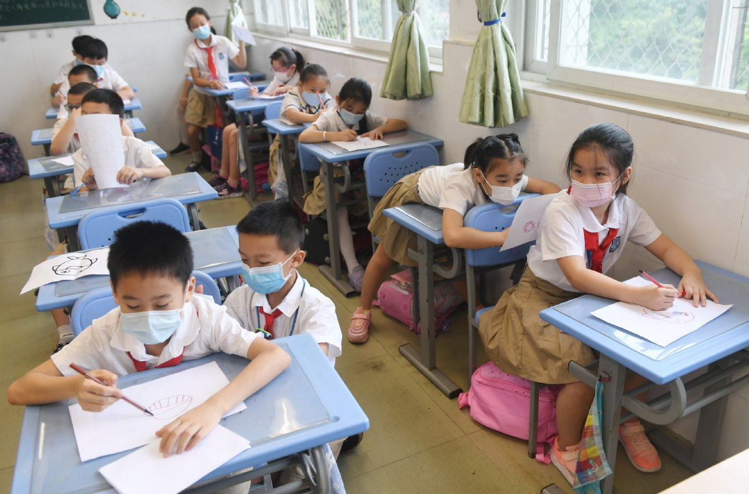
Students draw in a class at the Primary School Affiliated to South China Normal University in Guangzhou, Guangdong province, ______ May 25, 2020, the day the city's Grade 1 to 3 students returned to school. [Photo / China Daily]
on

Slide 5
Stop passing the buck 多地叫停家长批改作业
The education authority in Northeast China’s Liaoning province has joined a handful of others in __________________(ban) teachers from asking parents to grade students' homework after the practice sparked _________ outcry on social media platforms.
教师把作业推给家长改的做法在社交媒体平台上引发不满后，辽宁省教育厅近日出台文件严禁"学生作业家长改"，此前已有多地教育部门叫停了这种做法。
banning
an

Slide 6
Teachers at primary and middle schools who do not grade students‘ homework ______________________(they） will not be eligible for promotion or awards, according to the guideline ______________(issue) by the provincial education department on Tuesday.
根据辽宁省教育厅11月10日出台的文件，对于不亲自批改作业的中小学教师，一律取消职务晋级、评先评优资格；
Teachers will not be allowed to use the WeChat or QQ messaging apps ___________________(assign) homework or assign punitive or __________________(repeat) homework, the guideline said.
严禁教师在微信群、QQ群等布置家庭作业；严禁布置惩罚性、重复性作业。
themselves
issued
to assign
repetitive

Slide 7
In a video ______________(post) on Sina Weibo recently, a father in East China’s Jiangsu province blasted teachers for asking parents to grade children's homework in a parent-teacher WeChat group before __________________(exit) the group.
近日新浪微博上的一则视频中，江苏一名父亲在家长和老师沟通的微信群中抨击老师要求家长批改作业的行为，并愤而退群。
The video quickly sparked an angry reaction _______________ the teacher and an outpouring of support __________ parents, with the hashtag "all it needs to break a grown-up is a parent-teacher WeChat group" being ______________(view) more than 760 million times.
该视频立刻引发网友对这位老师的批评以及家长们一边倒的支持，话题"压垮成年人只需一个家长群"的浏览量超过7.6亿人次。
posted
exiting
towards
from
viewed

