Slide 1
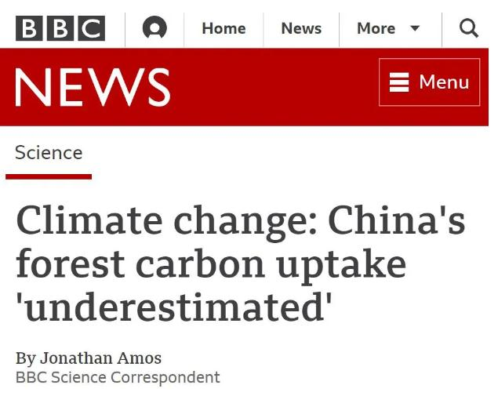
研究发现中国植树造林的碳吸收规模令人惊讶
BBC: China's forest carbon uptake 'underestimated'

Slide 2
An international team has identified two areas in the country _______________ the scale of carbon dioxide absorption by new forests _______________________________________.
一个国际研究团队发现在中国两个地区的新造树林对二氧化碳的吸收程度被低估了。
Taken together, these areas account _________ a little over 35% of China's entire land carbon "sink", the group says.
该团队表示，两个地区加起来，占中国整体陆地“碳汇”的35%多一点。
注：碳汇（carbon sink），是指通过植树造林、植被恢复等措施，吸收大气中的二氧化碳，从而减少温室气体在大气中浓度的过程、活动或机制。
where
has been underestimated
for

Slide 3
The two previously under-appreciated carbon sink areas are _______________(centre) on China's southwest, in Yunnan, Guizhou and Guangxi; and its northeast, ___________________(particular) Heilongjiang and Jilin provinces.
此前被低估的两个碳汇地区是在中国西南部的云南、贵州和广西三地；以及东北部，主要是黑龙江和吉林。
These provinces ____________________________(establish) a pattern of rapid afforestation of progressively larger regions, with provincial forest areas ____________________(increase) by between 0.04 million and 0.44 million hectares per year over the past 10 to 15 years.
这些省份已经形成了大面积快速造林的格局，在过去10到15年里，省级森林面积每年增加4万至44万公顷。
centred
particularly
have established
increasing

Slide 4
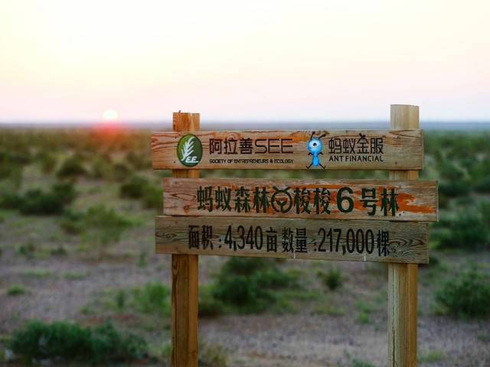
China's increasing leafiness has been evident for some time. Billions of trees ____________________________ (plant) in recent decades, to tackle desertification and soil loss, and _________
_________________ (establish) vibrant timber and paper industries.
have been planted
to
establish
近年来，中国的绿色植被增长有目共睹。最近数十年已经新种了数以十亿计的树木，来抵抗沙漠化和水土流失，同时还发展起了蓬勃的木材和造纸产业。

Slide 5
be supported
"Bold scientific statements must _______________________(support) by massive amounts of evidence and this is ___________ we have done in this study."
“大胆的科学结论必须有大量的证据支持，而我们在研究当中做到了这一点。”
“We have collected together a range of ground-based and satellite data-driven evidence ________________（form） a consistent and robust narrative about the Chinese carbon cycle."
“我们汇集了一系列实地测量和卫星数据的证据，对中国碳循环得出了一个前后一致并且站得住脚的说法。”
what
to form
该研究的联合作者、英国爱丁堡大学的保罗·帕尔默教授（Prof Paul Palmer）表示，这些森林碳吸储库的规模虽然令人惊讶_________________________(amaze)，但他指出，这个结论值得信赖________________________(rely)。
amazing
reliable

Slide 6
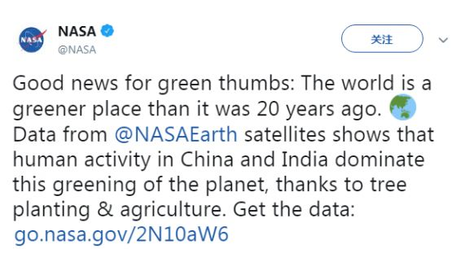
Data ________ NASA Earth satellites shows that human activity in China and India dominate this greening of the planet, thanks ________ tree planting & agriculture.
来自NASA地球卫星数据显示，中国和印度的植树造林和农业等活动主导了地球变绿的过程。
from
to

Slide 7
greening
Satellite data (2000–2017) reveal a ___________________(green) pattern that is _________________(strike) prominent in China and India and overlaps with croplands world-wide.
卫星数据（2000-2017年）显示，中国和印度境内的绿化带非常醒目，与世界各地的农田重叠。
China alone accounts for 25% of the global net increase in leaf area ___________ only 6.6% of global vegetated area.
中国的植被面积仅占全球的6.6%，但全球植被叶面积净增长的25%都来自中国。
strikingly
with

