Slide 1
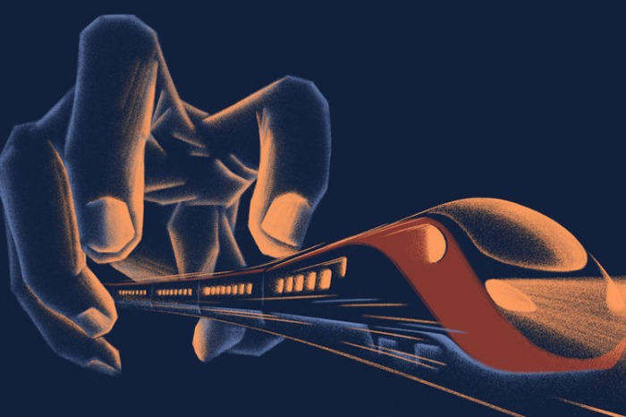
2020年要走了 这些好消息曾带给我们温暖2020 has good news, too, and they ___________ your attention
worth

Slide 2
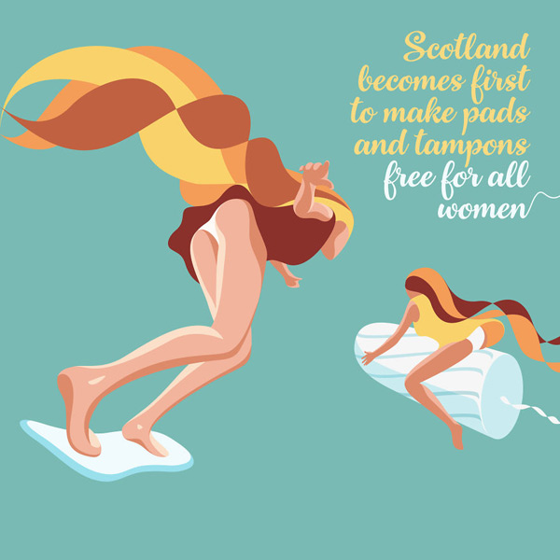
The Scottish Parliament passed a bill that will make pads and tampons free across the board, _______________ （make） Scotland the first country on the globe to end "period _______________ (poor)." This is a huge victory for the civic groups that supported the bill, ________________ (consider) that nearly 10 percent of Britain's girls have been unable __________________(afford) period products, and 19 percent have resorted to using substitutes.
making
poverty
considering
to afford
苏格兰议会通过了一项法案，在苏格兰全境免费供应卫生护垫和卫生棉条，这使得苏格兰成为世界上第一个终结“月经贫困”的地区。考虑到英国有近10%的女孩买不起经期卫生用品，19%的女孩不得不用其他东西来替代经期卫生用品，这对于支持该法案的民间团体是一个巨大的胜利。

Slide 3

planning
Germany is ________________(plan) to ban floodlights after dusk for much of the year as part of its bid to fight a dramatic decline in insect populations. The country's environment ministry _________________(draw) up a number of new measures to protect insects, _______________ (range) from partially outlawing spotlights to _____________ (increase) protection of natural habitats.
has drawn
ranging
increased
为了应对昆虫种群数量急剧下降的问题，德国计划在一年中的大部分时间禁止在黄昏后使用散光灯。德国环保部已经拟定了一系列保护昆虫的新举措，包括部分禁用聚光灯，加强对自然栖息地的保护等。

Slide 4
be banned
Light traps for insects are to ____________________(ban) outdoors, while searchlights and sky spotlights would be outlawed from dusk to dawn __________ ten months of the year. The draft also demands that any new streetlights and other outdoor lights __________________ (install) in such a way as to minimize the effect on plants, insects, and other animals. The use of weed killers and insecticides would also ______________________(ban) in national parks and within five to ten meters of major bodies of water, _______________ orchards and dry-stone walls are to be protected ___________ natural habitats for insects.
户外将禁止使用诱虫灯，一年中有10个月禁止在夜间使用探照灯和空中聚光灯。草案同时要求，新的街灯及其他户外照明设备的安装方式要将对植物、昆虫及其他动物的影响降至最低。国家公园及主要水体周边5到10米的范围内不得使用除草剂和杀虫剂，同时，果园和干石墙将作为昆虫自然栖息地受到保护。
for
be installed
be banned
while
as

Slide 5
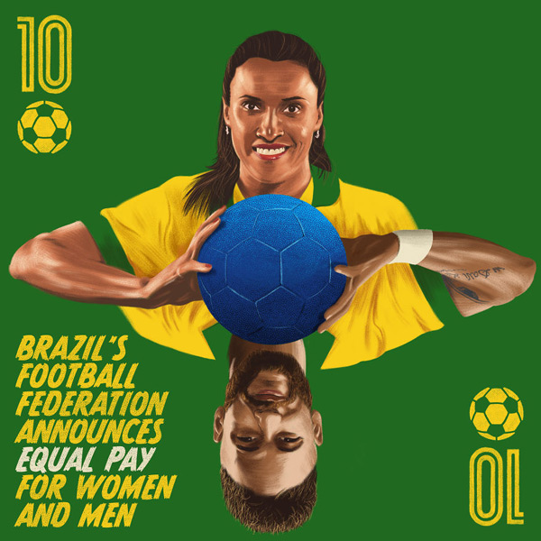
Brazil's football governing body has announced that it is adopting __________ equal pay policy for ___________ women's and men's football, ______________ (become) one of the first _________________(country) in the world to do so.
巴西的足球协会宣布，国家男子和女子足球队球员将享有平等的薪资水平，在全球创下先例。
an
both
becoming
countries

Slide 6
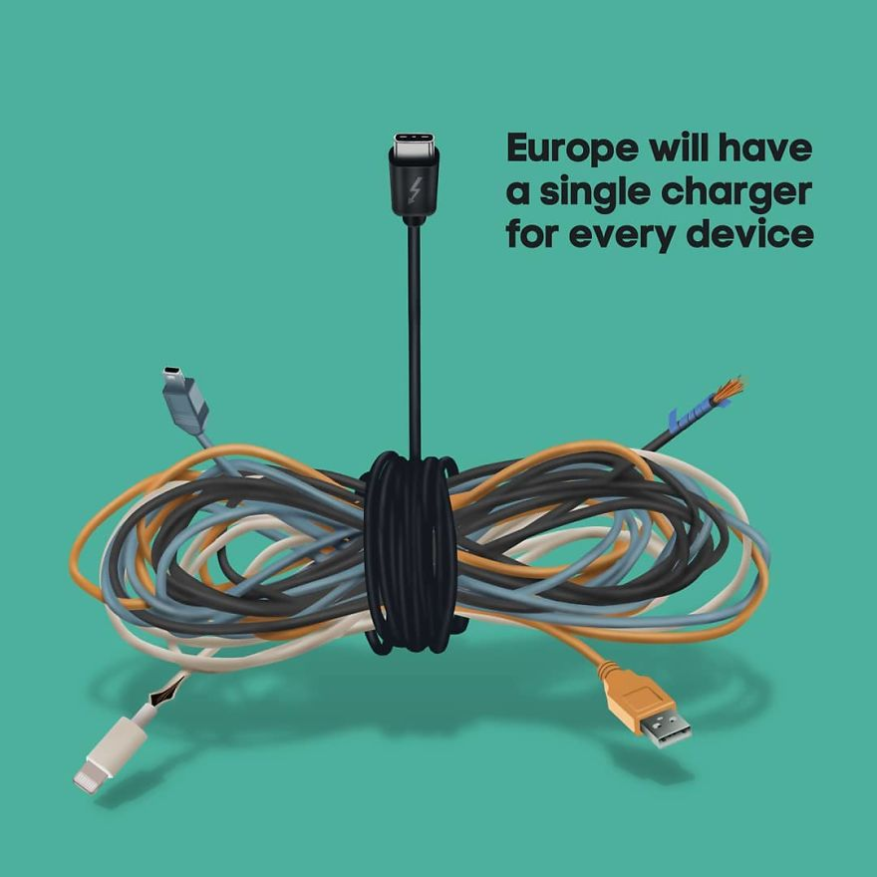
The European Parliament overwhelmingly passed a resolution that will force tech companies ___________(use) just one charger type for a range of devices, _______________ (include) mobile phones, tablets, and e-book readers.
to use
including
欧盟一致通过决议，将强制要求科技公司为手机、平板电脑以及电子书阅读器等设备提供统一、可通用的充电器

Slide 7

印度最高法院裁定印度军队中的女性可以享有和男性同样的权利，命令政府允许女军官获得常任军官职位和担任指挥官职务。这一裁决意味着所有的印度女性军官在晋升、军衔、福利和养老金方面将与男性平等。
on par with: 与……同等水平
in
The Supreme Court ruled __________ favor of equal rights for women in the Indian Army, ________________(order) the government to grant permanent commission and command positions to women officers on par with men. The decision means that all women will now be eligible for the same ____________________(promote), ranks, benefits, and pensions ________ their male counterparts.
ordering
promotions
as

Slide 8

Every day, up to 5,600 trucks, 20 ships, and 92 planes are _______ the move, delivering food and assistance in some of the most remote and ____________________(challenge） parts of the world. They're all part of the WFP, _________________(assist) 100 million people in 88 countries. So in 2020, the agency was given the Nobel Peace Prize for its efforts to combat _____________ (hungry) and improve conditions for peace.
on
challenging
assisting
hunger
每一天，有5600辆卡车、20艘轮船和92架飞机在不停地运送食物和补给到世界上最偏远、环境最恶劣的一些地方去。他们都是世界粮食计划署的成员，为88个国家的1亿人提供援助。2020年，世界粮食计划署因为在消除饥饿和改善和平条件方面做出的贡献而被授予诺贝尔和平奖。

Slide 9

Engineers from Google confirmed that Chrome will stop showing three of the most __________________(frustrate) ad types, starting in August. Long preroll ads, as well as midroll ads and images or text ads __________ appear in the middle of a video, will be gone. The decision comes after a survey _________________(conduct) by Google on 45,000 people, in which the types of ads mentioned above _______________(see) as the most annoying and intrusive. It is believed that Firefox, Safari, and ____________ browser engines will soon follow in its steps.
frustrating
that
conducted
谷歌工程师证实，谷歌浏览器将从明年八月起停止显示最烦人的三种广告。前贴片广告、插播广告和视频中间出现的图文广告将被移除。这一决定是在谷歌调查了4.5万人后做出的，以上提到的三种广告被视为最烦人、干扰性最强。据悉，火狐、苹果Safari和其他浏览器很快也会效仿。
were seen
other

