Slide 1

Unit 4 Seasons
Writing

Slide 2
目录
Review
1
Pre-Learning
2
While-Learning
3
Post-Learning
4

Slide 3
Part I Review

Slide 4
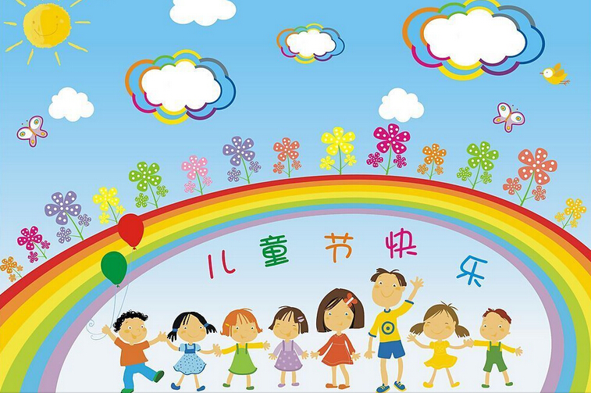
Talk about four seasons and festivals
Children's Day

Slide 5
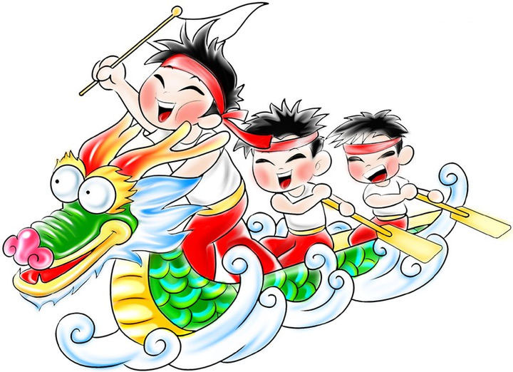
the Dragon Boat Festival

Slide 6
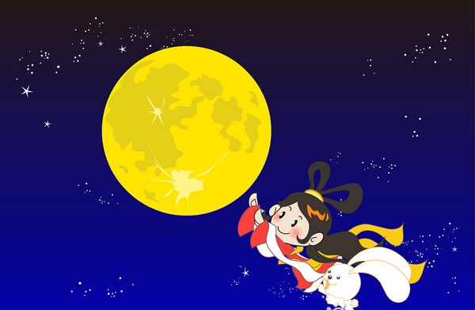
the Mid-Autumn Festival

Slide 7
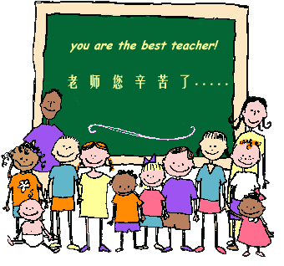
Teachers' Day

Slide 8
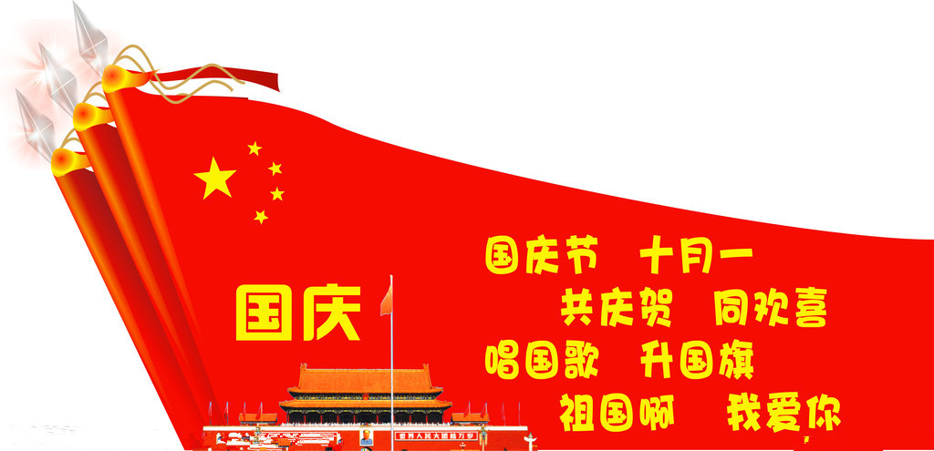
National Day

Slide 9
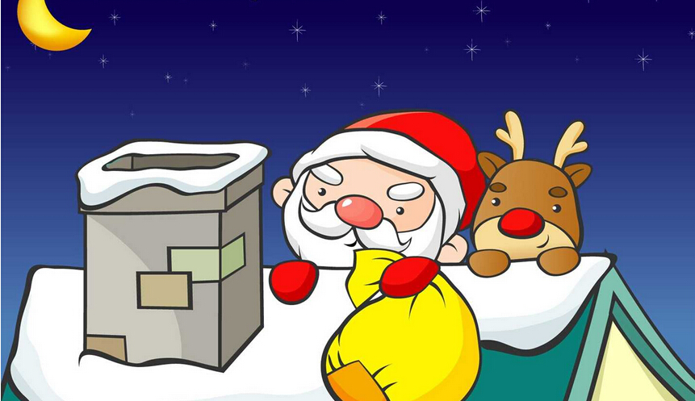
Christmas

Slide 10
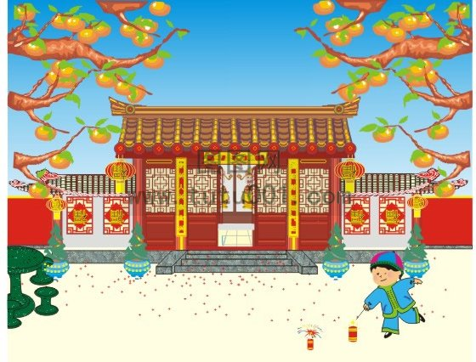
the Spring Festival

Slide 11
Part II Pre-Learning

Slide 12

Let's learn the new words and expressions.

Slide 13
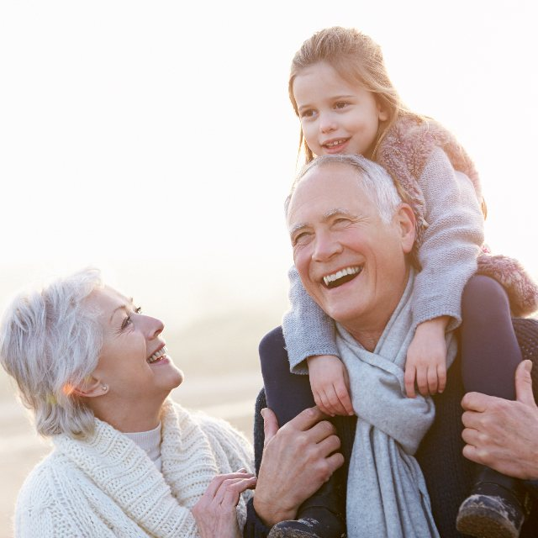
Notes (Writing)
grandparent n. 祖父（母）；外祖父（母）
grandfather （外）祖父
grandmother（外）祖母
grandchild （外）孙子；（外）孙女
grandson （外）孙子
granddaughter （外）孙女

Slide 14
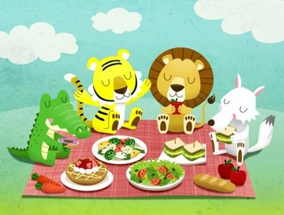
1. red packet 红包
也可以翻译为 red envelope
2. go swimming 去游泳
go+动词ing形式，常用来表示“去做某事”
go cycling 去骑车 go fishing 去钓鱼
3. have a picnic 野餐
have a picnic 强调“进行野餐活动”
go on a picnic 强调“去野餐”

Slide 15
Part III While-Learning

Slide 16
A Mandy has written about her favourite season, winter.
My favourite season is winter.
• What is Mandy's favourite season?
Winter is very cold and sometimes snowy. It is
interesting to make snowmen in winter.
What is the weather like in this season?
What things can she do in this season?

Slide 17

The Spring Festival is in winer and it is my
favourite holiday. I visit my grandparents and eat
lots of nice food. It is exciting to get red packets
during the Spring Festival.
Is there a festival or holiday in this season?
What is it?
What does she eat at this festival or holiday?
How does she like about this festival or holiday?

Slide 18
B Write a short passage about your favourite season. Follow the example in A.
☆warm/ hot/ cool/ cold/ wet/ rainy/ windy/ cloudy/ sunny/ snowy
☆exciting/ nice/ interesting
☆plant trees/ fly kites/ go swimming/ have a picnic
☆the Mid-Autumn Festival/ the Dragon Boat Festival

Slide 19
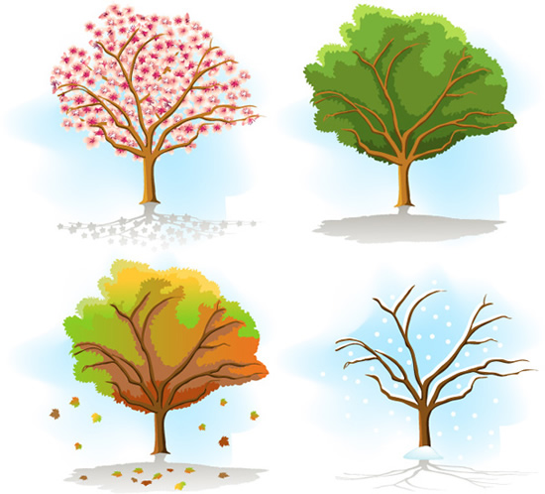
Learn to write a passage
1.What is your favourite season?
My favorite season is ______.
(spring/summer/autumn/winter)

Slide 20

2.What is the weather like?
It is ______ and sometimes ______ (weather).
(warm/hot/cool/cold/wet/rainy/windy/
cloudy/sunny/snowy...)

Slide 21
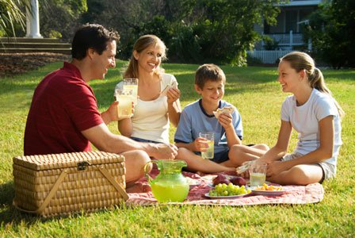
3.What do you do? And how do you feel about it?
It is _____ to _______________(acivity).
(exciting/ nice/ interesting...)
(plant trees/ fly kites/ go swimming/
have a picnic…)

Slide 22
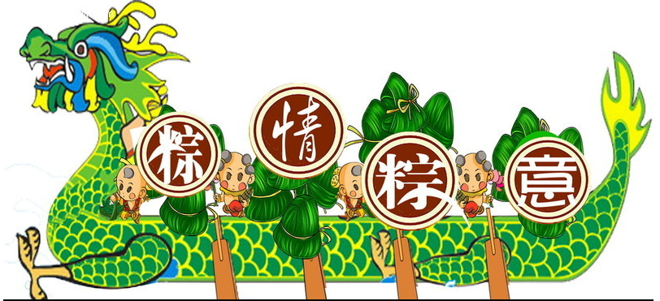
4.What festival does it have?
______(festival) is in ______(season).
(The Mid-Autumn Festival/the Dragon Boat Festival...)
(spring/summer/autumn/winter)

Slide 23
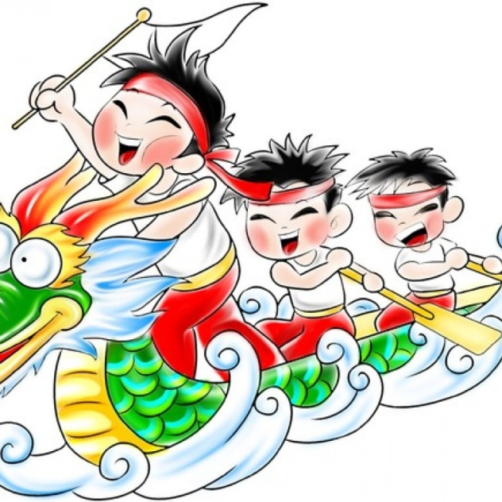
5.What do you do at this festival?
I _________________________.
It is _____ to_________________
(activity).

Slide 24
Join the sentences into a passage.
My favourite season is ______. It is ______ and sometimes ______(weather). It is _____to _______________(acivity). _______(festival) is in ______(season). I _________________________.
It is _____ to _______________ (activity).

Slide 25
Part IV Post-Learning

Slide 26
Interview
Name | Favourite season | Weather | Activity | Favourite festival

Slide 27
Exercise: According to the interview, write a short passage about your friend's favourite season.
_______'s favourite season
________________________________________________________________________________________________________________________________________________________

Slide 28
Thank you!

