Slide 1









Unit 2
Writing

Slide 2

Part II Pre-Learning
Let’s learn the new words and expressions.

Slide 3
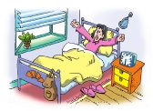
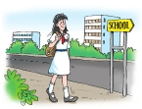
Complete the article about Fang Fang’s daily life.
Fang Fang is a Grade 7 student. She (1)___________ at 6:30 a.m. Then she washes her face and brushes her teeth. At 7 a.m., she (2)_____________. She often eats some bread and drinks a glass of milk.
gets up
has breakfast
Fang Fang lives close to school, so she always (3)_____________ on foot at 7:30 a.m. She (4)____________from 8:30 a.m. to 4 p.m.
goes to school
has classes

Slide 4
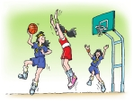
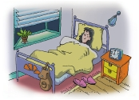
After school, she (5)____________________________________.
She (6)____________ at 4:45 p.m.
plays basketball with friends twice a week
goes home
Fang Fang usually (7)__________ at 6:30 p.m.
She sometimes watches TV in the evening. She always (8)____________________.
has dinner
goes to bed at 9 p.m.

Slide 5
Notes (Writing)
grade
n. 年级
七年级一班
Class One, Grade Seven
表示几年级几班，先写班级后写年纪；
数字在后，首字母大写
我在七年级一班。
I am in Class One, Grade Seven.

