Slide 1


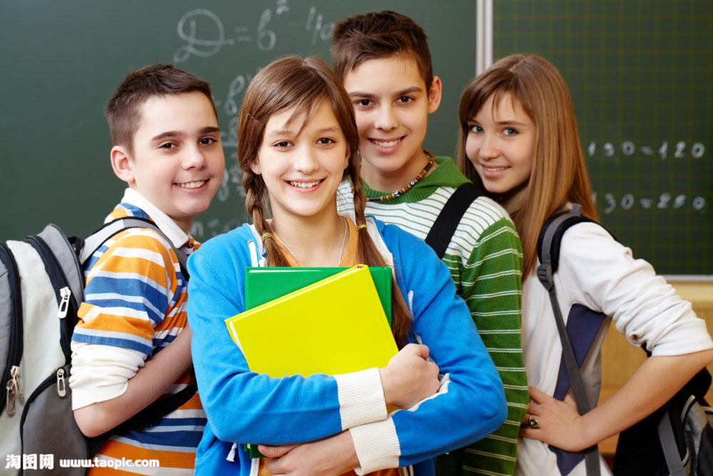
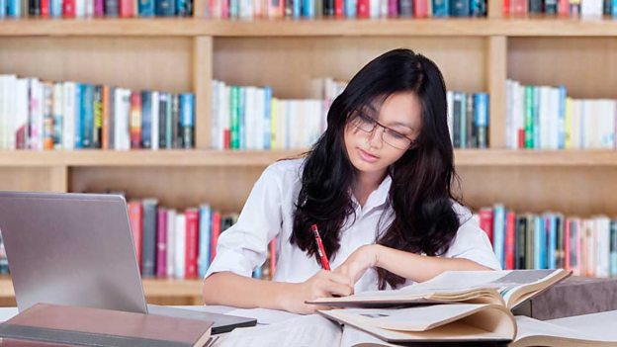
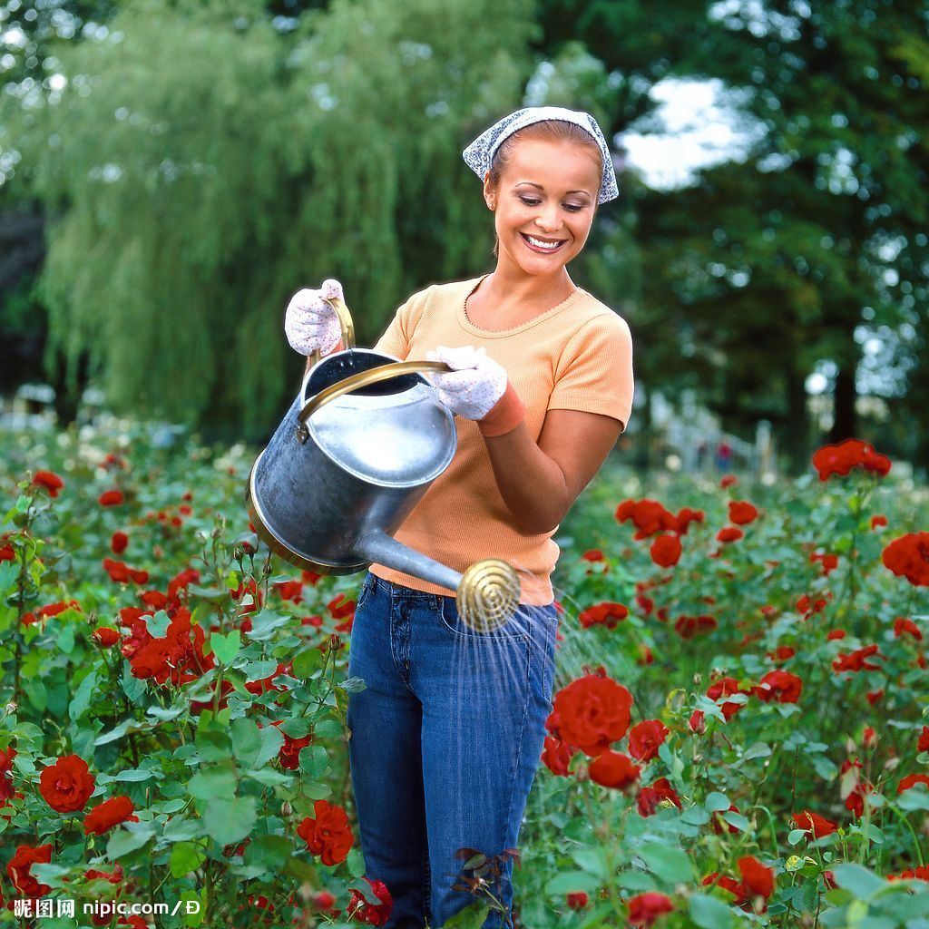
Unit2 Daily Life
Reading (1)
Notes:
What is daily life? Everyday life. Here is a question about your daily life. What time do you get up every morning? At 6: 30.

Slide 2

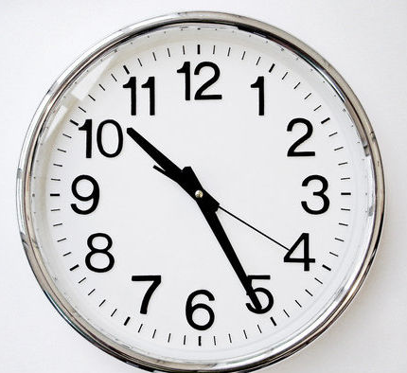

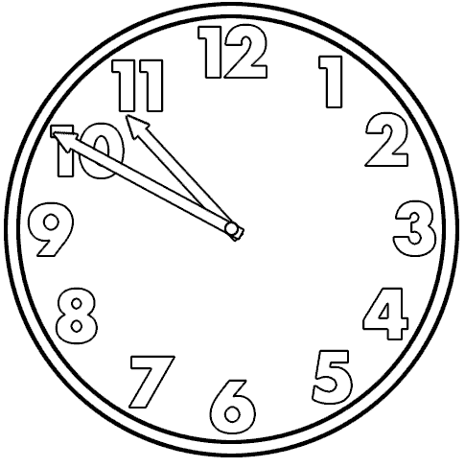
When to use “past” and when to use “to”?
What time is it?
eight o'clock
ten twenty-five
three thirty
ten fifty
twenty-five past ten
half past three
ten to eleven
Formal but easier way: say the hours first and then the minutes
More popuar way: say the minutes first and then the hours

Slide 3
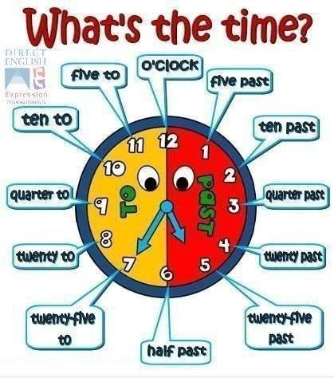
past: 超过
to: 到...还差
Work out the rule:
1. 30分以内,分在前,点在后,past在中间；
2. 30分以外,分用60减,点要加上1,用to来连接.

Slide 4
Exercise: What time is it?
6:10
2:40
10:35
11:30
9:15
3:45
six ten
ten past six
two forty
twenty to three
ten thirty-five
twenty-five to eleven
eleven thirty
half past eleven
nine fifteen
fifteen past nine
a quarter past nine
three forty-five
fifteen to four
a quarter to four

Slide 5
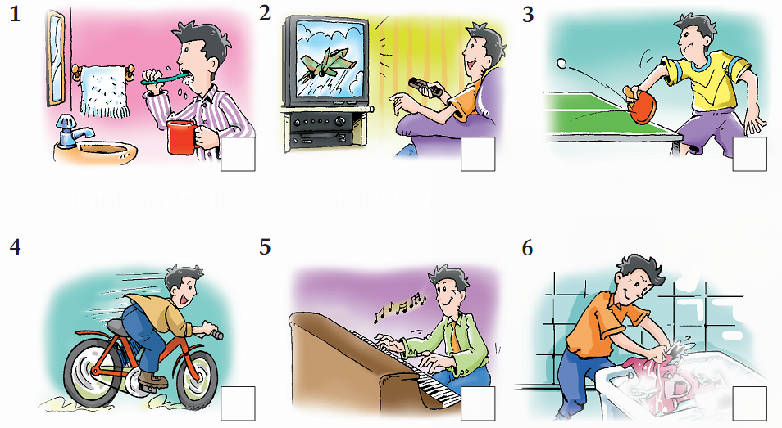
(P16) What do you know about...?
Which of these things do you …
a do every day? b do once or twice a week? c never do?
brush my teeth
watch television
play table tennis
ride a bicycle
play the piano
wash my clothes

Slide 6
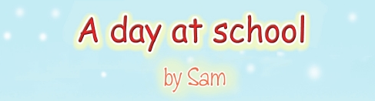

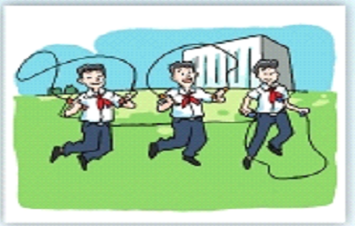
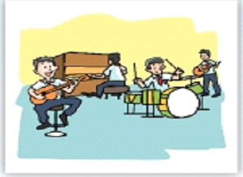
Before you read
B1 Look at the title of the article on page 17. Then circle the correct answers.
1 (Sam/Sam's friend) wrote this article.
2 It is about Sam's (school day/holiday).

Slide 7
B2 Read the first sentence of each paragraph in the article on page 17.
Paragraph 1
I am a junior high school student.
Paragraph 2
My school is close to my home, so I always
go to school on foot.
Paragraph 3
In the morning, we usually study Chinese, Maths and English.
Paragraph 4
Lunch is from 11:50 a.m. to 12:30 p.m.
Paragraph 5
I always have a good time at school.

Slide 8


Now answer the questions below.
1 How does Sam go to school?
He goes to school on foot.
2 What subjects does Sam usually study in the morning?
He usually studies Chinese, Maths and English in the morning.
3 How long is the school lunchtime?
The school lunchtime is forty minutes.

Slide 9
Task 1:
Read the article and match the paragraph with the main idea.
para. 1
Sam's morning activities
para. 2
Sam's afternoon activities
para. 3
About Sam's school and his favourite subject
para. 4
Sam always has a good time at school.
para. 5
About Sam

Slide 10
Task 2:
Read the article again and complete the information card about Sam.
Classes start at _________.
Favourite subject: _________
Reason: _________________________________
_________________________________
Morning: Morning break starts at ________ and ends
at ________.
Sam and his friends usually _________.
Lunch time: from _________to __________.
Afternoon: Classes end at __________
Sam takes part in ___________________
with his friends
8 a.m.
Geography
He enjoys learning about different places
in the world.
9:50 a.m.
10:10 a.m.
play games
11:50 a.m.
12:30 p.m.
3:30 p.m.
the school band practice

Slide 11
Task 3: group work
Four facts about Sam:
1. Sam likes his school.(2 sentences)
2. Sam likes sport very much.(2 sentences)
3. Students in Sam's school go home early
in the afternoon. (1 sentence)
4. Sam, Tom and Jack do well in the
school band. (1 sentence)

Slide 12
Task 3: group work
1. I love going to school.
Sam likes his school.
2. I always have a good time at school.
Sam likes sport.
1. When the bell rings, I run to the playground...
2. We often play games.
Students in Sam's school go home early in the afternoon.
Afternoon classes end at 3:30 p.m.
Sam, Tom and Jack do well in the school band.
We make great music together.

Slide 13

Sam's day at school
Task 4: Retell the text
junior high school student
Sam is a ____________________. He loves going
to school. Sam's school is ______ to his home, so
he always ____________ on foot. His classes
__________ 8 a.m. His ____________ is Geography.
He ___________________ different places in the
world.
close
goes to school
start at
favourite subject
enjoys learning about

Slide 14
In the morning, he usually ______ Chinese, Maths
and English. He ________________ at 9:50 a.m. When
the bell rings, Sam __________________ with his best
friends Tom and Jack. They often __________. Break
__________10:10 a.m. His ______ is usually from 11:50 a.m.
to 12:30 p.m. His ______________ end at 3:30 p.m. Then
Sam, Tom and Jack take part in _____________________.
They make __________ together. Sam always
_____________ at school.
studies
has morning break
runs to the playground
play games
ends at
lunch
afternoon classes
the school band practice
great music
has a good time

Slide 15
Sam's day at school
Task 4: Retell the text
junior
Sam's school, home, on foot.
8 a.m
Geography.
places in the world.

Slide 16
runs to the playground
play games
ends at
lunch
afternoon classes
the school band practice
great music
has a good time

Slide 17
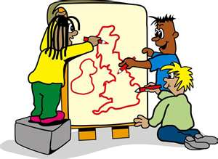
Comprehension exercise
D1 Read the article on page 17 and circle the correct answers.
1 Sam is a _____ school student.
a primary b junior high c senior high
2 Sam's favourite subject is _____.
a Maths b Geography c English
3 Sam often _____ during the morning break.
a plays with his best friends
b takes part in the school band practice
c reads books

Slide 18
Vocabulary exercise
C1 Here are some sentences from the article on page 17. Do you know the meanings of the words in italics? Circle the correct answers.
1 Classes start at 8 a.m., and I am seldom late.
a often b not often
2 We have our morning break at 9:50 a.m.
a a short time between lessons b a short holiday
3 When the bell rings, I run to the playground with my best friends Tom and Jack.
a makes a sound b is quiet

Slide 19

4 Afternoon classes end at 3:30 p.m.
a stop b begin
5 We make great music together.
a with each other b every day

Slide 20
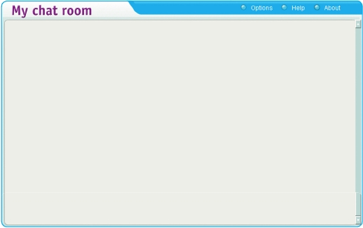
More exercise
C2 Sam and Mandy are talking about their daily lives on the Internet. Complete their conversation with the words and phrases from the box.
break
on foot
rings
end
take part in
usually
Sam:
Mandy:
Sam:
Mandy:
Sam:
Mandy:
Sam:
Mandy:
Is your school close to your home, Mandy?
Yes, it is, so I go to school (1)________________.
Do you have a lunch (2)___________?
Yes. We have one at 11:30 a.m.
When does the school day usually (3)___________?
At 3:30 p.m. Most students go home when the bell
(4)___________, but some of us (5)_______________
after-school activities. I enjoy playing basketball.
When do you (6)___________ begin your homework?
At about 5:30 p.m.
on foot
break
end
rings
take part in
usually
_
_
_ _

Slide 21
D2 Read the article again and answer the questions below in complete sentences.
1. Why does Sam go to school on foot?
Because his school is close to his home.
2. Why does Sam like Geography best?
Because he enjoys learning about different places in the world.
3. Who are Sam's best friends?
Tom and Jack are his best friends.
4. What does Sam do after school?
He takes part in the school band practice after school.

Slide 22
D3 Fill in the table below and then compare your school day with Sam's. Follow the example.
 | Sam | Me
Classes start at | 8 a.m.
Morning break | 9:50 a.m. - 10:10 a.m.
Lunchtime | 11:50 a.m. - 12:30 p.m.
Classes end at | 3:30 p.m.
Morning break: do (interesting?) morning exercises
Learn from “a day at school by Sam” about talk about your school day:
“A day at school ---- by …” [8 points]

Slide 23
Thanks for listening!

Slide 24
Talk about your daily life
Things |  | Time
I get up I eat breakfast I go to school Morning classes begin Morning classes end I have lunch Afternoon class begin School ends I have dinner I finish homework I go to bed | at | 1.__________________ 2.__________________ 3.__________________ 4.__________________ 5.__________________ 6.__________________ 7.__________________ 8.__________________ 9.__________________ 10._________________ 11._________________

Slide 25
Similarities and differences（相同点与不同点）
I get up at 6:30. She gets up at 6:45. (difference)
Both of us go to school at 7:10. (similarity)

