Slide 1

Unit 4 Seasons
Writing

Slide 2
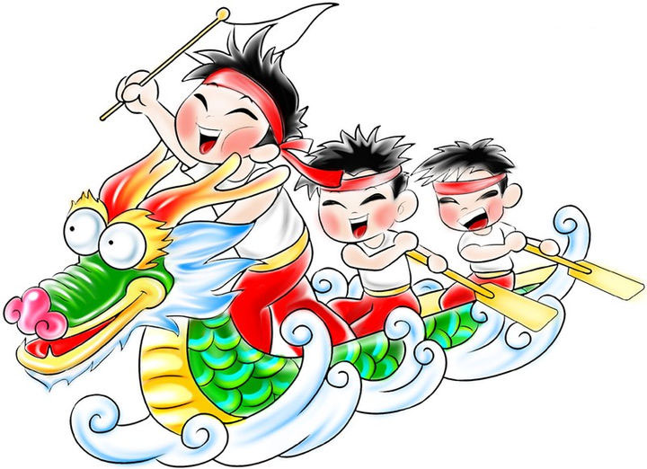
the Dragon Boat Festival
in summer
Activities: It’s exciting to eat zongzi.
and watch the dragon boat race

Slide 3
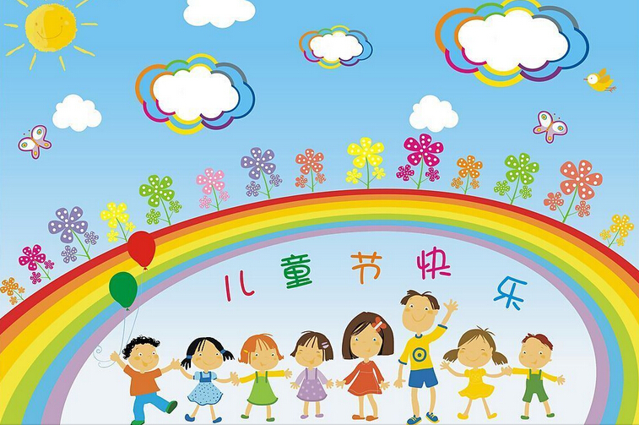
Talk about four seasons and festivals
Children's Day
in Summer
Receive presents from parents and teachers

Slide 4
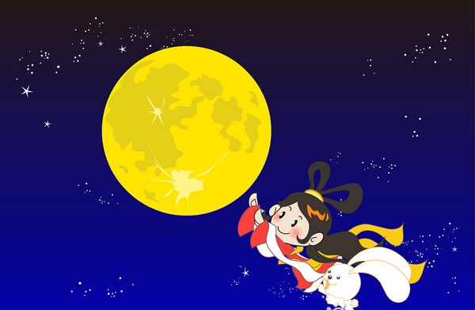
the Mid-Autumn Festival
in autumn
Activities: eat mooncakes
Family members get together and celebrate the festival

Slide 5
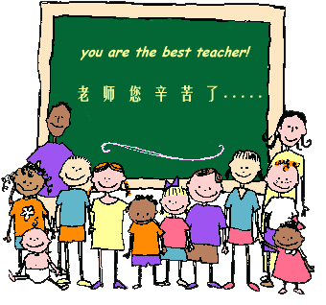
Teachers' Day
In autumn
Send cards to our teachers and express our thanks to them; behave well

Slide 6
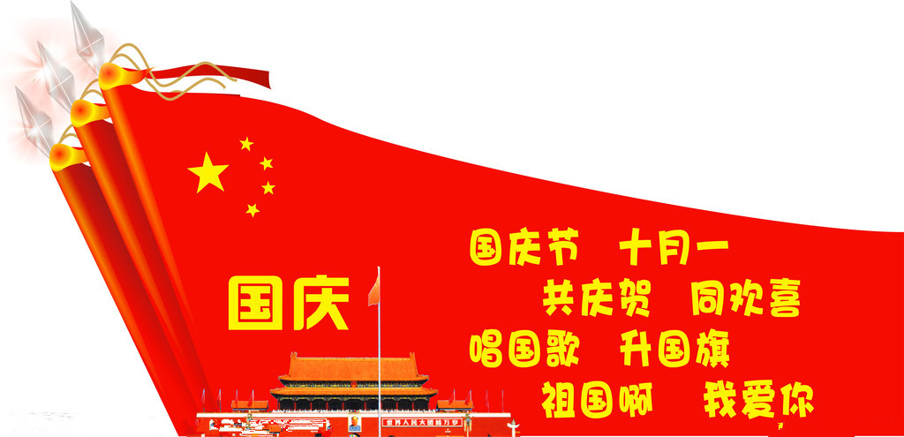
National Day
In autumn
Watch the military parade 观看阅兵仪式
military /ˈmɪlətri/ 军队的
parade /pəˈreɪd/游行

Slide 7
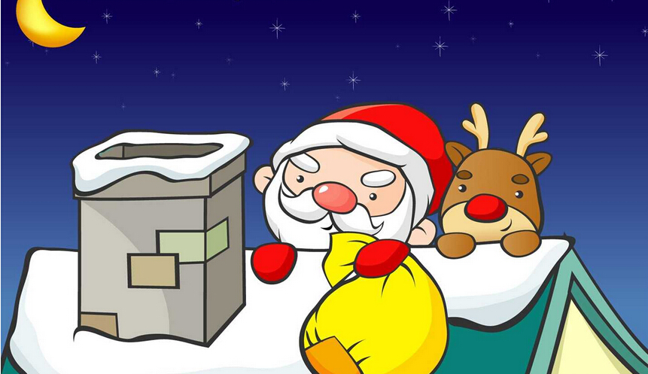
Christmas
In winter
Decorate Christmas trees, have a big dinner
Receive presents from Santa Claus 圣诞老人
Father Christmas

Slide 8
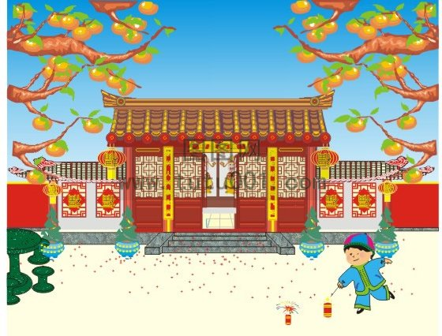
the Spring Festival
In winter
get red packets/lucky money from our
parents and relatives

Slide 9
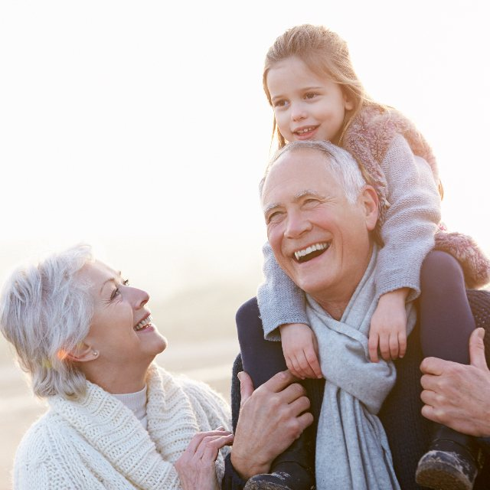
Notes (Writing)
grandparent n. 祖父（母）；外祖父（母）
usually plural
（外）祖父____________
（外）祖母______________
（外）孙子；（外）孙女_____________
（外）孙子__________
（外）孙女___________
grandfather
grandmother
grandchild
grandson
granddaughter

Slide 10
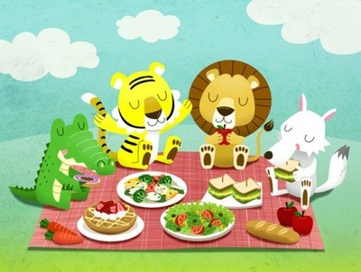
1. red packet 红包
也可以翻译为 red envelope/ lucky money
2. go swimming
go+V-ing形式，表示“去做某事”
去骑车________ 去钓鱼 __________
3. have a picnic 去野餐
=go on a picnic
4. fly kites
go cycling
go fishing

Slide 11
Part III While-Learning

Slide 12
A Mandy has written about her favourite season, winter.
My favourite season is winter.
Winter is very cold and sometimes snowy. It is
interesting to make snowmen in winter.
The Spring Festival is in winer and it is my
favourite holiday.
I visit my grandparents and eat lots of nice food.
It is exciting to get red packets during the Spring Festival.
Is there a festival or holiday in this season?
What is it?
What does she eat at this festival or holiday?
What does she think of this festival?
p53

Slide 13
B Write a short passage about your favourite season. Follow the example in A.
☆warm/ hot/ cool/ cold/ wet/ rainy/ windy/ cloudy/ sunny/ snowy
☆exciting/ nice/ interesting
☆plant trees/ fly kites/ go swimming/ have a picnic
☆the Mid-Autumn Festival/ the Dragon Boat Festival

Slide 14
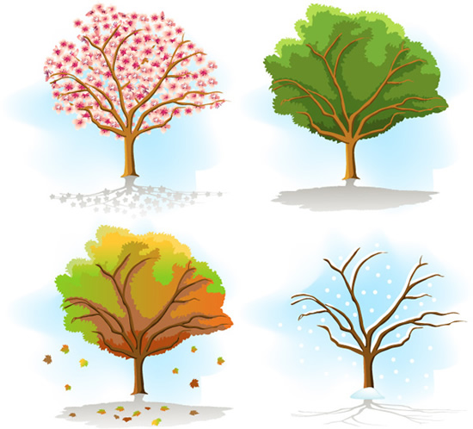
Learn to write a passage
1.What is your favourite season?
My favorite season is ______.
(spring/summer/autumn/winter)

Slide 15

2.What is the weather like?
It is ______ and sometimes ______ (weather).
(warm/hot/cool/cold/wet/rainy/windy/
cloudy/sunny/snowy...)

Slide 16
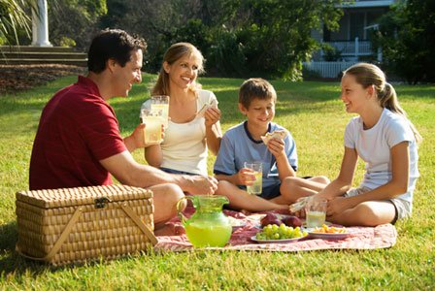
3.What do you do? And how do you feel about it?
It is _____ to _______________(acivity).
(exciting/ nice/ interesting...)
(plant trees/ fly kites/ go swimming/
have a picnic…)

Slide 17
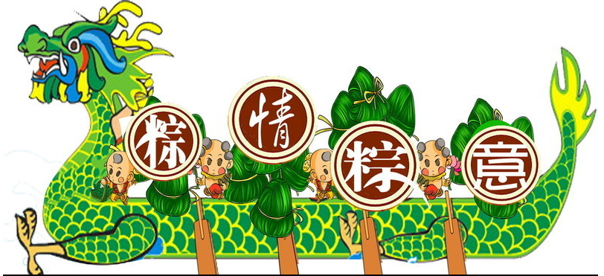
4.What festival does it have?
______(festival) is in ______(season).
(The Mid-Autumn Festival/the Dragon Boat Festival...)
(spring/summer/autumn/winter)

Slide 18
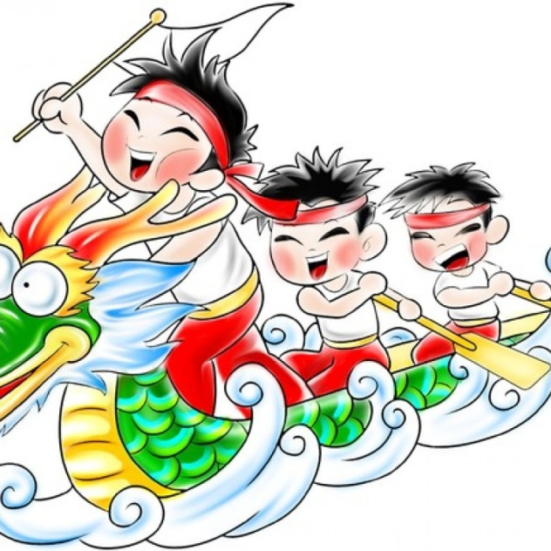
5.What do you do at this festival?
I _________________________.
It is _____ to_________________
(activity).

Slide 19
Join the sentences into a passage.
My favourite season is ______. It is ______ and sometimes ______(weather). It is _____to _______________(acivity). _______(festival) is in ______(season). I _________________________.
It is _____ to _______________ (activity).

Slide 20
Thank you!

