Slide 1

Unit 1

Slide 2

Unit 1 TEENAGE LIFE

Slide 3


Slide 4
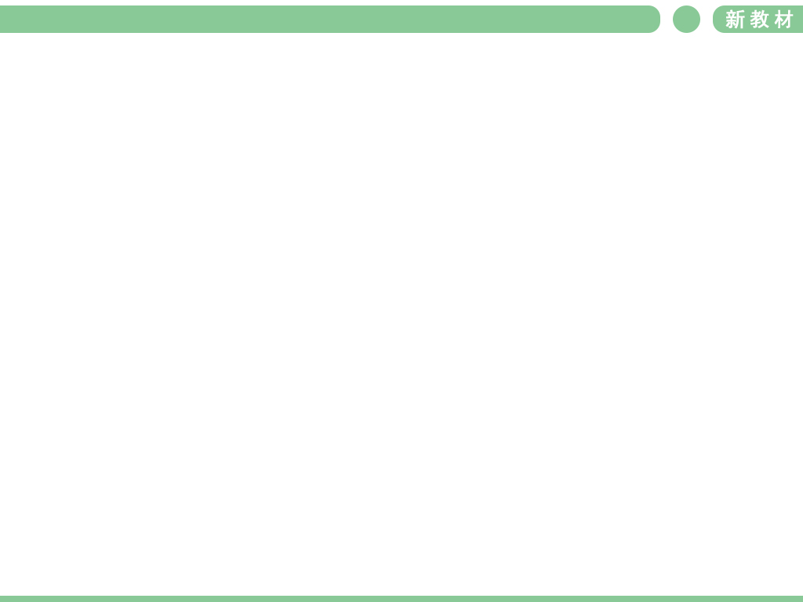

To read to learn American students’ school life.
To compare senior high school life between
China and foreign countries.
To learn useful words and expressions.

Slide 5


Fill in the table about the subjects you have learned and the extra-curricular activities you have participated in during junior high school.
Subjects | Extra-curricular activities

Slide 6
Work in pairs. Discuss the questions:
Which is your favorite subject? Why?
Which is the most boring subject? Why?
Which is the most difficult subject? Why?
What's your biggest challenge in junior high school?

Slide 7


Compare school life in different places.
1. What do you want to know about school life in
other countries?
2. What would you tell a teenager from another
country about school life in China?

Slide 8

Listen to the text about Adam’s senior high school life as a freshman and compare it with yours.

Slide 9


Read the text quickly to find the main idea of each paragraph.
Paragraph 1: _____________________________
Paragraph 2: _____________________________
_____________________________
Paragraph 3: _____________________________
_____________________________
Paragraph 4: _____________________________
_____________________________
Senior high school is a challenge.
It’s hard for Adam to choose which courses to take.
Adam needs to choose extra-curricular activities.
Adam will work/study harder to realize his dream.

Slide 10
Read the text again and answer the questions.
1. What courses did Adam choose? Which one
do you think would be his favourite? Why?
2. What does “make the team” in paragraph 3
mean?
3. What is Adam worried about?
4. Is Adam confident that he will get used to
senior high school life? How do you know?

Slide 11
1. What courses did Adam choose? Which one
do you think would be his favourite? Why?
He chose maths, English, chemistry,
world history, and Chinese.
I think advanced literature would be his favourite because he likes English and he is also good at it.

Slide 12
2. What does “make the team ” in
paragraph 3 mean?
3. What is Adam worried about?
Successfully join the team.
He is worried about keeping up with赶上 the other students in his advanced course高级课程 and getting used to习惯 all the homework.

Slide 13
4. Is Adam confident that有信心 he will get used to 习惯 senior high school life? How do you know?
He seems confident because he says that he is happy to be there, and he will be well prepared for做好准备 university or whatever else comes in the future.

Slide 14
*join加入社团组织
*join in = _________________
= _____________________
参加活动比赛讨论
take part in
participate in
joined
Last Saturday, I ________ a debate club and ________________ a heated discussion about whether it is right to ban smart phones on campus.
joined in

Slide 15
*so that =in order that 为了；以便
*so +adj./adv. +that=如此。。以至于。 。
(，)so 因此
Last Sunday night, I stayed up ______ late _______ I felt really sleepy in the English class. I had to stood up _________ I could prevent myself from falling asleep in class. Still, I did a bad job in the dictation ______ I had to re-dictate.
so
that
so that
so

Slide 16
Complete the outline.
Para. | Challenge | How Adam feels | Solution
1 |  | Confused
2 | Choosing _________ courses |  | The school adviser ________ _______________.
going from junior high school to senior high school
the suitable
serious
/ cafeful认真的/细心的
helped him choose suitable courses

Slide 17
Para. | Challenge | How Adam feels | Solution
3 |  |  | He will find a way to ______________________________.
4 |  |  | He will ____________ ____________.
Making the school football team
unhappy
improve his skills on his own
Keeping up with the other students and getting used to all the homework
Worried but still happy, confident about his future
study harder and be well prepared for university

Slide 18
Complete the summary.
Going from junior high school to senior high school is a really big _________ (挑战) for Adam. Firstly, he has to think ________ (careful) about which courses to take. He hopes to be fluent _______ Chinese and his adviser ____________ (建议) him to sign up for advanced literature. What’s more, he had to choose extra-curricular _________ (activity). He failed to join the school football team, but he wouldn’t ________ (放弃).
challenge
carefully
in
recommended
activities
quit

Slide 19
Instead he joined a volunteer club. Finally he will have to study ______ (hard) and get used to being ___________ (response) for a lot more.
harder
responsible

Slide 20

Discuss the questions with your partner.
1. Do you face the same challenges as Adam?
What other challenges are you facing?
2. What are some differences between
Adam’s school life and your school life?

Slide 21


Slide 22

1. Going from junior high school to senior high
school is really big challenge.
从初中过渡到高中真是一项巨大的挑战。
Going from junior high school to senior high school在句中作主语。英语中，当动词或动词短语作主语时，可以使用动词-ing形式。
e.g. Seeing is believing. (谚)百闻不如一见。
Reading outside school is necessary and
important in learning English.
课外阅读对于英语学习既必要又重要。

Slide 23
本节课使用了动词-ing形式作主语的句子还有哪些？你能找出它们并理解其意义吗？
1) Studying hard isn’t always fun,
but ......(p14)
2) Finding time for both studies and extra-
curricular activities is a big challenge, so I
need to make a workable schedule. (p15)

Slide 24

1. 动词-ing形式作主语一般表示经常性、习
惯性动作。
2. 动词-ing形式作主语时，谓语动词用第三
人称单数。
3. 有时用it作形式主语，把动词-ing形式后置。
不定式作主语与动词-ing形式作主语可互换，但不定式作主语经常被用来表示具体的某一次的行为或将来的动作，强调动作本身；动词-ing形式作主语用来表示习惯性的、经常的动作，表示的时间概念不强，强调事情本身。

Slide 25
【语境应用】
1)（2018浙江11月卷阅读）________ (travel)
by taxi in London is not just a way of going
from one place to another.
2)（2018全国I卷阅读）Running _____ (be)
cheap, easy and it’s always energetic.
Travelling
is

Slide 26
challenge n. something that tests strength, skill, or
ability, especially in a way that is
interesting 挑战；艰巨任务
【归纳】
the challenge of doing sth. 做某事的挑战
face a challenge 面对挑战
meet a challenge 迎接挑战
accpet/ take up a challenge 接受挑战
vt. 怀疑；向……挑战
challenge sb. to do sth. 向某人挑战（做）某事
【拓展】
challenging adj. 富有挑战的，困难的

Slide 27
【语境应用】用challenge的正确形式填空。
1) Solving this problem is one of the greatest
________ faced by scientists today.
2) Teaching young children is a very ________
job.
3) He __________ his brother to a tennis match
yesterday.
4)（2019北京卷）Nervously ______________
(面对挑战), I know I will whisper to myself
the two simple words “Be yourself”.
challenges
challenging
challenged
facing challenges

Slide 28
2. I know that Chinese is a very difficult
language, but I hope to be fluent when I
graduate.
我知道中文是一门难学的语言，但我希望毕
业时能说一口流利的汉语。
fluent adj. able to speak a language very well 流利的
【搭配】be fluent in… （语言表达）熟练的，
流利的
【拓展】fluently adv. 流利地
fluency n. 流利，流畅

Slide 29
【语境应用】
1) She was fluent ________ English, French and
German.
2) He speaks English well indeed, but of course
not ________________（像……一样流利）
a native speaker.
3)（2018浙江卷）Firstly, I have a good
knowledge of English and I can
communicate with native speakers _______
(fluent).
in
so/ as fluently as
fluently

Slide 30
graduate v. to complete school, college or
university correctly 毕业于
n. a person who has finished their
school, college or university
education 毕业生
【归纳】
graduate from 毕业于（某学校）
graduate in 毕业于（某专业）
【拓展】
graduation n. 毕业
on graduation 一毕业

Slide 31
【语境应用】单句填空。
1) Kate graduated ________ medical school last year.
2) He graduated ________ physics from Cambridge University.
3) As an actress she has graduated ________ small roles ________ more substantial parts.
from
in
from
to

Slide 32
graduation
4) (2019天津高考) Upon ____________
(graduate) from high school, I designed a
website, www.cuddlebuddies.net, to promote
the project.

Slide 33
3. My adviser recommended that I should sign
up for advanced literature because I like
English and I’m good at it.
我的指导老师建议我应该选修高级文学, 因为
我喜欢英语，而且成绩不错。
【句子结构】在这句话中，that引导的从句作recommend的宾语；because引导原因状语从句，从句包含and连接的并列句。

Slide 34
recommend vt. to advise someone to do something, especially because you have special knowledge of a situation or subject；to say that something or someone is good, or suggest them for a particular purpose or job
建议; 推荐

Slide 35
【归纳】
“推荐；介绍”
recommend sb. sth. / sb. 向某人推荐某物/某人
= recommend sth. / sb. to sb.
recommend sb. as ... 推荐某人为……
recommend ... for ... 推荐……作……用途 /
做……工作等
“建议”
recommend doing ... 建议做……
recommend sb. to do ... 建议某人做……
recommend + that 从句 (从句的谓语用“should+动词原形”, should可以省略)

Slide 36
【拓展】
recommendation n. 推荐, 提议, 正式建议
【语境应用】汉译英
1) 如果你去北京，我建议参观长城。
____________________________________
____________________________________
2) 我建议你看一下这部电影。
____________________________________
____________________________________
If you go to Beijing, I recommend visiting the Great Wall.
I recommend you to see this film.
/ I recommend you (should) see this film.

Slide 37
完成句子
1) I should recommend it ______ a useful
reference book.
2) Please recommend him a good physician.
= Please recommend a good physician ______ him.
3) I recommend you _______ (buy) this
dictionary.
4) I recommend _______ (buy) a dictionary for
your brother.
5) It is strongly recommended that the machine
___________________ (check) every year.
as
to
to buy
buying
(should) be checked

Slide 38
思考
你还知道哪些表达“建议；推荐”
的动词？

Slide 39
sign up (for sth.) add your name to a list for something because you want to take part in it, 报名（参加课程）
e.g. I have decided to sign up for evening
classes this term.
我决定这学期报名上夜校。
My sister is thinking of signing up for a
yoga club.
我姐姐正考虑报名加入瑜伽俱乐部。

Slide 40
4. I’ll find a way to improve on my own so that I
can make the team next year.
English and I’m good at it.
我会找到一个让自己提高球技的方法，这样
明年我就能加入球队了。
so that 以至于；结果
(1) 此处so that引导目的状语从句，可与in
order that, in order to, so as to进行互换，句
中常有情态动词。
e.g. (2018天津卷单选) Let’s not pick these
peaches until this weekend so that they
get sweet enough to be eaten.

Slide 41
(2) so that还可引导结果状语从句，表示“因此，
所以”，常用逗号与主句隔开。
e.g. Stephen was excellent in many ways, so
that he got the job.

Slide 42
【语境应用】
（2019天津卷）I often found myself telling my
mom to drive more slowly, _______ I could
read all of the road signs we passed.
so that

Slide 43
5. I know I’ll have to study harder as a senior
high school student and get used to being
responsible for a lot more.
我知道作为一名高中生，我必须更加努力
地学习，习惯承担更多的责任。
responsible adj. having a duty to be in charge
of or to look after someone or
something 负责的，有责任的

Slide 44
【搭配】
be responsible for (doing) sth. 对（做）某事
负责
be responsible for sb. 对某人负责
【拓展】
responsibility n. 责任，职责，义务
a sense of responsibility 责任感
have/ take responsibility for…对……有责
任/ 负责

Slide 45
【语境应用】
1) The chief editor of the newspaper is responsible ________ editing the whole newspaper.
2) Children get the opportunity to take on full ____________ (responsible) for another creature’s life.
for
responsibility

Slide 46
6. Studying hard isn’t always fun, but I’ll be
well prepared for university or whatever
else comes in the future.
努力学习并不是一直都有趣的，但是我会
为大学或将来任何其他的事情做好准备。
whatever引导名词性从句
whatever作链接代词，可引导名词性从句，相当于anything that或all that。

Slide 47
【拓展】
1) whatever也可引导让步状语从句，在从句
中作宾语，相当于no matter what, “不论
什么，不管什么”。
eg Whatever you do, you must do it well.
2) 疑问词when, where, how, who, which都可
加ever, 用来引导让步状从，相当于“no
matter+疑问词”。

Slide 48


Complete the sentences with the correct forms of the new words from the text.
1. I’m good at maths, so my teacher
_____________ that I should choose advanced
maths in my first year.
2. Finding time for both studies and extra-
curricular activities is a big __________ so I
need to make a workable schedule.
recommended
challenge

Slide 49
3. It’s a little __________ to choose suitable
courses. I hope that my adviser can help me
make a good decision.
4. We can try a course for two weeks after we
__________ up for it. After that, we cannot
change it.
5. The main purpose of the course is to help
__________ each student’s reading ability.
confusing
sign
improve

Slide 50
6. Some of the students want to become writers or
editors after they __________, so the teacher
advised them to start a writing club.
7. The school is __________ for the safety of all
the students.
8. Whenever I’m facing a difficulty, I always tell
myself, “Don’t let anything stop you. Don’t ever
__________.”
graduate
responsible
quit

Slide 51


根据课文内容和下面给好的段落开头为课文
续写一段，词数80词左右。
In addition, I had to adapt to the boarding
school life by myself. ____________________
______________________________________
______________________________________.

Slide 52


Slide 53

Decide whether the following statements are true (T) or false (F).
1. Adam’s father advised him to choose advanced
literature. ( )
2. Adam wants to speak Chinese fluently. ( )
3. Adam has quit the football team. ( )
4. The volunteer club that Adam is in helps
homeless people every weekend. ( )
5. Adam hasn’t got used to doing all the
homework. ( )
F
T
F
F
T

Slide 54
Focus on what kind of person Adam is. Find examples in the text for the following words describing Adam’s personalities.
1. loving literature __________________________________________________________________________________
2. loving sports __________________________________________________________________________________
3. warm-hearted __________________________________________________________________________________
I should sign up for advanced literature because I like English and I’m good at it.
I tried to join the school football team ... so that I can make the team next year.
I joined a volunteer club ... hand out food to homeless people ...

Slide 55
4. responsible __________________________________________________________________________________
5. well-prepared __________________________________________________________________________________
6. well-planned __________________________________________________________________________________
I’ll have to study harder ... get used to being responsible for a lot more.
I’ll be well prepared for university or whatever else comes in the future.
I hope to be fluent when I graduate ... I’ll find a way to improve on my own ...
I'll have to study harder ...

