Slide 1

Unit 3

Slide 2

Unit 3 Sports and fitness

Slide 3


Slide 4



To learn the usage of tag questions and their answers.
To learn to use tag questions to role-play a situation and make small conversations.

Slide 5

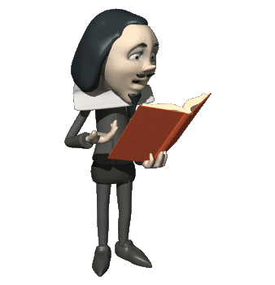
Make small conversations
Read the conversations below and underline the tag questions反义疑问句 and their answers. What functions功能 do the tag questions have?
It’s a beautiful day, isn’t it?

Slide 6
1. Amy: It’s not a real sport, is it?
Shen Qi: Yes, it is.
2. Adam: That sounds interesting, doesn’t it?
Julie: Sure, it does.

Slide 7
3. Lin Tao: Hi! It’s a beautiful day, isn’t it?
Han Jing: Yes, it is. I’m going to play soccer. Can you come along and join us?
Lin Tao: Sorry, I can’t. I’ve got to meet my adviser. By the way, our school soccer team won at last, didn’t they?
Han Jing: No, they didn’t. It’s too bad.
Notes:
7

Slide 8


疑问句类型
一般疑问句
e.g. Do you like these animals?
2. 特殊疑问句
e.g. Who runs fastest in your class?
3. 选择疑问句
e.g. Do you like to play football or basketball?
4. 附加疑问句
e.g. I don’t think he will come, will he?

Slide 9

Listen and check your answers. Then practise it with a partner.
提示：
当附加疑问句是一个需要得到回答/证实的问题时用升调，当附加疑问句仅用于希望得到对方的同意时用降调。

Slide 10

反意疑问句解题步骤
1. 判定：肯定/否定?
2. 找动：确定谓语动词的类型
3. 换代：将主语转换为相应的代词

Slide 11


Complete the conversations with appropriate tag questions or correct answers. Then act them out.
1. A: It’s not going to rain, is it?
B: __________. It’s a good day for sports.
A: Then we can play football, ________?
B: ___________. We don’t have a ball.
No, it isn’t
can’t we
No, we can’t

Slide 12
2. A: It’s Sports Day next Thursday, _______?
B: You’re right, it is. Let’s ask Xia Lei if she wants to join a team.
A: She likes soccer, __________?
B: ______________. But she loves volleyball. She could be in the volleyball team.
isn’t it
doesn’t she
No, she doesn’t

Slide 13
3. A: It’s time for badminton class. Where is the coach? He’s late, _______?
B: It’s been 10 minutes already. He isn’t coming, _____?
A: Cool! We can have a good time. That’s great!
B: Shh!
A: Oh no, he’s right behind me, ______?
C: Yes, I am!
isn’t he
is he
isn’t he

Slide 14

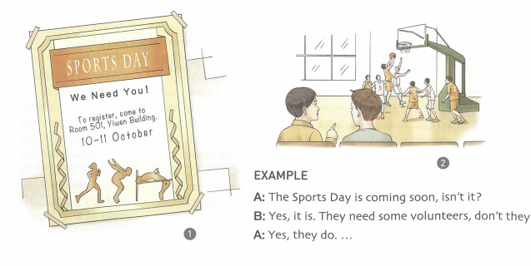
Use tag questions to role-play one of the situations below.

Slide 15


I. 用反意疑问句补全句子。
1. No one wants to leave, ________?
2. You must read more books next term,
___________?
3. Let’s talk about your son now, ________?
4. I don’t think you’ve heard of this concept
before, ________?
do they
mustn’t you
shall we
have you
Notes:
didn’t you

Slide 16
5. People should make the best of what
they’ve learnt, ______________?
6. There have been some terrible scenes on
television, ______________?
shouldn’t they
haven’t there

Slide 17
II. 用恰当的反意疑问句补全下面对话。
Host: You’ve lived in Hollywood for many years,
__________?
Guest: Since I was eighteen and came here to
write my first screenplay.
Host: You didn’t know anyone here at first,
__________?
Guest: No. And I didn’t have a cent to my name.
Just some ideas and a lot of hope. It
sounds crazy, __________?
haven’t you
did you
doesn’t it

Slide 18
Host: But things have worked out for you,
___________? You’re working on
another screenplay now, ___________?
Guest: Yes. It's a comedy about some kids who
become invisible.
Host: Speaking of kids, you have some of your
own, ________________?
Guest: Two boys and a girl — all very visible!
Host: I know what you mean. Do you ever wish
they were invisible?
Guest: Now, that’s an interesting thought,
___________?
haven’t they
aren’t you
don’t / haven’t you
isn’t it

Slide 19


Review grammar.
Make a conversation according to Activity 3 on page 40.

Slide 20


Slide 21
附加疑问句
附加疑问句，又称反意疑问句，主要用于口语，是说话人向对方验证自己的陈述或者判断，也可用于祈使句表示请求或建议。
1. 结构：
陈述句+附加疑问句（助动词/be动词/情态动词+陈述部分主语的相应代词）
2. 规律：前肯后否, 前否后肯, 助动词和人称前后一致。如：
You are from Australia, aren’t you?
He doesn’t live in Beijing, does he?

Slide 22
3. 回答方法:
附加疑问句的答语与一般疑问句类似，注意其与汉语表达习惯的差异。
事实是肯定的用yes+肯定结构，反之用no+否定结构。
但在前否后肯的结构中，yes表示“不”，no表示“是”。
如：
— They work hard, don’t they?
— Yes, they do./ No, they don’t.
是的，他们工作努力。/ 不，他们工作不
努力。

Slide 23
— They don’t work hard, do they?
— Yes, they do./ No, they don’t.
不，他们工作努力。/ 是的，他们工作不
努力。

Slide 24
一、附加疑问句主语
要与前面陈述句主语保持一致。
1. 陈述句主语是that, this, those, these，附加疑问句的主语要用it或they。如：
This is Tom’s textbook, isn’t it?
These are your books, aren’t they?
2. 陈述句主语是表示人的不定代词，如anyone, someone, no one, everybody, nobody, somebody等，附加疑问句的主语通常用they或he。如：
Everyone knows that writer, don’t they/ doesn’t he?

Slide 25
3. 陈述句主语是表示物的不定代词，如anything, nothing, something, everything
等，反意疑问句的主语用it。如：
Nothing in the world is difficult, is it?
4. 陈述句的主语是非谓语动词或主语从句，反意疑问句的主语用it。如：
Smoking is not allowed here, is it?
What he lacks is courage, isn’t it?

Slide 26
5. Let’s与Let us/me后的附加疑问句主语不同。如：
Let’s start early in the morning, shall we?
Let us / me know your new address, will you?
6. 陈述句如果是there be句型，反意疑问句的主
语用there。如：
There is little water left, is there?

Slide 27
二、附加疑问句的助动词
要与陈述句的助动词保持一致。
1. 在含I am的陈述句之后，附加疑问句的助动
词用aren’t。如：
I am supposed to be here, aren’t I?

Slide 28
2. 陈述句谓语动词为have to时，附加疑问句用do作助动词。当陈述句中have作“有”讲时，反意疑问句中既可用have作助动词也可用助动词do。如：
We have to take a test, don’t we?
He has a good memory, hasn’t / doesn’t he?
3. 陈述句的谓语动词含有used to时，反意疑问
句多用did作助动词。如：
She used to live in London, didn’t she?

Slide 29
4. 陈述句中有情态动词must时：
1) must“一定，准是”，附加疑问句中助动词
要与must后动词照应。如：
You must be very excited, aren’t you?
You must have waited here for a long time,
haven’t you?

Slide 30
2) must“必须”，附加疑问句中的助动词用mustn’t。如：
You must leave right now, mustn’t you?
3) mustn’t“禁止”，附加疑问句中的助动词用must或may。如：
You mustn’t walk on grass, must/may you?

Slide 31
三、反意疑问句用肯定还是否定
陈述句含有表示否定或部分否定意义的单词，如not, no, never, none, little, seldom, hardly, few, nowhere, nothing, barely, rarely, neither等，附加疑问句用肯定。如：
Mary seldom goes to the cinema, does she?

Slide 32
四、陈述句是主从复合句或其它句子时
1. 陈述句是主从复合句时，附加疑问句常重
复复合句中主句的主语。
主句中如果有I think/believe/suppose这样的主谓结构时，附加疑问句应与从句保持一致。如：
You never told us why you didn’t pass the
exam, did you?
I don’t think she cares, does she?

Slide 33
2. 陈述句是并列句时，附加疑问句与后一个分
句保持一致。如：
They were absent yesterday, but Mary
wasn’t, was she?

Slide 34
3. 祈使句的附加疑问句常用will或can作助
动词。祈使句为肯定句时，附加疑问句常
用will/won’t/can/can’t you；祈使句为否定句，附加疑问句则常用will / can you。如：
Please close the window, will/won’t/can/can’t you?
Don’t take photos in the meeting room, will/
can you?

Slide 35
4. 感叹句的附加疑问句用否定形式。如：
What a foolish child (he is), isn’t he?
How clever a boy he is, isn’t he?
What beautiful clothes (they are), aren’t they?

Slide 36

Read the conversation. Decide whether the intonation of the tag questions is rising or falling.
Dave: Wonderful gym, isn’t it?
Jack: Er…yes. It’s great.
Dave: This isn’t your first time here, is it?
Jack: Actually, it is. you come here often,
don’t you?

Slide 37
Dave: Yep. At least three times a week.
Jack: You’ve lost some weight, haven’t you?
Dave: Yes. All that fat has become muscle
now. If you want to lose weight, too. I
recommend using the spin bike.
Jack: OK, but it won’t make me too tired, will
it?

Slide 38
Dave: Maybe at first, but you’ll get used to it.
I used to come here every day when I
first started.
Jack: Oh, I don’t have to come here every day,
do I?
Dave: No. Of course not. It’s up to you, isn’t it?

