Slide 1

Unit 3

Slide 2
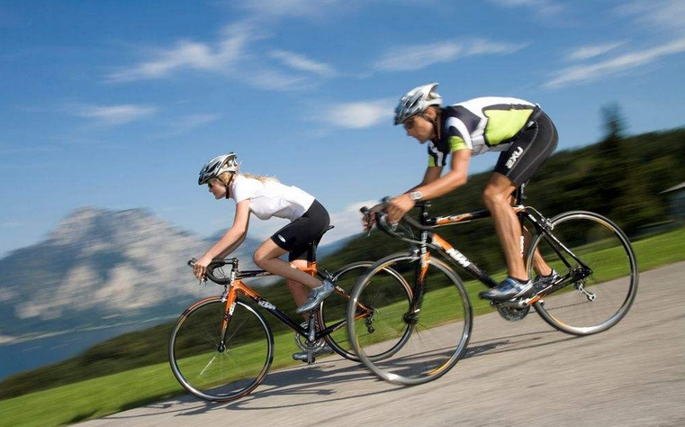
Unit 3 Sports and fitness

Slide 3


Slide 4



To read and talk about the story of Kayla.
To study the organisation and language features of the passage.
To learn to write a paragraph by using comparision and contrast.

Slide 5



Health and fitness
How do you keep fit?
List different ways of getting fit.

Slide 6

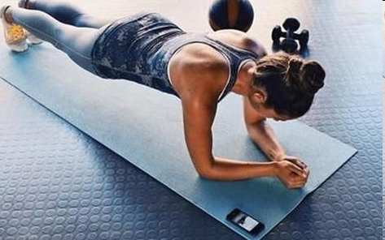
A high school class has a wellness book in which they exchange ideas about health and fitness. Listen and get the main idea of this passage.

Slide 7
Read and answer the questions.
1. What problem did Kayla have in the past?
She was worried about her weight and appearance.
2. What does the sentence “I almost went bananas” mean?
It means she nearly went crazy because she was so worried, and tried various methods.
3. What made her change her thinking?
An article on fitness.

Slide 8
Study the organization and language features.
1. Complete the outline with the words and phrases from the text.
The past | The present
worried about __________ and tried _____________ | think about __________
compared myself with __________________ | …
my weight
every new diet
Fitness rather than weight
n. 饮食
vi.节食
actresses and models
与……比较

Slide 9
2. Find the words and phrases used in the text to show similarities and differences.
Paragrahph | Words and phrases to show similarities and difference
1
2
3
Additional expressions
even though
instead of, make such a difference, rather than, but
instead
though, although, yet, however, in contrast, on the other hand，while

Slide 10


1. I worried about my weight and tried every new diet I read about online.
diet n. the kind of food that a person or
animal eats each day日常饮食
vi. to limit the amount and type of food
that you eat, in order to become thinner
节食
eg It is important to have healthy diet.
People who are on a diet mustn’t have
chocolate.
No sugar in my coffee, please, I’m dieting.

Slide 11
2. Rather than cutting out the foods I enjoyed,
I added healthy foods to my meals.
rather than instead of sb/sth 而不是
eg His son enjoys playing football rather
than playing basketball.

Slide 12
【归纳】
1) do A rather than do B
= rather than do B, sb. does A
某人不做B却做A
2) A rather than B 是A而不是B
3) would rather do A than do B
= would do A rather than do B
宁可做A而不做B
4) prefer to do A rather than do B
更喜欢做A而不做B
5) would rather sb. did/had done sth.
宁愿某人做某事

Slide 13
【点拨】
rather than连接的并列成分可以是名词、代词、形容词、介词(短语)、动词-ing形式、分词、不定式、动词等, 谓语动词应与rather than前面的名词或代词在人称和数上保持一致。
后接不定式时, 不定式可以带to, 也可以不带to。但rather than位于句首时, 则只能接不带to的不定式。

Slide 14
【语境应用】英汉互译。
1) 我想我要喝冷饮而不是咖啡。
I think I’ll have a cold drink rather than
coffee.
2) 杰克选择了离开而不是制造麻烦。
Jack chose to leave rather than (to) cause
trouble.
3) I prefer to wait rather than go at once.
我宁愿等待而不愿立刻就去。

Slide 15
cut out 停止做/使用/食用；剪下
【拓展】cut短语
cut down 削减，缩小，砍倒
cut in 插嘴，干预
cut off 切断，断绝
cut up 切碎

Slide 16
【语境应用】用适当的介词/副词填空。
1) The English teacher asked me to cut ______ that sentence.
2) The water supply has been cut ______ because they are repairing one of the main pipes.
3) The girl cut the paper ______ into little pieces.
4) Jennifer always cuts ______ when other people are talking.
5) The article is too long. You’d better cut it ______ to 1,000 words.
out
off
up
in
down

Slide 17
3. Finally, I stopped comparing myself with actresses and models and looking for things that were wrong with my face or body.
compare… with/to… 与……比较
eg Michael’s new house is like a huge
palace, compared with his old one.
We carefully compared the first picture
with/to the second.

Slide 18


Slide 19


Exercise
What can you do to make exercise like jogging more enjoyable?
Stress
How can you plan you work and make sure that you also have time to rest and relax?
vi.&n.慢跑
v.&n.压力
Self-confidence
What can you do to become more confident and feel better about yourself?
Food
How can you make your meals healthier?

Slide 20
Use the ideas from your discussion to list some positive changes.
What you used to do/ do now and results:
What you do now/ will do in the future and possible results:

Slide 21

show similarities and differences
like, so, too, still, similarly, similar to, the same (…as…), in common (with), both…and…
instead, than, however/but/though, different from, rather than, instead of, the difference is…

Slide 22
Write a short paragraph to describe and explain your changes.
Start with a general statement about the topic and your situation.
Tell the reader about how and why you changed or want to change.
Describe the changes and compare the (possible) results.
Tell the reader how the changes have improved or will improve your life.

Slide 23
Write a short paragraph to describe and explain your changes.
Start with a general statement about the topic and your situation.
Tell the reader about how and why you changed or want to change.
Describe the changes and compare the (possible) results.
Tell the reader how the changes have improved or will improve your life.

Slide 24
Writing outline
Topic: jogging, stress, self-confidence, food
Content:
What did you use to do? What do you do now?
What do you do now?/ What will do in the future?
Results:

Slide 25


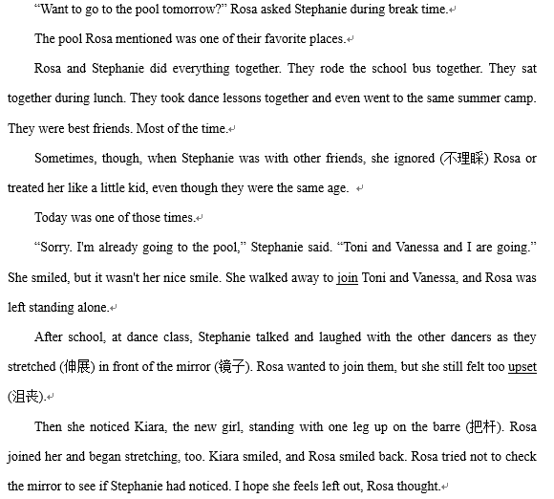
读后续写
阅读下面短文，根据所给情节进行续写，使之构成一个完整的故事。

Slide 26
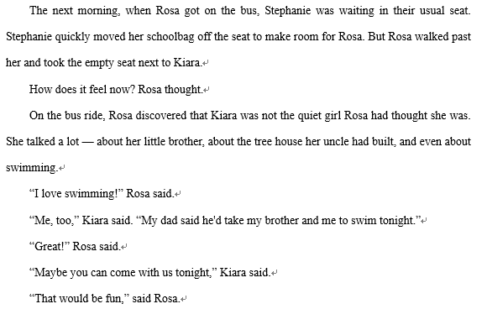

Slide 27
注意：1. 所续写短文的词数应为150左右；
2. 请按如下格式在答题卡的相应位置作答。
Paragraph 1:
When they stepped off the bus, Stephanie was waiting on
the sidewalk.
Paragraph 2:
Rosa suddenly began to feel unhappy and her face began
to burn.

Slide 28
One possible version:
When they stepped off the bus, Stephanie was waiting on the sidewalk. “Did you still want to go swimming tonight?” Stephanie asked Rosa. Here’s my chance. I hope Stephanie feels left out. I will ignore her just as she ignored me, Rosa thought. “I’m already going,” she said. “Kiara and I are going together.” She smiled. Somehow she knew it wasn’t her nice smile. Stephanie nodded and looked at her feet. She seemed very upset.

Slide 29
Rosa suddenly began to feel unhappy and her face began to burn. Why didn’t she feel happy? Getting even was what she’d wanted, wasn’t it? I could walk away with my new friend and not look back, Rosa thought. But it was too late. She had seen Stephanie’s face. Getting even didn’t feel the way she’d expected. It didn’t feel good at all. “Um,” she said instead, “maybe we could go to the pool together.” Stephanie brightened. “I’d like that.” Rosa smiled. “Kiara, meet my friend Stephanie.”

Slide 30


Finish your writing.

Slide 31


