Slide 1

Unit 3

Slide 2

Unit 3 Sports and Fitness
All sports for all people!
---Pierre de Coubertin
人人皆可找到适合自己的运动。
---顾拜旦
founder
Pierre de Coubertin is the _________ (found) of modern Olympics.
Winners
quitters
_________ (win) never quit and _____ (quit) never win.

Slide 3

三级跳远
Triple jump
Relay race
100-meter sprint
High jump
Long jump
Pole vault
Shot-put
110-meter hurdles
接力赛
100米
跳高
跳远
撑杆跳
铅球
110米跨栏
What sport events have you signed up for报名参加?

Slide 4

How can you keep fit every day?
keep fit
____a good sleep
___a balanced diet
_____ sports
_____a good mood
……
have
keep
do
have

Slide 5

海报
运动项目
Look at the posters. What sports events do you like to watch? Which sport would you like to try?

Slide 6


Slide 7
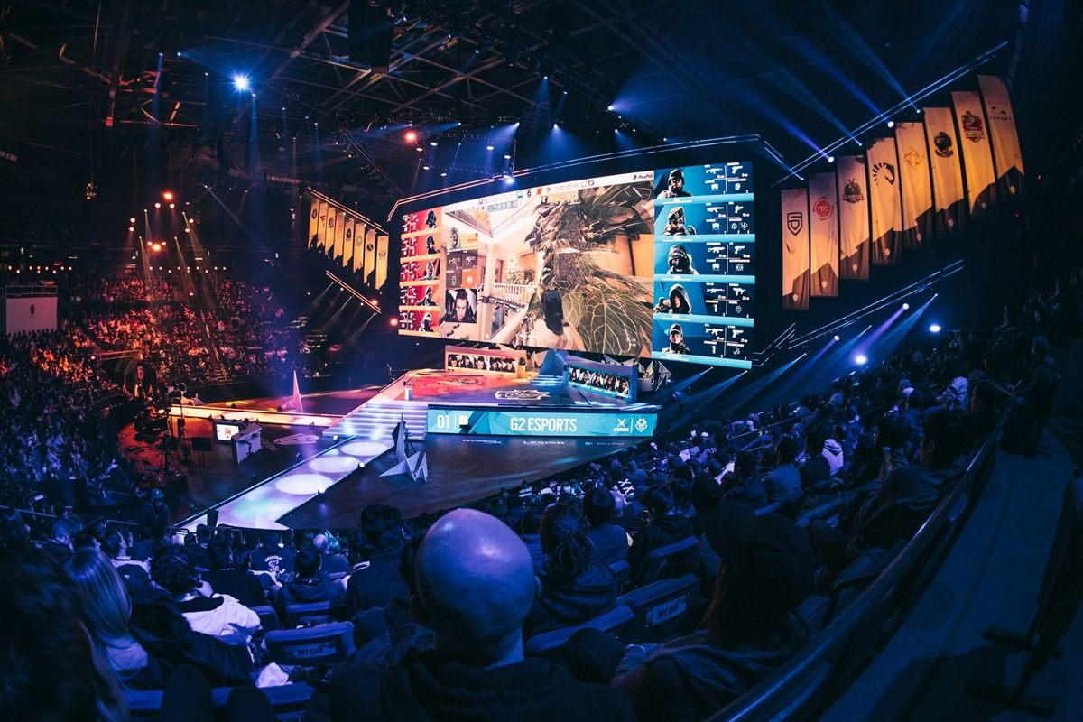
Besides the sports events mentioned in the posters, what other sports or events would you like to watch or try?
Do you know something about e-sports or a Blue-Paint run?
e-sports

Slide 8
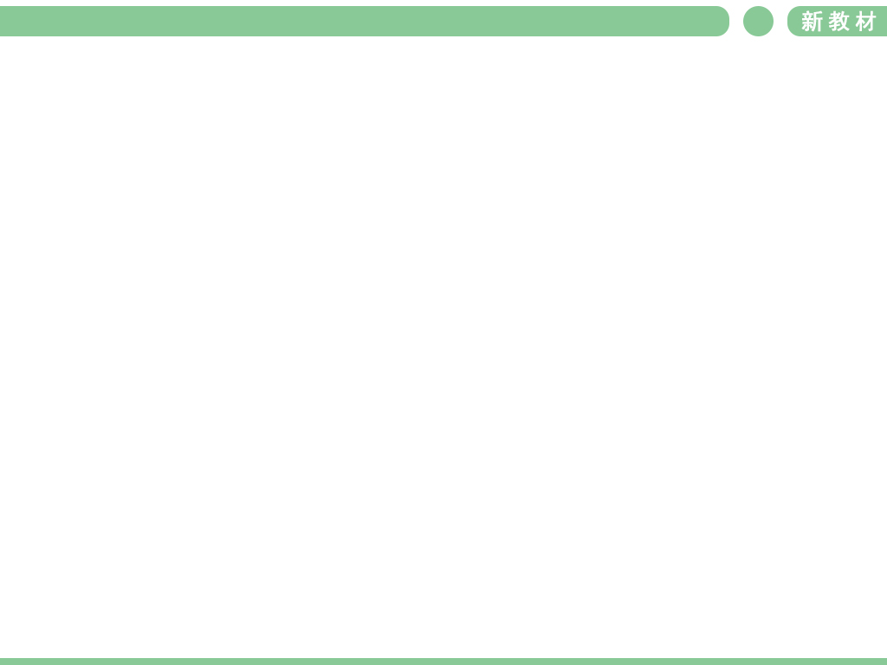


1. Listen to Conversation 1. What is
Shen Qi’s main purpose for
talking to Amy?
strategies
high frequency words
……
main purpose
main idea

Slide 9

What is Shen Qi’s main purpose for talking to Amy?
A. To invite Amy to an e-sports event.
B. To invite Amy to a soccer match.
C. To explain an e-sports event.

Slide 10
Listen to Conversation 1 again and circle the words that the speaker stresses.
1. Did you hear that there’s an e-sports
event this weekend?
2. Would you like to come along?
3. Really? I’d love to!
4. Why don’t you join us this Saturday
afternoon?
5. Oh, sorry. I can’t.

Slide 11
Listen to Conversation 1 again and answer the questions.
1. What are e-sports?
___________________________________
___________________________________
2. Why can’t Amy join them?
___________________________________
E-sports are sports that are played with computer, like computer games.
Because she has to meet her badminton coach.
羽毛球教练

Slide 12
Conversation 2
Adam is inviting Julie to a sports event. Listen to Conversation 2 and answer the questions.
1. When will the event happen?
The event will happen
____________________.
2. What’s a “Blue Paint” run?
A “Blue Paint” run is a fun run
that __________________.
take place
be held举行
on Saturday afternoon
helps the community
the money raised goes to charity

Slide 13
3. Why is it called a “Blue Paint” run?
Because people can buy water balloons filled with _______________and
____________ the runners.
4. If 200 people take part in the run and 400 balloons are sold, how much money will they collect?
blue paint
throw them at
5*400+ 20*200=6000 dollars

Slide 14


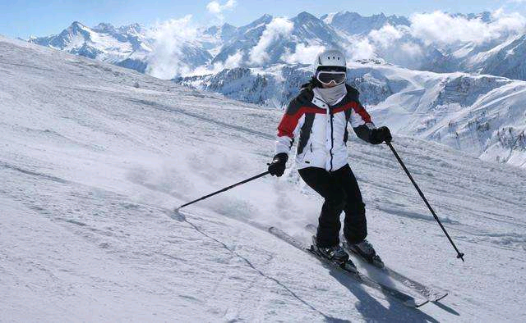
What event or activity would you like to invite your friend to? Make a conversation with a partner.
(Situation 1)
Ski Race: Zhang Jiakou, a beautiful city in northern China, will host the Youth Ski Race in December.
滑雪比赛：张家口，一个在中国北方的美丽城市，将于12月举办青少年滑雪比赛。

Slide 15
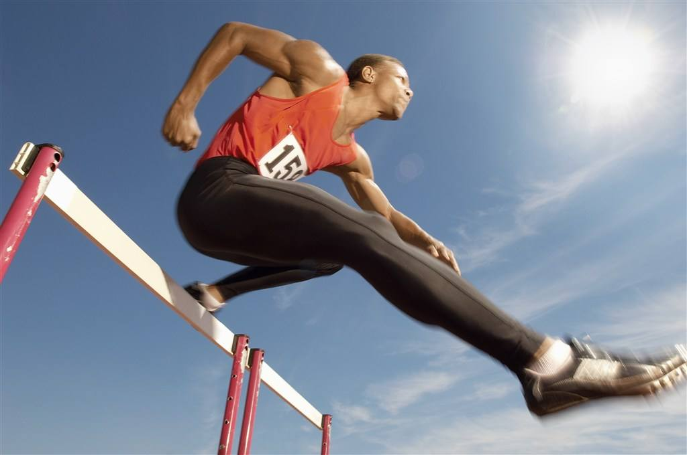
(Situation 2)
Track Meet: A great event for track-and-field lovers on 26 October.
田径运动会：10月26日田径爱好者的盛会。

Slide 16
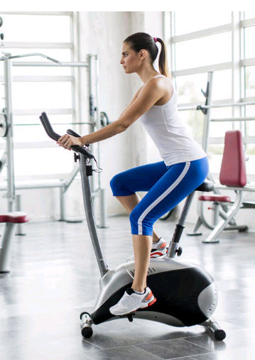
(Situation 3)
Gym class: Come and work out at a gym! Sweat your way to =fight for good health! You can make it!
健身班：来健身房锻炼吧！为健康挥洒汗水吧！你能行的！

Slide 17
Pronunciation发音
1 Read the conversation. Decide whether the intonation语调 of the tag questions反义疑问句 is rising or falling.
Dave: Wonderful gym, isn't it?
Jack: Er... yes. It's great.
Dave: This isn't your first time here,
is it?
Jack: Actually, it is. You come here often, don't you?
Dave: Yep. At least three times a week.
*a falling tone降调:
you expect期待 an agreement 同意
*a rising tone升调：
you need a confirmation 确认/证实
*a rising/falling tone升/降调

Slide 18
Jack: You've lost some weight, haven't you?
Dave: Yes. All that fat has become muscle now. If you want to lose weight, too, I recommend using the spin bike动感自行车.
Jack: OK, but it won't make me too tired, will it?
Dave: Maybe at first, but you'll get used to it. I used to come here every day when I first started.
*a falling tone降调：
you expect an agreement
*a rising tone升调：
you need a confirmation确认/证实

Slide 19
*a rising tone升调：
you need a confirmation确认/证实
Jack: Oh, I don't have to come here every day, do I?
Dave: No. Of course not. It's up to you, isn't it?
*a falling tone降调：
you expect an agreement
有你说了算，不是吗？

Slide 20

What/ How about…?
Why don’t you…?
Why not do…?
I’d like to invite you to…
Would you like…?
Could/ Would you please…?
I wonder if you’re interested in…

Slide 21
All right (them)!
Yes, I’d love to…
That would be very nice.
I’m looking forward to…
That sounds like a good idea.
That’d be great!
Thanks, that’s very nice of you.
I’m sorry / afraid that I can’t.
I’d love to, but…

Slide 22


主人；主持人；东道主
host n. ____________________
v. ____________________
track n. ____________________
v. ________________
sweat n. _______________
v. ________________
work out ___________________________
make it _____________________
主办
跑道;赛道；小道
追踪，跟踪
汗，汗水，汗液
出汗；流汗；冒汗
想出，得到(解决方法); 锻炼;健身
=be successful 获得成功

Slide 23
跟随；到达
come along ____________________
track and field ________________
田径

Slide 24


Write out your conversation.

Slide 25


