Slide 1
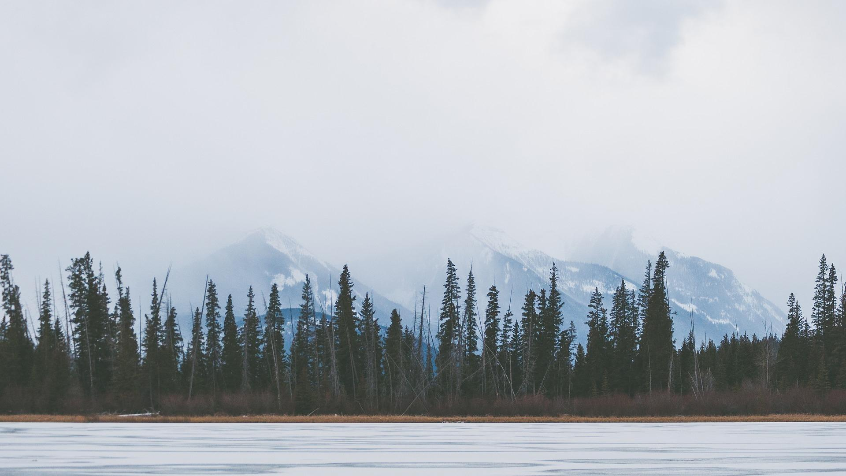
Reading
Unit3 Fascinating Parks

Slide 2
By the end of the class，
1. Read about the beauty and history of Sarek National Park.
2. Figure out the structure of the passage.
3. Express your ideas on the given topics through critical thinking.

Slide 3
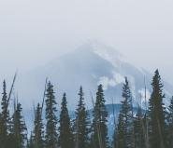
1 Warming up
What kinds of parks have you been to ? What were they like?
I have been to the theme parks and national parks. They are very beautiful and provide a wide range of activities for visitors.
When you think of national parks, what comes to your mind first?
When I think of national parks, beautiful scenery, wild plants and animals come to my mind first.

Slide 4
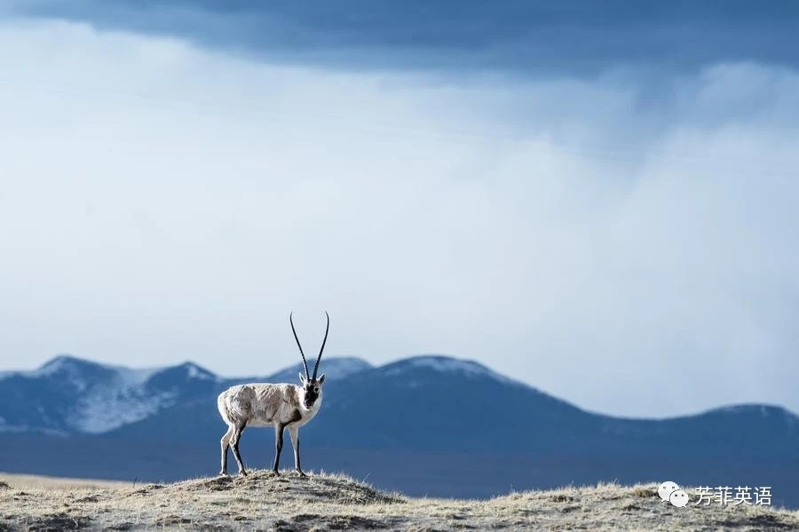
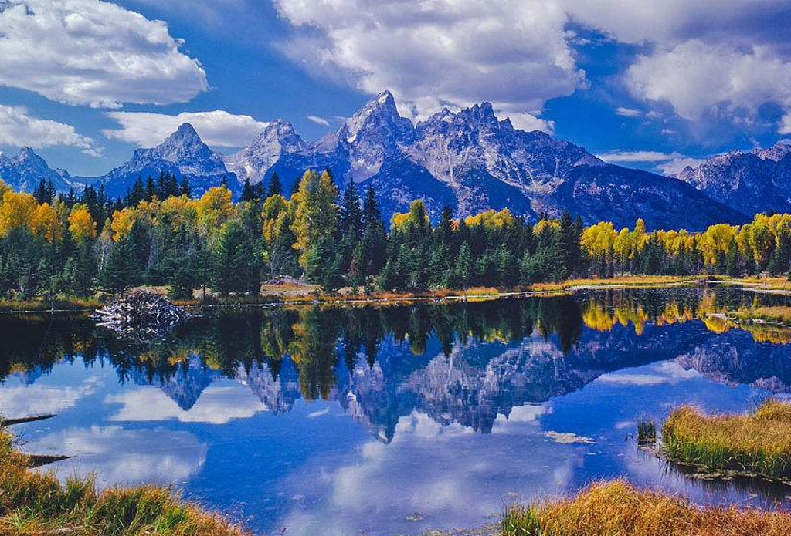
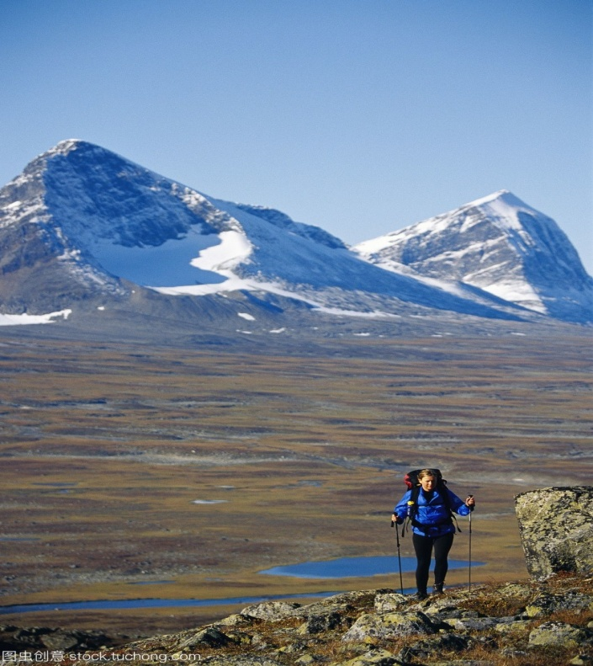
National parks
Sanjiangyuan National Park
Yellowstone National Park USA
Sarek National Park

Slide 5
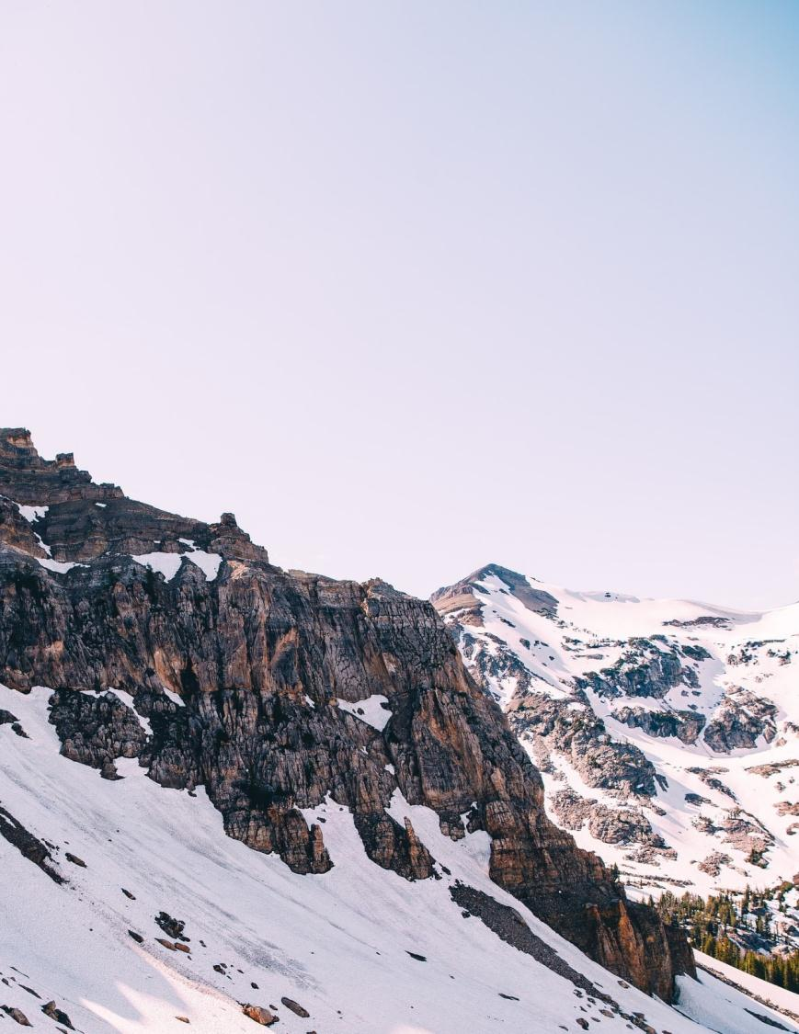
Reading
SAREK NATIONAL PARK
---EUROPES HIDDEN NATURAL TREASURE

Slide 6
Para1
A Summer Where the Sun Never Sleeps
________________________________
I wake up to the sound of the wind buffeting the cloth of my tent. Even though the sun is brightly shining, telling whether it is morning or night is impossible. I'm above the Arctic Circle, where in summer the sun never sets. Checking my watch, I see that it is 7: 30 a.m. I leave my tent and walk over to the mountain edge. Spreading out before me, branches of the Rapa River flow through the valley below. I'm in the remote far north of Sweden in Sarek National Park, a place with no roads or towns.
What’s the subheading of this paragraph?
Where was the author and what did he see?
The author was in the remote far north of Sweden in Sarek National Park above the Arctic Circle ;he saw beautiful scenery there, like the shining sun, the rivers and the valley.

Slide 7
Para2
2. ___________________________________
Sarek's mountains used to be covered by vast sheets of ice. Spreading out before me, branches of the Rapa River flow through the valley below. Soon after, reindeer began to arrive. Following the reindeer were the Sami people, who made this territory their home. Getting here is quite difficult, so apart from the Sami very few people have ever seen Sarek. In 1909, Sarek was made a national park in order to keep the land in its natural state. Though the Sami are allowed to continue their traditional way of life in the park, no one else can live here, and all new development is banned within park boundaries. At the far side of the valley, an ancient Sami cottage is visible. Close by, there are a few reindeer feeding on grass.
A Land of Mountains and Ice
What’s the subheading of this paragraph?
What steps has the Swedish government taken to keep Sarek in
its natural state?

Slide 8
Para3
3. ___________________________
For hundreds of years, looking after reindeer was a way of life for the Sami. They used the reindeer's meat for food, their bones for tools, and their skin for making clothes and tents. Since reindeer were always on the move, the Sami would pick up their tents and accompany them. Today, most Sami have houses in villages near Sarek and live a modern life just like their neighbours. But every spring, a small number of Sami still follow their reindeer into the valleys of Sarek, living in tents or old cottages and enjoying their traditions. I am not a Sami, but in Sarek I've adopted some of their habits. For example, this morning my breakfast is flat bread warmed over a fire, dried reindeer meat, and some sweet and sour berries that I found growing near my tent.
Man at Peace with Nature
What’s the subheading of this paragraph?
How has life changed for the Sami?

Slide 9
Para4
4. _________________________
After breakfast, I pack my bag and set out again. Since I must carry all of my food and supplies with me, my bag weighs about 30 kilograms. If today is anything like yesterday, it will be full of sweat and hard work as I hike over this difficult land to my destination on the other side of the valley. However, I cannot complain. Being in such a beautiful and wild place makes me feel blessed to be alive. Here I am, alone under this broad sky, breathing the fresh air, and enjoying this great adventure. What could be better?
A Land of Adventure
What’s the subheading of this paragraph?
Why does the writer think the sweat and hard work is worth it?
It is a beautiful and wild place and the writer is enjoying a great adventure

Slide 10

1. What is the style of the text?
Pragmatic Analysis
Travel journal
2. What’s the writing purpose of the text?
To tell us the beauty of the Sarek National Park
PPT模板下载：www.1ppt.com/moban/ 行业PPT模板：www.1ppt.com/hangye/
节日PPT模板：www.1ppt.com/jieri/ PPT素材下载：www.1ppt.com/sucai/
PPT背景图片：www.1ppt.com/beijing/ PPT图表下载：www.1ppt.com/tubiao/
优秀PPT下载：www.1ppt.com/xiazai/ PPT教程： www.1ppt.com/powerpoint/
Word教程： www.1ppt.com/word/ Excel教程：www.1ppt.com/excel/
资料下载：www.1ppt.com/ziliao/ PPT课件下载：www.1ppt.com/kejian/
范文下载：www.1ppt.com/fanwen/ 试卷下载：www.1ppt.com/shiti/
教案下载：www.1ppt.com/jiaoan/
字体下载：www.1ppt.com/ziti/

Slide 11
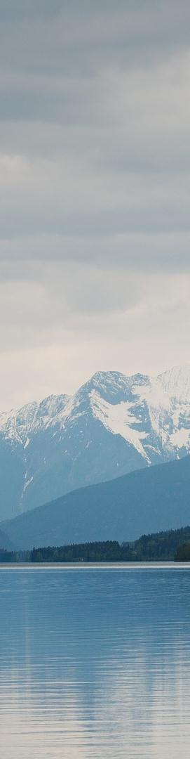
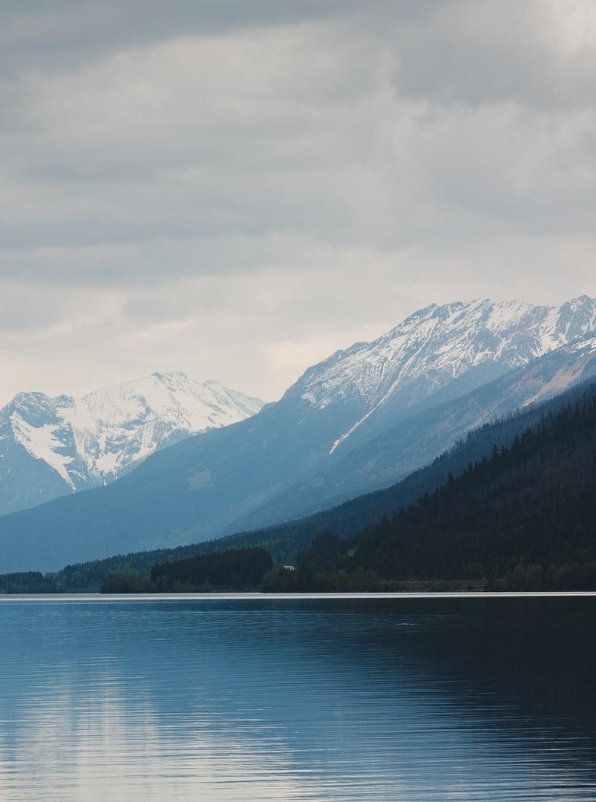
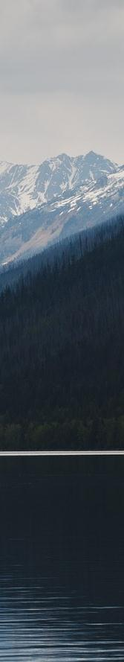
Critical Thinking
Is it a good idea to make a place like Sarek a national park? Give your reasons.

Slide 12
Consolidation
In the remote far north of Sweden, in Sarek National Park above the Arctic Circle, ____1____ in summer the sun never sets, I wake up to the sound of the wind ____2____（buffet)the cloth of my tent. Standing at the edge of the mountain, watching the Rapa River flow ___3__ the valley below, I feel so ____4____（bless）to be alive and have this rare opportunity to explore this unique territory, __5___ is almost unknown to the outside world.
Sarek's mountains, home to the Sami people, who are th native residents of the park, used to ___6_____(cover) by vast sheets of ice. Around 9,000 years ago, this ice melted, ___7___(leave) behind about 100 glaciers. For hundreds of years, the Sami lived __8___ reindeer, moved with them, and ____9_____(accompany)them for hundreds of years. Today, most Sami have left their ancient cottage in the mountain valleys and live a modern life in villages near Sarek instead.
___10____(keep) its natural state, except for the Sami, no one is allowed to live in Sarek, and all new development is ____11__(ban) within the park boundaries. It is hoped __12___ Sarek National Park will always remain as it is, natural and beautiful.
where
buffeting
through
blessed
which
be covered
leaving
off
accompanied
To keep
banned
that

Slide 13
我醒来时听到风在呼呼地吹我帐篷上的布。虽然阳关灿烂，但判断是早上还是晚上是不可能的。
虽然萨米人被允许在公园里继续他们的传统生活，但其他人不可以住在这里，公园范围内的一切新的开发活动都被禁止了。
例如，今天早上，我的早餐是在火上烤的扁面包，驯鹿肉干，和一些我在帐篷附近找到的酸甜的浆果。
由于我必须随身携带所有的食物和用品，我的包重约30千克。
如果今天像昨天一样，那将会充满汗水和艰辛，因为我要徒步跨越这片地形险峻的土地，到达峡谷另一端的目的地。
在这样一个美丽而荒凉的地方，我感到活着是幸运的。我在这里，独自一人在广阔的天空下，呼吸着新鲜的空气，享受着这伟大的冒险。

Slide 14
wake up to the sound of
spread out
used to do sth
be covered by vast sheets of ice
leave behind
apart from
make the territory their home
keep the land in its natural state
close by
feed on
Man is at peace with nature
on the move
pick up tents
live a modern life
a small number of
pack my bag
set out
make me feel blessed to be alive
breathe the fresh air
1.在……中声音在醒来
2.展开
3.过去常常做某事
4.被巨大的冰层覆盖
5.留下，遗留
6.除……之外
7.让这片土地成为他们的家
8.让这片土地保持自然状态
9.在附近；接近于；在…..近旁
10.以……为食
11.人类与自然和睦相处
12.在活动中，在进行中
13.收起帐篷
14.过着现代人的生活
15.少量的
16.整理好书包
17.动身出发
18.让我感觉活着真好
19. 呼吸着新鲜空气

Slide 15
Following the reindeer were the Sami people who made this territory their home.在驯鹿之后来的是萨米人，他们在这片土地上安家落户。
分析：这是一个完全倒装句，把主语the Sami people后置，以便与后面的定语从句更好的衔接。
英语中为了保持句子平衡，为了前后衔接或强调表语部分等，可以将作表语的形容词、分词、介词短语至于句首，并把句子的主语和谓语全部倒装，其倒装结构为形容词/现在分词/过去分词/介词短语+be +主语。
here, there, now, then 等副词开头的句子且主语又是名词时， 用完全倒装。
将表示地点的介词短语放在句首时，用全部倒装。
Eg:
Happy are those who are contented.知足者常乐
Growing all over the mountain are wild flowers.漫山遍野长满了野花。
Gone are the days when we had nothing to eat.
我们没有东西吃的日子一去不复返了。
Inside the parcel was a letter.包裹里是一封信。
At the meeting place of the Yangtze River and The Jialing River lies Chongqing, one of the ten largest cities in China.
重庆位于长江和嘉陵江的交汇处，是中国十大城市之一。
John opened the door. There stood a girl he had never seen before.
即学即练：
山脚下有一个村庄，在那里人们仍旧过着平静的生活。
At the foot of the mountain lies a village, where people still live a peaceful life.

