Slide 1

Unit 1 Great scientists

Slide 2
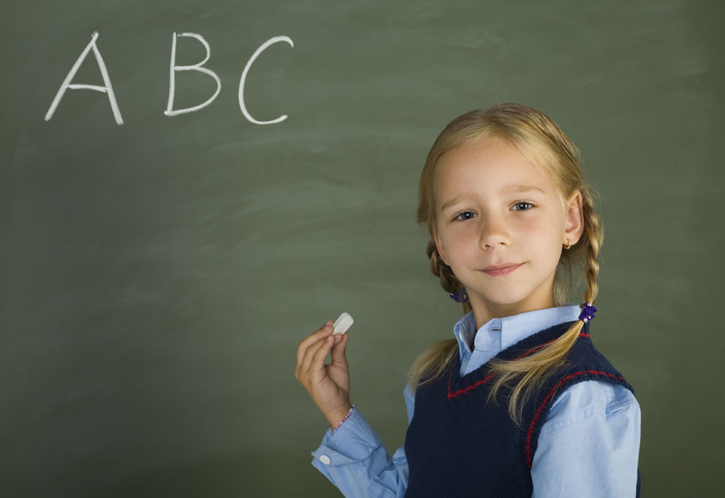
Listening

Slide 3

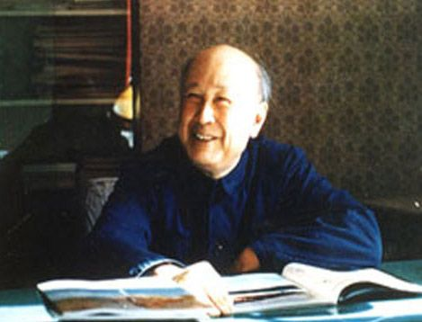
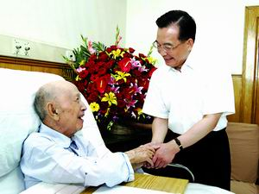
Pre-listening
Qian Xuesen

Slide 4
What do you know about Qian Xuesen?
Qian Xuesen, father of Missile in China, was born in Hangzhou.
As an academician, he has contributed greatly to the astronautical industry(航天事业) of the country.

Slide 5
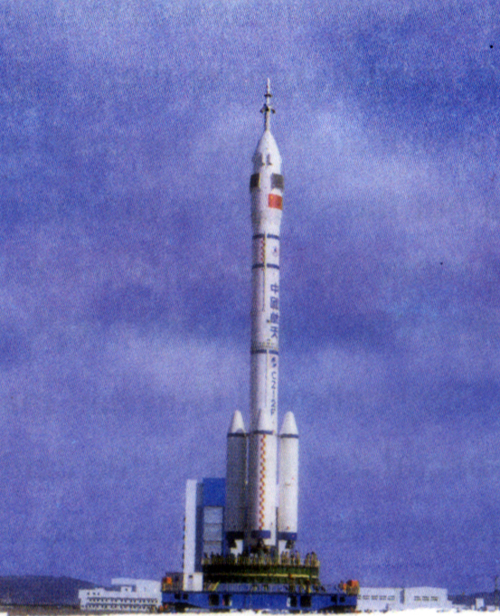
Before we begin to listen, read the new words in the material:
astronomer 天文学家
astronaut 宇航员
institute 研究所

Slide 6

While-listening
Listen to Parts 1 and 2 of the tape
for the first time and write down the
main idea.
It is about the role of _____________in the development of _______________in China.
Qian Xuesen
space technology

Slide 7
Listen to part 1 again and answer the questions.
1. What did Qian Xuesen study first?
Qian Xuesen first studied to be an engineer.

Slide 8
2. What experience did he get in America
that was very useful for China?
In America he began to work on space
rockets so that he was able to develop
a space programme when he came
back to China.

Slide 9
3. What was Qian Xuesen’s main achievement when he returned to China?
When Qian Xuesen returned to China
he set up a space institute to begin
training people in how to design and
build rockets.

Slide 10
Listen to Part 2 and fill in the chart below.
China’s achievements in space | Steve smith’s ambitions
1. China astronauts in space
2. Chinese satellites in space
1. become a rocket scientist
2. be the first to land on Mars and put Qian Xuesen’s picture there

Slide 11

Listening (P41)
Robert Briggs is very interested in biology and especially in the study of plants. Today he is telling his friend Zhang Wei some exciting news.
Before you listen to the tape discuss with your partner how you would find out the name of a flower.

Slide 12
New words in the listening passage:
species (种类)，
parrot (鹦鹉)，
blackbird (乌鸦)

Slide 13


1. Which of the following statements describes what this listening passage is about? Give your reasons.
A. This is about a man who wants to name
a flower.
B. This is about a man who finds a flower
and wants to own it.
C. This is about a man who finds a flower
and wants to know if it is a new species of
flower.
It does not give enough information.
B is inaccurate.

Slide 14
Listen to the tape again and complete the following passage.
To find the name of an unknown flower first you should ask your ________ teacher to help you. He /She will look in a special _____ written by Carl Linnaeus.
biology
book

Slide 15
He lived in ______ from ____ to _____. He was very important because he solved a ______ problem for biology.
Sweden
1707
1778
serious

Slide 16
Listen to the tape for the third time and answer these questions.
1. If Robert Briggs finds the flower in the book, what does that mean?
It means that his flower has already been identified and has a name.
2. How would he know if his lily is a new species?
He would know by checking his lily against other lilies in the specialist book. If his lily is different it will be a new species.

Slide 17
3. Why do plants all have two names?
All plants have two names just like people. The first is the group of flowers they belong to and is like the family name. the second is the kind fo flower within that group and is like a given/personal name.

Slide 18
4. What was the serious problem for biology that Linnaeus solved?
Before Linnaeus there was no way of finding out whether a plant was new or not. This caused problems because different scientists claimed that they had found and named flowers first. After he organized his system it was easy to discover whether a plant was new or not and so who had the right to name it.

Slide 19
Post-listening
In groups discuss a scientific job you might choose in the future.
These questions may help you:
What kind of scientific job do you want to do?
What education will you need?

Slide 20
What personality will be needed?
How long will the training take?
What work experience would be useful?
How will you prepare for this career?
Why are you so interested in this job?

Slide 21

Sample conversation:
MIKE: What do you want to do when
you grow up?
LI RU: I want to build robots. I will have
to do a physics and mathematics
degree in China.

Slide 22
After that I hope to go abroad
to Reading University in
England where you can study
all about robots. There is a
special cybernetics (控制论)
department there.
MIKE: What personality will be needed
for that job?

Slide 23
LI RU: I think I need to be patient
for my ideas which will take a
long time to develop. I also
need to be creative enough to
have good ideas.
MIKE: What experience will be
most useful to you?

Slide 24
LI RU: I think technology and
engineering projects. I hope
to work in a factory in my
holidays.
MIKE: What kind of person makes a
good inventor?

Slide 25
LI RU: I think someone who is happy to
persevere at something and
learns from his mistakes.
MIKE: Thank you. I think designing
robots sounds fun.

Slide 26


Preview the part of Reading and
writing.

Slide 27


