Slide 1

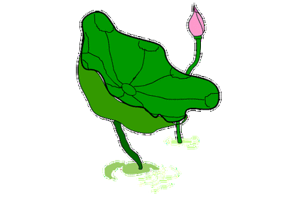
B5 UNIT1
Great scientists
Warming up &Reading Language points

Slide 2
Step1词性转换
scientific
science
scientist
1．______ adj.科学的→_______n．科学→ _____ n．科学家
2．________vt. & vi.结束；推断出→_______ n．结论；结束
3．_______ vt.暴露；揭露；使曝光→______ n．暴露；曝光
4．______ vt.污染；弄脏→ _______ adj.受污染的→________ n．污染
5．________ vt.宣布；通告→ ________ n．宣告；通知6．______ vt.命令；指示→_____ n．说明
conclude
conclusion
expose
exposure
pollute
polluted
pollution
announcement
announce
instruct
instruction

Slide 3

Step2词汇精讲
1．defeat
[教材原句] JOHN SNOW DEFEATS “KING CHOLERA”
约翰·斯诺战胜“霍乱王”
(1)vt.打败；战胜；使受挫
①The team defeated his opponent and won the champion in the final of the competition.
这个队在比赛的决赛中打败对手，获得冠军。
②The proposal was deafted by 16 votes to 6.
因16票反对，6票赞成，该提议未能通过。

Slide 4
(2)n.[C，U]失败
③He always seems cheerful even in defeat.
他总是看起来很高兴，即使输了也这样。
区别：
defeat | 击败，强调过程和结果 | 宾语是对手
beat | 打败；(连续)击打 | 宾语是对手
win | 赢得；获胜 | 宾语是game或prize等

Slide 5
[自填助记]
Yesterday I _________ John at chess. He ______only one set, while I _______ two sets.
昨天我和约翰下棋赢了他。他只赢了一盘，而我赢了两盘。
defeated/beat
won
won

Slide 6
5
2．attend vi.& vt.照料；护理(病人)；出席；参加
[教材原句] John Snow was a famous doctor in London — so expert, indeed, that he attended Queen Victoria as her personal physician.
约翰·斯诺是伦敦一位著名的医生——他的确医术精湛，因而成了维多利亚女王的私人医生。
①The professor is rich in knowledge, so we all like to attend his lecture.
这位教授知识渊博，因此我们都希望听他的演讲。

Slide 7
attend a meeting/a lecture/school
参加会议/听报告/上学
attend (on/upon) sb. 照顾某人；伺候某人
attend to 处理；对付；接待(顾客)；专心；注意
②Presidents from many countries attended the 2016 G20 Hangzhou Summit.
来自许多国家的元首出席了2016年杭州G20峰会。

Slide 8
③He was badly injured. As a result, he was attended (on) by three nurses.
他伤势严重。因此，有3名护士护理他。
比较：attend, join, join in, take part in
attend指参加会议、上课、上学、听报告等
join指加入某组织、团体，成为其中的一员
join in指参加某种活动，表示与某人一起做某事则用join sb. in sth.
take part in指参加群众性活动、会议等，往往指参加并持积极态度，起一定作用

Slide 9
[自填助记]
①I often ______ meetings and sometimes I _____
their discussion.
我经常出席会议，有时参与大会的讨论。
②My wish is to ______ the army after graduation.
我的愿望是毕业后参军。
③Lincoln ___________ politics and was strongly
against slavery.
林肯积极参加政治活动，强烈反对奴隶制度。
attend
join in/take part in
join
take an active part in

Slide 10
3．expose vt.暴露；揭露；使曝光；使接触
[教材原句] But he became inspired when he thought about helping ordinary people exposed to cholera.
但当他一想到要帮助(那些)受到霍乱威胁的普通百姓，他就感到很振奋。
(1)expose sb./sth. to ...使某人/某物暴露于……；
使某人/某物接触到……
(2)be exposed to ... 暴露于……；置身于……
exposure n. 暴露；揭发

Slide 11
①Exposed to such disasters, the local people were badly in need of help.
当地人深陷于如此大的灾难中，他们急需帮助。
②Don't expose yourself to the sun for too long. You will get burnt.
别在太阳下晒得太久，你会被晒伤的。
③We want to expose the kids to as much art and culture as possible.
我们想让孩子们受到尽可能多的艺术和文化熏陶。

Slide 12
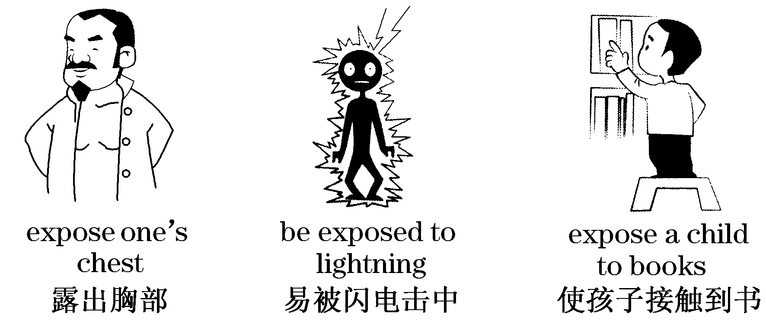

Slide 13
4．cure n．[C]治愈；疗法vt.治愈；治疗；改掉(坏习惯)
[教材原句] Neither its cause nor its cure was understood.
(人们)既不知道它的病源,也不了解它的治疗方法。
①Doctors are searching for a cure for AIDS.
医生们正在寻找艾滋病的治疗方法。
②There is no way to cure or prevent Ebola, though experimental vaccines are on the way.
尽管实验性的疫苗正在研制中，但市场上还没有治愈或预防埃博拉病毒的方法。

Slide 14
③We must cure the children of bad habits.
我们必须纠正孩子们的坏习惯。
④This medicine will cure you of your headache.
这种药可治好你的头痛。
⑤a cure for ... 治愈某种病的方法
⑥ cure sb. of sth. 治愈某人的病；改掉某人的坏习惯
区别：cure, treat
cure强调结果，即“治愈”；可构成cure sb. of sth.结构

Slide 15
treat强调过程，不涉及结果；可构成treat sb. for sth.结构
[自填助记]
①The doctor _______ her headache with a new medicine, but didn’t ________ her.
②He had been _________ for his heart disease for three months, but the doctors said they could _____ him of it in one month.
treated
cure
treated
cure

Slide 16
5．challenge n．[C，U]挑战vt.向……挑战
[教材原句] John Snow wanted to face the challenge and solve this problem.
约翰·斯诺想面对这个挑战，解决这个问题。
①To prevent hazes from happening frequently is a great challenge for most cities in China.
对于中国的大部分城市来说，阻止雾霾天气的频繁发生是一项巨大的挑战。
(1)face the challenge面临挑战
accept/take up a challenge 接受挑战

Slide 17
(2)challenge sb. to sth. 向某人挑战某事
challenge sb. to do sth. 向某人挑战做某事
②He accepted a challenge to a TV debate.
他接受了电视辩论的挑战。
③When I said I ran faster than her, she challenged me to a race.
当我说我跑得比她快时，她硬逼着要和我赛跑。
④Mr Wang challenged me to play another tennis game.
王先生向我挑战再打一场网球比赛。

Slide 18
6．absorb vt.吸收；吸引；使专心
The second suggested that people absorbed this disease into their bodies with their meals.
第二种看法是人们是在吃饭时把这种病毒引入体内的。
①This kind of paper absorbs ink.这种纸吸墨水。
absorb ... into ... 把……吸入……
absorb ... from ... 从……中吸收……
absorb sb.’s attention 吸引某人的注意
be absorbed in 专心于；全神贯注于

Slide 19
②Plants can absorb nutrients from the soil.
植物能从土壤中吸收养分。
③A student­centered class can absorb students' attention.
以学生为中心的课堂可以吸引学生的注意力。
④ Absorbed in his work , Tom simply forgot food and sleep.
汤姆专心工作，几乎忘记了吃饭和睡觉。

Slide 20
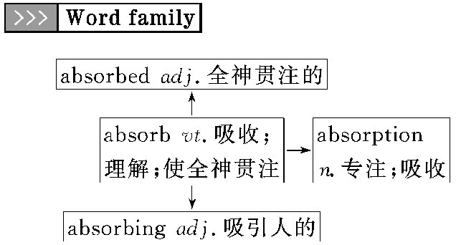

Slide 21
7．suspect
[教材原句] John Snow suspected that the second theory was correct but he needed evidence.
约翰·斯诺推测第二个理论是正确的,但他需要证据。
(1)vt.怀疑；认为
①Never employ the man you suspect, nor suspect the man you employ.
[谚语]疑人不用，用人不疑。
suspect that ... 怀疑……；觉得……
suspect sb. of (doing) sth. 怀疑某人(做过)某事

Slide 22
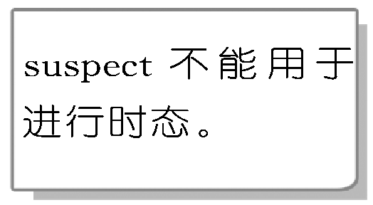
②What makes you suspect him of stealing the money?
你凭什么怀疑钱是他偷的？
③I suspect that he is a thief.
我怀疑他是个小偷。
(2)n. [C]嫌疑犯
④The police have taken the suspect to the police station.
警察把那个嫌疑犯带到了警察局。

Slide 23
8．blame
[教材原句] It seemed that the water was to blame.
看来水是罪魁祸首。
(1)vt.责备；指责；把……归咎于
be to blame (for sth.) (某事)负有责任；(因某事)应受责备
blame sb. for (doing) sth.因(做)某事而责备某人
blame sth. on sb.把某事归咎到某人身上

Slide 24
①Don't always blame your own failure on others. Sometimes you yourself are to blame.
不要总把自己的失败归咎于他人。有时该怪你自己。
②There was no evidence that the pilot was to blame for the air crash.
没有证据表明飞行员要为这场空难负责。

Slide 25
(2)n.[U]过失；责备
bear/take/accept/get the blame (for sth.)
(对某事)承担责任
put/lay the blame for sth. on sb.将某事归咎于某人
③I am ready to take the blame for what I said.
我已准备对我所说的负责。
④She'll put/lay the blame on me if it gets bad.
如果事情变糟，她会把此事归咎于我。

Slide 26
9．announce vt.宣布；宣告(决定、计划等)；(尤指通过广播)通知
[教材原句] With this extra evidence John Snow was able to announce with certainty that polluted water carried the virus.
有了这个额外的证据，约翰·斯诺就能够肯定地宣布，这种被污染了的水携带着病毒。
(1)announce sth.(to sb.) (向某人)宣布、通告某事
announce that ... 宣布……；通知……
It is announced that ... 据宣布……

Slide 27
(2)announcement n. 通知；通告
make an announcement 宣布；下通知
(3)announcer n. 广播员；播音员
①Guangdong police announced a reward for reporting crime clues.
广东警方宣布将给予提供犯罪线索者一笔奖金。
②The spokesman of the Foreign Ministry announced the news to the reporters.
＝ The spokesman of the Foreign Ministry announced to the reporters the news.
外交部发言人向记者发布了新闻。

Slide 28
[点津] 表示“向某人宣布某事”用announce sth. to sb.或announce to sb. sth.，而不用于announce sb. sth.。
③It is announced that there will be a celebration on National Day.
据宣布，国庆节要举行庆祝会。
④The announcer made an announcement that all the details should be announced through the broadcast.
广播员宣布所有的细节都应通过广播公布出来。

Slide 29
区别：announce, declare
announce指正式公布、宣布，侧重预告人们关心或感兴趣的事情，尤指新闻
declare指正式向公众宣布，侧重“当众发表”，多用于宣战、议和或宣判等。declare后可跟复合宾语
①The date of his visit has not been _______.
他来访的日期尚未公布。
②Fighting has been going on for a year, but war has not yet been _____________.
仗已打了一年，但并没有宣战。
announced
declared

Slide 30
Step3知识巩固
单句语法填空
1．The car accident caused yesterday ______ (expose)to all kinds of media.
2．Pay increases will _______ (link) to erformance.
3．We consider that you are not to blame _____ the fault.
4．To his disappointment, he found the suggestion he _____ (put) forward was turned down at the meeting.
5．With the development of economy, the countryside is increasingly being absorbed ________ large cities.
6．From what is said above, we can draw a ___________ (conclude)．
was exposed
be linked
for
had put
into
conclusion

Slide 31
Step4句型理解
1．So many thousands of terrified people died every time there was an outbreak.
因此每次(霍乱)暴发，就有成千上万惊恐的人们死去。
every time在句中引导时间状语从句，与each time相同，意为“每次……”。
①Every time I went to Beijing I would visit the Great Wall.我每次去北京都会去参观长城。
②Every time I see him, he's always wearing a smile on his face.我每次见到他时，他总是面带笑容。

Slide 32
Step4句型理解
可以用作连词引导时间状语从句的名词短语有以下三类：
(1)表示习惯、经常性：every time、each time、next time、the first/second/last ... time等。
③ The first time I went abroad , I couldn’t understand what foreigners said.
第一次出国时，我听不懂老外说什么。
(2)表示瞬间变化，意为“一……就……”：the moment、the minute、the instant、the second等。
④The moment I saw him, I knew what had happened.见到他的那一刻，我就知道发生了什么事。

Slide 33
Step4句型理解
(3)表示具体时间，意为“……的那天/那周/……”：the day、the week、the month、the year、the spring、the summer、 the autumn、the winter等。
⑤We got together the night he returned from abroad.
他从国外回来的那个晚上我们聚会了。
2．To prevent this from happening again, John Snow suggested that the source of all the water supplies be_examined.
为防止这种情况再度发生，约翰·斯诺建议所有水源都要经过检测。

Slide 34
Step4句型理解
句中suggest表示“建议”，另外suggest还有“表明；暗示”的意思。其用法如下：
suggest | 提议；建议 | suggest doing sth. suggest that sb. (should) do sth. (从句中常用虚拟语气)
suggest | 表明；暗示 | suggest that­clause(从句中用陈述语气)

Slide 35
Step4句型理解
①His attitude suggested that he was not interested in it at all.他的态度表明他对此一点也不感兴趣。
②Education experts suggest parents should be more careful when sending their young children abroad.
教育专家建议在把孩子送往国外时家长应该格外小心。
③My deskmate's sleepy look suggested that he was tired of his study and I suggested he (should) have/take a rest .我的同桌困倦的表情显示他学习累了。我建议他休息一下。

Slide 36
Step4句型理解
3．A woman, who had moved away from Broad Street, liked the water from the pump so much that she had it delivered to her house every day.
一位已经从宽街搬走的妇女特别喜欢从那个水泵里抽上来的水，每天都要让人把水送到她家。
句中had it delivered是“have＋sth.＋过去分词”结构，该结构有以下三种常见用法：
(1)表示“请/让别人做某事”，句中所用的便是此意。
①I'll have my bike repaired tomorrow.
我明天得(请人)修一下我的自行车。

Slide 37
Step4句型理解
(2)表示“经历或遭遇(一些不好的事)”。
②She had her computer stolen the other day.
前几天她的电脑被偷了。
(3)表示“完成/解决某事”，此时主语也可能是过去分词所表示的动作的执行者。
③When will you have your homework handed in?
你什么时候交家庭作业？
区别：have sth. done, have sb. do, have sb. doing

Slide 38
Step4句型理解
have sth. done | 让/叫/使/请别人做某事。宾语sth.后面用过去分词作宾语补足语，sth.与过去分词表示的动作之间是被动关系
have sb. do | 让某人做某事。do与sb.是主动关系
have sb. doing | 让/叫/使某人一直做某事。doing与sb.是主动关系

Slide 39
Step5知识巩固
单句语法填空
1．Who has him _______ (stand) over there?
2．I have a lot of homework _______ (do), so I can’t go shopping
with you.
3．You need to have you car _______ (examine) more regularly.
4．He suggested that the work ____ (start) at once.
5．His work suggests that he____ (be) a careful man.
standing
to do
examined
be started
is

Slide 40


Thanks for watching!
See you next time!

