Slide 1
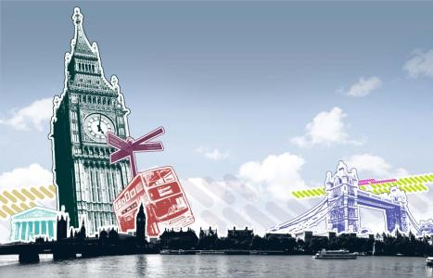
Module 5 Unit 2
----Using Language
Sightseeing in London

Slide 2
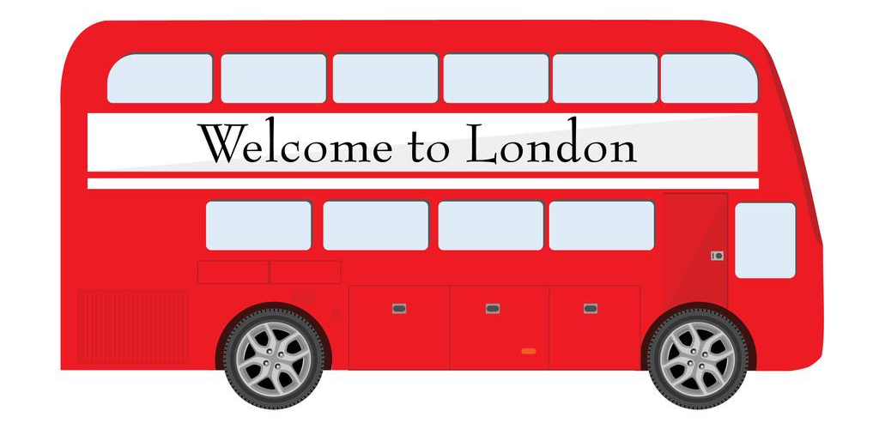
Learning objectives:
You are expected :
to expand the words and phrases about travel journal
to obtain the structure of a travel journal.
to get the idea of how to describe a travel.
to apply what’s been learned to writing a travel journal

Slide 3
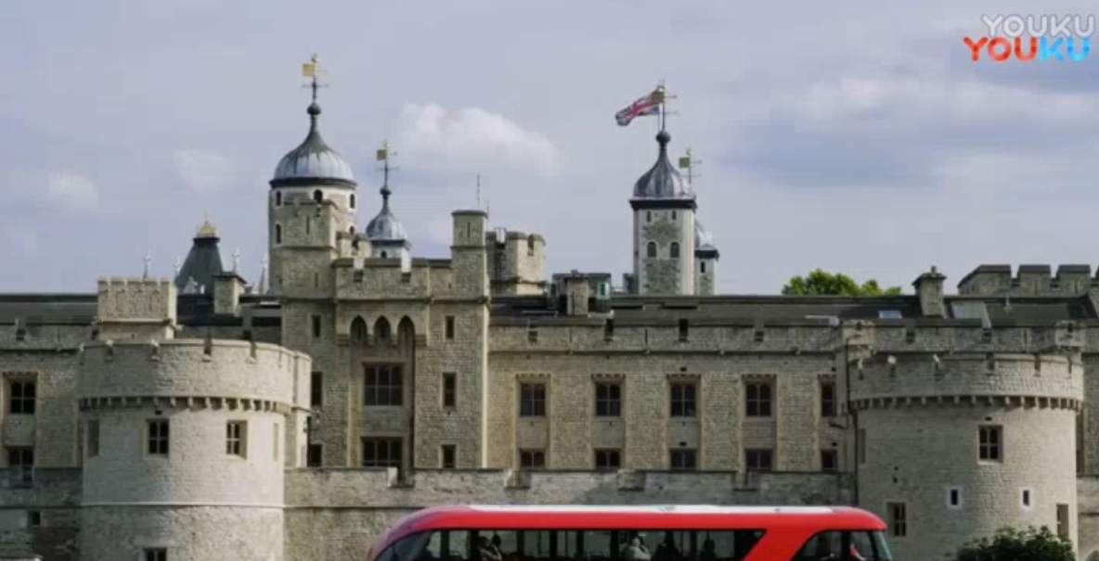
Warming up
The Tower of London

Slide 4
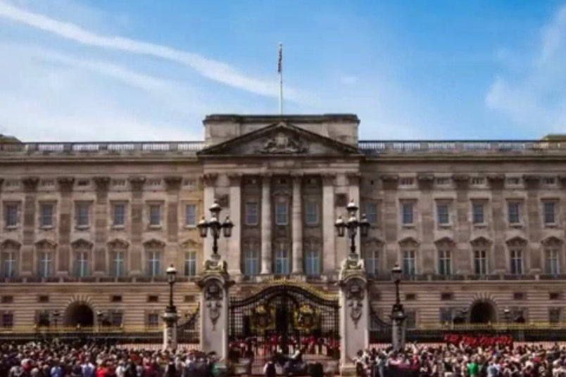
Warming up
Buckingham Palace

Slide 5
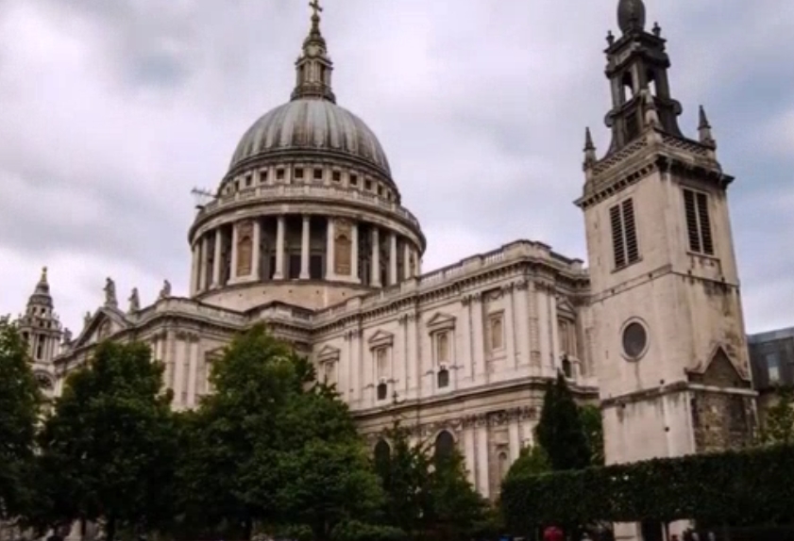
Warming up
St Paul's Cathedral
圣保罗大教堂

Slide 6
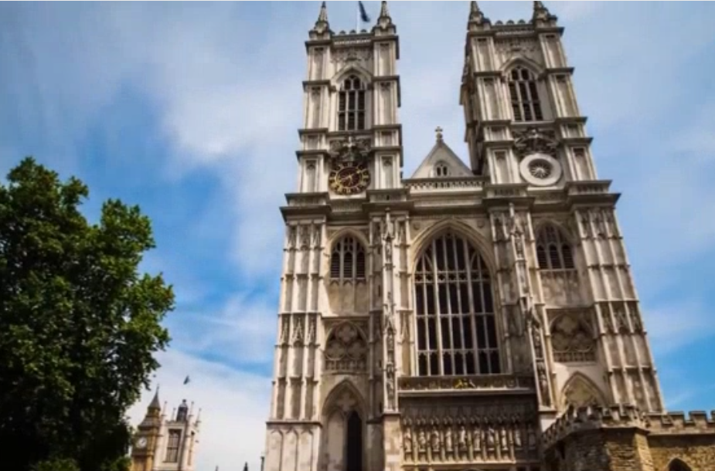
Warming up
Westminster Abbey
威斯敏斯特教堂

Slide 7
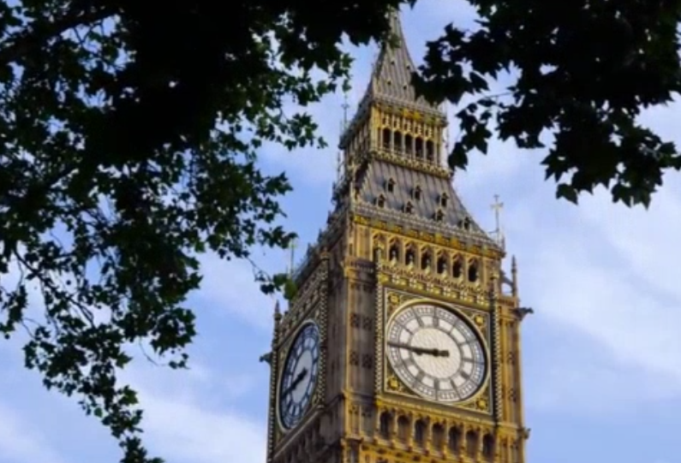
Warming up
Big Ben

Slide 8
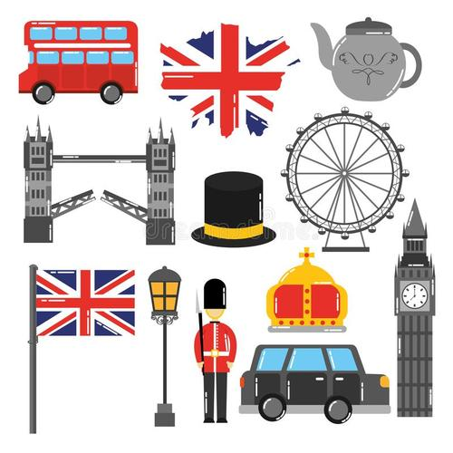
Skim the title
Sightseeing in London
Sightseeing
Which type of passage does it belong to?
a book review
an advertisement
a travel journal
a science report

Slide 9
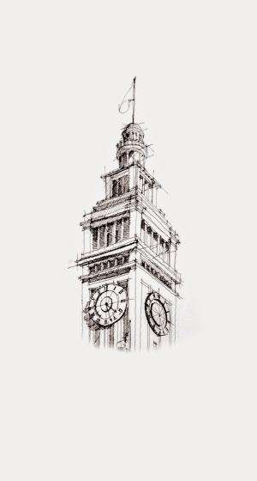
What aspects does a travel journal cover?
What can we get/ learn in a travel journal?
and other information
Where to go
When to go
Who to go
A travel journal
How to go
…
What to see

Slide 10
Skim for the general information
圈画关键词
（地名）
速度快
解决time order
追
How is this passage organized /arranged?
Who traveled in London?
Which sites did she visit in London?
How many days did she spend in London?
The whole passage
is in _____order.
(time , space)
time

Slide 11
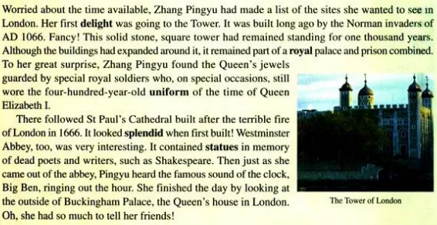

Activity 1: Skim for structure

Slide 12
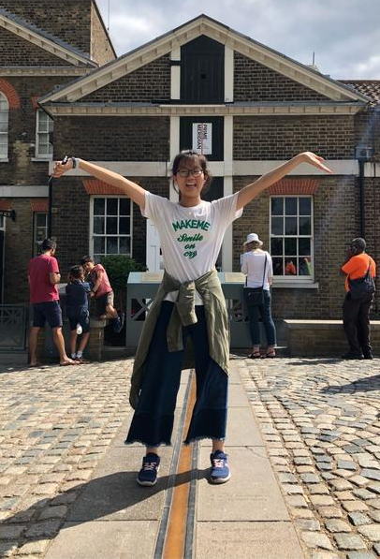

Activity 1: Skim for structure
Day 2: ( Para 3)
The sightseeing on Day 2 focuses more on _________
and why?
A. Feeling B. Outlook C. Highlight
Evidence:
What is the most attractive to tourists is
_________________ in Greenwich, and most people often
________________by _____________________
The site in P3 is described _______ ( in detail/ roughly)
C
an imaginary line
have photos taken
standing on either side of the line
in detail

Slide 13
Activity 1: Skim for structure
Day 3: ( Para 4)
The sightseeing on Day3 focuses more on _________
and why?
A. Feeling B. Outlook C. Highlight
Evidence:
Zhang Pingyu experienced a great changes in ________.
( )➔( )➔ ( )➔( )
Feeling
strange
sad
thrilled
proud

Slide 14
Activity 2: Expand the expressions
Words & Expressions Bank
Feeling | Description
delight
solid stone
fancy
remain standing
To sb’s surprise
find … done…
sb be thrilled by
have … done…
…
…

Slide 15
Activity 3 Read for the transitional sentences
过渡句
Her first delight was going to the Tower.
There followed St Paul’s Cathedral built after the terrible fire of London in 1666.
She finished the day by looking at the outside of Buckingham Palace.
The second day…
The last day…
The next day…

Slide 16
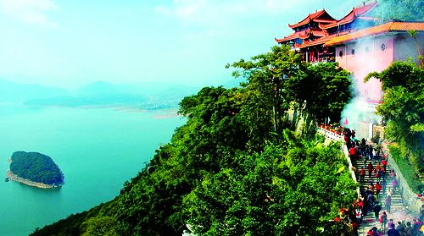
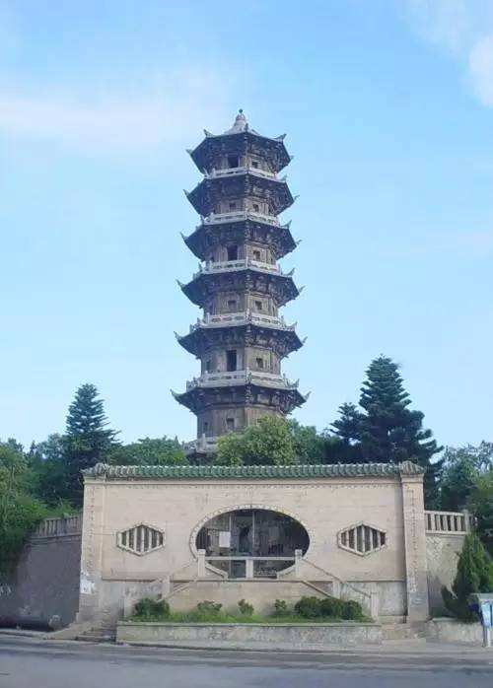

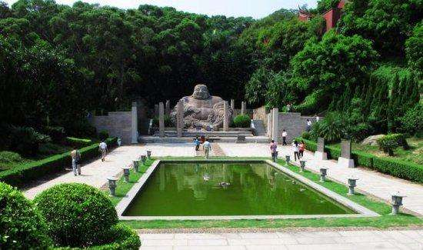
Activity 4：Write a travel journal

Slide 17

Activity 4：Write a travel journal
Write a passage about My Sightseeing In Fuqing .
The useful patterns:
What makes me … is…
it seems … that
have …done…
be …by …

Slide 18

Show Time

Slide 19
Homework: Continuous writing
The next day Pingyu would visit Windsor Castle. According to the above passage, continue to describe Pingyu’s rest journal. Visit the following website for more information. Remember to use the given words and make use of what you learned in this lesson.
The given words:
pity; dream; surprise; excitement, enjoyable
http://www.fjedu.cn/p/heyan
https://www.windsor.gov.uk/

Slide 20
Thank you for listening.

