Slide 1

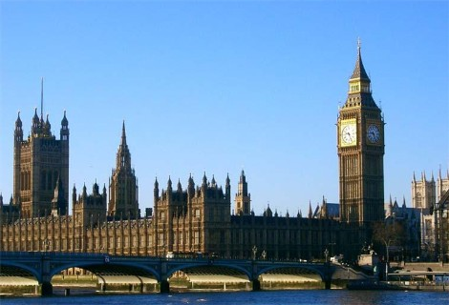
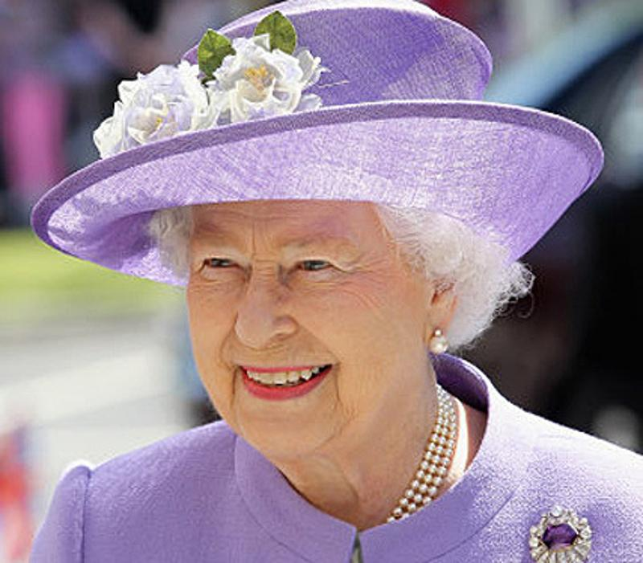
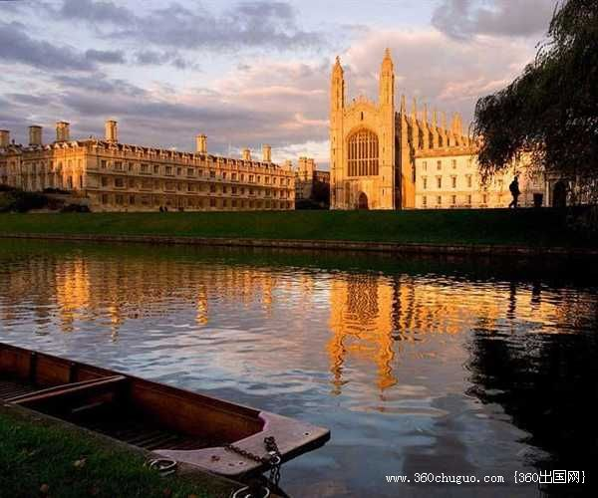
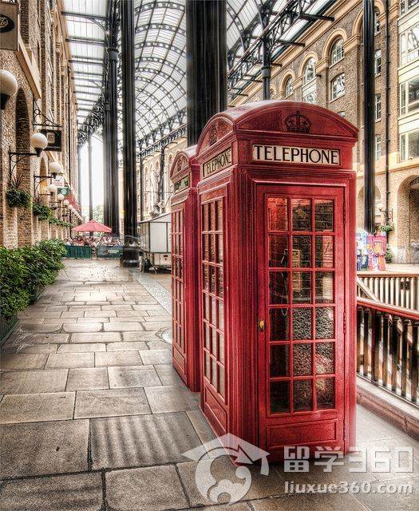
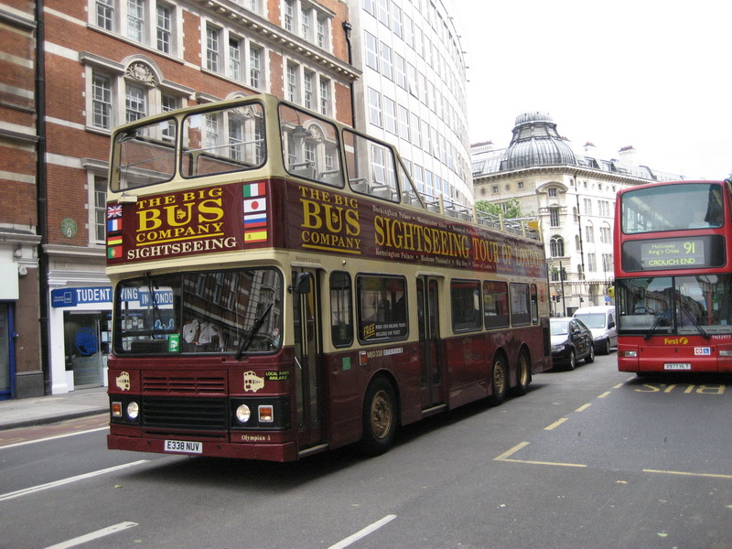
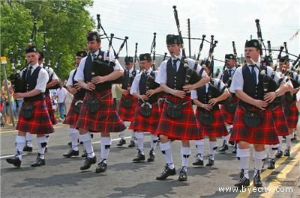
Module 5 Unit 2
The United Kingdom

Slide 2
写出下列单词的变化形式
1.联合；团结vt.&vi. ______; 团结的adj. ________; 联盟，协会，联合n. ______
2. 完成；达到；实现vt. ___________；成就；完成n. _______________
3. 方便；便利n. ___________；方便的；便利的adj.____________
4. 吸引，引起注意v.________；吸引人的，有吸引力的adj.__________； 吸引力，吸引人的事物n.__________
unite
united
union
accomplish
accomplishment
convenience
convenient
attract
attractive
attraction

Slide 3
写出下列单词的变化形式
5. 关系，联系，亲戚n._________; 相关，关联v.__________;相关的，关联的adj.___________; 关系，关联，人际关系n._____________
6. 描写；描述n. ____________；描述；描绘；形容vt.___________
7. 安排；筹备；整理vt. _________；安排n.____________
8. 快乐；高兴n. &使高兴；使欣喜vt. ________；_感到高兴的；欣喜的adj.__________；令人愉快的；可喜的adj.__________
relation
relative
relate
relationship
description
describe
arrange
arrangement
delight
delighted
delightful

Slide 4
写出下列单词的变化形式
9. 想象；猜想v. __________；想象力；幻想n. __________；可想象的adj._________；假想的；虚构的adj.________；富有想象力的adj. ___________
10. 一致的adj. _________；一致,并存，构成，在于v.______；一致(性) n. _________________
imagine
imagination
imaginable
imaginary
imaginative
consistent
consist
consistence/
consistency

Slide 5
写出下列单词的变化形式
11. ______ v. 划分；分开；除→________ adj. 有分歧的；分开的→_______ n. 分割；部门
12. _______ v. 澄清；阐明→___________ n. 澄清；说明；净化
13. ______ adj. 粗糙的，粗暴的→__________adv. 粗略地；粗糙地
14. __________ n. 收集；收藏品；珍藏→________vt. 收集→_________n. 收藏家
divide
divided
division
clarify
clarification
rough
roughly
collection
collect
collector

Slide 6
写出下列单词的变化形式
15. _________ adj. 不愿意的；不乐意的→______________n. 不愿意；不情愿→(反义词) ________adj. 乐意的；心甘情愿的
16. ________ n. 学会；协会→（对比）____________n. 制度；机制；公共机构
17. _________ n. 教育→___________adj. 教育的；有教育意义的→_____________n. 教育学家
unwilling
unwillingness
willing
institute
institution
education
educational
educationalist

Slide 7
写出下列词组
consist of
1. 由……组成_____________
2. 把……分成……
______________________________________
3. 摆脱(束缚)；脱离________________
4. 值得赞扬；在……名下_____________
5. 省去；遗漏；不考虑_____________
6. 代替__________________
7. (机器)损坏；破坏_____________
divide…into…(被动形式:be divided into)
break away (from)
to one’s credit
leave out
take the place of
break down

Slide 8
8. 让某人高兴的是________________
9. 为了方便起见___________________
10. 备有；提供有__________________
11. 与……争吵________________
12. 为某人安排某物___________________
13. 纪念；为了纪念_______________
14. 去……旅行；旅行到________________
to one’s delight
for convenience
be furnished with
quarrel with
arrange sth. for sb.
in memory of
make a trip to…
arrange to do sth. 安排做某事
make arrangements for 安排……；为……作安排

Slide 9
Key Sentences
1. ____ is a pity that the industrial cities ______ (build) in the nineteenth century do not attract ________ (visit). 很遗憾，19世纪建的工业城市没有吸引游客。(P10, L22)
2. Now ______ people refer to England you find Wales _________ (include) as well.
如今有人提起英格兰，你就会发现威尔士也是包括在内的。(P10, L5)
It
built
visitors
when
included

Slide 10
Key Sentences
built
3. It has the oldest port _____ by the Romans in the first century AD, the oldest building ______ by the Anglo-Saxons in the 1060s and the oldest castle ____________ by later Norman rulers in 1066.
它是公元一世纪由罗马人建造的最古老的港口，有盎格鲁-撒克逊人始建于11世纪60年代的最古老的建筑，还有公元1066年由后来的诺曼人统治者建造的最古老的城堡。 （P10， L27)
4. You must keep your eyes ______ if you are going to make your trip to the United Kingdom _________ and __________.
如果想使你的英国之旅不虚此行又有意义，你就必须留心观察。(P10, L40)
begun
constructed
open
enjoyable
worthwhile

Slide 11
Key Sentences
5. The temple looked splendid when first ______ (build). 寺庙刚建成的时候，看起来很壮观。(Para.2, P14)
6. It seemed strange ______ the man who _____________(develop) communism ______ have lived and died in London.这个发展了共产主义的人竟然在伦敦生活和去世，真是太奇怪了。（Para.4, P14）
built
that
had developed
should

Slide 12

Key Points

Slide 13
1. consist
1) A consist of B and C = A be made up of B and C=A be composed of B and C
A由B和C组成；
2) consist in = lie in
存在于；在于
3) A consist with B /A be consistent with B
A与B一致；符合

Slide 14
填空
(1) The wonder of the Forbidden City consists ____ its splendid construction.
(2) As we all know, theory should consist ____ practice.
(3) Do you know how many states the USA consists ____?
in
with
of

Slide 15
2. divide … into… /be divided into
把…分成…/ 被分割成…
separate …from…/ be separated from
把…分离 / 被...分离开
Nine divided by three is three. ( )
He divided his money among his five sons.( )
除
分配

Slide 16
填空
divided into
1. I _______ the cake ______ four parts.
2. The cake _____________ four parts (by me).
3. Let’s ___________ the good apples _____ the bad ones.
4. A group of six women and 23 children got ______________ the others.
was divided into
separate
from
separated from

Slide 17
3. break
break the rules
违反规定
break the world record
打破世界纪录
break away from
挣脱；脱离
break down
(机器)出故障；身体垮掉
break into
破门而入；闯入
break out
(战争，火灾) 爆发
break up
分解；结束；解散
break off
突然停止，暂停

Slide 18
填空
“Richard has to (1)________________ our team, because he (2)_________________.” His coach announced it in the media yesterday. Richard, who (3)_____________________ in 200-meter race in London Olympic Games, (4) ______________his training for frequent activities.
break away from
breaks the rules
broke the world record
had broken off

Slide 19
break down
His coach said he would (5)____________ sooner or later, if he kept drinking like that. “A war” between them(6) ____________ this morning. Richard was so angry that he (7)____________ the room, where there was meeting. Richard cut in, “It is time to (8)____________ the team, our coach is too strict. We need more freedom.”
broke out
broke into
break up

Slide 20
4. credit
to one’s credit
值得赞扬的是
credit sth. to sb./sth.
把……归功于……

Slide 21
4. credit n. 信用；赞扬；声誉
vt. 信任；把……归功于
(1) _____________(值得赞扬的是), the three sons of the poor farmer graduated from Beijing University.(=It is his credit that…)
To his credit
(2) He always _____________________ (把他的成功归功于) his teachers.
(3) I have no cash on me but I can pay it _________________ (用信用卡).
credits/owes his success to
by my credit card

Slide 22
5.convenience n.
___convenience 为…方便起见
___ sb’s convenience 在方便时
___ ___ convenient __ sb
在你方便的时候
convenien_ adj.
It is convenient for sb. to do sth.
某人方便做某事
for
at
It is to
t

Slide 23
2) Come and see me whenever ___ .
A. you are convenient
B. you will be convenient
C. it is convenient to you
D. it will be convenient to you
C

Slide 24
6. arrange (P13)
arrange to do sth.
安排做某事
make arrangements for
安排……；为……作安排
arrange sth. for sb
为某人安排某事

Slide 25
6. arrange vt. 筹备；安排；整理
(1) The girl __________________________ __________(安排上钢琴课) at the training center with her sister where she would stay for an hour.
was arranged to have piano
lessons
(2) The local newspaper ______________ ______________________________________________________(安排了对钟教授进行采访) .
(3) They______________________ (安排一个宴会) to celebrate their wedding anniversary last week.
made
arrangements for an interview with
Professor Zhong
arranged a dinner/feast

Slide 26
7. Place 短语
take place 发生；举行
take the place of 替代
in place 在适当的位置；适当的
in place of 代替……
out of place 地方放得不对；不适当
in the first/second place 首先，其次
take one’s place 就座;坐……的座位;取代某人

Slide 27
即时练习 用以上短语的适当形式填空。
(1) I am absent for some time, so I’ll invite another teacher to give you lessons ___________ me.
(2) It is ____________ for you to stare at others for so long.
(3) The manager is ill in hospital now, so we have no idea who _________________ in the coming conference.
in place of
out of place
will take his place

Slide 28
In the first place
(4) ________________, let us show our warm welcome to our American guests.
(5) We don’t know where and when the celebration will ___________.
(6) The arrangements are all _________ for the concert next Sunday.
(7)He is such a great leader that nobody can __________________him.
take place
in place
take the place of

Slide 29
Sentence structure

Slide 30
1.状语从句省略
当时间、地点、条件、让步、方式等状语从句与主句主语一致或从句主语是it, 且从句谓语动词含有be时，可以把从句主语和be动词一起省略。
⑴ 一旦形成, 坏习惯将很难改掉。
______________, the bad habits are
hard to get rid of .
⑵ 当被问到发生什么事, 他突然间哭了。
____________________________, he burst into tears.
Once formed
When asked what had happened

Slide 31
(3)如果不邀请我，我就不去参加聚会。
I won’t take part in the party unless invited.
(4)这座古老的建筑虽然建于300年前，但依然 完好的挺立着。
__________________________，the old building still stands up well.
Though built 300 years ago

Slide 32
2. It seemed/seems/is strange that sb. should do 某人竟然……, 这似乎不可思议
运用 根据汉语意思完成下列英语句子。
⑴ 他竟然能吃玻璃, 这似乎不可思议。
__________________ he should eat glass.
⑵ 真奇怪,他竟然考试不及格.
It seems strange that
It’s strange that he should fail the exam.

Slide 33
3. when … you will find …included as well 当……的时候, 你会发现……也包括在内。
仿写 根据汉语意思完成英文句子。
⑴ 当人们谈到我们班的高材生时, 你会发现汤姆也包括其中。
Now when people refer to the top students in our class, _____________ _______________________.
you will find
Tom included as well

Slide 34
(2) 当人们谈论到中国时, 你会发现台湾也包括在内。
When people refer to China, you’ll find Taiwan included as well.

Slide 35
翻译句子
这个博物馆的收藏品包括全世界的历史瑰宝。(consist of)
The collections of the museum consist of historical treasures from all over the world.
2. 值得称赞的是，史密斯先生愿意无私帮助我们完成计划。(to one’s credit)
To his credit, Mr. Smith selflessly offered to help us with the project / to help us (to) finish the project.

Slide 36
3. 为了图方便, 我把参考书放在书桌附近。
（for convenience）
I keep my reference books near my desk for convenience.
4. 她在单词“because”一词中漏掉了一个字母e。(leave out)
She left out an “e” in ‘because’.
5. 很遗憾我不能阐明我的立场。
(it’s a pity…clarify)
It’s a pity that I cannot clarify my position.

Slide 37
Unit 1
haracteristic
1. The main c_____________ of the strike has been its longevity.
2. By a__________ the parts of the sentence we learn more about English grammar.
3. She r________ what she had said to make herself understood.
4. He never considers the possibility of d_________. He is confident enough.
5. The meeting is so boring that nobody wants to a___________ it.
nalyzing
epeated
efeat
ttend

Slide 38
6. He became inspired when he thought about helping ordinary people e________ to cholera.
7. He was treated well, so he is c_______ now.
8. He got so angry that he lost c________ of himself.
9. Clever children a_________ knowledge easily.
10.She is s________ with her children because she wants them to go to their dream universities.
xposed
ured
ontrol
bsorb
trict
trict

Slide 39
Unit 2
consisting
of
1.Have you heard of this club _______ ______ more than 200 members?
2.We should _____ _______ ______ the old traditional ideas and build up new ones.
3.They will go to Beijing by plane _______ _______ _______ by train.
4. After the accident, who do you think will _______ _______ _____ _____ Susan?
5.Can you c_________ what you said just now?
6.This was the only room a________.
7.What a________ me most to the job was the chance to travel.
break away from
in
place of
take the place of
larify
vailable
ttracted

Slide 40
nfluence
8.Watching too much TV has a bad i_________ on our health.
9.To the d________ of his parents, he has made a full recovery.
10. Our class is d_______ into two groups for the discussion.
11. R_______ speaking, I would say that about 100 people attended the exhibit.
12. The habit of c___________ stamp benefits him a lot.
13. Our company will a________ transport to your apartment.
14. He gave a ___________（描述）of what he had seen.
elight
ivided
oughly
ollecting
rrange
description

Slide 41
15.我对此问题大惑不解.
16.我已安排一辆小车去车站接她了.
17.我们将在哪里开会没有任何区别.
18.他竟然考试作弊,真是遗憾.
I was puzzled by the question.
I have arranged a car to pick her up
at the station.
Where we shall have the meeting
makes no difference.
It was a pity / shame that he
should have cheated in the exam.

Slide 42
19.这座城市的诱人之处是难以抗拒的.
20. 有你住在我们隔壁，极为方便。
21.人们为演出成功 而称赞苏珊.
The attractions of this city are difficult to resist.
It's a great convenience to have you live
next door to us.
People gave Susan credit for the success
of the show.

Slide 43
M4U5
1. 主题（曲）theme 11. 中心的 central
2. 各种各样的 various 12. 无论哪一个whichever
3. 幻想 fantasy 13. 娱乐活动 amusement
4. 旅游业 tourism 14. 独一无二的unique
5. 保存 preserve 15. 长度length
6. 移民者 settler 16. 运动的athletic
7.译员 translator 17. 少数(民族) minority

Slide 44
8. 纪念品 souvenir 18. 牌子brand
9. 动物 creature 19. 高速公路freeway
10. 先进的 advanced 20. 丛林jungle
21. 以…而闻名 be famous for
22. 难怪no wonder
23. 根据…模仿be modelled after
24. 提前in advance
25. 接近… get close to
26. 活跃起来come to life

Slide 45
1. Everybody present was amused at the little child’s words.
2. I often go hiking because I like getting close to nature.
3. Prices vary according to the quality of goods.
4. The school came to life again as the new term began.
5.To find a new cure for the disease, he made a lot of experiments.

Slide 46
6. There are more and more countries applying for admission to the European Union.
7. I should warn you in advance that the train might be late.
8. He is more than our teacher; he is also our friend.
9. Only a small minority of students is/ are interested in politics.
10.We should take part in athletic sports to build up our body.

Slide 47
Unit 1 Module 5
1.特征
2.谨慎的；小心的
3.出席；参加；护理
4.控制
5.吸收；使专心
6.贵重的；有价值的
7.责备；谴责
8.怀疑；嫌疑犯
9.宣布；宣告
10.命令；指示
1. characteristic
2. cautious
3. attend
4. control
5. absorb
6. valuable
7. blame
8. suspect
9. announce
10. instruct

Slide 48
11.私下地；秘密地
12.热情的
13.分析
14.战胜
15.剧烈的；严厉的
16.肯定的；积极地
11. privately
12. enthusiastic
13. analyse
14. defeat
15. severe
16. positive

Slide 49
17. put forward
18. draw/make a conclusion
19. apart from
20.be strict with/in sb/sth
21. lead to
22. make sense
23. link…..to
短语
17.提出
18.得出结论
19.除…..之外
20.对….严格
21.通向导致
22. 有意义
23.把…和….连接起来

Slide 50
C to E
1. 她说话带着特有的热情。
She spoke with characteristic enthusiasm.
2. 我们英语老师要考查我们一 年以来学过的知识。
Our English teacher will examine us in/on everything that we have learned this year.
3. 我们可以从实验中得出一个结论。
We can draw a conclusion from the experiment.

Slide 51
4.当母亲不 在家的时候，我就必须得照顾我的弟弟。
I must attend my brother when my mother is not at home.
5. 冰淇淋不可以被强烈的阳光照射。
Ice cream can’t be exposed to strong sunlight.
6. 四周的 小城镇已并入这座城市。
The surrounding small towns have been absorbed into the city.

Slide 52
7. 秘书比老板更应多负责任。
The secretary was more to blame than the boss.
8. 众所周知，这位科学家已经为世界做出了 重要的贡献。
As we all know, the scientist has made great contributions to the world.

Slide 53
9. 当理论第一次提出时，大多数人不大接受。
Most people didn’t accept the theory when it was put forward.
10. 这个故事太令人兴奋了 ，兴奋的 孩子们整夜都不能入睡。
The story was so exciting that the excited children couldn’t fall asleep all night.

Slide 54
U2 Module 5
根据中文写出相应的单词或词组
1省，行政区 n province
2矛盾，冲突 n conflict
3制度，机制 n institution
4便利，方便 n convenience
5全国性的 adj nationwide
6澄清，阐明 v clarify
7描写，描述 n description
8争吵，争论 v&n quarrel
9虚构的 adj imaginary
10．错误，过失 n error

Slide 55
11. 一致的 adj consistent
12. 带家具的 adj furnished
13. 观光，旅游 n. sightseeing
14. 由…组成 consist of
15. 把…分成 divide…into
16. 值得赞扬 to one’s credit
17. 省去，遗漏 leave out
18. 代替 take the place of
19. 损坏，破坏 break down
20. 挣脱 break away from

Slide 56
C to E
1.联合国组织由一百六十多个国家组成
The United Nations Organization
consists of over 160 nations.
2.你的行为和你所说的不一致
Your behavior is not consistent with what you say.
3.她受过良好的教育。
She was well-educated.
She received good/decent education.

Slide 57
4.方便的时候,请随时来。
Please come whenever it is convenient for you.
5.那个花园城市吸引许多游客。
The garden city attracts many tourists.
6.过去侦探小说对我特别有吸引力。
Detective novels
used to be a special attraction for me.
7.语言难以描述那景色之美丽。
Words cannot describe the beauty of the scene.

Slide 58
8.我感到很震惊他竟然把那个人杀了
I am shocked that
he should have killed the man.
9.此行证明是值得的。
It proved worthwhile to make the trip.
The trip proved (to be) worthwhile.
10. 母亲反对说,吉米身体虚弱,不可承担那份工作
Mother objected that
Jimmy was too weak to
take up the job.

