Slide 1

Unit 1 Making friends
Grammar

Slide 2
目录
Lead-in
1
While-Learning
2
Post-Learning
3
Review
4

Slide 3
Part I Lead-in

Slide 4

观察这些句子
1. Who is that pretty girl?
2. Where are Jack and Tom?
3. How do you go to school?
4. Which is your book?
5. Whose ball is this?
6. Why are you late?

Slide 5
Part II While-Learning

Slide 6

Grammar A
Wh-questions

Slide 7
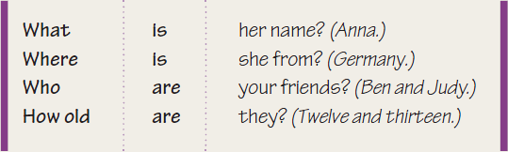

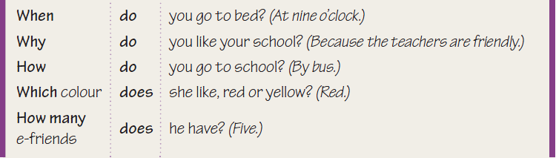
A Wh-questions
We use Wh-questions to ask for information about someone or something.

Slide 8
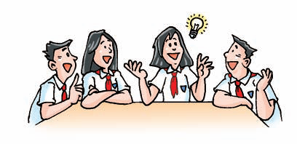
Work out the rule
1. We can make Wh-questions with Wh-words and the verb to be
(e.g. am, ______ and ______.)
2. We use _______ or ______ to make
Wh-questions with other verbs.
is
are
do
does

Slide 9
Summary
Wh-questions特殊疑问句
特殊疑问句是指以 Wh- （How）等特殊疑问词开头，对陈述句中某一部分提问的句子。回答时不用Yes/No,而是用一个句子或短语回答。

Slide 10
结构：特殊疑问词+一般疑问句
1.在特殊疑问词与be动词构成的特殊疑问句的结构中，特殊疑问词在句中充当表语成分。
她叫什么名字？
What is her name?
特殊疑问词
一般疑问句
句子中有be动词"is"，特殊疑问词后用Be动词构成疑问语序。

Slide 11
结构：特殊疑问词+一般疑问句
2. 特殊疑问词与实义动词构成的特殊疑问句要借助于助动词来提问，
你什么时候上学？
When do you go to school?
特殊疑问词
一般疑问句
句子中有实义动词"go"，特殊疑问词后用助动词do构成疑问语序。

Slide 12
特殊疑问句的回答：
特殊疑问句不能用yes或no来回答，要根据实际情况来回答。如：
— How many people are there in your family?
— Where did you go last Sunday?
—There are five / Five.
—To the park.

Slide 13
常考特殊疑问词
特殊疑问词 | 意思 | 对…提问
what |  | 东西
which |  | 选择
when |  | 时间
who |  | 人
whose |  | 某人的东西(所属)
where |  | 地点
why |  | 原因
how |  | 方式，方法
什么
哪一个
什么时候
谁
谁的
在哪里
为什么
怎么样

Slide 14
which＆what
which：从已知或有限范围内的人或事物作出选择
what：从未知或无限范围内的人或事物作出选择
父母中，哪个更疼你？
Which parent loves you better?
你的帽子是哪种颜色的——红的、绿的或黄的？
Which color is your cap, red, green or yellow?
这朵花儿是什么颜色的？
What color is the flower?

Slide 15
Jason gets an email from a new e-friend. Mandy is asking Jason some questions.
Jason: I got an email from a boy called Bruce.
Mandy: (1)________ does he live?
Jason: He lives in Australia.
Mandy: (2)________ is he?
Jason: He's 12.
Mandy: (3)________ does he go to school?
Jason: He goes to school by bus.
Where
How old
How

Slide 16
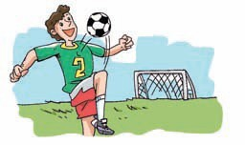
Mandy: (4)________ are his hobbies?
Jaon: Swimming and playing football. He
likes an English football team.
Mandy: There are many English
football teams. (5)________
team does he like?
Jason: Liverpool.
What
Which

Slide 17
Fill in the blanks with "what, who, how, how old, which, why, where, how many, when".
1. --_______ is her name? -Anna.
2. --_______ is she from? -Germany.
3. --_______ are your friends? -Ben and Judy.
4. --_______ are they? -Twelve and thirteen.
5. --_______ do you go to bed? -At nine o'clock.
6. --_______ do you like your school?
--Because the teachers are friendly.
7. --_______ do you go to school? -By bus.
8. --_______ colour does she like? -Red.
9. --_________ e-friends does he have? -Five.
What
Where
Who
How old
When
Why
How
Which
How many

Slide 18

Grammar B
The articles：a and an

Slide 19
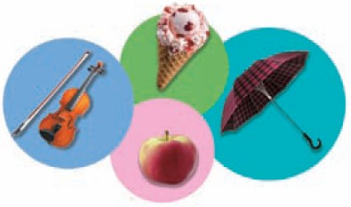
Indefinite articles: a and an
a
_____ boy _____ teacher
_____ computer _____ unit
_____ football team _____ violin
_____ apple _____ ice cream
_____ egg _____ old book
_____ hour _____ umbrella
a
a
a
a
a
an
an
an
an
an
an

Slide 20
Work out the rule:
1. If a noun starts with a consonant sound,
we use _______ before it.
2. If a noun starts with a vowel sound,
we use _______ before it.
a
an

Slide 21
Summary
Indefinite articles: a and an
不定冠词a和an
a和an是不定冠词，仅用在单数可数名词前面，表示"一"的意义。a用在以辅音（指辅音音素）开头的词前，an用在以元音（指元音音素）开头的词前。如a book；an apple。

Slide 22
a/an用法分析
开头 | a/an | 举例
辅音音素 | a | 一本书
元音音素 | an | 一个苹果
u | ['juː] a | 一个单元
 | [ʌ] an | 一把雨伞
h | 一般情况 a | 一个快乐的男孩
 | h不发音 an | 一个小时 一个诚实的男孩
字母在引号之中 | 根据字母的发音 | 一个"f" 一个"d"
a book
an apple
a unit
an umbrella
a happy boy
an hour
an honest boy
an "f"
a "d"

Slide 23
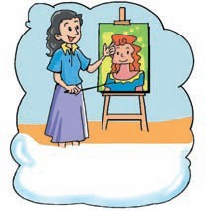

B1 Some students are talking about their dreams. Complete the sentences below with a or an.
My dream is to
be _____ scientist.
My dream is to be
_____ Art teacher.
a
an

Slide 24
I want to be _____
actor in films.
an
I want to be
_____ engineer.
an

Slide 25
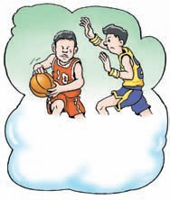
My dream is to be
____ basketball star.
I want to be _____
nurse.
a
a

Slide 26
常见职业名称
actor 男演员
actress 女演员
artist 艺术家
bank clerk 银行职员
cleaner 清洁工人
cook 厨师
dancer 舞蹈家
dentist 牙医
doctor 医生
driver 司机
engineer 工程师
farmer 农民
firefighter 消防员
football player 足球运动员
manager 经理
nurse 护士
painter 画家
pilot 飞行员
policeman 男警察
policewoman 女警察
postman 邮递员
reporter 记者
secretary 秘书
shop assistant 售货员
singer 歌手
teacher 教师
waiter 男招待
waitress 女招待
worker 工人

Slide 27
B2 What do you want to be? In groups, discuss this with your classmates.
S1: What do you want to be?
S2: My dream is to be a(n) ... / I want to be a(n) ...
Students' names
Their dreams

Slide 28
Part III Post-Learning

Slide 29
Preparing the interview
If you are a reporter of the school newspaper, you are going to interview a new student from the US. What questions do you want to ask him?
Question 1
Question 2
Question 3
Question 4
Question 5

Slide 30
Part IV Review

Slide 31
一. 用所给词的适当形式填空。
1. How old _____ the little girl? (be)
2. How ______ you? (be)
3. Where ______ Mike from? (be)
4. Where ______ Mike _____ from? (come)
5. How many friends _____ they _____? (have)
6. Which colour _____ he _____? (like)
7. When _____ you _____ to school? (go)
is
are
is
does come
do have
does like
do go

Slide 32
二. 根据划线部分内容将下列陈述句转换为特殊疑问句。
1. They are violins.
→ What are they?
2. Li Lei is Amy's best friend.
→ Who is Amy's best friend?
3. Tom goes to school on foot every day.
→ How does Tom go to school every day?
4. Sarah is going to Hong Kong next month.
→ Where is Sarah going to next month?

Slide 33
三. 用适当的特殊疑问词填空。
1. -- _____ class are you in, Class One or Class Two?
--Class Two.
2. -- _____ do you usually go to school?
-- On foot.
3. -- _____ does the housework in your family?
-- My mother.
4. -- _____ people are there in the room?
-- There are three.
5. -- _____ do you want to be a teacher in the future?
-- Because I like to stay with children.
6. -- _____ car is this?
-- It's Joan's.
Which
How
Who
How many
Why
Whose

Slide 34

四. 选用a或an填空。
1. Is it _____ Chinese book or _____ English book?
2. That is _____ ID card.
3. There is _____"l" in the word "luck".
4. My father often says, "To be _____ honest
boy today and _____ useful man tomorrow."
a
an
an
an
an
a

Slide 35
Thank you!

