Slide 1
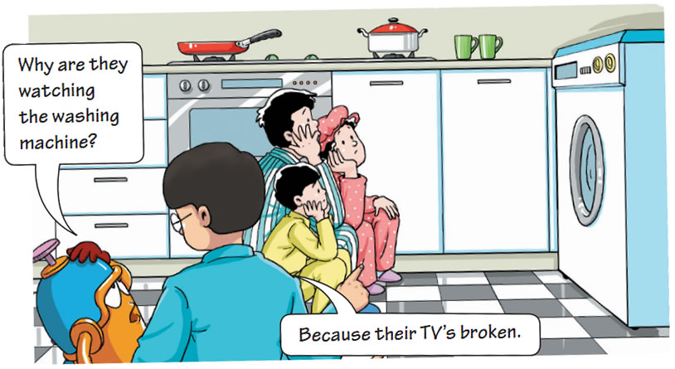
Getting ready
Look at the cartoon and answer the questions.
What are the family doing?
Why are they doing that?
What does this cartoon imply?
It implies that TVs are important
in people’s daily lives.

Slide 2
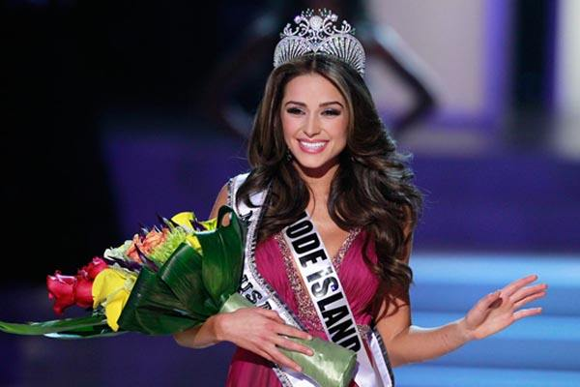
Brainstorm the question below.
What is your favourite TV programme?
beauty contest 选美比赛

Slide 3
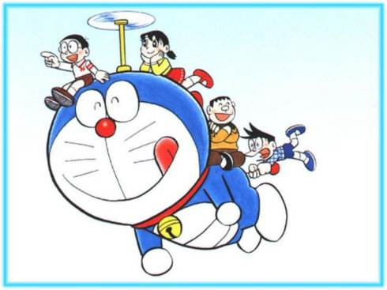
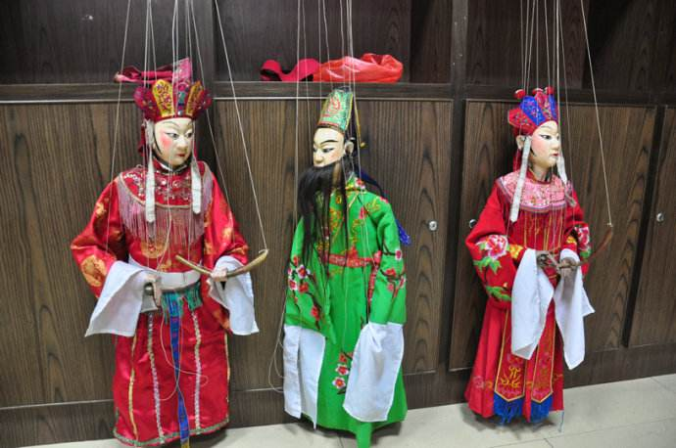
What is your favourite TV programme?
puppet show
木偶剧
cartoon
卡通片

Slide 4
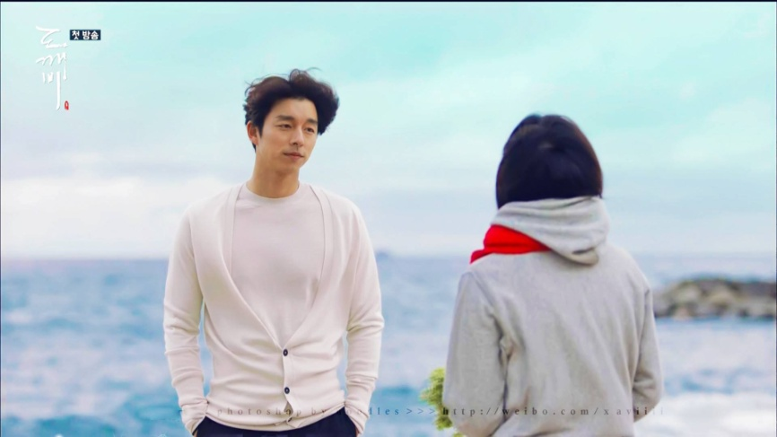
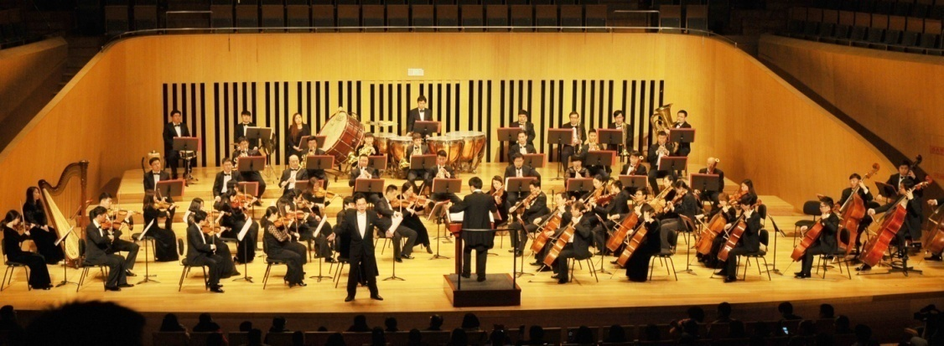
What is your favourite TV programme?
romantic drama
浪漫剧
concert
音乐会

Slide 5
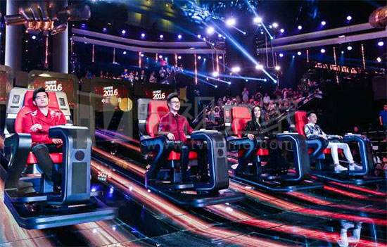
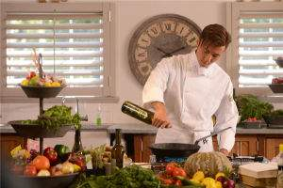
What is your favourite TV programme?
singing contest
歌唱比赛
cookery programme
烹饪节目

Slide 6
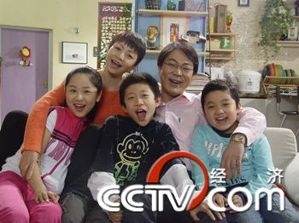
What is your favourite TV programme?
sitcom(situation comedy)
情景喜剧

Slide 7
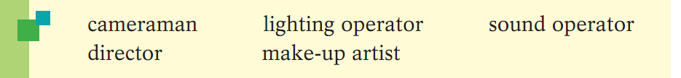
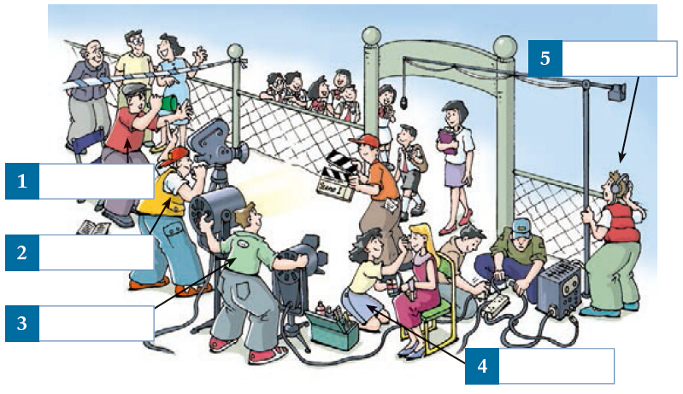
What do you know about …?
The picture below shows the filming of a TV programme. Write the words in the correct boxes.
sound operator
director
cameraman
lighting operator
make-up artist

Slide 8
Before you read
Look at the picture and the title of the article on page 67. Then answer the questions below.
a
1.What type of programme are the people making at the TV studio?
a A quiz show. b A travel show. c A talent show.
2.What is the name of the programme?
3.What surprising thing is happening in the picture?
a A woman is crying. b A woman has passed out.
c A woman has won the quiz.
b

Slide 9
Read lines 1 to 12 of the story.
"Five minutes to go," shouted the director. "Is everyone
ready? "I'm glad that I'm not one of the contestants!"
Denise said. "I'm not that brave. "Oh, I'd love to be a
contestant," said Angela. The three contestants were
sitting at their desks on the stage and waiting. The hot
lights were shining down upon them. Suddenly one of
them passed out and fell across her desk.

Slide 10
Fill in the blanks.
Denise and Angela were at the TV ______. They were in the audience. The Travel Quiz was about to begin. The _______ was checking if everything was OK. The _________ were sitting on the stage. The two big lights were shining down upon them. It was very hot. Suddenly, one of them felt sick and ____________.
studio
director
contestants
passed out

Slide 11
I. Skim the story. Then complete the diagram below.
Setting:
______
Characters:
___________
at the studio
Denise, Angela
The elements of the story
Plot:

Slide 12
Setting:
________
Characters: ___________
at the studio
The elements of the story
Denise, Angela
Plot:
1–7
Opening (Lines _____ ) : Angela and Denise took part in ____________________ .
• Rising action (Lines ____ ) : One of the contestants _______________.
• Turning point (Lines _____ ) : Angela_______________.
• Falling action (Lines _____ ) : Angela answered all the questions _________ and ___________ the other two contestants.
• Ending (Lines ______ ) : Angela ____________ .
a TV programme
8–14
passed out
replaced the
contestant
15–24
25–44
correctly
was ahead of
45–51
won the prize

