Slide 1
1. About《 The Gifts of Magi》, What do you think of them?
2. Girls: If you were Della, what would you do for Chirstmas?
Boys: If you were Jim, what would you do for Christmas?

Slide 2
9AU8 Listening
Learning From The Great

Slide 3
Introduction of a person
The young boy was born in ....
In ..., he ....
....
....
....
Today, he....
He was born in the 1970s
In 1990s, He studied in a University in Guangzhou.
From 2001 to now, he was always the teacher of Junior 3 in ......
The man was Lu Zhishen.
...
...
...
...

Slide 4
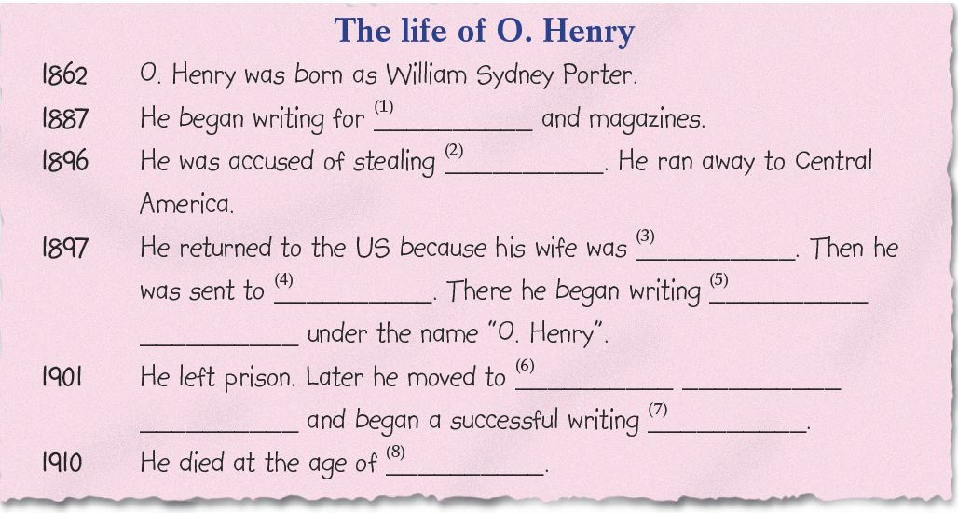

3-1. Listen and fill in the blanks
newspapers
money
dying
prison
short
stories
New York
City
career
47

Slide 5
3-2. Complete the passage
newspapers
money
dying
prison
short
stories
New York
City
career
47

Slide 6

The life of O.Henry
O. Henry was born in 1862 in the US as William Sydney Porter.
When he was 25, he first began writing for newspapers and magazines to support his wife and daughter.
In 1896, he was accused of stealing money. Afraid of going to prison, he ran away to Central America.
When he was in Central America, he found out that his wife was dying, so he returned to the US in 1897 and was sent to prison. In prison, he began writing short stories to support his daughter, he wrote under the names of O. Henry.
After leaving prison, he moved to New York City and began a successful writing career.
O. Henry died at the age of 47 in 1910. Today, he’s remembered as one of the writers who invented the short story.

Slide 7
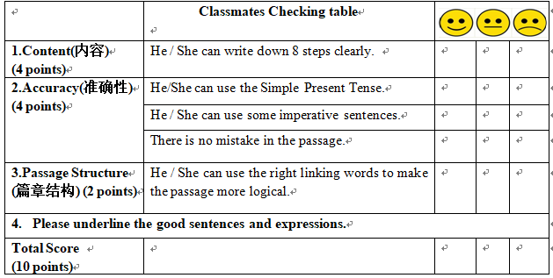
4-2. Assessment
What do you think of the retelling?
1. It includes all the given key information.
2. He uses the past tense.
3. He pronounces the words correctly
4. He speaks fluently

Slide 8
Mark Twain
Mark Twain was born in 1835 in the USA.
When he was just 12 years old, his father died .
And he then went to work to help support his family. Then he started working as a writer for a newspaper.
In 1865, he wrote a story about a jumping frog. The story and the writer became famous. Mark Twain died in 1910.
He is one of the greatest writers in American history.

Slide 9
4-3 Discussion
What do you think of their childhood?
How could they be successful?
What can you learn from the great men?

Slide 10
Never give up,
and you will be successful !
Together, we’ll stand
hand in hand, we will get there !

