Slide 1


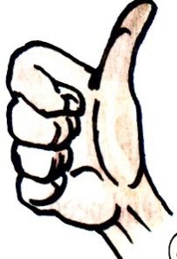
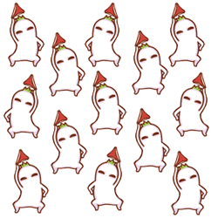

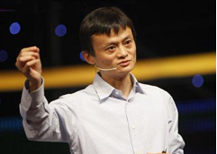
Module 1 Social communication
Unit 2 Body language
Grammar:
Gerunds
动名词

Slide 2
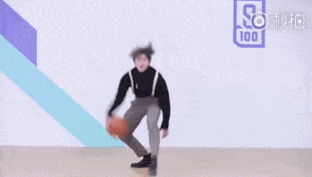
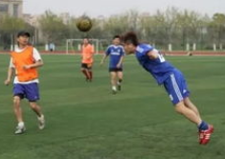
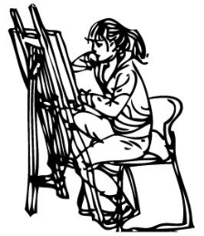
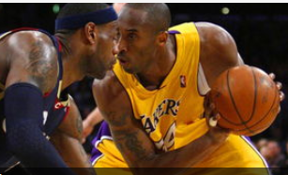
Free talk
1. Cai Xukun is good at dancing.
Dancing is his favourite hobby.
2.Cai Xukun is good at singing.
Singing is also his favourite hobby.
3.Cai Xukun is not good at playing basketball.
Playing basketball is not his favourite hobby.
4. What's his/her favourite hobby in our class?
________ is his/her favourite hobby in our class.

Slide 3

Exercise : Group work
make sentences with Gerunds used as subjects.
_________is not allowed(不被允许) in our school.
_________makes a teacher popular with students.
__________helps us improve our English.
_________shows that I am a good boy (a good girl).

Slide 4
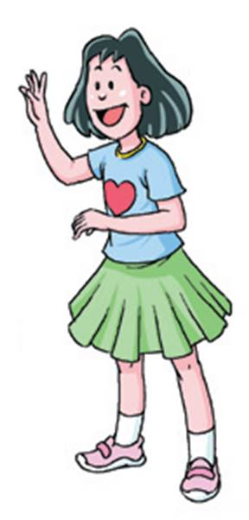
Gerunds
动名词 doing
动名词是由动词+ing 而变成的表示有动作和活动意义的名词。
1. Gerunds are _____________.
2. We usually form (构成) a gerund by adding
__________ to a __________.
3. Gerunds refer to (指的是）___________ and
_____________.
nouns (名词)
ing
verb (动词)
actions
activities

Slide 5
Part 1 ：The rules of forming gerunds
Verb | Gerund | Examples
英语重读闭音节是指在一个音节中，以辅音音素结尾而且是重读音节的音节。重读闭音节中元音字母不是发它本身的字母音，而是发短元音。
sigh-sighing
hold-holding
大部分动词
直接+ing
dance-dancing
joke-joking
大部分以字母e结尾的单词
去e+ing
双写最后的辅音字母+ing
begin-beginning
sit-sitting
以重读闭音节结尾的单词
die-dying
lie-lying
tie-tying
把 ie 变成y再+ing
以 ie 结尾的单词

Slide 6
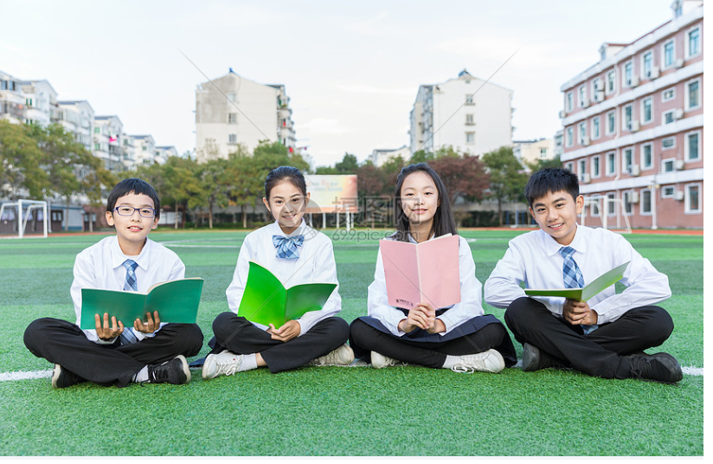
Play a game
Each student writes down at least three words of the rules above, then show them in groups.

Slide 7

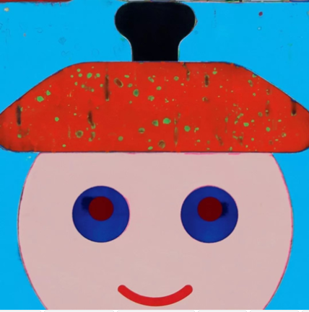
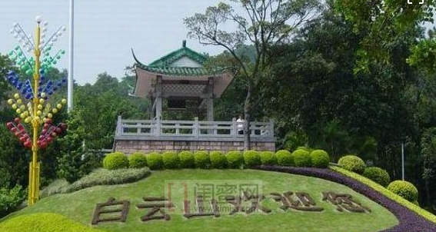
动名词的用法：
一. Gerunds as subjects(动名词作主语)，表示概念、习惯或者经验。
Smiling shows that you are happy.
Singing is our maths teacher's hobby.
Dacing and playing basketball are my favourite hobbies.
Climbing Baiyun Mountains is really fun
动名词作主语，主语是单数，谓语动词一般用第三人称单数形式。 两个或两个以上不同的动名词作主语，主语是复数。

Slide 8
Fill in the blanks with the proper forms.
Reading （read）books makes (make) one wise.
Collecting (collect) stamps is _(be) interesting.
Walking (walk) is__(be)a good form of exercise for both young and old.
Planting (plant) flowers needs (need) constant watering.
Sighing(sigh) usually means (mean) the person is unhappy.

Slide 9

Practise in pairs
Ask some students to show the talent, for example, handwriting, playing chess, running, playing computer, then the other students practise:
A: What is his/her hobby?
B: Doing is his /her hobby.

Slide 10
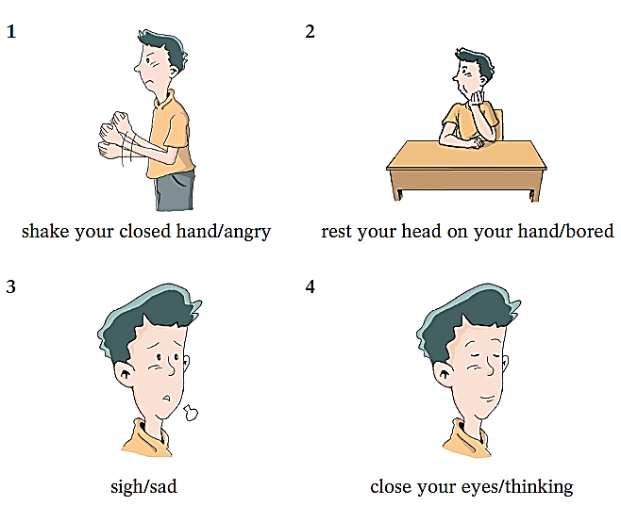
Practise in pairs on P24 , ask and answer questions about the pictures. Follow the example.
S1: What can shaking your closed hand show?
S2: Shaking your closed hand can show that you’re angry.
S1: What can resting your head on your hand show?
S2: Resting your head on your hand can show that you’re bored.

Slide 11
S1: What can sighing show?
S2: Sighing can show that you’re sad.
S1: What can closing your eyes show?
S2: Closing your eyes can show that you’re thinking.

Slide 12
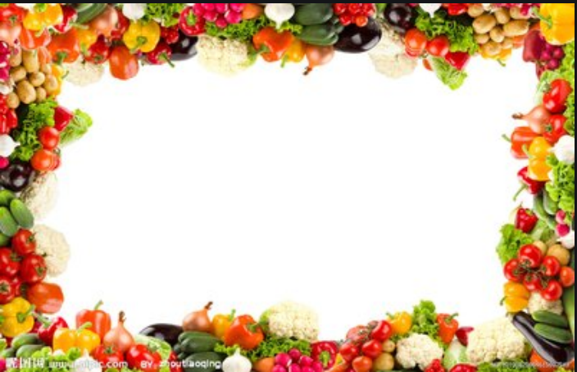
拓展
动名词作主语与不定式作主语的区别：
动名词作主语表示概念、习惯或者经验，指抽象的或泛指的行为。
Playing football in the street is very dangerous (泛指踢球)
不定式作主语表示未完成的事，指具体的动作或行为。
To play football in the street will be dangerous （具体踢球动作）
当表语是动名词时，主语也要用动名词；
当表语是不定式时，主语也要用不定式，也就是说平衡原则。
如： Seeing is believing.
To see is to believe.

Slide 13

二、Gerunds as objects (动名词作宾语)
1．作动词的宾语 V+doing sth
某些动词后出现非限定性动词时只能用动名词作宾语，不能用不定式。常见的此类动词有：
admit doing 承认
allow doing 允许 avoid doing避免
consider doing 考虑 deny doing否认
enjoy = like = love doing 享有,喜爱
finish doing 完成 keep doing 保持,坚持
imagine doing 设想 mind doing 介意
suggest doing 建议 practise doing练习,实践
prevent doing 阻止

Slide 14

2. 介词Prep. +v-ing: for/ at/of/ in/ on/ from/about …
3. 常见的“动词＋介词+动名词”的短语有：
prefer doing A to doing B 比起做B来说更喜欢做A
be used to doing sth 习惯做某事
look forward to doing 渴望做某事
feel like doing 想做某事 give up doing 放弃做某事
keep on doing 继续做某事
be busy doing sth 忙于做某事
be worth doing sth 值得做某事
4. 拓展:
It’s no use doing sth 做某事没有用。
It’s no good doing sth. 做某事没有好处。

Slide 15

拓展
有些动词 (continue 继续， prefer 更喜欢，begin开始，hate讨厌，憎恨，like喜欢，start开始，love喜爱)后面既可以接不定式作宾语，也可以接动名词作宾语，意义差别不大。通常认为用动名词泛指一般的倾向性，用不定式则表示特定或具体某一种动作。

Slide 16
拓展与复习：下列单词既可以接动词不定式也可以接动名词作宾语，但意思相差较大。
go on | to do | 做了一件事后，接着做另一件事 | After we jump rope, we go on to run during the 30-minute break every day .每天在30分钟的大课间，我们跳完绳后，接着继续跑步。
 | doing | 继续或不间断地做同一件事 | Though they were so tired, they went on working late . 尽管他们很累，但是他们继续工作到很晚。

Slide 17
stop | to do | 停止，中断做某事后去做另一件事 | Let’s stop to have a rest because we work for a long time.因为工作很长一段时间了，让我们停下来休息。
 | doing | 停止做某事 | Stop talking, and listen to the teacher. 别讲话，听老师讲。
forget | to do | 忘记要去做某事 | Tim forgot to hand in his homework, so he must be left. Tim 忘记交作业了，所以要留堂。（没有做交作业的动作）
 | doing | 忘记做过某事 | He forgot returning the money to his friend. 他忘记还过钱给朋友了。（已做过还钱的动作）

Slide 18
remember | to do | 记得去做某事 | Remember to visit your grandparents after school. 记着放学后去看望爷爷奶奶。
 | doing | 记得做过某事 | I remember seeing the man before in school. 我记得以前在学校见过这个人。
try | to do | 努力，企图做某事 | We should try to achieve our dream. 我们尽力去实现我们的梦想。
 | doing | 尝试着做某事 | I tried a new way to solve the maths problem yesterday. 我昨天尝试了一种新方法去解决这个数学题。

Slide 19
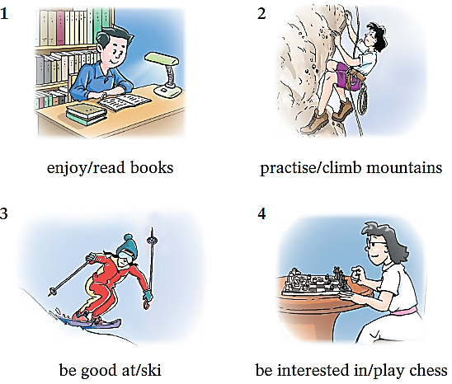
Practise in pairs on P25 ，ask and answer questions about the pictures. Follow the example.
S1: What does the boy enjoy?
S2: He enjoys reading books.
S1: What is the girl practising?
S2: She is practising climbing mountains.

Slide 20
S1: What is the girl good at?
S2: She is good at skiing.
S1: What is the girl interested in?
S2: She is interested in playing chess.

Slide 21
拓展二：动名词作主语放句首 ——
动词原形开头的祈使句
imperative
祈使句
Sit (sit) up straight please!
Read (read) the text twice!
Carry (carry) the large box downstairs！
Open (open) your mouth!
原形
祈使句是由动词________开头,
并且在句子中_________主语。
没有

Slide 22
________(sit) up straight in the class shows that you are listening to the teacher carefully.
________(Read) English every morning is a habit of learning English.
________(carry) this large box downstairs is impossible for a boy aged three.
________(open) your month means that you are surprised!
Sitting
Reading
Carrying
Opening

Slide 23
▲ 用于某些惯用法中。例如：
be busy doing sth “忙于做某事”
妈妈在厨房忙着做饭。
Mother is busy cooking dinner in the kitchen.
(2) be worth doing sth “值得做某事”
这本书值得一读。
The book is worth reading.
(3) It’s no use / good doing sth
“做……无用 / 无好处”
向他寻求帮助没有用。
It’s no use going to him for help.

Slide 24
用所给动词的适当形式填空。
1. I’ll keep on ________(try).
2. He practises ________ (play) the piano every day.
3. ________(run) is a very popular sport.
4. I’m looking forward to ________ (meet) Lin Shuhao.
5. It took me two months to finish ________ (write) the book.
trying
playing
Running
meeting
writing

Slide 25
中考链接
中考链接
1. --Would you like______ camping with me? 【2018山东滨州】
--I’d like to. But I’m busy______ my homework.
A. to go; to do B. to go; doing
C. going; to do D. going; doing
2.--Where is Mike? 【2018西城二模】
--I don’t know. But I saw him ______ football on the playground just now.
to play B. playing
C. played D. plays

Slide 26
中考链接
3. While we were running on the playground, Jack suddenly stopped _______ and lay on the ground, so we all stopped______ what was wrong with him. 【2018 四川成都】
to run; to see B. running; seeing
C. running; to see D. ran; seeing
4. Sarah, you’d better drink more water after ___for such a long time. 【2015 广州市】
A. run B. runs C. to run D.running

Slide 27
中考链接
5. Kevin is looking forward to ______ his family this Christmas. He hasn’t been home for the holiday in years! 【2019东莞一模改编】
A. visit B. visited C. visiting D. visits

Slide 28
中考链接
Thank you!

