Slide 1
Unit1
People around us
Grammar

Slide 2

A
The definite article the

Slide 3
Review: the indefinite article a/an
不定 冠词 | a/an | 修饰单数可数名词，表泛指 | a用于辅音音素开头的单词前 | a cat a Europeana book a unit
 |  |  | an用于元音音素开头的单词前 | an umbrella an owl an hour an honest girl

Slide 4
A The definite article the
定冠词 | the | 可修饰单数或复数可数名词，也可修饰不可数名词，表特指。 | 在辅音音素开头的单词前读作/ðə/ | the car the tall buildings the beautiful girl
 |  |  | 在元音音素开头的单词前读作/ðɪ/ | the apple the adventure the eggs

Slide 5
Some rules for the definite article: the
1. 表示特指的人或物
p9
The girl with glasses is Joyce’s best friend.
The man in the black coat is our English teacher.
The woman with long, straight hair is Mrs Zhang.
The factory near my home is very noisy.

Slide 6
2. 用在说话双方都明了的人或事物前
Shut the door, please. 请关门。
Has he returned the book? 那本书他还了吗？
Take the blue one, it is cheaper. 拿那个蓝的，它便宜些。

Slide 7
3. 用在前文提到的人或事物前
某人或某物第一次提到时用不定冠词，第二次提到时要用定冠词。
Sara found an interesting photo yesterday. The photo was of her grandpa.
There was once an old fisherman. The old fisherman had a cat. The cat was white.

Slide 8
4. 用在世界上独一无二的名词前
The Sun is shining brightly.
There were lots of stars in the sky last night.
He is the richest man in the world.
The moon goes round the earth.
【注】有球无星: 日球（太阳）月球地球之前加the，其余行星之前不加。

Slide 9
5. 用在表示方向、方位的名词前
这类词有： the east, the west, the south, the north,
the right, the left, the top, the bottom
The moon rises in the east and sets in the west.
月亮从东方升起，在西方落下。
【注】方位词成对使用构成平行结构时，不用定冠词。
from east to west从东到西 from north to south 从北到南

Slide 10
6.用在形容词最高级前
Summer is the hottest season of the year.
夏天是一年中最炎热的季节。
Hangzhou is one of the most beautiful cities in the world.
杭州是世界上最美的城市之一。

Slide 11
7. 用在序数词或序列词之前
the+序数词：the first, the second...
the+序列词：the next, the last....
the+“同一”或“唯一”: the same, the only...
The first man to the moon is an American.
第一个登上月球的人是美国人。
This may be the last chance. 这可能是最后一次机会。
He is the only one to get the scholarship.他是唯一一个的奖学金的人。
They went to the same school. 他们上的是同一所学校。

Slide 12
the+序数词的特殊情况：
a .序数词表示“又一”时，前面用不定冠词a(an) 。
He bought a second pair of shoes. 他又买了一双鞋。
b. 序数词用作状语或表语时，前面不加定冠词。
George arrived first. 乔治第一个到。
Jim and Jack are both second in the match.
汤姆和杰克在比赛中并列第二。

Slide 13
8. 表示演奏某种乐器时，与play搭配使用
He plays the guitar / the piano / the violin.
He plays basketball / football / table tennis.
p8
After the verb play, we put the before the names of (musical instruments/sports), but we do not put the before the names of (musical instruments/sports).

Slide 14
9. 用在江河湖海、山川群岛等专有名词前
the Yangtze River 长江 the Red Sea 红海
the West Lake 西湖 the Himalayas 喜马拉雅山
例外的情况: 若Mount（...山，...峰）在前，则不加the。
如：Mount Tai 泰山 Mount Huang 黄山
Mount Everest 珠穆朗玛峰

Slide 15
10. 用在由普通名词构成的专有名词前
the Great Wall 长城 the Red Cross Hospital 红十字医院
the North Pole 北极 the People's Park 人民公园
the Shanghai Railway Station 上海火车站

Slide 16
11. 用在某些形容词前，表示一类人或某种抽象概念
The rich should help the poor. 富人应该帮助穷人。
The good is what people like. 人们总是喜欢美好的东西。
The wounded have been sent to the hospital.
伤员已经被送到医院去了。

Slide 17
12. 用在姓氏的复数形式前，表示全家人或夫妇二人
The Greens will more to the country.
格林一家要搬到乡下去。
The Wangs came to see us yesterday.
王家一家人昨天来看我们。

Slide 18
13. 用在国名的全称和缩写前。
the People’s Republic of China (the PRC)
the United States of America (the USA)
the United Kingdom (the UK)

Slide 19
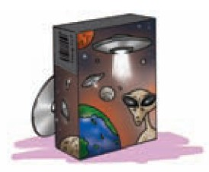
A1. In pairs,S1 talks about what he or she did in the
past few days. S2 asks about it. Follow the example.
p7
1. play/great computer game/yesterday/saving the
Earth from aliens
S1: I played a great computer game
yesterday.
S2: What was the game about?
S1: It was about saving the Earth from aliens.

Slide 20
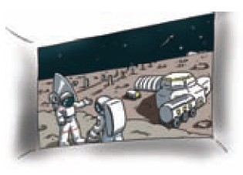
2.see /exciting film / last Saturday / a visit to the Moon
S1: I (do something) (time).
S2: What was...... about?
S1: It was about......
S1: I saw an exciting film last Saturday.
S2: What was the film about?
S1: It was about a visit to the Moon.

Slide 21
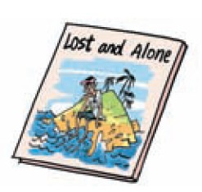
3.read / good story / last week / a man on an island
S1: I (do something) (time).
S2: What was...... about?
S1: It was about......
S1: I read a good story last week.
S2: What was the story about?
S1: It was about a man on an island.

Slide 22
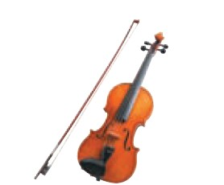
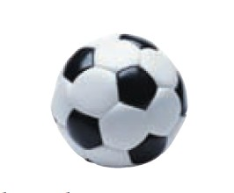
The sentences below are about some students. Complete the sentences. Add the if necessary.
p8
1.Vanessa loves music.
She plays _________.
football
2.Robin plays _______
very well.
the violin

Slide 23
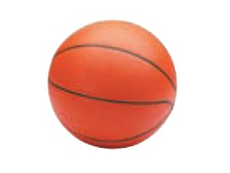
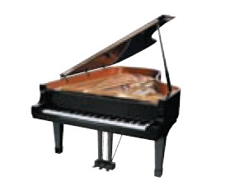
3.James’s dream is to play
_________ in the NBA.
4.Lily is good at playing
________.
basketball
the piano

Slide 24
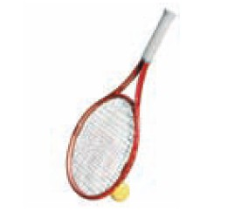
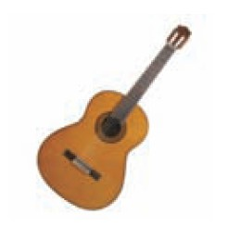
the guitar
5.Linda likes playing
______.
6. Alex plays __________
in the school band.
tennis

Slide 25
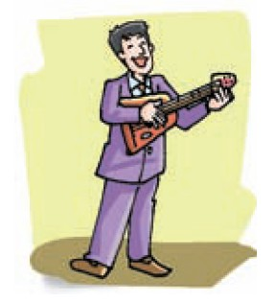
In pairs, talk about the people in the pictures below.
Use the words in brackets to help you. Add the if
necessary. Follow the example.
p9
S1: What’s the man playing?
S2: Which man?
S1: The man in the purple suit.
S2: He’s playing the guitar.
(in the purple suit / guitar)

Slide 26
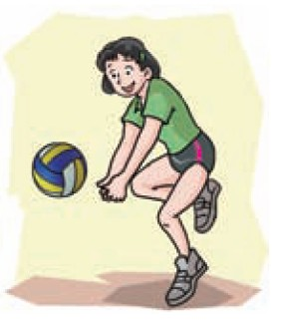
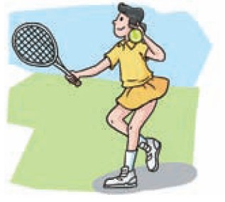
S1: What’s the girl playing?
S2: Which girl?
S1: The girl in the yellow skirt .
S2: She’s playing tennis.
(with short hair / volleyball)
S1: What’s the girl playing?
S2: Which girl?
S1: The girl with short hair.
S2: She’s playing volleyball.
(in the yellow skirt / tennis)

Slide 27
1. It was about saving the Earth from aliens.
save v. 拯救；节省；储蓄，攒钱
1. save表示“拯救，挽救”。
这只狗救了这个女孩。
The dog saved the girl. (save sb/sth 拯救某人/某物)
他救了这个男孩，使他免于溺水。
He saved the boy from drowning.
save sb from (doing) sth 拯救....免于....

Slide 28
2. The man in the black coat is our English teacher.
in 此处是介词，意为“穿着，戴着”，后接表示服饰或颜色的名词。
那个戴着红色帽子的女孩是我的妹妹。
The girl ____________ is my sister.
那个穿黑衣服的男孩看上去很英俊。
The boy __________ looks handsome.
in the red hat
in black

Slide 29
3. The factory near my home is very noisy.
noisy adj. 喧闹的，吵闹的
noise n. 噪音，喧闹声 [C/U]
例 Don't _________ in the library.
A. noisy B. be noisy C. is noisy D. be noise

Slide 30
选择最佳答案填空。
( )1. At the weekend, I often play ____ piano and my
brother usually plays ____ football.
A. the, / B. /, the C. /, / D. the, the
( )2. Lily bought ____new dress and ___dress is beautiful.
A. the, a B. a, a C. the, the D. a, the
( )3. What’s ____ capital of England?
A. a B. / C. the D. an
A
D
C

Slide 31
( )4. Which is bigger, ____Sun or ____ Earth?
A. a, a B. a, the C. the, the D. the, a
( )5. — Do you play ____ violin in your free time?
— No, I like sports. I often play ____football
with my friends.
A. /, the B. the, / C. the, the D. a, a
( )6. ____woman over there is ____English teacher.
A. The, an B. The, the C. An, the D. An, an
( )7. I hope I can fly to ____ Moon one day.
A. the B. a C. an D. /
C
B
A
A

Slide 32
8. A spaceship flies at about eleven kilometers _______ second.
A. / B. the C. a D. an
9. _______ India and China are of _______ same continent.
A. /； the B. The ； the C. /； / D. /； a
10. A: Has the little girl passed ___ P.E. test?
B: She has tried twice, and the teacher allows her to have _____ third try.
A. the; 不填 B. a; the C. the; a D. the; the

Slide 33
B 零冠词的用法
(1)在日期、月份等名词前不加the。
10 October is my birthday.
Uncle Tom will visit us in May.
(2)复数可数名词和不可数名词前不加the表示泛指。
Camels are very useful animals in the desert.
Do you often listen to light music?
(3)学科、语言前不加the。
My favourite subject at school is Physics.
Can you speak English?

Slide 34
(4) 球类、棋类、牌类运动或游戏前不加the。
A lot of people enjoy playing football/ chess/ poker.
(5) 一日三餐前不加the。
Who did you invite to dinner yesterday?
We usually discuss the business at breakfast.
【注】三餐前有形容词修饰时，可以使用冠词：
a quick breakfast匆忙吃完早餐, a light dinner清淡的晚餐,
a big dinner一顿丰盛的大餐
(6) 抽象名词前一般不加the。
People all over the world love peace.
(7) television/ TV表示“电视节目”时，前面不加the。
My grandmother is watching television in the next room now.

Slide 35
Reading补充语言点
Never give up and you will be successful.
祈使句+and+陈述句
表示如果做到了祈使句表示的事情，就会有后面句子的结果。
努力点，你就会通过考试。
Work hard and you will pass the exam.

Slide 36
(8)有些固定搭配既可以带冠词，也可以不带冠词，但意思
却发生了变化。
go to school 上学 go to the school 去学校
in hospital 住院 in the/ a hospital 在医院里
on earth 究竟；到底 on the Earth 在地球上
at table 进餐 at the table 坐在桌子旁边
in prison 坐牢 in the prison 在监狱
in front of 在某物外部的前面 in the front of 在某物内部的前面

