Slide 1
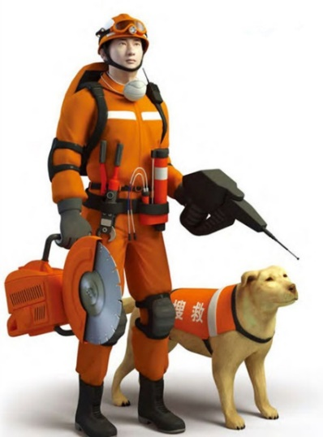

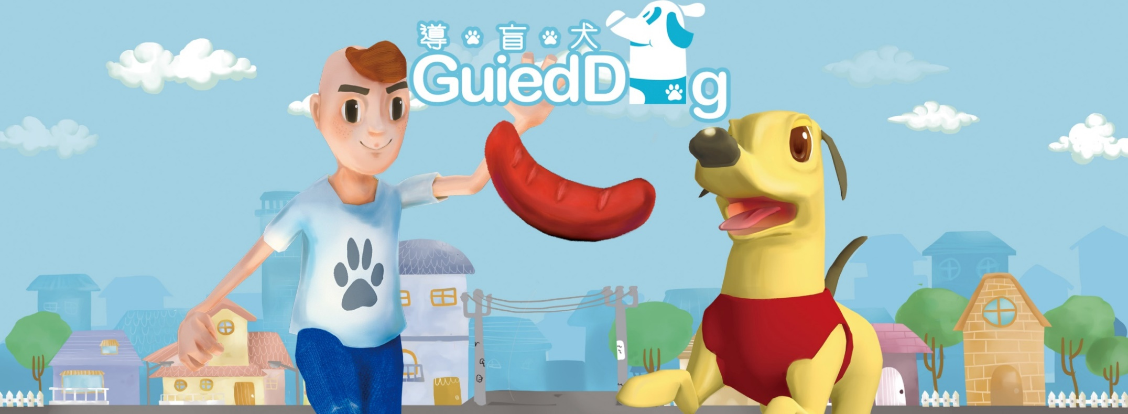
Unit 3 Our animal friends
Grammar

Slide 2
一、代词：
1、人称代词
 | 第一人称单数 (我) | 第二人称 (你/你们) | 第三人称单数 (他，她，它) |  |  | 第一人称复数 (我们) | 第三人称复数 (他们，她们，它们)
主格 | I | you | he | she | it | we | they
宾格 | me | you | him | her | it | us | them

Slide 3
人称代词的用法
（1）人称代词的主格在句中做主语。例如：
I love my country.
（2）人称代词的宾格在句中作动词/介词的宾语
或作句子的表语。例如：
I don't know her.
His mother is waiting for him outside.

Slide 4
一. 根据句意，用人称代词的适当形式填空。
1. Ann's new teachers are kind to ______.
2. Mr Black is my English teacher. ______ is very
kind.
3. Lily likes music. ______ listens to music
every morning.
4. John lives with his grandparents and he often
does morning exercises with ______.
5. --Mum, where is my school bag?
--______ is on the desk.
her
He
She
them
It

Slide 5
us
6. Andy is a helpful boy and he often helps ______
with our English.
7. Wake up, Tom. It's 7:30 a.m. ______ will be late
for school.
8. Mr Wang is my Chinese teacher and I like
______ very much.
9. Look at the boys and girls over there. ______
are singing and dancing.
10. My sister often teaches ______ some English
songs. I like to sing with her.
You
him
They
me

Slide 6
2、形容词性物主代词 vs 名词性物主代词
形容词性物主代词 | 我的 | 你的/你们的 | 他的、她的、它的 |  |  | 我们的 | 他们的
主格 | my | your | his | her | its | our | their
名词性物主代词 =形容词性物主代词+n. | 我的东西 | 你的/你们的东西 | 他的、她的、它的东西 |  |  | 我们的 东西 | 他们的东西
主格 | mine= my+n. | yours = your+n. | his = his+n. | her = her+n. | its = its+n | ours = our+n. | theirs= their+n.

Slide 7
二. 从括号中选择适当的词填空。
1. This is ______(my / mine) English book. Where is ______(yours / your)?
2. The girl is Cindy. ______(She / Her) sister can play the piano very well.
3. These are ______(theirs / their) chairs and ______(our / ours) are in the next room.
4. Here is my dog. ______(Its / It's) name is Toby.
5. ______(He / His) bike is so old that it can hardly work.
my
yours
Her
their
ours
Its
His

Slide 8
三. 选择最佳答案填空。
( )1. He is an Australian. ____ name is David.
A. He B. Him C. Himself D. His
( )2. Could you help ____ with ____ Maths,
please?
A. I, my B. me, me
C. me, my D. my, I
( )3. ____ will go to the Canton Tower tomorrow.
And my brother will go with ____.
A. Us, we B. We, us
C. Our, us D. Ours, our
D
C
B

Slide 9
( )4. ____ dress is beautiful. But ____ is more
beautiful than ____.
A. Kates', my, her
B. Kate's, mine, hers
C. Kates', mine, her
D. Kate's, my, hers
( )5. My classmates like singing very much. Most
of ____ join the Music Club.
A. they B. their C. them D. theirs
( )6. How hard ____ works!
A. we B. her C. she D. hers
B
C
C

Slide 10

3.反身代词
myself
I finish the work by ______.

Slide 11
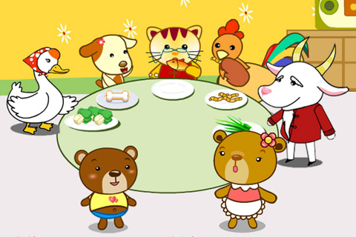
Help _______ to some fish.
yourself

Slide 12

Little Tom can dress _______.
himself

Slide 13
反身代词的定义:
Reflexive pronouns
反身代词是一种表示反向或强调的代词。
通过反身代词指代主语或施行者自己本身的代词。

Slide 14
我自己
我们自己
你自己
你们自己
他自己
她自己
它自己
他们自己
反身代词共有8个
1.myself
2.ourselves
3.yourself
4.yourselves
5.himself
6.herself
7.itself
8.themselves
用oneself
指代所有的
反身代词

Slide 15
Reflexive pronouns
反身代词
人称 | 第一人称 | 第二人称 | 第三人称
单数
复数
数
himself
herself
itself
myself
yourself
ourselves
yourselves
themselves

Slide 16
反身代词用法：
1、当主语和宾语指同一个人时，用反身代词。
He blames himself for the mistake.
She made herself a cup of tea.
We should not think only of ourselves.
2、用反身代词强调某人独自完成某事（没有他人的帮助）
He did the homework himself.
We can clean the kitchen ourselves.

Slide 17
Work out the rule
Singular reflexive pronouns have the ending ______.
Plural reflexive pronouns have the ending ______.
-self
-selves

Slide 18
反身代词的固定习语
有些词与反身代词一起构成了固定搭配。例如：
(all) by oneself 靠自己
hurt oneself 伤着自己
teach oneself 自学
dress oneself 自己穿衣
enjoy oneself 玩得开心
look after oneself 自己照顾自己
help oneself (to) 请随便（取、吃）

Slide 19
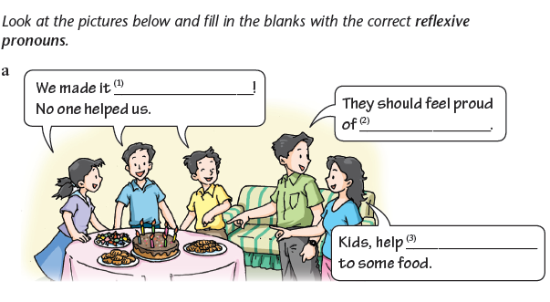
Grammar exercise
ourselves
themselves
yourselves

Slide 20
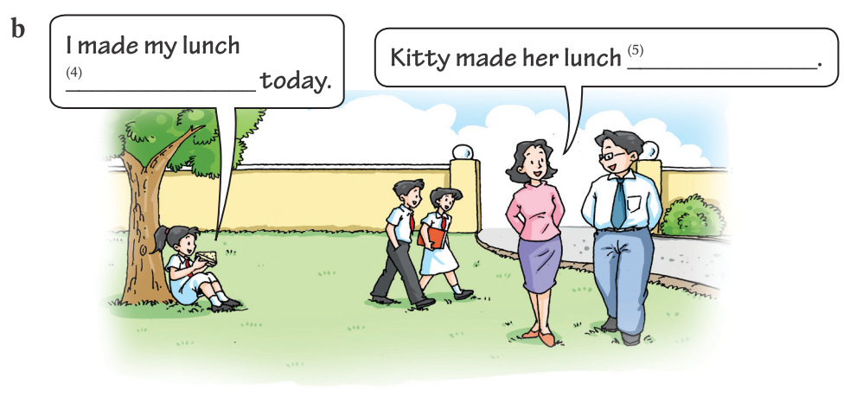
herself
myself

Slide 21
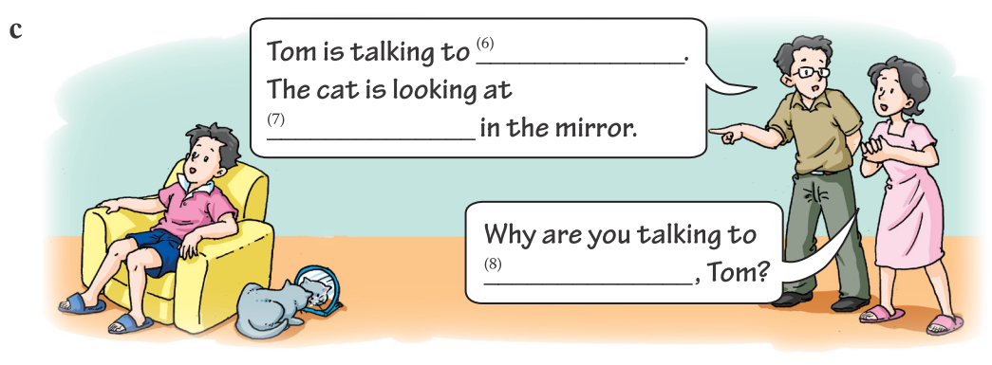
himself
itself
yourself

Slide 22
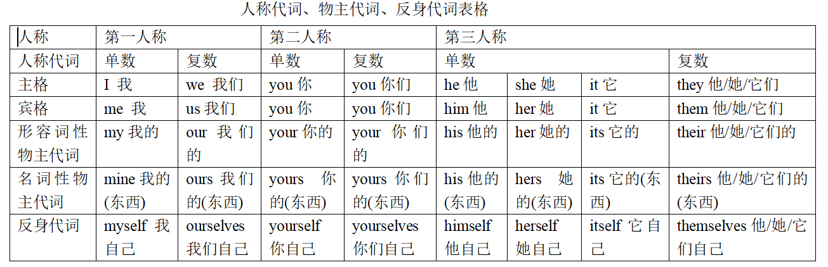

Slide 23
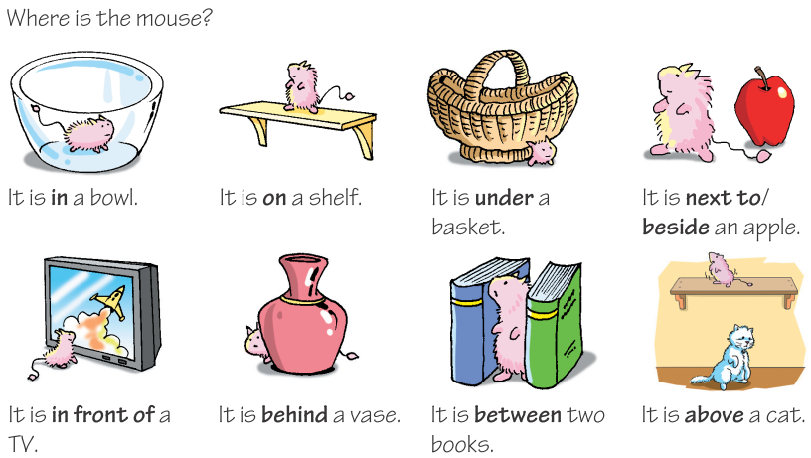
二、Prepositions of position
方位介词

Slide 24
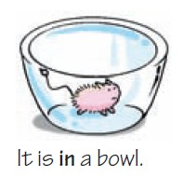
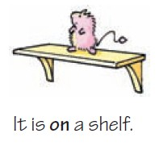
It is in a bowl.
1.in在……里面
It is on a shelf.
2.on在……上面(表面接触)

Slide 25
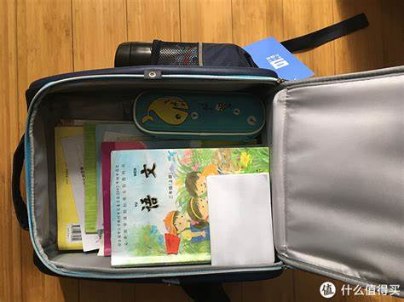
用in和on填空。
Where is my book, mum?
——It’s your schoolbag.
in

Slide 26

用in和on填空。
Where is my book, mum?
——It’s the desk.
on

Slide 27
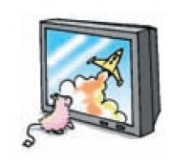

It is in front of a TV.
3.
in front of
在(事物外部)的前面
in the front of
在(事物内部)的前面
It is behind a vase.
4. behind
在……后面

Slide 28
in front of 和in the front of
in the front of
The blackboard is the classroom.
The teachers’ office is the classroom.
in front of

Slide 29


It is next to / beside an apple.
6. next to / beside
在……旁边
It is between two books.
5. between
(两者)之间

Slide 30
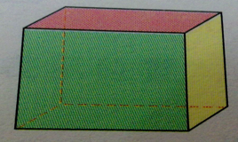
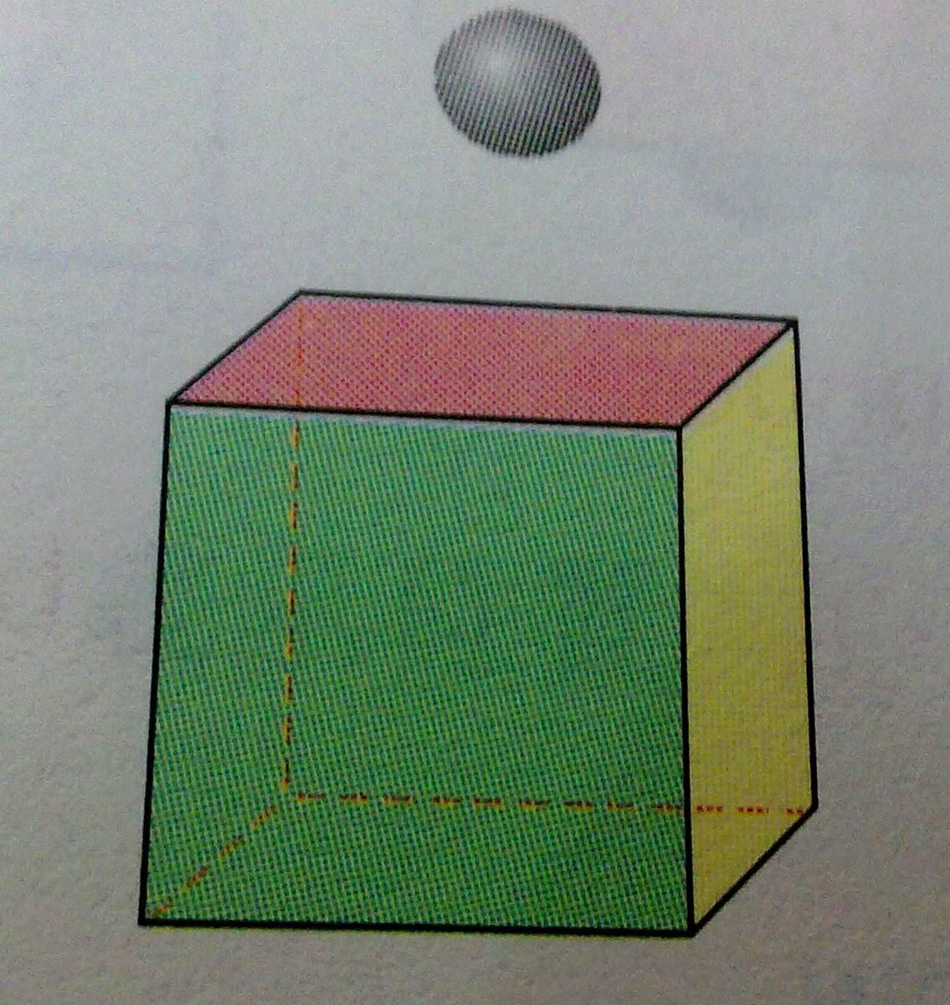
Where is the ball?
It is over the cube (立方体).
7. over在…正上方
（表面无接触，常悬空）
It is under the
cube(立方体).
8. under
在……正下方

Slide 31
It is above the cube.
It is below the cube.
9. above 在……上方
(不一定是正上方，
常指斜上方)
10. below 在…下方
(不一定是正下方
常指斜下方)

Slide 32
用above, over, on 填空
1. There is a mountain our school.
2. There is a bridge the river.
3. There is a picture of his wife the fireplace(火炉).
4.There is a clock on the wall. It’s
___ the blackboard.
A. on B. in C. above D. over
above
over
above
不悬空的“在…上方” ：常用above.

Slide 33
用above, over, on 填空
6. There is a picture the wall.
7. Can you see the egg ___ the plate?
A. on B. in C. over
on
照片挂在墙上。因为是表面，用on
on
8. The temperature will fall__ zero at night.
A. below B. above C. over

Slide 34
11. across from 在…….对面
12. in the middle of 在---中间
13. on the right/left 在右/左边

Slide 35
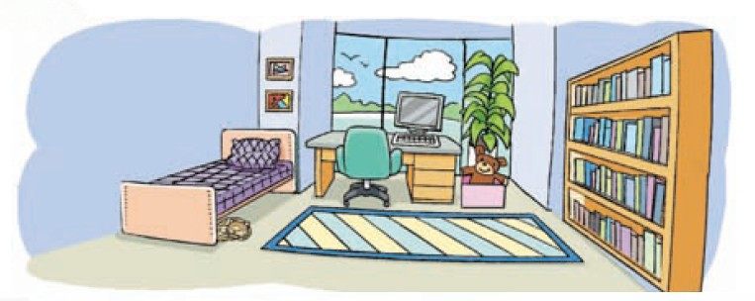
Jason is describing his bedroom. Help him complete his description with the correct prepositions.

Slide 36
My bedroom is a big room with a big window.
There is a desk ________ the window. There is a
computer ______ the desk and a box ______
the desk. There is a toy bear _____ the box and a
pot of plant ______the box. My bed is on the other
side of the desk. There are some pictures ______
the bed. My cat, Gigi, likes sleeping ______ the
bed. I have a new carpet ______ the floor ______
my bed and the bookshelves.
in front of
on
next to/beside
in
behind
above
under
on
between

Slide 37
Work in pairs. Talk about the picture like this:
A: Where is the …?
B: It’s in/on/under/…
A: Where are the …?
B: They’re …

Slide 38

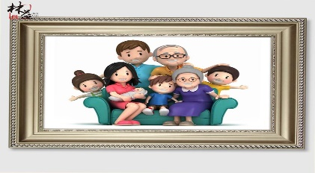
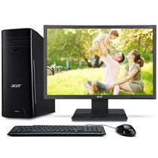
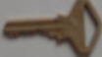






Slide 39
Part V Review

Slide 40
一、选择最佳答案填空。
( )1. — Peter and John, did you enjoy ____
on Children's Day?
—Yes, we did.
A. yourself B. yourselves
C. himself D. ourselves
B

Slide 41
B
( )2. — I made the cake by ____. Help____
to it, Tom.
— Thanks, Jane.
A. ourselves, yourself
B. myself, yourself
C. myself, yourselves
D. ourselves, yourselves

Slide 42
A
( )3. I think you can do the job ____, John.
A. yourself B. myself
C. himself D. yourselves
( )4. — Did she go to school when she was young?
— No, she taught ____ at home.
A. her B. herself
C. hers D. she
B

Slide 43
二、根据句意，从方框中选择合适的介词
或介词短语填空（每个词语限用一次）。
1. Jim likes lying ________ his bed and reading a comic book.
2. The new shop is ________ my house. It only takes me ten minutes to walk there.
3. Emily sits in front of Amy, but she sits ________ Betty.
near, on, below, in front of, between, behind
on
near
behind

Slide 44
near, on, below, in front of, between, behind
4. Look out of the window! A plane is flying ________ the clouds.
5. Mike, don’t stand ________ me. I can’t see the blackboard.
6. I sit ________ Mary and Sally.
below
in front of
between

Slide 45
Thank you!

Slide 46
Prepositions of position
1. in 在…….里面
2. on 在……..上面（表面接触）
3. above 在……上方 (但不一定是正上方)
4. over 在……正上方 (垂直的上方)
5. beside 在……旁边
6. below 在……下方(不一定是正下方 反义 词above)
7. under 在……正下方 (反义词是over)

Slide 47
in front of 在(事物外部)的前面
in the front of 在(事物内部)的前面
9. behind 在……后面
10. between 在……之间（用于两者 between …and …）
11. near 在…附近
12. next to 紧靠…的旁边;贴近

