Slide 1

Unit 6 Electricity
Grammar

Slide 2
Modal verbs情态动词
can
cannot(can’t)
may
may not
must
must not

Slide 3
1、情态动词具有一定的词义，但不能独立存在，须与动词原形一起构成谓语。
He can’t sing. But he can dance.
2、表示说话人对动作的观点，如意愿、需要、可能或怀疑等。
3、情态动词有时态的变化（如can-could），但没有人称和数的变化（have to 除外）。
I can, He can, They can。can没有因为人称和数，产生变化。I have. She has. They have. 有人称和数的变化。

Slide 4
1、情态动词can的用法
can
① be able to “能”，表示能力
I can/am able to sing an English song.
②表示许可或请求对方允许，意为“可以”
Can I use your dictionary?
③ 过去式：could
I could do that 10 years ago.
④否定式： cannot = can’t

Slide 5
⑤ could的两个用法:
(1) 作为can的过去式。表“能，会”。用于过去式。
He could swim 10 years ago.
②表请求许可，比can更委婉，不表示时态。用could 提出的请求要用can来回答。
-我能用你的笔吗？ -可以。 -不可以
-Could I use your pen?
-Yes, you can. -No, you cannot/can’t.

Slide 6
练习：Peter can speak English.
否定→
Peter can’t/cannot speak English.
一般疑问句→
Can Peter speak English?
(一般疑问句，提前情态动词)
特殊疑问句→
What can Peter speak?

Slide 7
Modal verbs情态动词
A can and cannot
We use can and cannot (can't) to say we are able or unable to do something.
We can use electricity to do many things.
We cannot/ can’t see electricity.
Can you think of an example?
Yes, I can./No, I cannot/ can't.

Slide 8
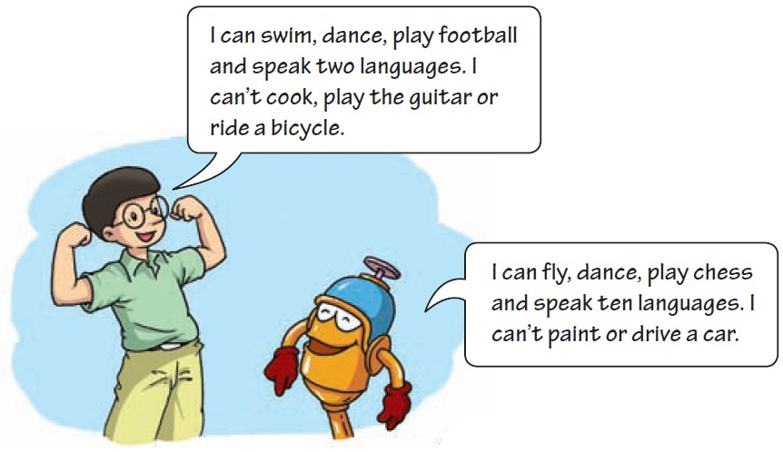
Hi and Lo are talking about themselves. What are they saying? Read their conversation and then complete the statements below with can or cannot. P77

Slide 9
can
1. Hi _____ play football.
2. Lo _____ paint.
3. Hi _____ speak as many languages as Lo.
4. Both Hi and Lo _____ dance.
5. Lo _____ drive a car, but he _____ play
chess.
6. Hi ____ swim, but he _____ play the
guitar.
cannot
cannot
can
cannot
can
can
cannot

Slide 10
2、情态动词may的用法
may ：表示许可或请求对方允许， 意为“可以”。
①can和may的区别：
都可表示许可, 基本可以互换；但是 may语气更委婉。更能表示礼貌和敬意。
can 可以强调有能力做某事，而may不行
— May I watch TV now, grandma?
— No, you may not.
—— 外婆，我现在可以看电视吗？
—— 不，你不可以。

Slide 11
②否定式： may not 意为“不可以”。
③may构成的一般疑问句及其回答形式如
下：
— May I ...?
— (肯定回答) Yes, you may / can.
— (否定回答)
No, you may not / can’t /mustn’t.
(注：mustn’t 的语气最强，表示禁止)

Slide 12
④ may be 和 maybe的区别：
may be “情态动词+动词be”, 意为“可能是”。放在主语后，做为谓语动词。
maybe 副词, 意为“大概，也许”。（句子次要成分，可以删除）
他可能是个老师。
He may be a teacher.
= Maybe he is a teacher.
⑤may 可表示祝愿。
e.g. 祝你成功！
May you succeed!

Slide 13
B may and may not
We use may and may not to ask for and give permission (许可). We also use can and cannot (can’t) for the same purpose（目的）.
May/Can I use your mobile phone？
Yes, you may/can.
No, you may not/can't.
You may/can turn on the TV.
You may not/cannot play in the kitchen.

Slide 14
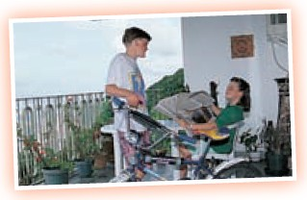
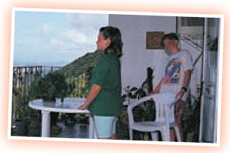
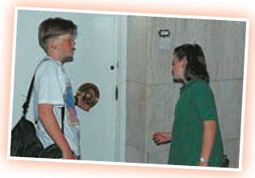
P78 Daisy is not feeling well today. Benny is at home with her. Read their conversation below. Fill in the blanks with may or can.

Slide 15
Benny: How are you feeling, Daisy?
Daisy: Not very well.
Benny: _________ I get you a chair?
Daisy: Yes, thanks.
Benny: I’m going out. _____ I borrow your bicycle,
Daisy?
Daisy: Yes, you may. Before you go to meet your friends,
can you come and see the doctor with me?
Benny: Yes. I ____. ______ I carry your bag for you?
Daisy: Yes, that’s very kind of you, Benny.
I’m ready to go.____ you open the door for me?
Benny: Yes, I can.
Daisy: Thanks.
May/Can
May
Can
May
Can

Slide 16
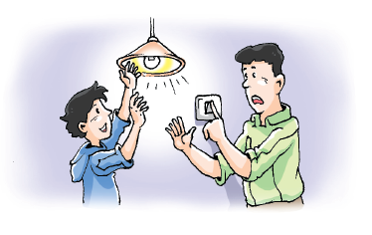
C must and must not

Slide 17
3、情态动词must的用法
must
①表示规定、命令、强制，意为“必须；一
定”。
如：
You must do your homework first.
你必须先做作业。
You mustn’t smoke here.
你不许在这里吸烟。

Slide 18
②must 的否定式为must not / mustn’t，意为
“禁止；不准”
③must 构成的一般疑问句及其回答形式如下：
— Must I ...?
— (肯定回答) Yes, you must.
— (否定回答) No, you needn’t.

Slide 19
④辨析must和have to
 | 意义 | 用法
must | “必须；一定” | 强调主观上必须做某事(自己觉得要做某事)
have to | “ 不得不；必须” | 强调客观上不得不做某事 (他人干预)

Slide 20
C must and must not
We use must and must not (mustn't) to tell people what to do or what not to do.
You must not/ mustn’t do that, Benny!
We must always be careful with electricity.
They must not/mustn’t play near the heater.

Slide 21
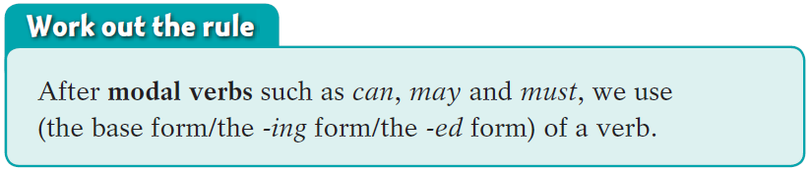
情态动词后使用动词的原形

Slide 22
P79 Daisy saw a doctor. The doctor told her what to do and what not to do. Help her write down the doctor’s instructions.
drink more water go to bed early
eat cold food share cups with others
go out alone take the medicine on time
I must drink more water.
______________________________
______________________________
I must not _____________________
______________________________
______________________________
I must go to bed early.
I must take the medicine on time.
eat cold food.
I must not go out alone.
I must not share cups with others.

Slide 23
◆ 情态动词表 (推测,可能)
must ~100% (表强烈推测, 用于肯定句)
句型：must be, must have done
e.g.他肯定在教室。
He must be in the classroom.
她不在这里。她肯定离开了。
She’s not here. She must have left.
· may 50% (may表推测，用于肯定句)
e.g. He may be in the classroom.
他可能在教室。
· can’t / couldn’t ~100% (表强烈推测，用于否定句)
e.g. He can’t be in the classroom.
他不可能在教室。

Slide 24
Summary
原形
情态动词后接动词______，没有人称和数的
变化， ______（能/不能）单独作谓语，要
与后面的______共同作谓语。其否定形式
是在其后面直接加______ 。
情态动词can 的用法：表示能力。构成一般
疑问句时，需把can 移到______（句首/
中）。肯定回答为“Yes,主语+ ______”；否
定回答为“No,主语+ ____________”。
不能
动词
not
句首
can
can’t / cannot

Slide 25
情态动词may 的用法：表示允许。may在表
达这个意思时可以与can 互换使用。由may
引起的一般疑问句，其否定回答用_______，
___________ 或 ________ 。
表示请求时，could 和can 不表示时态的区别，
只是could的语气更加委婉。
may not
can’t / cannot
mustn’t

Slide 26
情态动词must 的用法：表示必须/一定。
其否定形式mustn’t 表示______。由must
引起的一般疑问句，其否定回答要用
______ 。
禁止
needn’t

Slide 27
Part V Review

Slide 28
一、用本单元所学的情态动词填空。
1. — Kate, you have won the English competition!
— Oh, it _______ be true. I made a lot of
mistakes in it.
2. You ________ talk to your grandparents like that. It’s impolite.
3. We _______ wash our hands before meals. It is good for our health.
can’t
mustn’t
must

Slide 29
4. Excuse me, ____ you tell me the way to the
nearest park?
5. You ________ go with us to the zoo if you
want to.
6. I ____ speak Chinese very well, but I ____
speak French at all.
can
can /may
can
can’t

Slide 30
二、翻译下列句子。
1. 门锁了。他不可能在家。
The door is locked. He _____ be at home.
2. 我的手表停了，肯定有毛病。
My watch doesn’t work. There _____ be something wrong with it.
3. — 我可以借用你的尺子吗？
— 当然可以。但是你必须明天还给我。
— ____ I borrow your ruler?
— Of course. But you _____ return it to me
tomorrow.
can’t
must
May
must

Slide 31
三、选择最佳答案填空。
( )1. If you feel tired, you ____ sit on this chair
and have a rest.
A. must B. can C. need D. can’t
( )2. — ____ I watch TV now, Mum? I finished
my homework.
— Yes, you ____.
A. Must, need B. May, can
C. Need, need D. May, must
B
B

Slide 32
( )3. He ____ see the words on the blackboard
because he sits far away.
A. mustn’t B. may not
C. can’t D. needn’t
( )4. — ____ I do all the housework now?
— No, you ____. You can do it later.
A. Must, mustn’t B. Must, can’t
C. Must, may not D. Must, needn’t
C
D

Slide 33

Let’s learn the new words and expressions.

Slide 34
I can’t cook, play the guitar or ride a bicycle.
我不会做饭、弹吉他和骑自行车。
①play the guitar 弹吉他
play与西洋乐器名词连用时，乐器名词
前要加定冠词the。
②or在否定句中 表示“和”的意思
我不喜欢面包、米饭和粥。
Or也可以用在肯定句。My dad or my mon is going to the parents’ meeting.
I don’t like bread ,rice or porridge.

Slide 35
2. Hi can’t speak as many languages as Lo.
Hi会说的语言不如Lo多。
1）as + many +[C]复+ as ...
2）as + much + [U] + as ...
两个都表示“和……一样多的……”。
若其用于否定句中，则意为“……不
如……多”。如：
我有和你一样多的玩具。
I have as many toys as you.
你每天喝的水不如我多。
You don’t drink as much water as I every day.

Slide 36
Practice
1. 选择最佳答案。
( )You made _____ I.
many as mistakes as
B. as many mistakes as
C. as many mistakes like
D. mistakes many as
2. 根据中文意思完成句子。
我弟弟的钱不如我的多。
My brother ______ have __ _____ _____ __
I.
B
doesn’t as much money as

Slide 37
3. — How are you feeling, Daisy?
— Not very well.
黛西，你现在感觉怎么样？
身体不是很舒服。
1）How is sb feeling 某人现在感觉怎么样
（侧重于询问对方的身体状况）
回答这句话可以用：
I’m feeling well. （我身体很好）
I’m not feeling well / Not (very) well.
（我身体不舒服）
Much better. （好多了）
2）well adj. 健康的；身体好的

Slide 38
Practice
根据中文意思完成句子。
当医生询问这位病人感觉怎么样时，他
说他感觉好点了。
When the doctor asked the patient
____ ___ ___ ______, he said that he _____ _____ _____.
2. 我今天身体不舒服。
I _____ _____ _____ _____today.
how he was feeling
felt much better
am not feeling well

Slide 39
4. I’m ready to go. 我准备好出发了。
ready adj. 准备好的
常用的句型有：
be ready to do sth 准备好做某事
be ready for sth 为某事做好准备 如：
I am ready to do the work.
我准备好做这项工作了。
I am ready for the work.
我为这项工作做好准备了。

Slide 40
Practice
1. 选择最佳答案。
( )Let’s be ready _____ the competition!
A. to B. for C. of D. with
2. 根据中文意思完成句子。
看！学生们都准备好回答问题了。
Look! The students ___ _____ __ ______.
the questions.
你为这次旅行做好准备了吗？
_____ you _____ _____ the trip?
B
are ready to answer
Are ready for

Slide 41

5. take the medicine on time 按时吃药
on time 按时
6. go out alone 独自外出

Slide 42
7. share sth with sb 与某人合用/分享 某物
Lucy shares a bedroom with Lily.
露西和莉莉合用一间卧室。

