Slide 1

Unit 8
From hobby to career
Reading (1)
广州牛津版七年级下册

Slide 2
C
目 录
ONTENTS
01
Cartoon talk
02
Pre-reading
While-reading
03
04
Post-reading

Slide 3
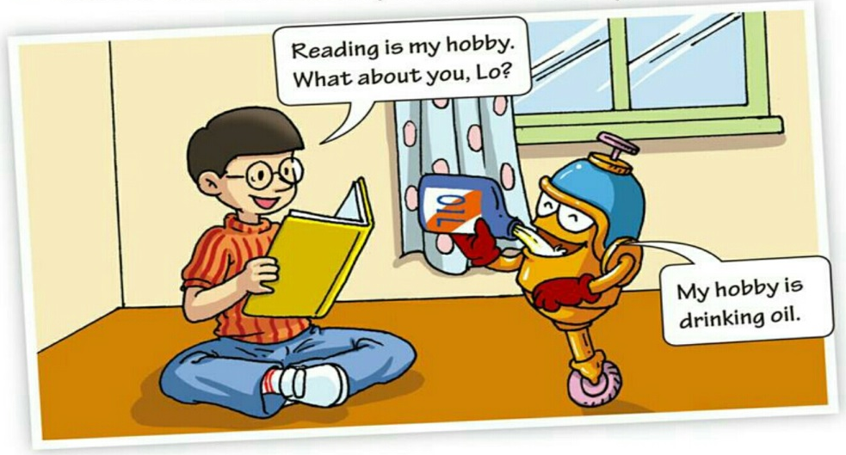
01.
Cartoon Talk
1. What is Hi's hobby?
2. What is Lo's hobby?
3. What do you think about Lo's answers ?
4. What do you think the unit will probably be about?
Reading.
Drinking oil
He misunderstood the meaning of “hobby”.
Hobbies.

Slide 4
Step 2. Pre-reading.
Hobby
Basketball player
Enjoy doing in free time.
Playing basketball
???
Artist
Job
Studying the stars and planets
Drawing
The activity you do to make money.
Hobbies
Singer
Singing
Watching movies
Career
Actor / actress
Director
The activity you do to make money and to achieve your dream.
Playing the piano
Musician

Slide 5
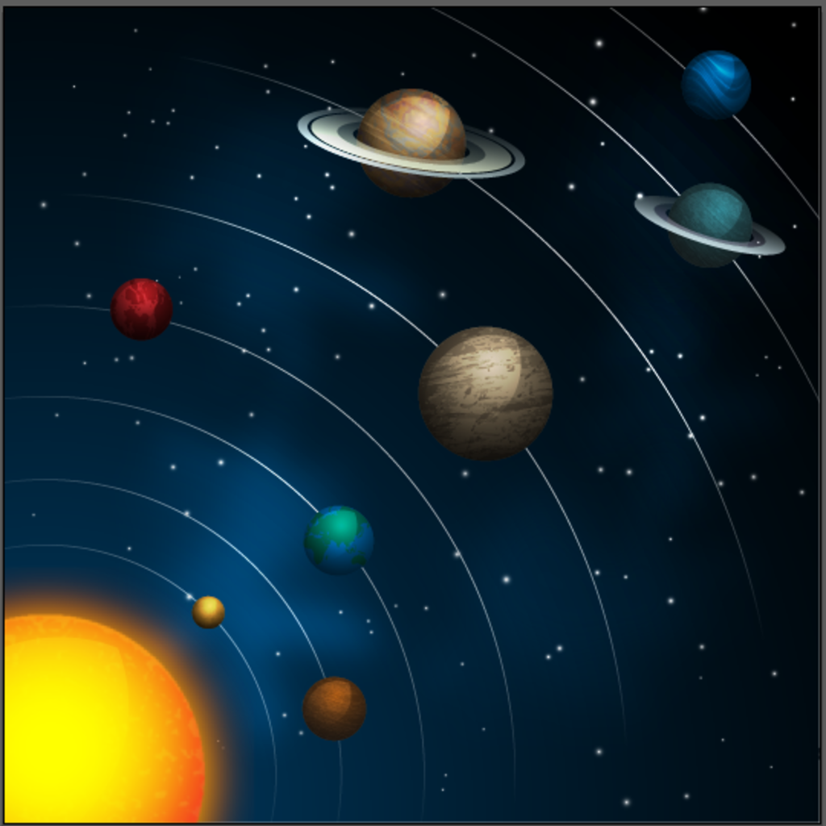
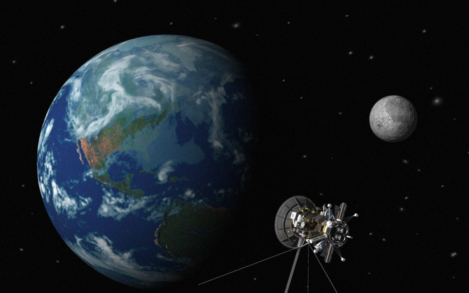
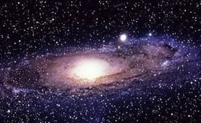
satellite
star
planet
planet
star

Slide 6
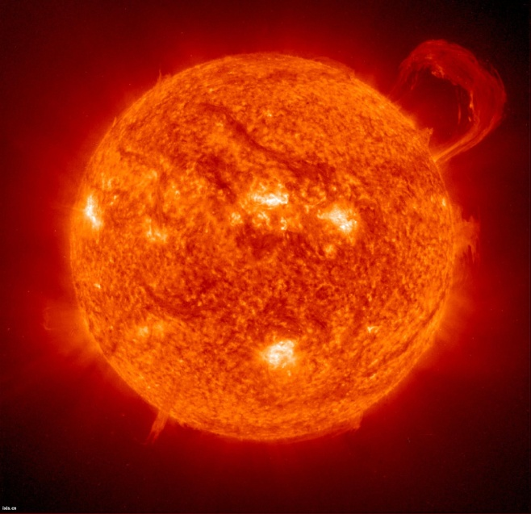
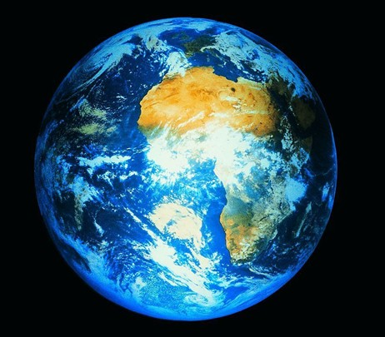
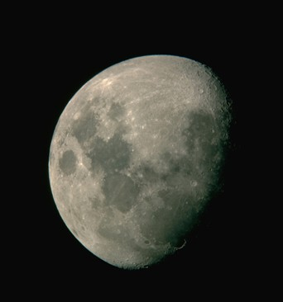
A1 Use the words form the box to complete the sentences below. (P104)
行星
卫星
恒星
planet satellite star
1 The Sun is a
________.
2 The Earth is a
________.
3 The Moon is a ________.
star
planet
satellite

Slide 7
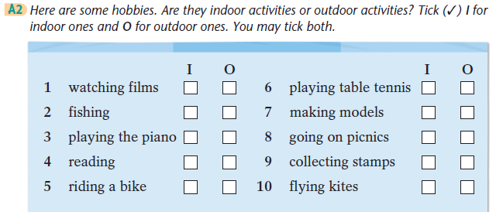
√
√
√
√
√
√
√
√
√
√
√

Slide 8
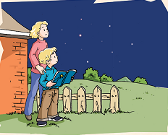
Look at the pictures and the title of the article on
page 105. Then answer the questions below.
What are they looking at?
My lifetime hobby
—studying stars
by PatricMoore
1. What is Patrick Moore’s hobby?
2. What is probably his job now?

Slide 9
Fast reading: read through the passage quickly and match the main ideas with each paragraph.
Paragraph 1
Paragraph 2
Paragraph 3
Paragraph 4
A. I host a TV programme and I love my career.
B. It talks about the beginning of my lifetime hobby.
C. It talks about how to change our hobby into our career.
D. I used to look at the sky with my mum and I really enjoyed it.

Slide 10
Careful reading: Read the passage and answer the questions.
When was the beginning of the writer’s lifetime hobby?
What did the writer use to do with his mum?
What did the sky look like on clear nights?
What does the writer do now?
How can we achieve our dreams?
When he was eight, he got a book about stars. That was the beginning.
He used to go outside with his mum on clear nights and look at the sky.
It looked like black velvet with a million diamonds on it.
He hosts a TV programme and uses his knowledge to tell people about the stars in a lively way.
We just have to enjoy what we do!

Slide 11
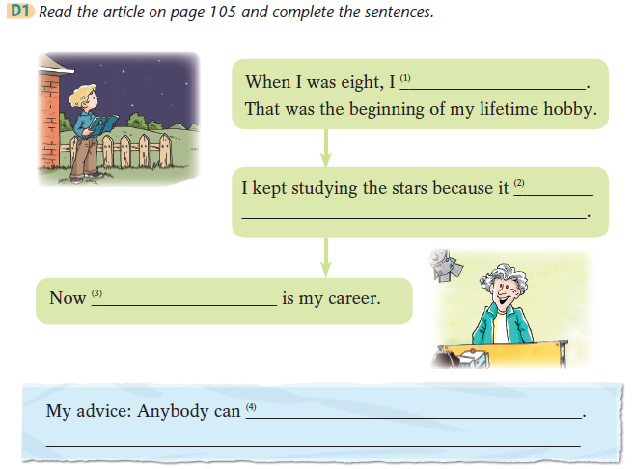
Careful reading: Read the passage and finish the exercise on P107.
got a book about stars
was great fun for me
studying the stars
achieve their dreams
You just have to enjoy what you do!

Slide 12
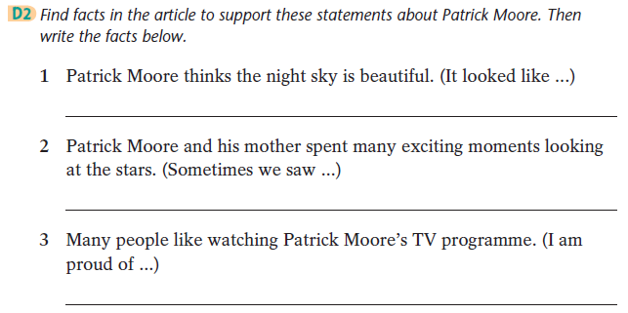
It looked like black velvet with a million diamonds on it.
Sometimes we saw stars shooting brightly across the sky. How beautiful they were!
I am proud of my TV programme — it has lasted for more than 50 years!

Slide 13
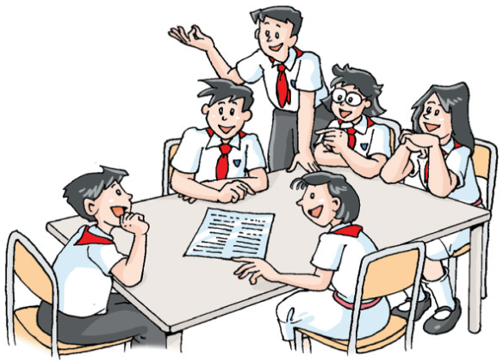
04. Post-reading
Group discussion
How can Patrick Moore turn his hobby into his career?
How can we turn our hobby
into our career?
HOW?
hobby
career

Slide 14
05. Homework
1. 用自己的话复述课文；
2. 划出课文中包含的短语。

Slide 15
Thank you!

