Slide 1

Unit 8
From hobby to career
Reading (2)
广州牛津版七年级下册

Slide 2
C
目 录
ONTENTS
01
Revision
02
Language points
Exercise
03
04
Homework

Slide 3
Revision

Slide 4
Revision: fill in the blanks.
When Patrick was ________ , he got a book about ______. That was the _____________ of his lifetime hobby.
He used to go outside with ____________ on clear nights and ___________________. They saw _____________________ in different seasons. Sometimes they saw stars_________ across the sky. He thought they were ____________.
Patrick was quite interested in _________________. He learnt _______________. And now he hosts ________________ called The Sky at Night. He uses his _____________ to tell people about the stars in a ______way. He is ______ of his _______. It has ______ for over 50 years.
Patrick believes that we can ____ our hobbies ____ our careers. We can ________ our dreams .We just have to ______________________.
eight
stars
beginning
his mum
look at the sky
different groups of stars
shooting
know a lot about something
beautiful
continue for a while
interesting and exciting
studying the stars
more and more
a TV programme
knowledge
knowledge
lasted
career
lasted
lively
proud
career
lively
work hard to get something
turn
into
lifetime job
achieve
achieve
enjoy what we do

Slide 5
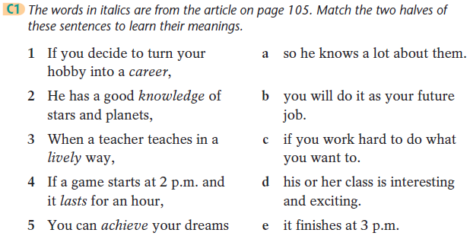
Exercise time.

Slide 6

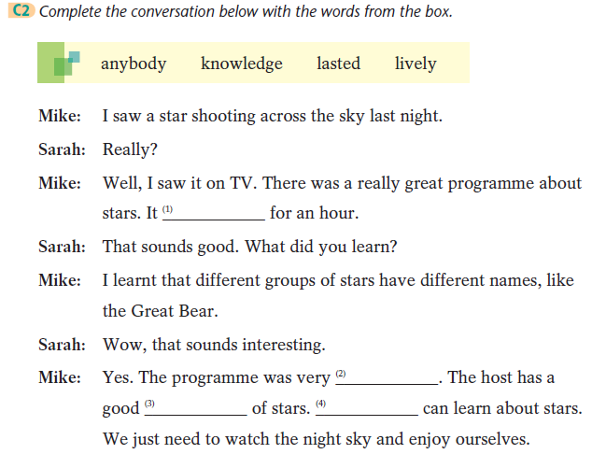
lasted
lively
knowledge
Anybody

Slide 7
Language points
Production
Practice
Presentation

Slide 8
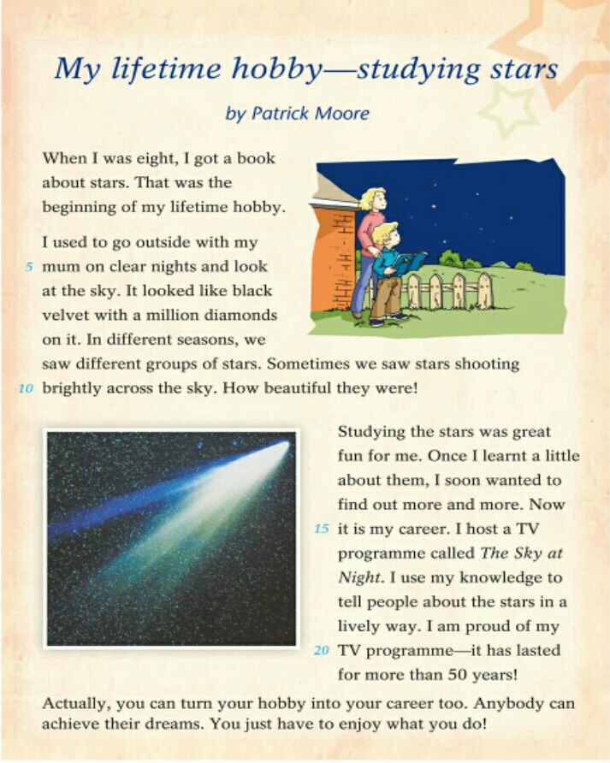
Let’s underline the phrases .

Slide 9
1.When I was eight, I got a book about stars.
= I got a book about stars at the age of 8.
when I was eight = at the age of 8
在我8岁时

Slide 10
2. I used to go outside with my mum on clear nights...
used to do sth.意为“过去常常做某事”，
表示过去经常而现在不再有的行为.
否定形式：didn’t use to
e.g. She used to go to school by bike.
她过去经常骑自行车上学。
【拓展】
used to do 过去做某事
use sth to do sth 用某物去做某事
be used to doing 现在习惯做某事
be used to do sth 被用于做某事
be used for (doing) sth 被用于（做）某事

Slide 11
go inside
go outside 外出
e.g. If you want to make a call, please go outside.
如果你想打电话，请到外面。
at night 在晚上
on a clear night 在一个晴朗的夜晚
on clear nights 在晴朗的夜晚

Slide 12
3. It looked like black velvet with a million
diamonds on it.
look like 看起来像（外貌） ≈ be like（性格）
like :介词
e.g. The cloud looks like a lion.
这云看起来像一头狮子。
like v. 喜欢
e.g. I like listening to English songs.

Slide 13
4. Once I learnt a little about them, I soon wanted to find out ...
once是连词，意为“一旦”，在句中引导 时间状语从句，与as soon as意思相近。
e.g. Once you are successful, you will get some congratulations.
一旦你成功了，你就会得到一些祝贺。
【拓展】
I have read the book once.
Once he liked playing chess.
Once you put your hand in it, you will get hurt.
一次
曾经
一旦…(就…)

Slide 14
a little / more and more （代词）
= a little / more and more knowledge
find out 意为“查明，弄清（情况）”
e.g. I want to find out the truth.
我想查明真相。

Slide 15
5.I host a TV programme called The Sky at Night.
一个叫...的电视节目
a TV programme called ....
一个叫Tim 的男孩
a boy called Tim

Slide 16
6. I use my knowledge to tell people about the stars in a lively way.
use sth. to do sth. 用某物做某事。其中动词不定式短语做目的状语。
e.g. I use my computer to solve a lot of problems in my work.
我用电脑处理工作中的很多问题。
in a lively way 用一种生动的方式
lively: adj. 活泼的，生动的
alive: adj. 活着的，有生命的
e.g. She is a lively child and popular with everyone.
The fish is still alive.

Slide 17
Exercise

Slide 18
Fill in the blanks.
1. She h_____ a TV programme and many people like to watch it.
2. My teachers all teach us in a l____ way. We enjoy them very much.
3. After thinking for a little while, we d______ to carry out the plan.
4. My friend Lily lives a_____ , but he doesn't feel lonely at all.
5. The party started at 8 p.m., and it l______ for two hours.
6. I am teacher now and I really enjoy it. I want to make it as my c_____
hosts
lively
decide
alone
lasted
career

Slide 19
Complete the sentences.
1、在将来，我想成为一名老师。
I want to be a teacher _____ _____ _____.
2、我曾经去河边游泳。
I ____ ____ swim in the river.
3、他经常在星期天外出。
He always ______ ______ on Sundays.
4、越来越多的人来这个博物馆参观。
_____ _____ _____ people come to visit the museum.
5、那些星星看起来像闪闪发光的钻石。
Those stars ______ ______ shining diamonds.
in the future
used to
goes outside
More and more
look like

Slide 20
Homework
1. 再次思考如何将一个人的爱好发展成事业；
2. 完成双语报Reading部分；

Slide 21
Thank you!

