Slide 1

Unit 8
From hobby to career
Writing
广州牛津版七年级下册

Slide 2
C
目 录
ONTENTS
01
Warming up
02
Pre-writing
Writing
03
04
Post-writing

Slide 3


01. Warming up
Guessing game
Guess your classmate’s hobby.
One student describes his / her hobby. Other students guess what the hobby is.

Slide 4
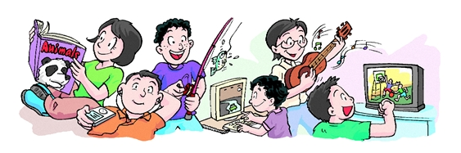
We can also describe our hobby like this:
I like making model trains. Maybe I could become an engineer on a train.
I enjoy making model trains.
My hobby is making model trains.
I often make model trains in my free time.

Slide 5

02. Pre-writing
Finish the word puzzle
w | f | a | h | o | b | b | y | v | n
i | n | t | e | r | e | s | t | e | d
a | j | k | l | u | a | m | t | s | c
v | v | m | p | r | h | k | c | e | l
n | e | c | f | u | n | f | b | f | g
v | c | a | u | r | u | u | w | u | g
n | e | r | l | h | a | t | h | e | r
n | o | e | e | o | j | u | b | r | t
a | j | e | v | k | n | r | l | u | x
u | r | r | m | t | a | e | i | t | b

Slide 6
Let's find out some words about hobby.
w | f | a | h | o | b | b | y | v | n
i | n | t | e | r | e | s | t | e | d
a | j | k | l | u | a | m | t | s | c
v | v | m | p | r | h | k | c | e | l
n | e | c | f | u | n | f | b | f | g
v | c | a | u | r | u | u | w | u | g
n | e | r | l | h | a | t | h | e | r
n | o | e | e | o | j | u | b | r | t
a | j | e | v | k | n | r | l | u | x
u | r | r | m | t | a | e | i | t | b
fun
rest
alone
hobby
career
helpful
in the future
be interested in

Slide 7

Reading

Slide 8
My favourite hobby is reading books. I usually read every day. I read books at home and in the school library. I prefer to read by myself, but sometimes I share books with my friends. I usually read for two hours and then take a break. I like reading because it helps me know more about the world and gives some time to myself. I would like to make my hobby my future job.
(1) What is the writer’s favourite hobby?
(2) How often does he do it?
(3) Where does he do it?
(4) Does he do it alone or with a group of friends?
(5) Why does he like it?
(6) Would he like to make your hobby your future career?

Slide 9
Pair work
In pairs, ask and answer the questions.
1. What is your favourite hobby?
2. How often do you do it?
3. Where do you do it?
4. Do you do it alone or with a group of friends?
5. Why do you like it?
6. Would you like to make your hobby your future career?

Slide 10
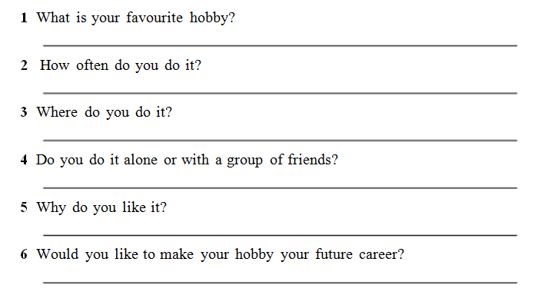

Write down your answer on Page 113.

Slide 11

03. Writing
Writing
My favourite hobby

Slide 12

Share and evaluate!
04. Post-writing
内容 6分 | 内容完整， 体现要点。
准确性 6分 | 语法准确（能够正确使用when引导的时间状语从句和used to结构）， 拼写正确。
流畅性 3分 | 结构连贯， 书写整洁。

Slide 13
05. Homework
1. 完善自己的作文并进行互评；
2. 完成双语报相关练习；

Slide 14
Thank you!

