Slide 1

Unit 7 Poems
Grammar
广州牛津版七年级下册

Slide 2
C
目 录
ONTENTS
01
Presentation
02
Practice
Production
03
04
Homework

Slide 3
Imperatives

Slide 4

01. Presentation.
1. Open the door, Daisy. 2. Listen to me carefully.
3. Be careful. 4. Be quiet, please.
5. Let's go home together. 6. Let's make a million smiles.
7. Don't take photos here. 8. Don't bring your phone to school.
Positive imperatives.
Negative imperatives.
When do we use these sentences?
What do we call them?
We use these sentences to give orders or advice .
They are called imperatives.

Slide 5
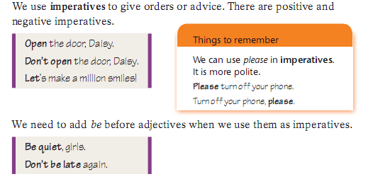
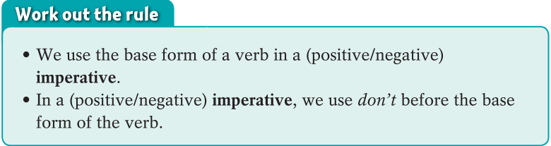
01. Presentation.
1. Open the door, Daisy. 2. Listen to me, please.
3. Be careful. 4. Be quiet, please.
5. Let's go home together. 6. Let's make a million smiles.
7. Don't take photos here. 8. Don't bring your phone to school.

Slide 6
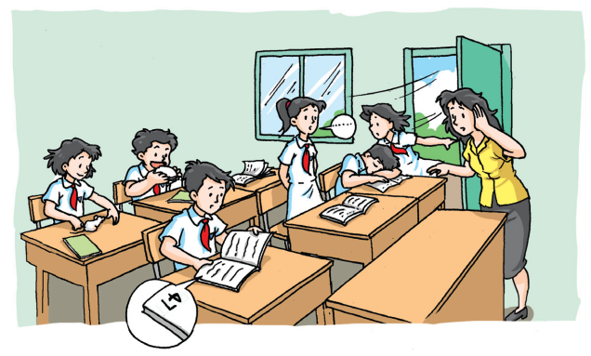
02. Practice.
Look at the picture. What will the teacher say? Make sentences with the words from the box on page 95. Some of them must begin with Don’t.

Slide 7
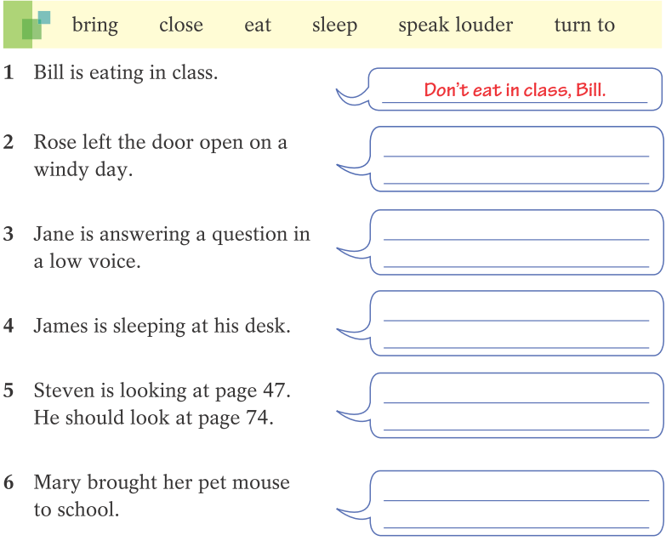
Close the door, Rose.
Speak louder, Jane.
Don’t sleep in class, James.
Turn to page 74, Steven.
Don’t bring pets to school,
Mary.

Slide 8
03. Production.
Students take turns to give orders or advice to other students.
Other students should try to follow the instructions if possible.
eg:
A: Stand up. (All the students stand up.)
B: Touch your nose. (All the students touch their noses.)
...

Slide 9
Exclamations

Slide 10
01. Presentation.
the sentences with emphasis and strong feelings
declarative sentences
exclamations
You sentences are wonderful.
You are so clever.
How wonderful your sentences are!
How clever you are!

Slide 11
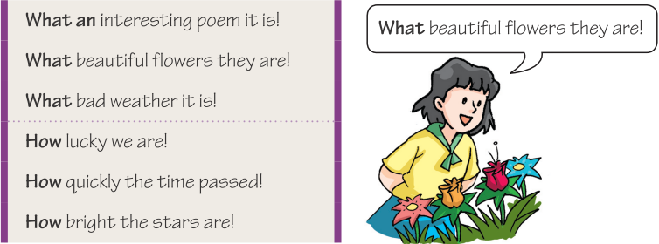
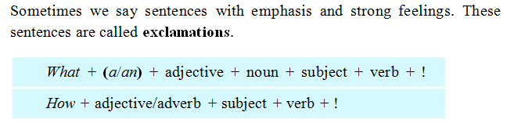

Slide 12
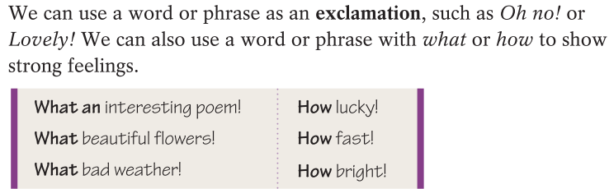

Slide 13
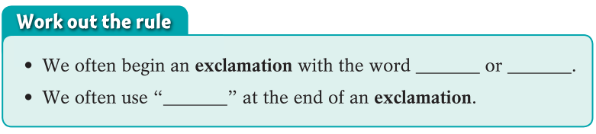
Turn the following sentences into exclamations and read them aloud with feelings.
He is a great man.
He runs fast.
The buildings are tall.
The water is clean.
My dad is tired.
The old man works hard.
What a great man he is! / How great he is!
How fast he runs!
How tall the buildings are! / What tall buildings!
How clean the water is! / What clean water!
How tired my dad is!
How hard the old man works!
what
how
!

Slide 14
02. Practice.
B1 Rewrite the sentences below using exclamations with what or how.
1.You are wearing an old shirt.
What an old shirt you are wearing!
2.The boys are excited.
How excited the boys are!
3.They are friendly people.
What friendly people they are!
How friendly they (those people) are!
4. She studies very hard.
How hard she studies!

Slide 15
B2 Lisa and Bob are talking about their friends. Complete their conversation with the exclamations in the box.
Oh, no! How wonderful! What a lovely baby!
Lisa: Tom won first prize in the speech competition.
Bob: _________________ He must be very happy.
Lisa: Yes. But Jeff hurt his leg when he played basketball.
Bob: ________ How is he feeling now?
Lisa: He’s feeling better. By the way, our Maths teacher had a baby last month. Look, here’s a picture.
Bob: Wow! _________________
How wonderful!
Oh, no!
What a lovely baby!

Slide 16
03. Production.
Use exclamations to show your strong feelings and emphasis.
Remember to say it out with feelings.

Slide 17
Exercise

Slide 18
一 单项选择
1. Jim, _____ me a hand.
A. gives B. is giving C. will give D. give
2. ____ careful, Jenny! A car is coming towards us.
A. Am B. / C. Be D. Was
3. Let's ____ our time.
A. not waste B. no wasting C. not to waste D. no waste
4. —____ higher, and you will see the house.
—OK.
A. If you stand B. To stand C. When you stand D. Stand

Slide 19
5. Please ___ do it.
A. he B. let him C. let he D. him
6. _____ let anyone open the door.
A. Don't B. Will C. Not D. No
7. —Don’t be late again.
—Sorry, ______.
A. I may B. I must C. I will D. I won’t
8. —Call me when you get home.
—OK, ____.
A. I must B. I can C. I will D. I may

Slide 20
二 完成下列感叹句。
________ hard-working student he is!
________ happily the boy laughs!
________ clever students they are!
________ delicious food it is!
________ patient your mother is!
________ exciting news it is!
________ funny the story is!
________ excellent student she is!
________ well he speaks English！
________ fine weather it is today!
What a
How
What
What
How
What
How
What an
How
What

Slide 21
Homework
1. 大声朗读教材中的感叹句。
2. 结合校规，用祈使句为学校写一些英文提示标语，要用礼貌的表达方式。
3. 完成双语报Grammar部分的练习。

Slide 22
Thank you!

