Slide 1
国家安全教育
Thanks a billion for your sacrifice and protection, not an inch of our motherland's territory is lost. Therefore, your contributions will never be forgotten!
感谢你们的拼命守护，祖国的领土一寸也不会丢，你们的贡献祖国不会忘记！

Slide 2
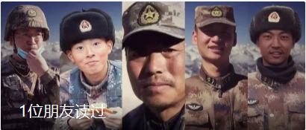
Let’s show our greatest respect for these five heroes

Slide 3
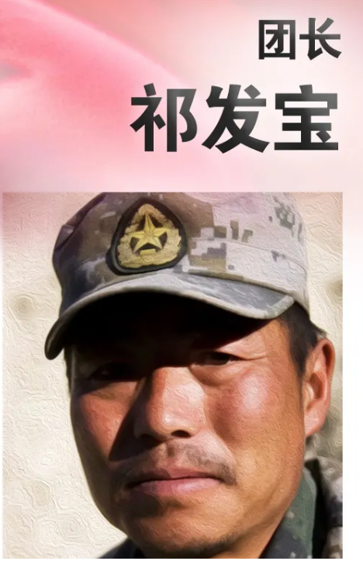



Slide 4
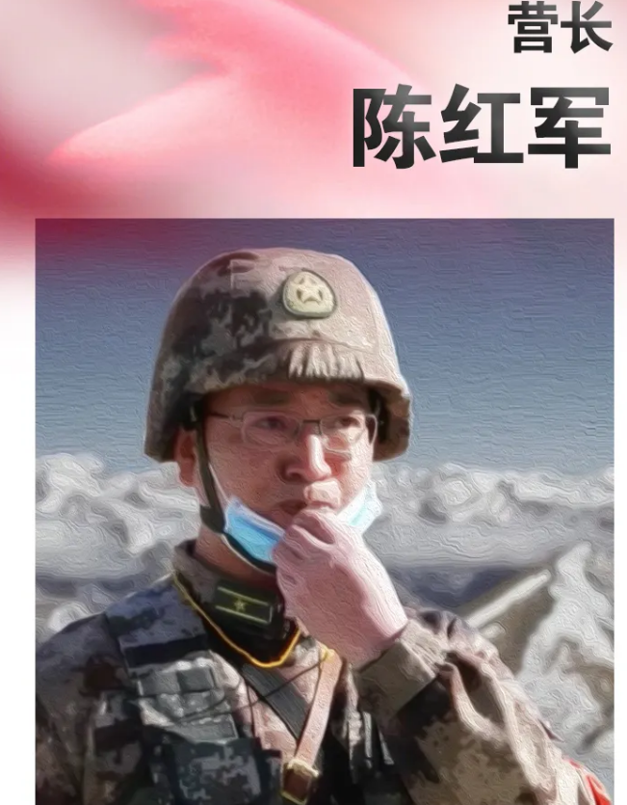

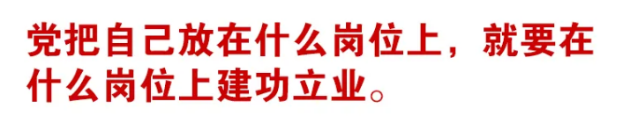

Slide 5
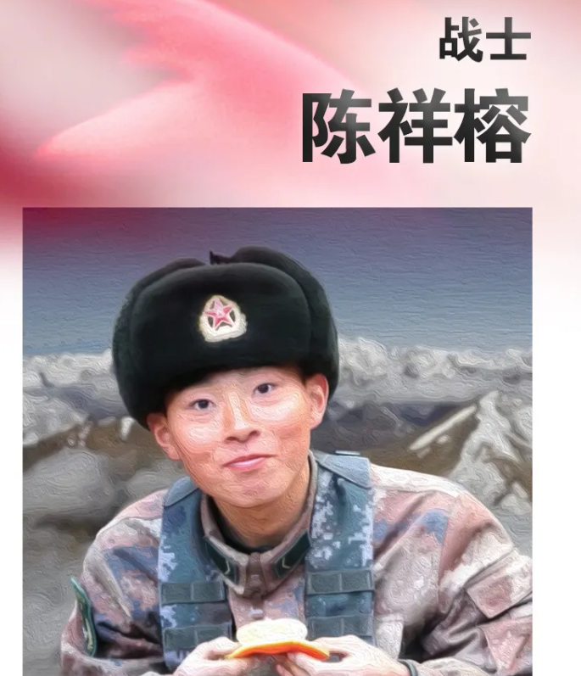



Slide 6
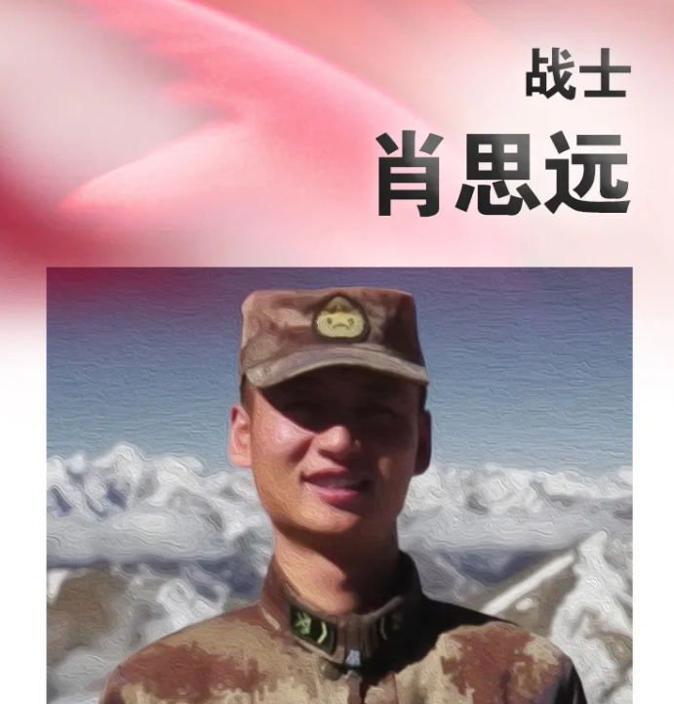
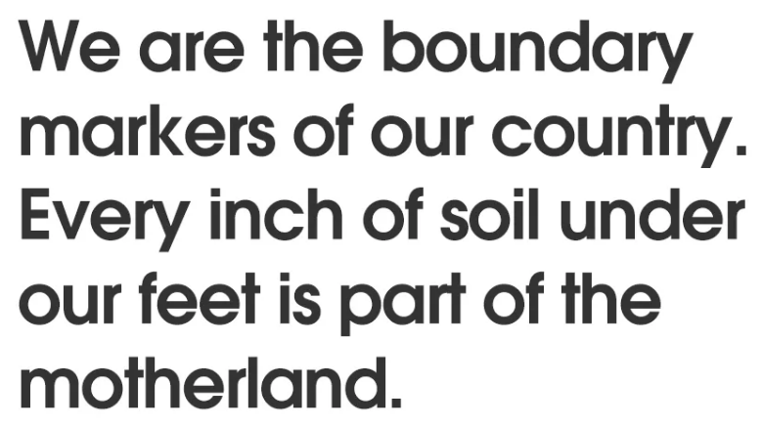
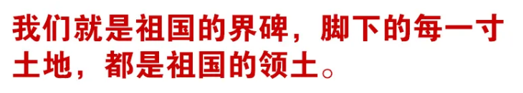

Slide 7
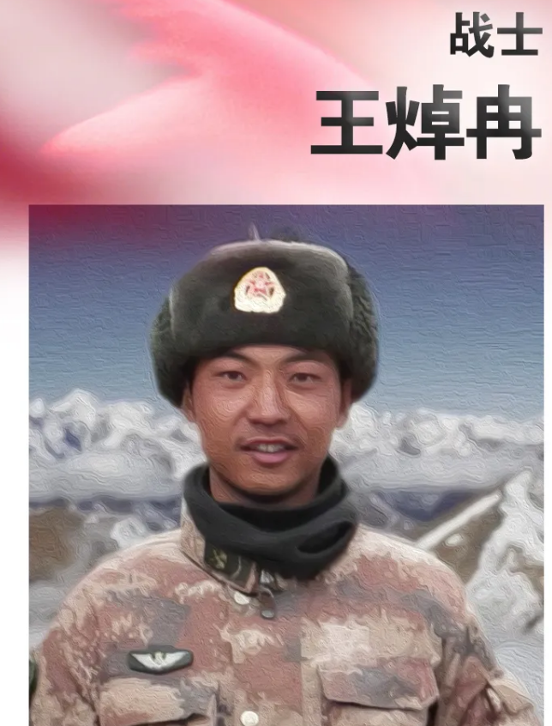
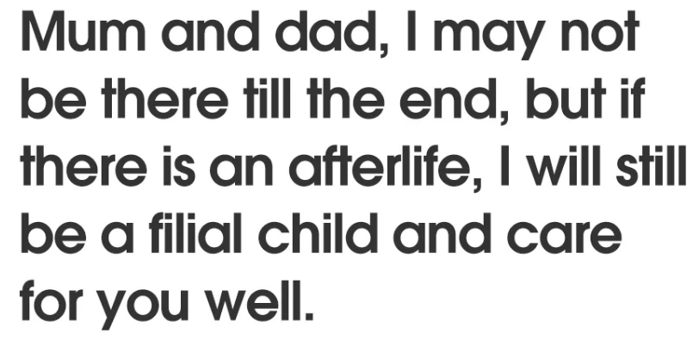
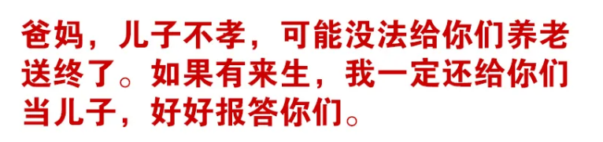

Slide 8
China’s top military authority has conferred posthumous [ˈpɒstjʊməs]死后的 citations [saɪˈteɪʃn] 表彰；嘉奖令 ____ four members of the People's Liberation Army Ground Force ______ died during a border clash ______ Indian troops in June last year the Galwan Valley.
on
who
with
in
中国最高军事当局对去年6月在加尔万山谷与印度军队发生边境冲突时死亡的4名中国人民解放军地面部队成员给予表彰。

Slide 9
This is the first time the Chinese military _________________ (publish) the number of casualties[ˈkæʒəltiz] 伤亡, the names of the _________ (fall) soldiers and ________ (detail) about the border clash with India.
has published
fallen
details
这是中国军方首次公布伤亡人数、阵亡士兵姓名以及与印度边境冲突的细节。

Slide 10
the Indian side has ____________ (repeat) sensationalized 渲染and hyped up 炒作 this incident with the casualties and distorted the truth ____________(mislead) the international public opinion.
repeatedly
to mislead
印方多次渲染和炒作这起伤亡事件，歪曲事实，误导国际舆论。

Slide 11
Now the PLA Daily reveals the truth on the matter _________ people can have a better understanding of really happened and who is right and who is wrong. It is the least we could do to pay tribute ____ these martyrs[ˈmɑːrtərz] 烈士 _______ made the ultimate sacrifice __________ (defend) the country's border.
so that
what
to
who
to defend
人民解放军日报揭露了这件事的真相，以便人们能够更好地了解到底发生了什么，谁对谁错。我们至少应该向这些为保卫国家边界作出最终牺牲的烈士致敬。

