Slide 1
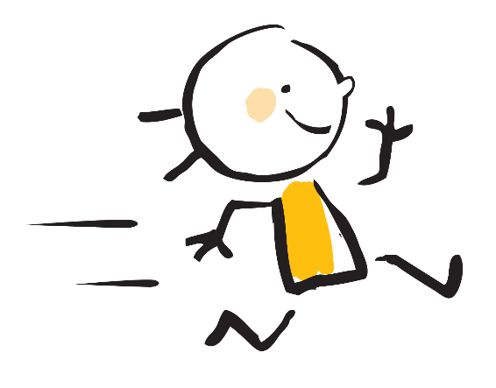

读后续写作文
Continuation

Slide 2

读后续写范例
阅读下面短文，根据所给情节进行续写，使之构成一个完整的故事。
Jenny was a pretty eight-year-old girl.
One day when she and her mother were checking out at the grocery store, Jenny saw a plastic pearl necklace (项链), by which she was totally defeated. How eagerly she wanted it! But when she saw the price, her heart sank a little. She gathered up her courage and asked her mother if she would buy it for her. Her mother said, “Well, it is a pretty necklace, but it costs an awful lot of money. I can buy you the necklace, but when we get home, we should make up a list of housework that you can do to pay for the necklace.” Jenny agreed immediately, feeling a burst of joy. So her mother bought the pearl necklace for her. Jenny worked on her housework determinedly and earnestly every day. Soon Jenny paid off the pearls.
Jenny had a very loving daddy. When Jenny went to bed, he would read Jenny her favorite story. One night when he finished the story, he said, “Jenny, do you love me?” “Oh, yes, Daddy, you know I love you.” the little girl said delightedly (高兴地), with a broad smile on her face. “Well, then, give me your pearls.” Hearing that, Jenny froze there, an anxious expression twisting her face. “Oh! Daddy, not my pearls! But you can have Rosy, my favorite doll. Remember her? You gave her to me last year for my birthday. Okay?” “Oh no, darling, that’s okay.” Her father brushed her cheek with a kiss, gently and calmly. “Good night, little one.”
A week later, her father once again asked Jenny after her story, “Do you love me?” “Oh yes, Daddy, you know I love you.” the little girl murmured softly, trying to escape from her father’s eyes. “Well, then, give me your pearls.” “Oh, Daddy, not my pearls! But you can have Ribbons, my toy horse. Do you remember her? She is my favorite.” The little girl begged. “No, that’s okay,” her father said, smiling broadly and sweetly and brushed her cheek again with a kiss. “God bless you, little one. Sweet dreams.”
注意：1. 所续写短文的词数应为150左右；
2. 应使用5个以上短文中标出下划线的关键词语
2. 续写部分分为两段，每段的开头语已为你写好；
3. 续写完成后，请用下划线标出你所使用的关键词语

Slide 3
Paragraph 1：
Several days later, when Jenny’s father came in to read her story, Jenny was waiting anxiously for him on the bed. ___________________________________________________________________________________________________________________________________________________________________________________________________________________________________________________________________________________________________________________________________________________________________________________________________________________________________________________________________________________________
Paragraph 2：
Holding the plastic pearl his daughter offered, the father dragged out a blue box.____________________________ ________________________________________________________________________________________________________________________________________________________________________________________________________________________________________________________________________________________________________________________________________________________________________________________________________________________________________________________________________________________________________________________________________________________________________________________________________________________________________________________________________________________

Slide 4

Thorough Reading
构思续写的内容
Plot planning
STEPS
Make a draft
Polish your draft

Slide 5

01
Thorough Reading

Slide 6
Thorough Reading
以记叙文为例
读六要素（ Who, What, When, Where, Why, How）
Person：First person? Second person? Third person?
Tense : The simple past tense ? The simple present tense?

Slide 7
Thorough Reading
读六要素（ Who, What, When, Where, Why, How）
注意：有时候一个文本并不具备所有的要素，可能只会涉及其中的三到四个
Who is the main character?
When did the story happen?
Where did the story happen?
What happened in the story?
Why did he want the necklace?
How was the story ended?
Jenny and her daddy
One night when her daddy finished the story
At Jenny’s bedroom
Her daddy wanted her plastic pearl necklace.
He wanted to know which is more important to Jenny, he or her necklace.
Jenny didn’t give it to her daddy.

Slide 8
Thorough Reading
读六要素（ Who, What, When, Where, Why, How）
Who: Jenny and her daddy
What is the story about?
Jenny did a lot of housework in exchange for a plastic pearl necklace . Her daddy asked her twice whether she could give him her necklace. She said no to her daddy.
When: One night when her daddy finished the story
Where: At Jenny’s bedroom
What : Her daddy wanted her plastic pearl necklace.
Why: He want to know which is more important to Jenny, he or her necklace.
How: Jenny didn’t give it to her daddy.

Slide 9
Thorough Reading
Person：First person? Second person? Third person?
A: Third person
Tense : The simple past tense ? The simple present tense?
A: The simple past tense

Slide 10

02
Plot planning

Slide 11
Plot planning
情节: 一般包括开端、发展、高潮、结局等部分。
Characters | Jenny, her mother, her daddy
Beginning | Jenny did a lot of housework in exchange for a plastic pearl necklace.
development | Her daddy asked her twice whether she could give him her necklace. And she said no to her daddy.
Climax | ?
Ending? (your opinion) | ?

Slide 12
Plot planning
The underlined key words:
Jenny
at the grocery store
pearl necklace
Daddy
bed
love
delightedly
give
favorite
kiss
Tip1:
应该选择分别代表
重要信息
主要人物

Slide 13
Plot planning
Infer the plot development according to the given sentences
Paragraph 1：
Several days later, when Jenny’s father came in to read her story, Jenny was waiting anxiously for him on the bed.
Paragraph 2：
Holding the plastic pearl his daughter offered, the father dragged out a blue box.
Tip2: 先留意所给第二段的开头语，里面的一些关键信息必须要在第一段里面有所体现

Slide 14
Plot planning
Tip3: 结合下划线的关键词展开推断
Paragraph 1：
Several days later, when Jenny’s father came in to read her story, Jenny was waiting anxiously for him on the bed.
思考： 根据第二段开头，可知Jenny把项链给了爸爸。可以从动作，对话，情绪等几方面去考虑
1. 门打开了，爸爸走进来。
2. 爸爸发现Jenny心事重重，问她发生什么事了。
3. Jenny坐在那，不回答。
4. Jenny问她爸是不是真的想要她的珍珠项链
5. 答曰是。
6. Jenny把项链给了爸爸。

Slide 15

03
Make a draft

Slide 16

Make a draft
门打开了，爸爸走进来。
__________________________________________________________________________
2. 爸爸发现Jenny心事重重，问她发生什么事了。
__________________________________________________________________________
3. Jenny坐在那，不回答。
__________________________________________________________________________
4. Jenny问她爸是不是真的想要她的珍珠项链
__________________________________________________________________________
5. 爸爸说是的。
__________________________________________________________________________
6. Jenny把项链给了爸爸。
__________________________________________________________________________
The door opened, and Jenny’s father came in.
Jenny’s father found her daughter upset, and asked her what had happened?
Jenny just sat there. She said nothing.
Jenny asked her father whether he really wanted her pearl necklace.
Her father said yes.
Jenny gave it to her daddy.

Slide 17
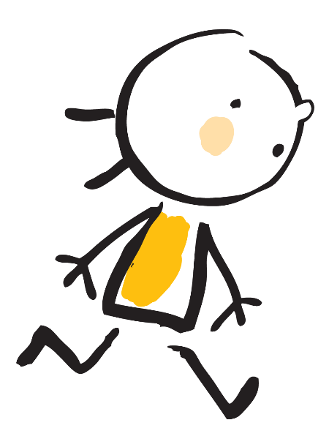
04
Polish your draft

Slide 18
Polish your draft
修改: 保证用上划线的词汇，确保语法正确，替换高级词汇，然后运用各种从句、复合结构、非谓语动词、以及强调句和倒装句等特殊句式
扩写: 增加一些语言描写、动作描写、情绪描写、环境描写，增添语言的丰富性。
1. The door opened, and Jenny’s father came in.
When the door opened, her dad came in, with a story book in his left hand.
2. Jenny’s father found her daughter upset, and asked her what had happened?
Seeing Jenny sitting on the bed with an anxious look, he went over, held her hands, and asked what was the matter.
3. Jenny just sat there. She said nothing.
Shaking her head, Jenny said nothing.

Slide 19
Polish your draft
修改: 保证用上划线的词汇，确保语法正确，替换高级词汇，然后运用各种从句、复合结构、非谓语动词、以及强调句和倒装句等特殊句式
扩写: 增加一些语言描写、动作描写、情绪描写、环境描写，增添语言的丰富性。
4. Jenny asked her father whether he really wanted her pearl necklace.
For a moment, silence filled the room. “Daddy,” Jenny’s voice broke the silence, “Do you really want my pearl necklace?”
5. Her father said yes.
Looking gently into her daughter’s eyes, he nodded with a delighted smile on the face.
6. Jenny gave it to her daddy.
“Okay.” Jenny continued, “Despite my affection for the lovely necklace, it is you and mom that I love much better.” Before her dad could say a word, Jenny took out the necklace from under the quilt and gave it to him.

Slide 20
Last Step
Neat copying

Slide 21
Neat copying
草稿版：
The door opened, and Jenny’s father came in. Jenny’s father found her daughter upset, and asked her what happened? Jenny just sat there. She said nothing. After a while, Jenny asked her father whether he really wanted her pearl necklace. Her father said yes. Jenny gave it to her daddy.
润色版：
When the door opened, her dad came in, with a story book in his left hand. Seeing Jenny sitting on the bed with an anxious look, he went over, held her hands, and asked what was the matter. Shaking her head, Jenny said nothing. For a moment, silence filled the room. “Daddy,” Jenny’s voice broke the silence, “Do you really want my pearl necklace?” Looking gently into her daughter’s eyes, he nodded with a delighted smile on the face. “Okay.” Jenny continued, “Despite my affection for the lovely necklace, it is you and mom that I love much better.” Before her dad could say a word, Jenny took out the necklace from under the quilt and gave it to him.

Slide 22
升级版
Several days later, when Jenny’s father came in to read her a story, Jenny was waiting anxiously for him on the bed. When listening to the story, Jenny was totally absent- minded, with her hands holding the pearl necklace tightly and firmly. When the story came to an end, unexpectedly, Jenny offered her beloved necklace to her father, with her fingers trembling automatically. No one knew what the necklace meant to her. She whispered to her father, softly and gently, “ Daddy, you know I love you more than the necklace.” Then, the necklace slid into her father’s hands determinedly.

Slide 23
Have a try
Paragraph 2：
Holding the plastic pearl his daughter offered, the father dragged out a blue box.

Slide 24
Have a try
Paragraph 2：
Holding the plastic pearl his daughter offered, his father dragged out a blue box. Much to Jenny’s amazement, a beautiful real pearl necklace lay peacefully in the box, which set her heart racing. Jenny froze there, a thrilled expression twisting her face. Before Jenney was able to say something, her father brushed a warm kiss on her face and gathered her into his arms. Holding the genuine necklace in her hand, Jenny lifted her lip, tears beginning to blur her vision.

Slide 25
感谢倾听
Thanks for your watching

