Slide 1
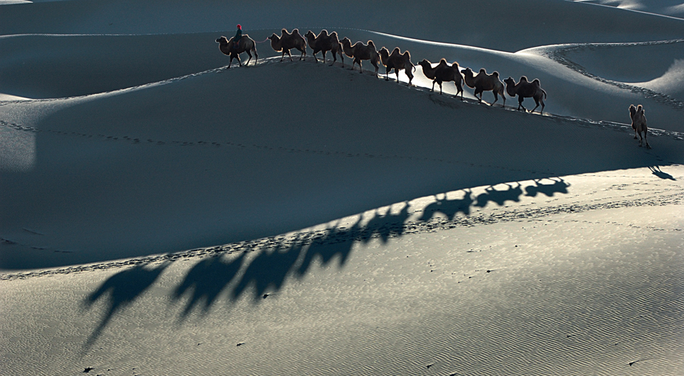
Unit 1 Great explorations
Grammar

Slide 2
目录
Lead-in
1
While-Learning
2
Post-Learning
3
Review
4

Slide 3
Part I Lead-in

Slide 4
用such或so填空
1. This is ____ a difficult Maths problem that nobody in my class can work it out.
2. My sister's hair is ____ long that it touches her waist.
3. He is ____ strong that he can lift the heavy box alone.
such
so
so

Slide 5
用such或so填空
4. I live in ____ a noisy flat that I cannot sleep at night.
5. The ground was ____ hot that you could cook an egg on it.
6. The film was ____ exciting that we were watching on the edge of our seats.
such
so
so

Slide 6
Part II While-Learning

Slide 7

Grammar A
Adverbial clauses of result

Slide 8
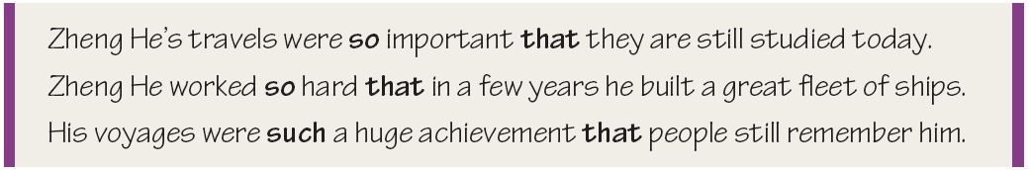
Grammar A
Adverbial clauses of result
We can use so/such … that to talk about the result of an action or
situation. These clauses are called adverbial clauses of result.

Slide 9
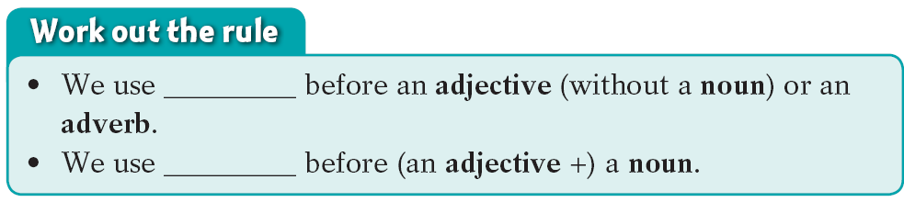
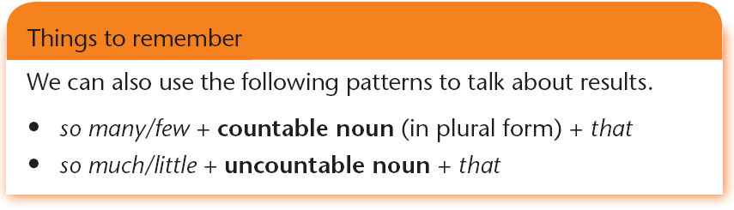
so
such

Slide 10
so…that…如此…以至于… so 是副词常常用来修饰形容词和副词
句型一：主语+谓语+so+adj/adv+that 从句
1. 这个小男孩跑得如此快以至于我赶不上他。
The boy ran so fast that I couldn’t catch up with him.
2. 他如此生气以至于一句话都说不出来。
He was so angry that he couldn’t say a word.
句型二：主语+谓语+so+adj+a/an+单数名词+that 从句
1. 昨天天气如此好，我们都出去野餐了。
It was so fine a day that we all went out to have a picnic.
2. 他是个如此调皮的孩子以至于他经常使他的父母陷入麻烦。
He is so naughty a boy that he always gets his parents
into trouble.
Notes:
10
10

Slide 11
常用结构搭配： 当名词前有many, little, few, much
等表示大小多少的词来修饰时，只能用so, 不能用such
缸里的水如此的少不够用。
There was so little water that it was not enough for all us to use.
有这么多的工作要做，每个人都感觉很厌烦了。
There is so much work to do that everyone feels bored.
注意： 当little 表示“ 小”修饰名词时，还要用such。
They are such little puppies that all the children love them
very much.
Notes:
11
11

Slide 12
such…that…如此…以至于… such 是用来修饰名词的。
句型一：主语+谓语+such+a/an+adj+单数名词+that 从句
=主语+谓语+so+adj+a/an+单数名词+that 从句
1. 这是如此有趣的一本书，以至于大家都喜欢读。
It is such a good book that everyone likes to read it.
= It is so good a book that everyone likes to read it.
2. 这是很有趣的一部电影， 我看了两次。
This is such an interesting film that I saw it twice.
=This is so interesting an film that I saw it twice.

Slide 13
句型二：主语+谓语+such+adj+名词复数+that 从句
1. 他的手臂如此的长几乎能够得到膝盖了。
He has such long arms that he could touch his knees.
句型三：主语+谓语+ such + adj.+不可数名词+that 从句
1. 这是如此好的一个消息，以至于我们听了都很激动。
It was such good news that we all felt excited after hearing
it.

Slide 14
用so … that …或such … that …填空。
1. 她是如此疲惫，以致于很快就睡着了。
She was ____ ____ ____ she fell asleep quickly.
2. 这是一本非常有趣的小说，以致于我读了三遍。
It was ______ ____ _________ novel that I read it
three times.
3. 他跑得非常快，没人能追上他。
He runs ____ ____ ____ nobody can catch up
with him.
4. 玛丽有如此多的工作要做，以致于她整天呆在办
室。
Mary had ____ _____ _____ to do that she stayed
in her office all day.
so tired that
such an interesting
so fast that
so much work

Slide 15
so … that /
such … that用法小结
so |  | that
such |  | that
adj. / adv.
many / few + 可数名词复数
much / little + 不可数名词
adj+a/an+可数名词单数
a/an + adj. + 可数名词单数
adj. + 可数名词复数
adj. + 不可数名词

Slide 16
Join the sentences in column A and column B with so … that or such … that.
The fleet of ships was huge.
The Silk Road was long.
The Pacific is a big ocean.
There were many men on
the ship.
It passed through many countries.
It takes many days to cross it.
The ship’s cook was always busy.
People could see it from far away.
The fleet of ships was so huge that people could see it from far away.
1________________________________________
2________________________________________
3________________________________________
4________________________________________
The Silk Road was so long that it passed through many countries.
The Pacific is such a big ocean that it takes many days to cross it.
There were so many men on the ship that the ship’s cook was always busy.

Slide 17
Use “so…that…/ such…that” to rewrite the sentences
1)The story was so funny that it made us laugh.
=
2)It is such an interesting book that I want to
read it again.
=
It was such a funny story that it made us laugh.
The book is so interesting that I want to read...
2. so many/ much/ little/ few + N … that…
1)He made _______mistakes that he didn’t pass the exam.
2) There is ________time left that we had to hurry up .
so many
so little

Slide 18

3.Use “so… that…/such…that…” to make sentences.
Make sentences with adverbial clause.
For example:
music…soft…feel relaxed
The music was so soft that the girl felt relaxed.
It is such soft music that the girl felt relaxed.

Slide 19
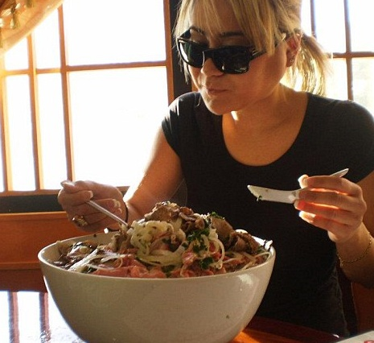
Make sentences with adverbial clause.
food…delicious…can’t stop eating
The food is so delicious that the woman can’t stop eating it.
It is such delicious food that the woman can’t stop eating it.

Slide 20
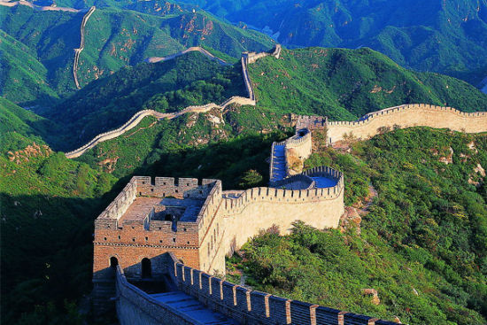
Make sentences with adverbial clause.
The Great Wall … famous…millions of …
every day
The Great Wall is so famous that millions of people visit it every day.
The Great Wall is such a famous place that millions of people visit it every day.

Slide 21
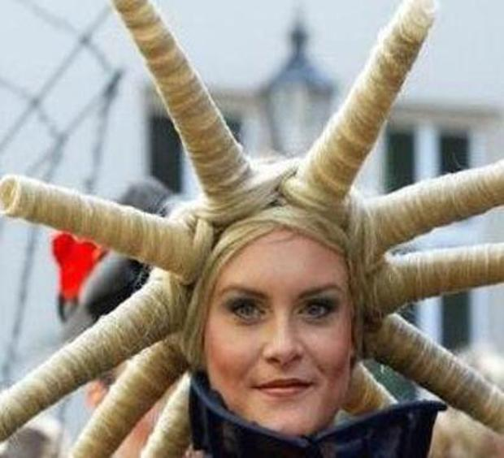
Make sentences with adverbial clause.
her hairstyle … strange … can’t help(忍不住)looking
Her hairstyle is so strange that people can’t help looking at her .
Her hairstyle is such a strange one that people can’t help looking at her.

Slide 22

Grammar B
too...to

Slide 23

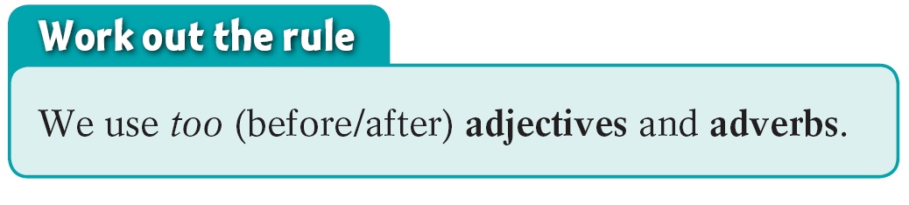
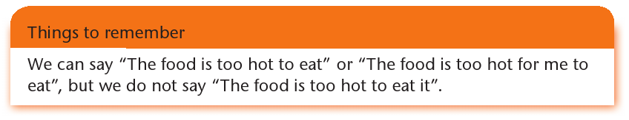
Grammar B too … to
We can use too ... to to talk about results. We sometimes add for + noun/pronoun before to-infinitives.

Slide 24
Complete the following conversation with too … to and the words in brackets.
Mandy: Did you hear what the teacher said at the end of
the class?
Jason: No. I was 1)______________________(far
away/hear) her.
Mandy: She told us to hand in our homework on Friday,
so I need to talk to you about it.
Jason: Well, I’m afraid it’s 2)______________________
(noisy here/us/talk).
Mandy : Let’s go to the library then.
too far away to hear
too noisy here for us to talk

Slide 25
Jason : It’s 3)______________(early/go) to the library. It isn’t open yet.
Mandy: Why don’t we just sit in the garden and talk
here?
Jason: But it’s 4)__________________(cold/us/sit)
outside. By the way, what’s the topic of the
homework?
Mandy: It’s a question: “Would you like to be a great
explorer?”
Jason : My answer is “no”! I’m 5)________________
(afraid/explore) new places.
Mandy: Why? It must be so exciting to be an explorer!
too early to go
too cold for us to sit
too afraid to explore

Slide 26
Combine the sentences with too … to according to the example.
1. I’m very sleepy. I can’t do my homework.
I’m too sleepy to do my homework.
2. My grandfather is very old. He can’t travel.
My grandfather is too old to travel.
3. I’m very bored. I can’t listen to this lecture any
longer.
I’m too bored to listen to this lecture any longer.
4. Sally is very tired. She can’t climb the mountain.
Sally is too tired to climb the mountain.
5. I was very afraid. I couldn’t move.
I was too afraid to move.

Slide 27
Combine the sentences with too … to according to the example.
6. Molly was very ill last week. She couldn’t go to
school.
Molly was too ill to go to school last week.
7. My pet dog is very fat. It can’t run.
My pet dog is too fat to run.
8. My grandmother is very deaf. She doesn’t hear
what people say.
My grandmother is too deaf to hear what people
say.

Slide 28
Grammar C
enough to

Slide 29
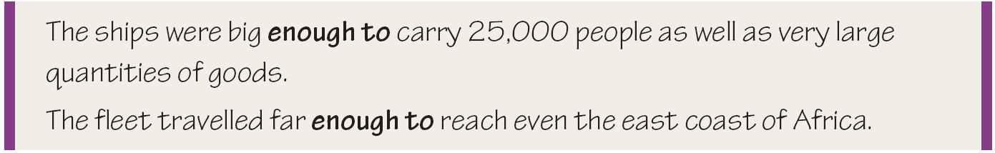
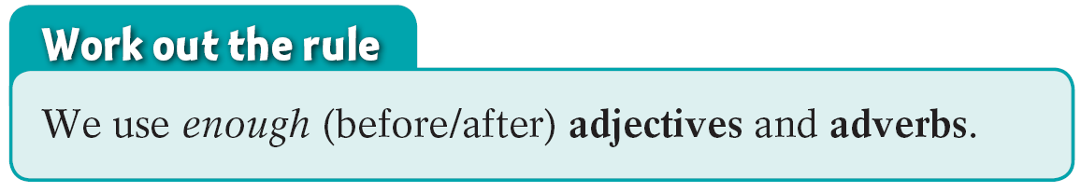
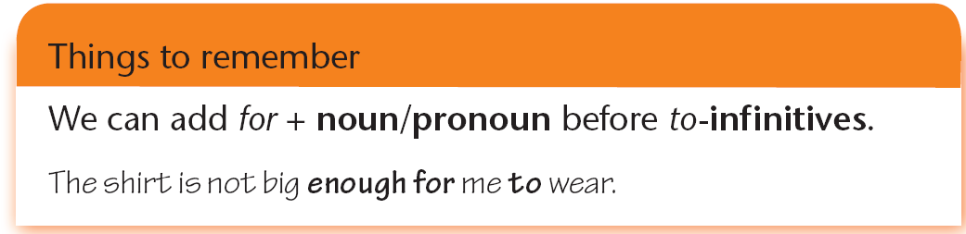
Grammar C enough to
We can also use enough to to talk about results.

Slide 30
C1.When are you old enough to do these things? Fill in the table below.
Activity | Age | Activity | Age
choose your own clothes |  | travel alone
stay at home alone |  | learn to drive a car
have a part-time job |  | live on your own

Slide 31
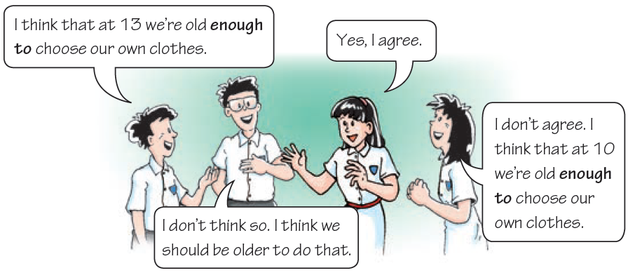
Work in groups of four. Compare your table in C1 with your group members’. Then talk about it. Follow the example.

Slide 32

Pair Work
Pick a number from 12, 13, 15, 16, 17, 18,20, 21 for your partner, and your partner have to make up a sentence with “be (not) old enough to do ” according to the graph on the next page, then you two switch to make another sentence.

Slide 33
In Britain ——Can you …at the age of …?
When you are …3 | you can …
13 | Work part-time
16 | Leave home
17 | Leave school
18 | Drive a car
18 | vote
18 | Change your name
21 | Drive a bus
16
are old enough
Eg: You are ______ years old ,you __________________ to work part-time.

Slide 34
Part III Post-Learning

Slide 35
拓展
too…to…
so…that…
not…enough to…
三个句型的相互转换：
他太小而不能上学。
He is too young to go to school.
=He is so young that he can’t go to school.
=He is not old enough to go to school.
在什么情况下三者可以相互转换呢？

Slide 36
A. so…that与too…to的转换
1.当that引导的从句为否定式,且从句主语与主句的
主语相同时，so…that可转换为too…to结构。例如：
She is so young that she can’t go to school.
＝She is too young to go to school.
2. 若从句主语与主句的主语不相同时，so…that可
转换为too…for sb to结构。例如：
The box is so heavy that he can’t carry it.
＝The box is too heavy for him to carry.

Slide 37
B. so…that与enough to的转换
一、当that引导的从句为肯定式时
1.若从句主语与主句主语相同时，so…that可转换为enough to结构。例如：
Xiao Lin is so old that he can go to school.
＝Xiao Lin is old enough to go to school.
2. 若从句主语与主句主语不相同时，so…that可转换为enough for sb to结构。例如：
The box is so light that he can carry it.
＝The box is light enough for him to carry.

Slide 38
二、当that引导的从句为否定式时
1. 若从句主语与主句主语相同时，so…that可转换为enough to的否定结构；同时要注意，转换后的形容词（副词）要用其相应的反义词。
The man is so old that he can’t go to work.
=The man isn’t young enough to go to work.
2.若从句主语与主句主语不相同时，so…that可转换为enough for sb to的否定结构。同时要注意，转换后的形容词（副词）要用其相应的反义词。
The desk is so heavy that I can’t move it.
＝The desk isn’t light enough for me to move.

Slide 39
enough to的句式为否定式时，enough to可以转
换为too…to结构。
但转换后的too…to结构中的形容词（副词）要用相
应的反义词。例如：
He is not old enough to do the work.
＝He is too young to do the work.
The problem is too difficult for me to work out.
=The problem isn’t easy enough for me to work out.

Slide 40
Practice
1. The soup is so hot that l can't have it.
用too … to 和not ... enough to句型转化。
2. This question is too difficult for us to work out.
用not ... enough to 和so ... that 句型转化。
The soup is too hot for me to have.
The soup is not cool enough for me to have it.
This question is so difficult that we can't work it out.
This question is not easy enough for us to work out.

Slide 41
3. The forest is so big that we can‘t walk out of it.
用too…to 和not .. enough to 句型转化。
The forest is too big for us to walk out of it.
The forest is not small enough for us to walk out of it.

Slide 42
4. The diver drinks too much beer to drive the car safely.
用not .. enough to 和so...that 句型转化。
5. The boy is too young to go to school.
用not .. enough to 和so...that 句型转化
The driver drink so much beer that he can't driver the car safely.
The driver drinks beer not less enough to drive the car safely.
The boy is so young that he can't go to school.
The boy is not old enough to go to school.

Slide 43
Part IV Review

Slide 44
一、用so, such, such a或such an填空。
1. He was ________ excited that he couldn't get sleep.
2.There is ________ much food in the fridge that we don’t need to buy anything.
3. This is_________ funny story that we all enjoy listening to it.
4. It was ________ bad weather that he had to stay at home.
5. They are __________ lazy boys that they never do anything.
so
so
such a
such
such

Slide 45
二、将下列句子改为同义句。
1. The book is interesting enough for everybody to read.
The book is ____ interesting ____ everybody likes to read it.
2. The boy is so short that he can’t reach the buttons of the lift.
The boy is ____ short ____ _____ the buttons of the lift.
The boy isn’t ____ ______ ____ _____ the buttons of the lift.
so
that
too
to reach
tall enough to reach

Slide 46
三、根据中文意思完成句子。
1. 他年纪太小了还不能够上学。
He is ____ ____ ____ go to school.
2. 你的建议是如此有帮助以至于我们及时完成了任务。
Your suggestions were ____ useful ____ we finished the task in time.
3. 这个会议室足够大可以容纳500人。
The meeting room ____ ____ ______ ____ hold 500 people.
too young to
so that
is big enough to

Slide 47
Thank you!

