Slide 1
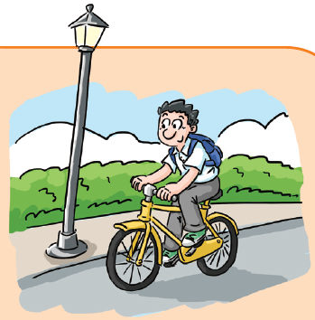
Unit 3 The environment
Writing

Slide 2
目录
Review
1
Pre-Learning
2
While-Learning
3
Post-Learning
4

Slide 3
Part I Review

Slide 4
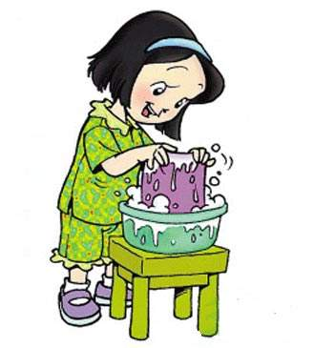
What can we do to be GREEN?
Wash our clothes by hand.

Slide 5

Save water and remember to
turn off the tap after washing hands.

Slide 6

Use shopping bags
instead of plastic bags.

Slide 7
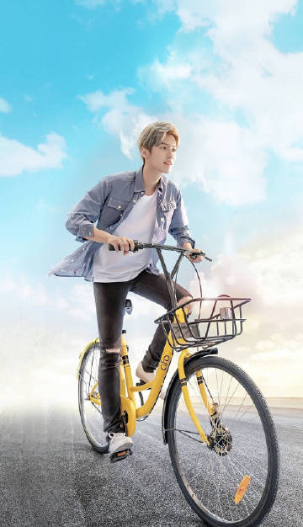
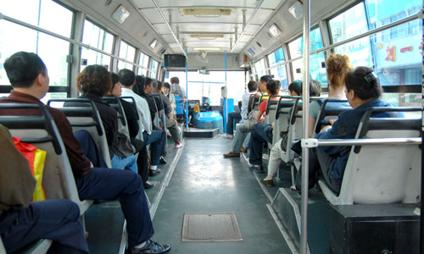
Ride a bike or take a bus when we go out.

Slide 8
Part II Pre-Learning

Slide 9
Read and answer
Read the introduction and answer the questions.
Your school is going to encourage students to protect the environment by introducing a cartoon character called Gary Green. He will act as a role model for the students.
What is your school going to encourage students to do?
How is your school going to do it?
What is the name of the cartoon character?
To protect the environment.
By introducing a cartoon character.
Gary Green.

Slide 10
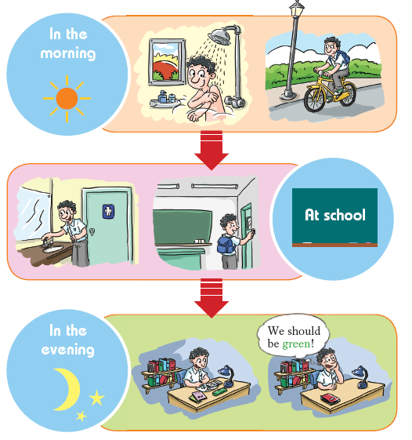
Brainstorm
Look at the pictures in A and brainstorm ideas with your classmates of Gary Green’s good habits.
save water
save energy
What can we learn from Gary Green?
recycle resource

Slide 11
Part III While-Learning

Slide 12
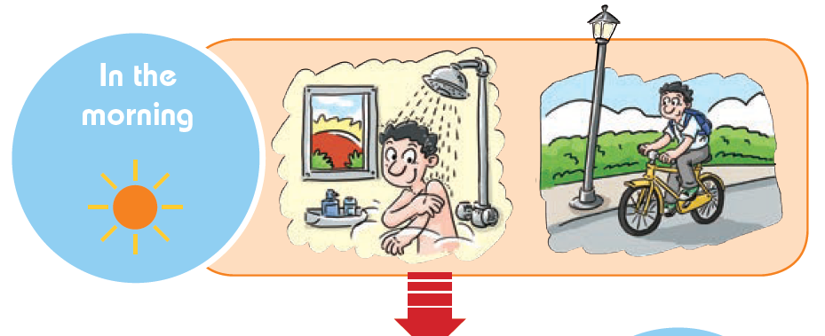
Gray Green
He will act as a role model for the students to encourage them to protect the environment

Slide 13
A day in the life of Gray Green
Take a shower instead of a bath.

Slide 14
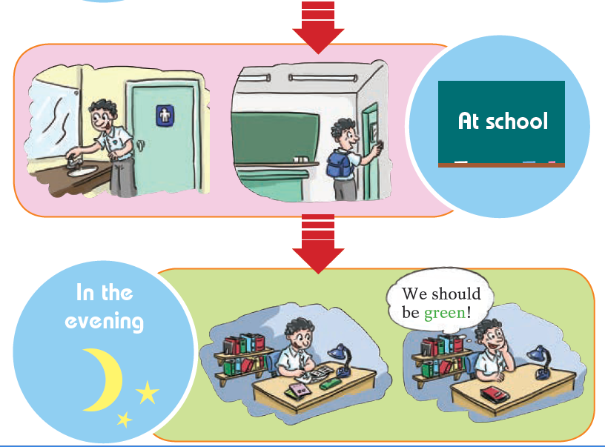
Turn off the tap and lights
when leaving the classroom.

Slide 15
Use both sides of paper
when doing homework.

Slide 16
S1: What does Gary do in the morning?
S2: He takes a shower.
S1: How does Gary go to school?
S2: He goes to school by bike.
S1: What does Gary do after he washes his hands?
S2: He turns off the tap.
S1: What does Gary do when he leaves the classroom?
S2: He switches off the lights.
S1: What does Gary do when he does his homework?
S2: He uses both sides of the paper.
S1: Do you think Gary is green?
S2: Yes.

Slide 17
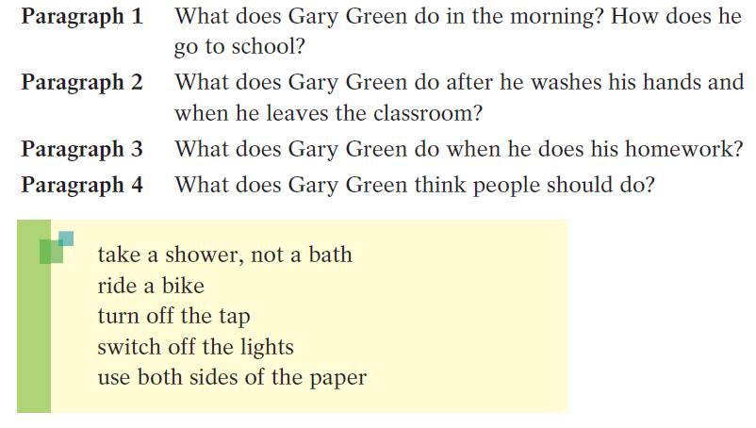
B Use the outline and expressions below to write an introduction to Gary Green.

Slide 18
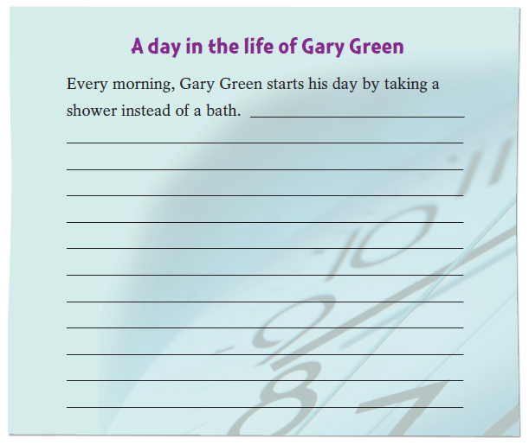
Write your article

Slide 19
A day in the life of Gary Green
Every morning, Gary Green starts his day by taking a shower instead of a bath. He usually rides a bike to school.
At school, Gary always turns off the tap after he washes his hands. When he leaves the classroom, he switches off the lights.
Gary uses both sides of the paper when he does his homework in the evening.
Gary thinks that in order to protect the environment, people should all be green.

Slide 20
Part IV Post-Learning

Slide 21
Brainstorm
What does Gary Green think people should do to be green? Brainstorm ideas with your classmates.
How to be green

Slide 22


Make a poster about Gary Green’s suggestions for being green.
1.___________________________
2.___________________________
3.___________________________
4. …

Slide 23
Language points
He will act as a role model for the students.
他将充当学生的楷模。
解析：act as 意为“充当；担任”，表示身份或
职业时，可与work as 互换。表示担任独一无二的
职务时，职务名词前面通常不用冠词。

Slide 24
act as还有“起……作用”之意。例如：
我不在时他担任经理。
He acted as manager during my absence.
他获选担任我们的领导。
He was chosen to act as our leader.
这枚硬币可以起到螺丝刀的作用。
This coin may act as a screwdriver.

Slide 25
选择填空。
( )1. Besides ____ stamps, I like making model planes.
A. collect B. collecting
C. to collect D. collected
( )2. Mrs White as well as her children ____ invited to
the party.
A. be B. are C. were D. was
( )3. ____ this unit, we must learn another two units
before the exam.
A. Except B. Besides
C. In addition D. Except for
B
D
B

Slide 26
完成句子。
1.他不仅是个老师，还是个作家。
He is a teacher _____ _____ _____ a writer.
2. 盒子里面可能有东西。
_____ _____ _____ something in the box.
3. 这个公园被称为“颐和园”。
This park _____ _____ _____ the Summer
Palace.
as well as
There may be
is known as

Slide 27
Thank you!

