Slide 1
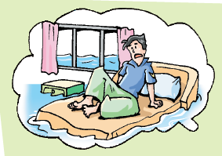
Unit 4 Natural disasters
Grammar

Slide 2
目录
Lead-in
1
While-Learning
2
Post-Learning
3
Review
4

Slide 3
Part I Lead-in

Slide 4
请说出各句中it的作用。
1. It is easy to understand why he has not come back.
代替动词不定式短语
2. It is winter now.
表示季节
3. It seems strange that they arrived at the same time.
代替that从句
4. It is two blocks to the nearest bank from here.
表示距离
5. It is hot in summer and cold in winter in that city.
表示天气
6. It is ten thirty now.
表示时间

Slide 5
Part II While-Learning

Slide 6

Grammar
Using it as the empty subject

Slide 7
Using it as the empty subject
We can use it as the empty subject like this:
It is one o’clock.
It is summer now.
It rained all day.
It is only a five-minute walk from my home to the school.
It is hot in this room.

Slide 8
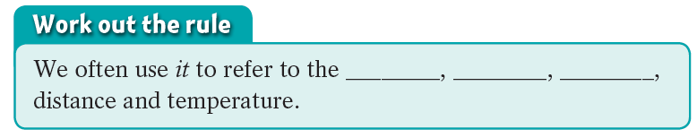
It’s nine o’clock in the morning. My bedroom floor is a pool of water.
time
season
weather

Slide 9
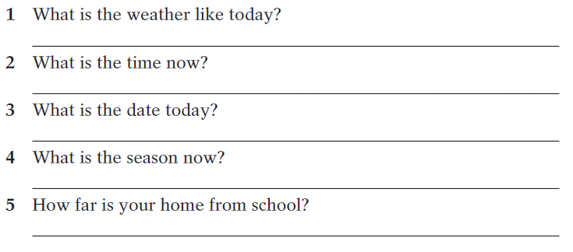
A Answer these questions using it as the subject.
It’s hot.
It’s ten o’clock in the morning.
It’s 31 March, 2021.
It’s summer now.
It is about 20-minute walk from my home to the school.

Slide 10
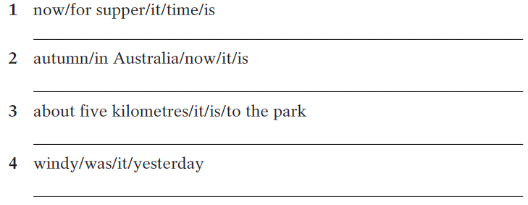
B Put the words in the correct order to make meaningful sentences.
It is time for supper now.
It is autumn in Australia now.
It is about five kilometres to the park.
It was windy yesterday.

Slide 11
We can also use it as the empty subject of a sentence to
replace a to-infinitive.
It’s important to stick with it.

Slide 12
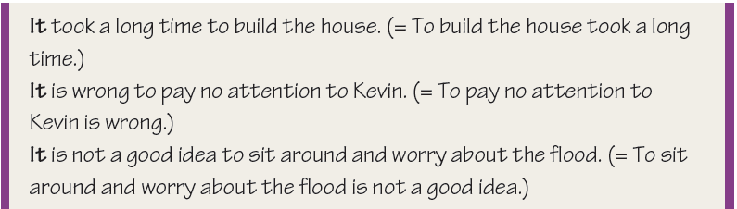
We can also use it as the empty subject in the following sentence pattern:
It seems/appears that …

Slide 13
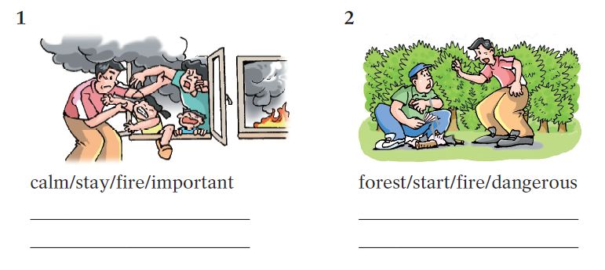
C Write a sentence using it and a to-infinitive under each picture below.
It is important to stay calm when there is a fire.
It is dangerous to start a fire in the forest.

Slide 14
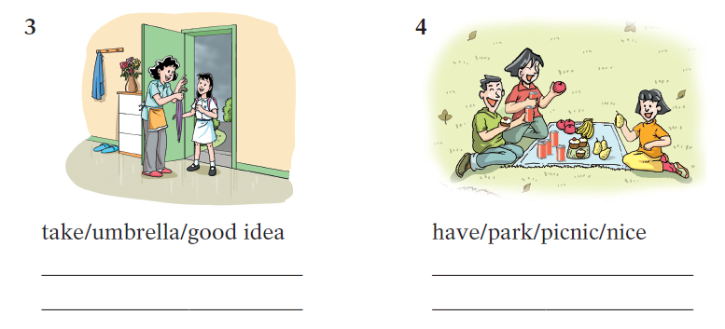
C Write a sentence using it and a to-infinitive under each picture below.
It is a good idea to take an umbrella.
It is nice to have a picnic in the park.

Slide 15
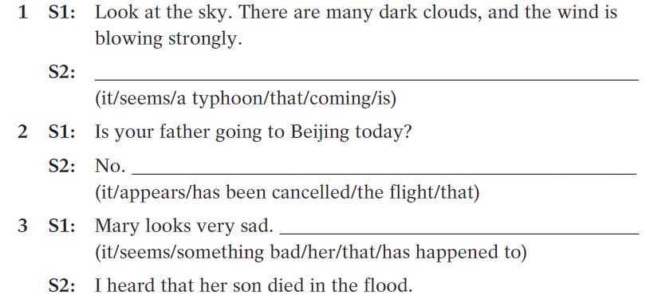
D Put the words in brackets in the correct order to complete the conversations.
It seems that a typhoon is coming.
It appears that the flight has been cancelled.
It seems that something bad has happened to her.

Slide 16
Part III Post-Learning

Slide 17
It作形式主语常见句型
用It作形式主语放到句首， 指代动词不定式，动词的ing形式和主语从句，通常把它们放在谓语动词后，常见句型有：
1. It + 动词 +形容词/名词/过去分词/不及物动+主语从句
It is uncertain whether he can come back or not.

Slide 18
这类名词有a fact, a pity, a shame, an honour, a question
这类过去分词有：announced, believed,
expected, hoped, decided, reported, said, shown 等，如：
It is reported that 16 people were killed in the flood.
这类不及物动词有: appear, happen, seem等，如：
It seemed that he didn’t tell the truth.
It happened that I was out when he called.
It remains a question whether he will come or not.

Slide 19
It作形式主语常见句型
2. It + be + adj./n. + for/of sb+ 动词不定式, 如：
It’s necessary for the young to learn Chinese well.
It is unwise of you to give your son whatever he wants.
3. It is no use/good/a waste of time doing sth.
It's no good drinking too much Coke.
4. It + takes ( sb )+ 时间（金钱）+ 动词不定式，如：
It took the workers three years to finish building the
tower.

Slide 20
Part IV Review

Slide 21
一、用it及be的适当形式填空。
1. __________ very expensive to travel by plane.
2. __________ easier to keep the environment clean if we don’t throw so much rubbish away.
3. He warned us that __________ dangerous to go out alone at night.
4. __________ a good idea to eat everything slowly?
5. __________ said that Jim has gone to America for further study.
It is
It will be
it was
Is it
It is

Slide 22
二、选择最佳答案填空。
1. It is generally considered unwise to give a child ____.
he or she wants.
A. however B. whatever
C. whichever D. whenever
2. In fact ____ is a hard job for the police to keep order
in an important football match.
A. this B. that C. there D. it
3. ____ is a fact that English is being accepted as an
international language.
A. There B. This C. That D. It
B
D
D

Slide 23
4. Is ___ necessary to take off our shoes when we
enter the lab?
A. everyone B. this C. her D. it
5. ____ will take you a lot of time to find him in the
crowd.
A. It B. I C. We D. They
6. It is no use ____ there, the situation is hopeless
now.
A. to go B. to be going
C. going D. having gone
D
A
A

Slide 24
7. It is never too late to learn, ____?
A. is it B. isn’t it
C. does it D. doesn’t it
8. ____ is known to all that Shenzhou VI launched
successfully.
A. As B. What C. It D. That
9. ____ is reported in the newspaper, the Earthquake
in East China's Jiangxi Province killed 13 people.
A. It B. As C. That D. What
A
C
A

Slide 25
10. ____ certain that his invention will make people’s
life convenient.
A. That’s B. This is C. It’s D. What’s
11. ____ that there is another football match on
the air this evening.
A. It says B. It was said
C. It is said D. What was said
12. ____ that their daughter got an opportunity
to study abroad.
A. It’s a exciting news B. This is an exciting news
C. This is exiting news D. It’s exciting news
C
C
D

Slide 26
Thank you!

