Slide 1

Unit 1 A land of diversity

Slide 2
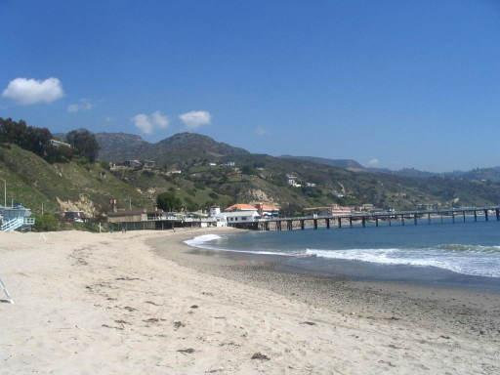
Learning about language
Discovering
useful words
and expressions

Slide 3
Complete the following chart with
new words from the text.
Adjective | Noun
major
hard
 | race
distinct
majority
hardship/hardness
racial
distinction

Slide 4
Adjective | Noun
Italian
 | Korea
 | Pakistan
 | Denmark
Italy
Korean
Pakistani
Danish

Slide 5
2 Complete these sentences, using
new words from the text.
A _______ country consists of a group of
states.
2. That is the biggest _______ church I have
ever seen.
federal
Catholic

Slide 6
3. The ________ of us voted for Mr Red, who
then became chairman of the committee.
4. The ________ of Education is one of the
government departments.
5. The economic ______ in recent years has
created more job opportunities.
6. _______ shaped like a boot lies in the south
of Europe.
majority
Ministry
boom
Italy

Slide 7
7. We should draw a __________ between
right and wrong.
8. To make the crossing from Shandong to the
Northeast, our ancestors suffered all kinds
of _________.
9. The people from South or North _______
are called Koreans.
10. Nobody knows who will be _________ as
president or vice president of this country.
distinction
hardships
Korea
elected

Slide 8
3 Choose the words and phrases to fill
in the blanks, changing their forms if
necessary.
aircraft crossing by means of
make a life rail strait Arctic

Slide 9
My nephew’s first holiday to the ______ was a
delight. The scenery and the icebergs excited
him. Looking across the Bering _____ into
Russia was something he would remember
forever. To make the ________ between these
two great countries seemed as if it would take
no time at all! Then he travelled across the
ice ___________ a dog sled. It made the
journey he had earlier done by _______ seem
very ordinary.
Arctic
strait
crossing
by means of
rail

Slide 10
When he reached the North Pole, he found
nothing exciting except for a sign marking
the spot, but he did meet some scientists there
who were studying the melting of the ice
______________and for themselves among
the snowyhills and plains. After a short break
he took the local ________to fly back to
Alaska and the sea voyage back home!
making a life
aircraft

Slide 11
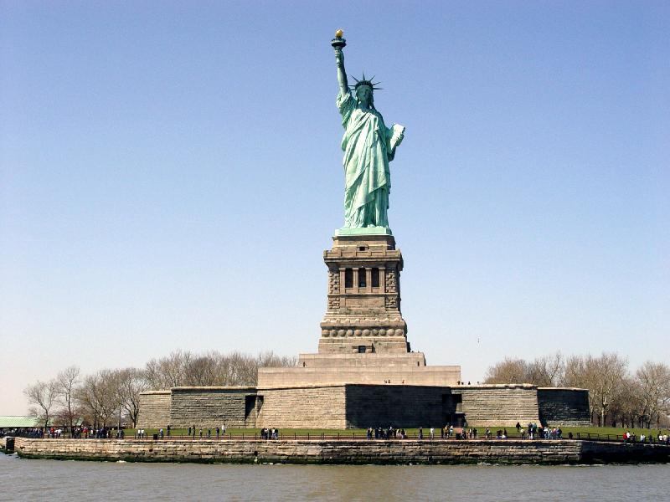
Revising
useful
structures

Slide 12
subject clause
主语从句
object clause
宾语从句
Noun Clauses
名词性从句
predicative clause
表语从句
appositive clause
同位语从句

Slide 13
名词性从句相当于名词,可分别作主句的主语、
表语、宾语和同位语。因此,名词性从句可
分为主语从句、表语从句、宾语从句和
同位语从句。
1. What it was to become was a mystery.
2. I don’t know who will help Henry to
win the bet.
3. His trouble is that he doesn’t know
anybody in London.
4. The fact that ships can go there surprises
many people.
主语从句
宾语从句
表语从句
同位语从句

Slide 14
1. 主语从句：从句在句中充当主语成分
2. 宾语从句：从句在句中充当宾语成分（ 可以作谓语动词、介词、不定式等非谓语动词的宾语）
3. 表语从句：从句在句中充当表语成分，一般放在连系动词之后。
4. 同位语从句：从句在句中充当同位语成分，其一般跟在一些抽象名词(idea, belief, fact, truth, problem, news等)后面, 对名词作进一步解释说明。

Slide 15
1. 主语从句
做主语用的名词性从句, 因其在复合句
中做主语, 又称主语从句, 引导主语从句
的有连词 that, whether, 连接代词 who,
what, which, 连接副词 when, where,
how, why 等。

Slide 16
That she left him cut him to the heart.
What seems easy to some people seems
difficult to others.
Whether it will please them is not easy
to say.

Slide 17
1. 主语从句在复合句中充当主语，大多数主语从句都可以用 it作形式主语而把主语从句置于句尾。
2. that引导的主语从句时可用it作形式主语，that不可省；但 what引导的主语从句表示“……的东西”时，一般不用it作形式主语，whatever，whoever，whichever一般也不用it作形式主语。

Slide 18
That she will succeed is certain.
→It is certain that she will succeed.
她肯定会成功的。
What he needs is more experience.
他所需要的是更多的经验。

Slide 19
  (1)It＋系动词＋形容词(necessary，right，likely，unlikely，wrong，important，certain，clear，obvious，strange，normal等)＋that从句
  It is certain that most of the farmers have brought in more money by all means.
  很明显大多数农民通过各种方式赚了更多钱。

Slide 20
  (2)It＋be＋名词(短语)(a pity，a shame，good news，a fact，an honour，a wonder，no wonder等)＋that从句
  It's no wonder that you've achieved so much success.
  难怪你取得了这么多成绩。

Slide 21
(3)It＋be＋过去分词(said，told，heard，reported，decided，suggested，advised，ordered，remembered，thought，considered，well­known，announced等)＋that从句
It is said that the professor has already succeeded in carrying out the experiment.
据说这位教授已成功地完成了这个实验。

Slide 22
(4)It＋特殊动词(seem，appear，happen，matter)＋that从句
It happened to me that I had been away when he called.
他打电话时我恰巧不在。

Slide 23
[注意]
(1)在“It is necessary，important，strange，natural＋that从句”结构中，从句常用(should)＋动词原形形式。
It is necessary and important that one (should) master the skill of operating computers so as to meet the need of a job.
为了找工作，掌握电脑操作技巧是很有必要并且是很重要的。

Slide 24
(2)在“It＋be＋suggested，advised，ordered，requested，
insisted，required＋that从句”结构中，that从句应用“(should)＋动词原形”。
It was suggested that they(should)start at once.
有人建议他们应该立即开始。

Slide 25
2. 宾语从句
宾语从句在复合句中起宾语作用,可以
作动词的宾语，也可以作介词的宾语。
引导宾语从句词有连词that, if,
whether; 连接代词who, whose, what,
which; 连接副词 when, where, how,
Why 等。

Slide 26
1) I think (that) women can reach very
high achievements in many fields of
science.
2) I wonder whether/if she remembered
how many babies she had delivered.
3) Do you know who/whom Jack was
speaking to?

Slide 27
宾语从句可分为三类：动词的宾语从句、介词的宾语从句和形容词的宾语从句。
1.动词的宾语从句
(1)大多数动词(hope，tell，say，know，think，consider，imagine，hear，expect，suppose，guess等)可以带宾语从句。
We all expect that they will win，for members of their team are stronger.
我们都预料他们会赢，因为他们的队员更强壮。

Slide 28
[注意]
在think，believe，suppose，expect等动词引导的宾语从句中，有时谓语尽管是否定意思，却不用否定形式，而将think等动词变为否定形式，这一现象称为否定前移。
I don't think you are right.我想你是不对的。
I don't suppose he cares，does he？
我看他不在乎，对吧？

Slide 29
(2)动词find，feel，think，consider，make，believe等后有宾语补足语时，则需要it作形式宾语而将that宾语从句后置。
I think it necessary that we take plenty of boiled water every day.
我认为每天多喝开水是有必要的。

Slide 30
有些动词带宾语从句时习惯上需要在宾语从句前加it。这类动词(词组)有hate，enjoy，like，love，dislike，see to等。
I hate it when they talk with their mouths full.
我讨厌他们说话时嘴里含着食物。

Slide 31
2.一般情况下介词后只能用wh­类连接词引导宾语从句。
We are talking about whether we admit students into our club.
我们正在讨论是否让学生加入我们的俱乐部。

Slide 32
[注意]
(1)where引导的从句有时也可用作介词的宾语。
We could see the temple quite clearly from where we lived.
从我们住的地方可以很清楚地看到这座寺庙。
(2)that引导的从句作介词宾语时是很少有的，只有在 except，in，but等介词后偶尔可能用到。

Slide 33
Your composition is quite good except that the organization is a bit loose.
除了结构有点松散以外，你的作文相当不错。
3.sure，certain，glad，pleased，happy，surprised等表示“情感”的形容词后也可带宾语从句。
I'm sure that they will make it in spite of the terrible weather. 我确信不管天气多么恶劣，他们都会取得成功的。

Slide 34
3.表语从句
表语从句在复合句中起表语作用。
引导表语从句词有连词 that, whether, what,
which, who, whom, whose 等。 what,
which, who, whom, whose除在句子中起
连接作用外, 还可在从句中充当主语、
表语、定语, 且各有各的词义。

Slide 35
Tom is no longer what he used to be.
The question is which of us should come
first.
The problem is who is really fit for the
hard job.
The important thing is whose name
should be put on the top of the list.

Slide 36
[注意]
1.如主句的主语是idea，advice，suggestion，order， request，requirement等名词时，则表语从句的谓语应用虚拟语气，即“(should)＋动词原形”的形式。
His suggestion is that we (should) change our course.
他的建议是我们应该改变路线。

Slide 37
2.主语为名词reason时，表语从句中的连接词要用that、而不用why或because。
The reason for such a serious accident is that the driver was too careless and drunk.这么严重的交通事故是由于司机太粗心、喝酒太多造成的。

Slide 38
3.because，as if，as though，as，like等连接词也可引导表语从句。
He has heart disease. That is because he has been smoking too much. 他有心脏病，那是因为他抽烟太多了。

Slide 39
连接词that，whether和if
(1)这三个连词在句中只起连接作用，不作句子成分，that 本身无意义，有时可省略，whether和if本身有意义，均不能省略。that和whether可以连接所有的名词性从句，而if引导名词性从句时只能引导宾语从句或不在句首的 主语从句。

Slide 40
(2)whether与if的用法比较
二者均可作“是否”讲，都可以引导名词性从句，引导 宾语从句可以互换。
I don't know whether/if he'll attend the meeting. 我不知道他是否会参加这会议。
在下列情况下，常用whether，不用if。
①whether引导从句可以放于句首。
Whether he comes or not makes no difference.
他来不来都一样。

Slide 41
②whether可引导表语从句和同位语从句，if不可。
The question whether he should join the team has not been decided upon.
他是否入队的问题还没决定。
The question is whether it is worth trying.
问题是这是否值得一试。

Slide 42
③whether可以作介词宾语，if则不可。
I haven't settled the question of whether I'll lend him the money.关于是否借给他钱的问题，我还没做决定。

Slide 43
④whether后可以加不定式，if不可。
He didn't know whether to get married or to wait.
他不知道是结婚还是再等等。
⑤可以说whether...or引导让步状语从句，“无论，不论”，if则不可。
Whether it rains or snows，I don't care.
不论下雨还是下雪，我都不在乎了。

Slide 44
Suggested answers to Exercise 3 on Page 5:
1. She pretended that she was a socialist, believing in socialism.
2. It is not surprising that so many people love California.
3. Why she didn’t tell you herself is what I can’t explain/ what I want to know.
4. I wonder why she lied to me.

Slide 45
5. The trouble was that she had lost her passport.
6. It is essential that you get a visa before you travel to the USA.
7. What George discovered in California was different from what he saw in the movies.
8. Where they got all that money is what I want to know/ what I can’t explain.

Slide 46
Suggested answers to Exercise 4 on Page 5:
Alice: Not really. The problem is that it’s too late to do what I really wanted to.
Alice: Well, I wanted to go to New York. But I’ve found out that all the hotels are full.
Alice: Yes. It didn’t occur to me that there’d be a big festival on at the same time as my holiday.
Alice: I suppose that it’s worth trying.

Slide 47
occur vi.发生;出现
Sth occurred to sb. 某人想起…
It occurred to/hit/struck sb that…
某人想起…
It didn’t occur to him that she would refuse his invitation.
他没有想到她会拒绝他的邀请。

Slide 48
Using Structures
Answer key for Exercise 1 on Page 49 ：
1. how (OC) 2. What (sc) 3. whether (OC)
4. what／which (OC) 5. what (SC) 6. That (SC)
7. Why (SC) 8. why (OC) 9. When (SC)
10. as if (PC) 11. where／why (PC)
12. How (SC) 13. why (PC) 14. that (PC)
15. whether (OC)

Slide 49
Answer key for Exercise 2 on Page 49：
1. it is used as the subject, object，predicative or appositive in a sentence
2. it is used as an attribute modifying a noun, a pronoun or a sentence

Slide 50
Exercise 3 on Page 49 : sample dialogue ：
S1: Oh dear! Where’s Lucy? We agreed to meet at 3 o’clock and it’s now half past.
S2: She’s not us usually late. I am sure she’ll be along soon.
S1: Well, it’s a problem as we’ll be late for the film.
S2: Perhaps the trouble is she's lost her way to the cinema.

Slide 51
S1: Yes. Maybe. What makes me annoyed is that she hasn't contacted us to tell us why she's late.
S2: But I don’t understand why since she has a mobile, and it's easy for her to contact us.
S1: I wonder if she's met someone and is talking and has forgotten the time.

Slide 52
S2: Never mind. We'll just go to the next showing. Anyway here comes Lucy now.
S1: Good. Now she can tell us the reason why she kept us waiting for her for so long.

Slide 53


