Slide 1
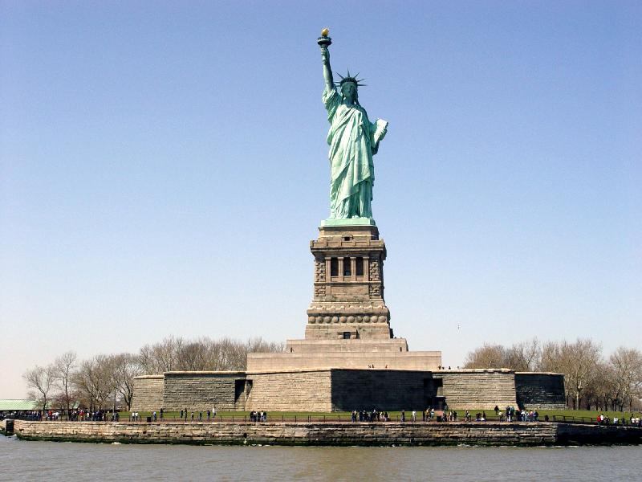
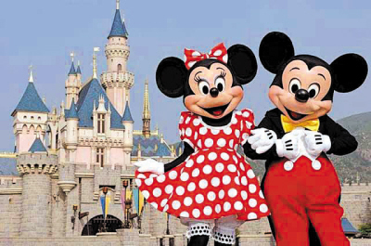
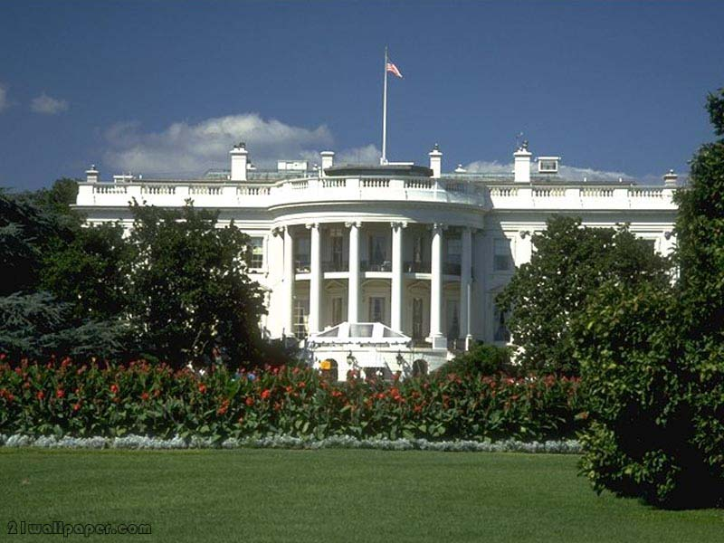
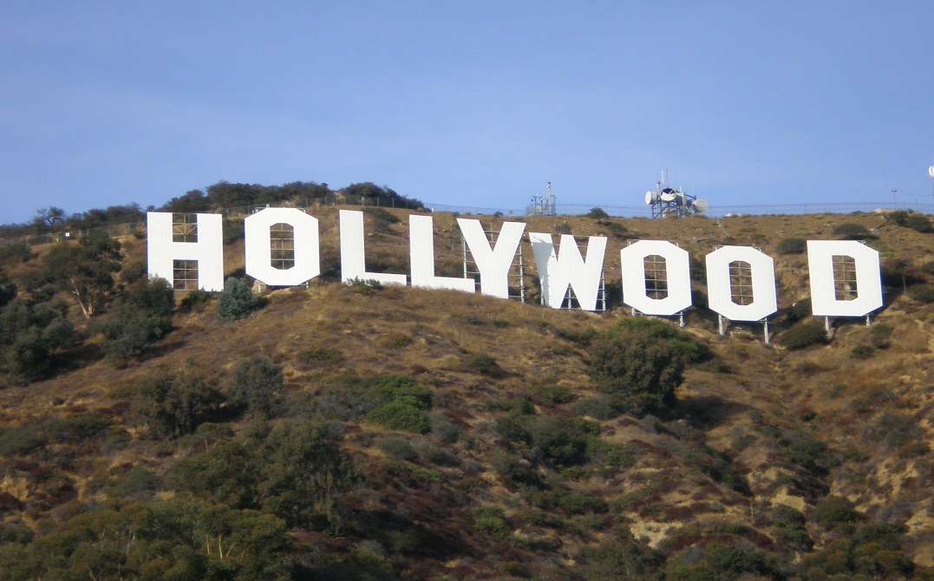
How much do you know about the USA ？
Lead-in
Statue of Liberty
Disneyland
The White House
Hollywood

Slide 2

What does USA stand for?
The United States of America

Slide 3

Star-Spangled Banner (星条旗)
50 states
the original 13 states
Red—— courage
White —— freedom
Blue——loyalty and justice

Slide 4
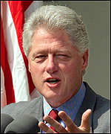

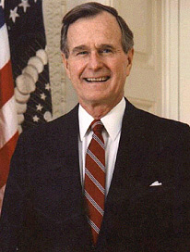
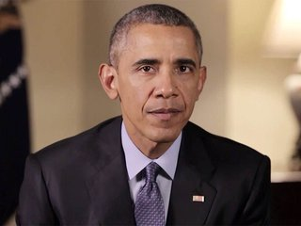
Who is the President of America now?
A.
B.
Donald Trump
Bill Clinton
C.
D.
George H.W. Bush
Barack Obama

Slide 5
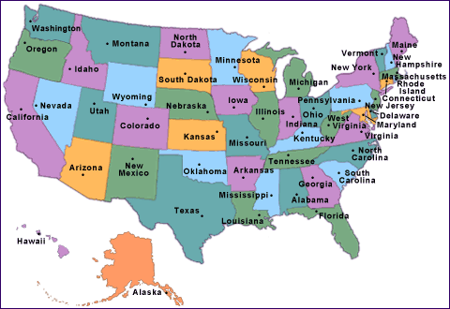
How many states are there in the USA?
A.
45
B.
52
C.
34
D.
50

Slide 6
Warming Up
Look at the map of the USA. Work with your group to write on the map the names as many of the following as you can.

Slide 7
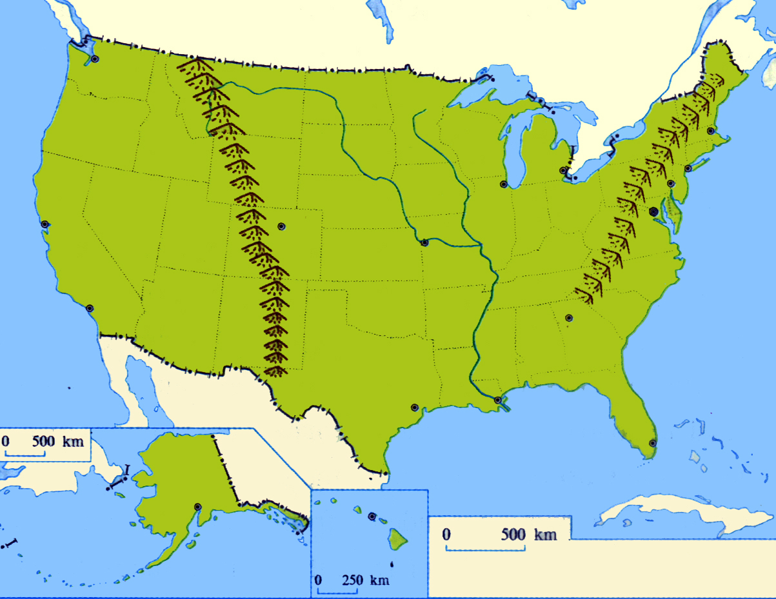
Canada
Appalachian
Rocky Mountains
California
the Mississippi
Atlantic Ocean
Pacific Ocean
Mexico

Slide 8
Superior
Huron
Ontario
Erie
Michigan

Slide 9
Canada
Boston
New York
Appalachian
Chicago
San Francisco
Washington, D.C
Rocky Mountains
the Mississippi
California
St. Louis
Los Angeles
Atlantic Ocean
Pacific Ocean
Mexico
Houston

Slide 10
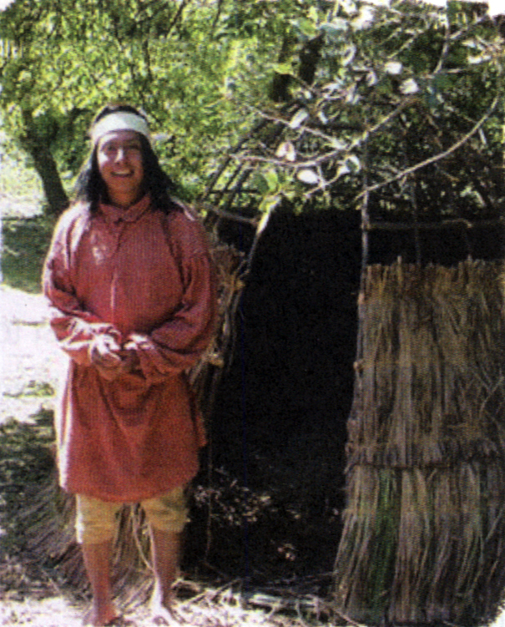
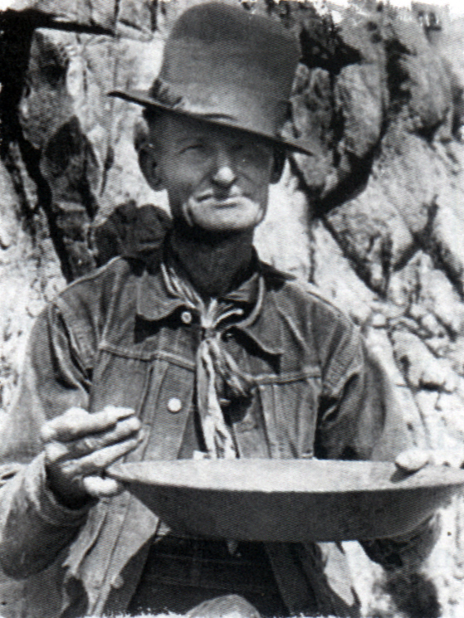
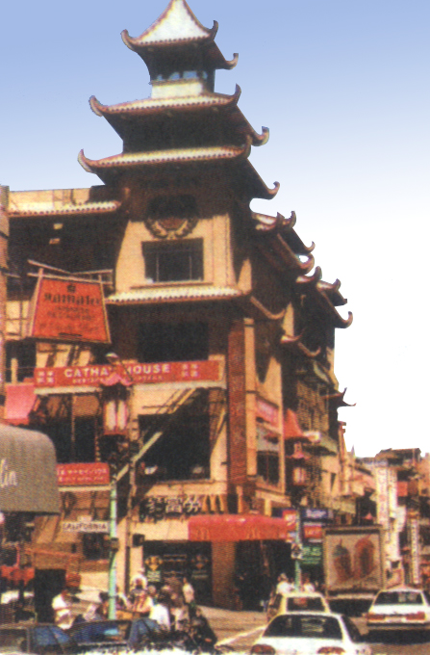
Pre-reading
How each picture is relevant to the history of California?

Slide 11
Fast reading
Divide the passage into three parts and try to match the main idea of each part.
Part1
Part2
Part3
Brief introduction to California.
(para1)
The future of California.
(para2-para9)
The history about people from different countries moved to California.
(para10)

Slide 12
California:
Detailed Reading
Introduction (Para.1)：
The Characteristics of California
multicultural
California is the most ___________ state and the ____ largest state with the _______ population.
third
largest
California has attracted people from nearly every country in the world

Slide 13

Comprehending: EX1
15,000 years ago
16th century:
1821
1846
1848
1850

Slide 14
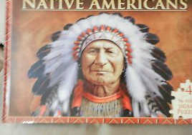
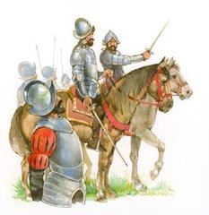
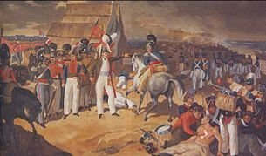
15,000 years ago
First settlers crossed the Bering Strait
from Asia. These people are now
known as Native American.
16th century
The Europeans arrived, and the native people suffered greatly.
Spanish soldiers arrived in South America.
1821
California became part of Mexico.

Slide 15
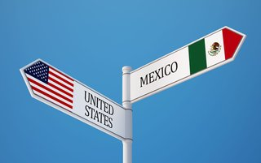
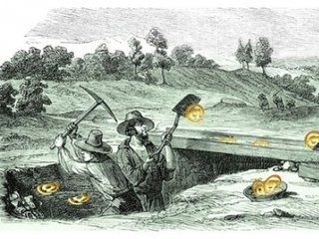
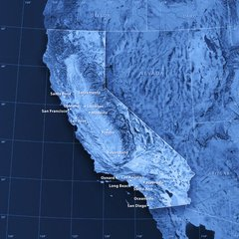
1846
The US declared war on Mexico
1848
Gold was discovered in California
1850
California became the 31st state of
the US.

Slide 16
Later Arrivals
People | Time | Event
 |  | moved from Mexico
 |  | built the railway
 |  | farmed
 |  | established a town
 |  | developed industry
 |  | fished and made wine
 |  | worked in ship& aircraft industries
Africans
1800s
Chinese
1860s
Italians
late 1900s
Danish
1911
Jewish
by the 1920s
Beginning of
20th century
Japanese
Africans
1942-1945

Slide 17
Most Recent Arrivals
People | Time | Event
 |  | worked in computer industry
 |  | immigrated
Indians
Pakistanis
1970s
Cambodians
Koreans
Vietnamese
Laotians
recent
decades

Slide 18

II. Choose the best answer.
1). During which period was California part of Mexico?
A. 1846 — 1848.
B. 1821 — 1848.
C. 1821 — 1846.
D. 1848 — 1850.
C

Slide 19
2). Which of the following is NOT true about the Gold Rush?
A. Only a few people became rich in the Gold Rush.
B. Many people died in the Gold Rush.
C. It happened during the American-Mexico war.
D. The first to arrive for gold were South Americans.
C

Slide 20
3). Which of the following is NOT true according to the 7th paragraph?
A. Film industry attracted many foreign people to California.
B. The town established by the Japanese was located in Hollywood.
C. Most Africans worked in the ship and aircraft industries.
D. Jewish people take up a large percentage in California.
B

Slide 21
4). Which of the following is NOT true?
The text mainly talks about the history of California.
B. Over 40% of Californians speak Spanish as a first or second language today.
C. It was so hard to make a life in California that most didn’t survive during the Gold Rush Period.
D. Today a large percentage of Chinese-Americans live in the “Chinatowns” of Los Angeles and San Francisco in California.
C

Slide 22
Native Americans
Exactly when the first people arrived in what we now know as California, no one really knows. However, it’s likely that Native Americans were living in California at least fifteen thousand years ago. Scientists believe that these settlers crossed the Bering Strait in the Arctic to America by means of a land bridge which existed in prehistoric times. In the 16th century, after the arrival of the Europeans, the native people suffered greatly. Thousands were killed or forced into slavery. In addition, many died from the diseases brought by the Europeans. However, some survived these terrible times, and today there are more Native Americans living in California than in any other state.

Slide 23
Language points
1. diversity = variety 多样性、变化
a diversity of vegetables
diversify vt. 使…多样性，使…不同
diversify one’s skills / interests
We should diversify the syllabus (教学大纲）to attract more students.
diverse adj.多种多样的

Slide 24
2. illustrate vt. 说明、阐明（用图示、实例等）
The lecturer illustrated the theory with examples.
Please illustrate how to use the machine.
illustration n. 实例
by way of illustration 以实例说明

Slide 25
3.California is the third largest state in the …
1) 序数词可以修饰形容词的最高级
The Yellow River is the second longest river in China.
2) population un / cn. 人口
The population of China_______ large, and 70% of the population of China_________ peasants.
表示整体人口时谓语动词用单数，表示部
分人口时谓语动词用复数。 而形容人口的
多少通常用large / small.
is
are

Slide 26
对人口的多少进行疑问时，可用what, 不用how many或 how much。
What’s the population of ….?
What’s the population of China?
have a population of …. 有多少人口
China has a population of 1.3 billion.
an increase / growth in population 人口增长

Slide 27
4. It also has the distinction of being the most multicultural state in the USA, …
加州与众不同之处在于它也是美国最具多元文化的一个州，…
It also has the distinction of being …意思是What it is known for is …
make a distinction between 对……加以区分
win a distinction for 因……而获功勋
without distinction 无差别地；一视同仁地
with distinction以优异的成绩；以杰出的表现

Slide 28
We should make a distinction between right and wrong.
She passed all the exams with distinction.
distinct adj. 清晰的；明显的；明确的
be distinct in ...from ... 在某方面与……不同
（as）distinct from ... 与……不同（的）
he has a distinct gift for drawing.
他有很明显的绘画天赋。
you should make your writing distinct.

Slide 29
前缀multi-是“多、多方面、多方向”的意思。如：
multi-coloured (多色的),
multi-racial (多种族的),
multi-media (多媒体),
multiparty (多党制 ),
multi-purpose (多种用途)

Slide 30
5. live on 继续存在，继续生存
Mozart was dead but his music lives on.
live on sth 以…为生
live by doing sth 靠做…为生
live with… 和…住一起/忍受
make/earn a living 谋生
live/lead a … life 过着…生活

Slide 31
6. Exactly when the first people arrived in
what we now know as California, no one
really knows.
no one really knows 是主句, exactly
when… California是knows的宾语从句
what we… California是宾语从句, 作介词
in的宾语。
No one knows when the first people arrived
in the place that/which we now know as
California.

Slide 32
George Washington was born in ______ is
now the state of Virginia.
which B. where C. that D. what
= George Washington was born in the place
that is now the state of Virginia.
D

Slide 33
1）Pudong Development Zone is no longer a
rural area ________ it used to be.
2）Pudong Development Zone is no longer ________ it used to be.
A. what B. where C. that D. there
C
定语从句, 先行词是area, that作关系代词
A
表语从句

Slide 34
7. However, it is likely that Native Americans were living in California at least fifteen thousand years ago.
1) sb./sth. is likely to do sth.
某人/某物有可能做某事
It is likely/probable/possible that ...
有可能 …
It is possible for sb. to do sth. ....
有可能做...

Slide 35
2) 辨析：likely, possible与probable
possible指客观上有可能性，但往往含有希望很小的意味；probable比possible可能性稍大，有“较为可能、大概”，指有实际依据；likely是从外表迹象判断有可能发生的事。
probable: 句型为 It is probable that…
possible: 句型为 It’s possible (for sb.) to do
sth. / It’s possible that…
likely 的主语可以是人，而possible与probable的主语不能是人。

Slide 36
8. by means of…: by using … 用……办法,借助
He crossed the river by means of a raft.
We express out feelings by means of words.
means 单复数同形
All possible means have been tried.
The quickest means of travel is by plane.
by this means 用这种方法
by no means 决不，一点也不
by any means 用任何方式
by all means 当然可以;一定

Slide 37
9. In the 16th century, after the arrival of Europeans, the native people suffered greatly.
vi. 受痛苦；受损害
vt. 遭受；忍受
suffer

Slide 38
辨析：suffer与suffer from
suffer (vt.) 和suffer from的区别：suffer 指一般的损害、痛苦等等, 其宾语为pain, loss, grief, insult, punishment, wrong, hardship, injustice, discouragement, disappointment, setback (挫折)，但suffer from表示遭受战争，自然灾害带来的苦难及患病之意。

Slide 39
suffer the result / heavy losses / injuries承受结果/遭受大损失/负伤
suffer from headache / illness / war / the flood
遭受头痛/疾病的困扰/战争／洪水

Slide 40
10. in addition : besides 此外,再者
You need time and money. In addition,
you need diligence.
我打算进城看望我的老师,此外还要买点东西.
I am going to visit my teacher. In addition,
I need to buy some articles of daily use.
what’s more; furthermore; moreover;
in addition to .. 除…外
In addition to cakes and candies, guests
were provided with fruits.

Slide 41
11. Spanish soldiers first arrived in South America in the early 16th century, when they fought against the native people and took their land.
16世纪早期, 西班牙士兵到达南美洲, 这时同土著人作斗争并占领这片土地。

Slide 42
辨析: fight against, fight for与fight with
fight for
“为事业, 自由, 真理, 权利等而斗争(战斗)”
fight against (可用with) the enemy
“为反对……而斗争”；接人和国家名词，意思是“与……战斗”
fight with sb. 也可表示与某人并肩作战

Slide 43
12. Of the first Spanish to go to California, the majority were religious men, whose ministry was to teach the Catholic religion to the natives.
1)句中Spanish前面有序数词限定成分，故其后用不定式定语形式。
She was the first woman to win the Nobel Prize.

Slide 44
2) majority n. 大多数…
The majority____________ for the budget.
The majority of students ________ hard-working.
The majority of the damage _______ easy to
repair.
was / were
are
is
单独做主语时，若强调整体，谓语动词用单数，强调个体时，谓语动词用复数 。
the majority of + n. 后可用不可数名词，也可用可数名词复数, 谓语动词由后面的名词决定。

Slide 45
in the/a majority 占大多数
get a majority 获得多数票
have a majority over sb. 获得多于某人的票数，战胜某人
a great majority 大多数
by/with a majority of 以大多数……赢得……
minority 少数的……

Slide 46
12. declare vt.
1）宣布,宣告
The chairman declared the results of the
election.
警方现在已经对这个地区的毒贩宣战了.
The police have declared war on drug dealers in this area.
2） 宣称,声称,断言
他郑重声明此事属实.
He declared that it was true.

Slide 47
13. make a life 开始新生活，习惯于新的生活方式
Many farmers go to the big cities to make a life.
It’s not easy to make a life in a new country.

Slide 48
14. a large percentage have chosen
1). A large percentage of population live in big cities.
2).这宾馆很大比例的收入来自于游览这湖的游客。
A large percentage of the hotel’s income comes from the visitors to the lake.
3).Only a small percentage of students are foreigners.
percent (用在数词后）（其余都用percentage)

Slide 49
The result is expressed ________________(以百分比).
________________________ (比例越来越大)of the population own their own houses.
______________________(大部分) people came.
_______________________ (百分之五十的学生) came form worker’s family.
as a percentage
An increasing percentage
A large percentage of
50 percent of students

Slide 50
15. keep up 继续，保持
If we can keep up this speed, we should arrive there in about two days.
Keep up your courage!
鼓起勇气，不要气馁！

Slide 51
16. establish a town 建立城镇
establish a new business 开创新事业
establish friendly relations with…建立友好关系
…establish that he was right.证明他是对的。
17. immigrate vi. (to/ into)移居，迁入
他很小时从爱尔兰移民到美国
As a child, he immigrated to the US from Ireland.
immigration n. immigration laws移民法
immigrant (s) n. the European immigrants

Slide 52
18.It is believed that…
It is said that …
It is hoped that…
It is supposed that…
It is suggested that…
It is reported that
主语从句
It is reported that some European countries are flooded severely .
It is hoped that the cost of medical care can be cut down.

Slide 53
19. mix vi.混合，使……结合
1).Oil and water don’t mix
2).Oil doesn’t mix with water.
3).Tom and John mix like oil and water.
4).I got /was mixed up at first. 头脑混乱
5).He was mixed up in the scandal.(丑闻) 牵连到
6).Don’t get mixed up with them.
与……交往, 有联系

Slide 54
mixture n. 混合物,混合体
这种饮料是三种不同饮料的混合物
The drink is a mixture of 3 different sorts of drinks.
a mixture of sadness and anger / water and oil
Success is a ___ of a sharp mind and hard training rather than just talking.
A. mixture B. thought C. time D. action
★

Slide 55
20.nationality 国籍
1). 她是美国国籍但住在中国。
She has American nationality but lives in China.
2). -你是哪国人？
- 中国人
--What’s your nationality?
--Chinese

Slide 56
She’s on attachment to the Ministry of Defense. 她现在隶属于国防部。
He is training for the ministry.
他正在接受培训，准备做牧师。
We are ready to face any hardship.
我们准备好了面对任何艰难。
They elected him chairman.
他们选他做主席。
It's a boom year this year.
今年是繁荣昌盛的一年。
We should not have racial discrimination.
我们不该有种族歧视。

Slide 57
Useful phrases
live on
by means of
in prehistoric times
in addition
die from a disease
fight against
gain one’s independence
继续存在；继续生存
借助…
在史前时期
此外，另外
死于疾病
对抗...
获得独立

Slide 58
declare war on
achieve one’s dream
make a life
keep up
向…宣战
实现梦想
习惯于新的生活方式、工作等
坚持；维持；沿袭
become home to
by the time…
elect to do…
before long
成为…的家园
到…的时候
选择/决定做某事
不久以后

Slide 59


