Slide 1

Unit 1 A land of diversity

Slide 2
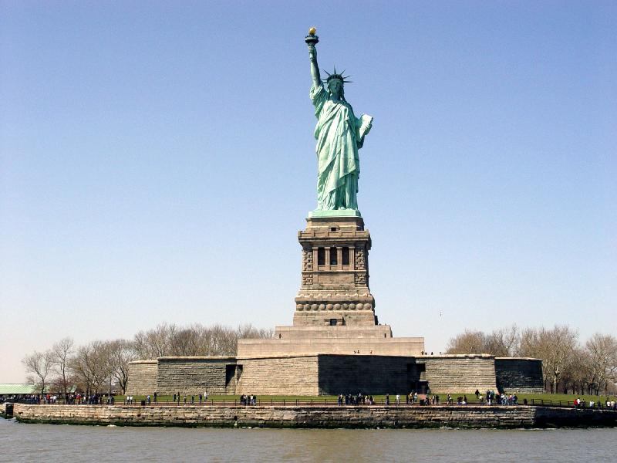
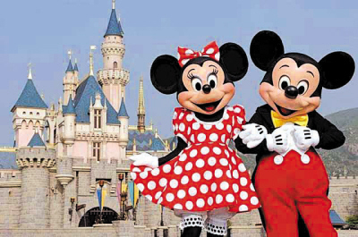
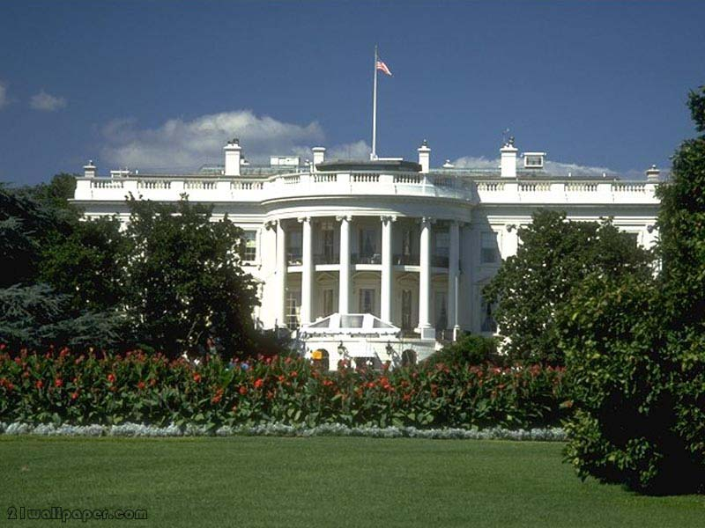
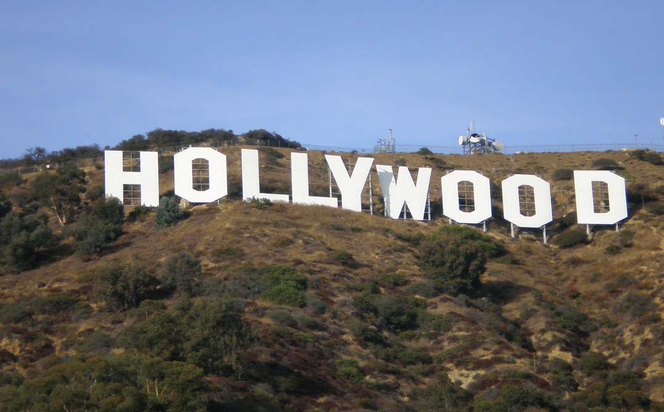
How much do you know about the USA ？
Lead-in
Statue of Liberty
Disneyland
The White House
Hollywood

Slide 3

What does USA stand for?
The United States of America

Slide 4



Which flag is American flag?
A. B. C.
Which city is the capital of the USA?
New York
Washington D.C.
Los Angeles

Slide 5

The America flag is known as “the stars and strips”.
50 stars—— Each star
represents one state
13 stripes—— the original
13 states.
Red—— courage
White —— freedom
Blue——loyalty and justice
June 14 —— Flag Day.
National Flag
Star-Spangled Banner (星条旗)

Slide 6





Which stands for the USA?
A.
B.
National
Emblem
（国徽）
C.
D.

Slide 7
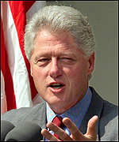
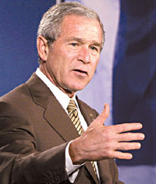
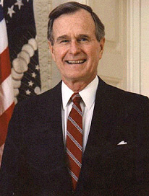
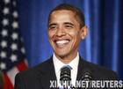
Who is the President of America now?
B.
George W. Bush
A.
Bill Clinton
C.
D.
George H.W. Bush
Barack Obama

Slide 8
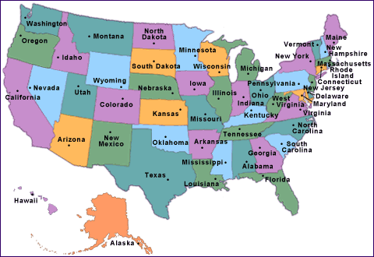
How many states are there in the USA?
A.
45
B.
52
C.
34
D.
50

Slide 9
●Which state is the largest one in the USA?
A. New York B. Texas
C. California D. Florida
● ____ has the largest population in the USA.
A. California B. Alaska
C. Washington D. Texas

Slide 10

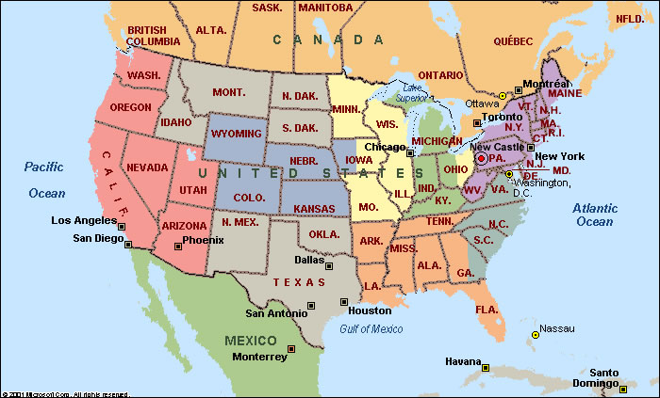
It has an area of 411.ooo square kilometers. And it is one of the American states of the largest population, with the most developed economy.

Slide 11
Warming Up
Look at the map of the USA. Work with your group to write on the map the names as many of the following as you can.

Slide 12

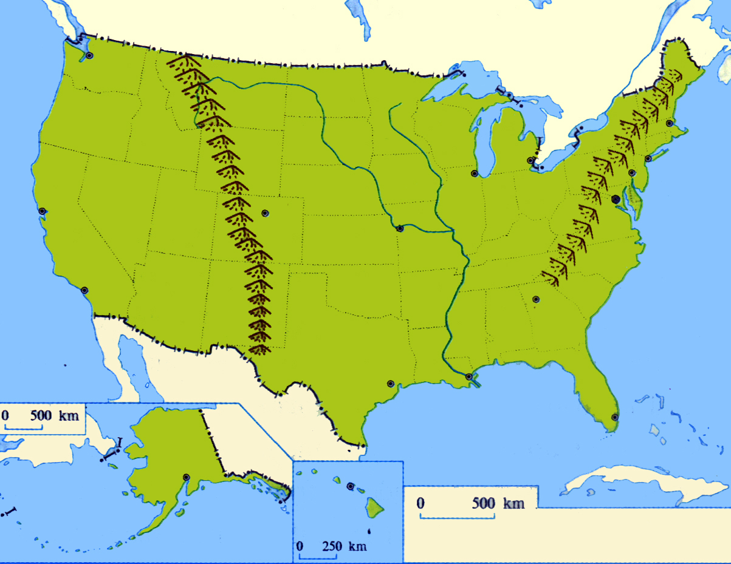
Canada
Boston
New York
Appalachian
Chicago
San Francisco
Rocky Mountains
Washington, D.C
the Mississippi
St. Louis
Los Angeles
Atlantic Ocean
Pacific Ocean
Mexico
Houston

Slide 13
Superior
Huron
Ontario
Erie
Michigan

Slide 14

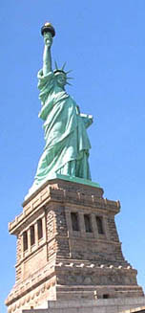
ocean on the east coast _______________
ocean on the west coast _______________
country to the north of USA ________________
country to the south of USA ________________
California
_________________
Atlantic Ocean
Pacific Ocean
Canada
Mexico
Southwestern USA

Slide 15
mountains range in the west
_________________
Rocky Mountains
Great Lakes
Superior, Michigan, Huron, Erie and Ontario
longest river in the USA
Mississippi River
some important cities
New York, Washington D.C.,
Los Angeles, San Francisco,
Chicago, New Orleans

Slide 16
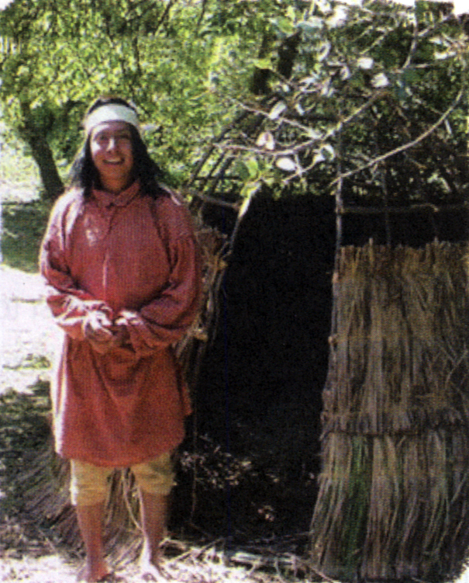
Pre-reading
How each picture is relevant to the history of California?
Native American Indian—one of the first people to live in California.

Slide 17
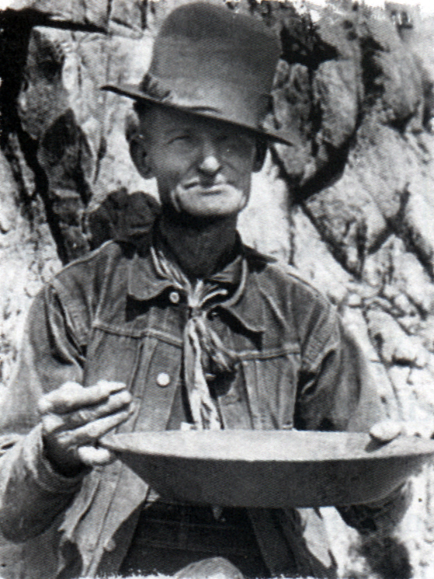
A gold miner—the discovery of gold in California created a gold rush which brought people from all over the world to California.

Slide 18
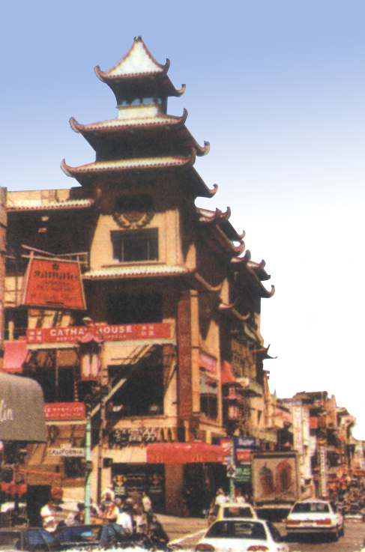
A building in Chinatown, San Francisco—Many Chinese have settled in California and many of them live in Chinatown in San Francisco.

Slide 19

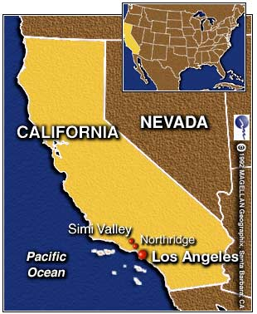
Reading
California is on the west coast, borders the Pacific Ocean.
The pleasant weather, long beach and graceful natural landscape attract many tourists from all over the world.
California

Slide 20
Fast reading
Divide the passage into three parts and try to give the main idea of each part.
Part1 ( ) Brief introduction to California.
Part2 ( ) The history about people from different countries moved to California.
Part3 ( ) The future of California.
para1
para2-para9
para10

Slide 21
California:
Detailed Reading
Introduction (Para.1)：
The Characteristics of California
multicultural
California is the most ___________ state and the ____ largest state with the _______ population.
third
largest
California has attracted people from nearly every country in the world

Slide 22
Native Americans:
15,000 years ago
1. Time:______________
2. How did they come :
_____________________
3. What happened to them after the arrival of the Europeans?
by means of a land bridge
Native
Americans
were killed by European
were forced into slavery
died from the disease

Slide 23
The Spanish:
Fill in the form (note down an important events)
16th century 18th century in 1821
in 1846
Spain soldiers
Arrived
California was
ruled by Spain
California
became part
of Mexico
Mexico gave
California to
the United States
today over 40% of Californians speak Spanish as a first or second language
Influence:

Slide 24


Russian& Gold- Miners:
1.Translate the first sentence.
In the early 1800s, Russian hunters, who had originally gone to Alaska, began settling in California.
在19世纪初期，一批最初到阿拉斯加的俄罗斯猎人开始在加利福尼亚定居下来。
2. Do some T or F questions:
1.In 1848, before the American-Mexican war, gold was discovered in California.
2.A lot of adventures achieved their dream of becoming rich.
3.California become the thirty-first state of the United states of America in 1850.
after
Few

Slide 25
Later arrivals & most recent arrivals:
Which event brought even large members of Chinese immigrants to California?
The building of the rail network from the west to the east coast.

Slide 26
Later Arrivals
People | Time | Event
Africans |  | moved from Mexico
Chinese |  | built the railway
Italians |  | farmed
Danish |  | established a town
Jewish |  | developed industry
Japanese |  | fished and made wine
Africans |  | worked in ship& aircraft industries
1800s
1860s
late 1900s
1911
by the 1920s
Beginning of
20th century
1942-1945

Slide 27
Most Recent Arrivals
People | Time | Event
Indians Pakistanis |  | worked in computer industry
Cambodians Koreans Vietnamese Laotians |  | immigrated
1970s
recent
decades

Slide 28
The future:
What attract people from different parts of the world to California?
People from different parts of the world are attracted by and of California.
the climate
lifestyle

Slide 29

Comprehending: EX1
First settlers crossed the Bering Strait
from Asia. These people are now
known as Native American
15,000 years ago
16th century:
1821
1846
1848
1850
Spanish soldiers arrived in
South America
Became part of Mexico
The US declared war on Mexico
Gold was discovered in California
California became the 31st state of
the US.

Slide 30
Comprehending: EX2
Spanish
Russians
Africans
Chinese
Italians
Danish
in the early 16th century
early 1800s
1800s
late 1840s/ early 1850s
in the late 19th century
1911

Slide 31
1920s
beginning of the 20th century
from about the 1970s
from about the 1970s
in more recent decades
from about the 1970s
Jewish
Japanese
Koreans
Cambodians
Vietnamese
Pakistanis

Slide 32
Comprehending: EX3
The state of California is a multicultural community because European, African and Asian people have been moving into the state for the last 200 years. It is this mix of peoples with their own customs, culture and food that have given California its multicultural flavour. Problems that might arise include intercultural rivalry or competition, discrimination or misunderstanding. It is to the credit of Californians that such problems do not arise very often.

Slide 33
Language points
1. diversity = variety 多样性、变化
a diversity of vegetables
diversify vt. 使…多样性，使…不同
diversify one’s skills / interests
We should diversify the syllabus (教学大纲）to attract more students.
diverse adj.多种多样的

Slide 34
2. illustrate vt. 说明、阐明（用图示、实例等）
The lecturer illustrated the theory with examples.
Please illustrate how to use the machine.
illustration n. 实例
by way of illustration 以实例说明

Slide 35
3.California is the third largest state in the …
1) 序数词可以修饰形容词的最高级
The Yellow River is the second longest river in China.
2) population un / cn. 人口
The population of China_______ large, and 70% of the population of China_________ peasants.
表示整体人口时谓语动词用单数，表示部
分人口时谓语动词用复数。 而形容人口的
多少通常用large / small.
is
are

Slide 36
对人口的多少进行疑问时，可用what, 不用how many或 how much。
What’s the population of ….?
What’s the population of China?
have a population of …. 有多少人口
China has a population of 1.3 billion.
an increase / growth in population 人口增长

Slide 37
4. It also has the distinction of being the most multicultural state in the USA, …
加州与众不同之处在于它也是美国最具多元文化的一个州，…
It also has the distinction of being …意思是What it is known for is …
make a distinction between 对……加以区分
win a distinction for 因……而获功勋
without distinction 无差别地；一视同仁地
with distinction以优异的成绩；以杰出的表现

Slide 38
We should make a distinction between right and wrong.
She passed all the exams with distinction.
distinct adj. 清晰的；明显的；明确的
be distinct in ...from ... 在某方面与……不同
（as）distinct from ... 与……不同（的）
he has a distinct gift for drawing.
他有很明显的绘画天赋。
you should make your writing distinct.

Slide 39
前缀multi-是“多、多方面、多方向”的意思。如：
multi-coloured (多色的),
multi-racial (多种族的),
multi-media (多媒体),
multiparty (多党制 ),
multi-purpose (多种用途)

Slide 40
5. live on 继续存在，继续生存
Mozart was dead but his music lives on.
live on sth 以…为生
live by doing sth 靠做…为生
live with… 和…住一起/忍受
make/earn a living 谋生
live/lead a … life 过着…生活

Slide 41
6. Exactly when the first people arrived in
what we now know as California, no one
really knows.
no one really knows 是主句, exactly
when… California是knows的宾语从句
what we… California是宾语从句, 作介词
in的宾语。
No one knows when the first people arrived
in the place that/which we now know as
California.

Slide 42
George Washington was born in ______ is
now the state of Virginia.
which B. where C. that D. what
= George Washington was born in the place
that is now the state of Virginia.
D

Slide 43
1）Pudong Development Zone is no longer a
rural area ________ it used to be.
2）Pudong Development Zone is no longer ________ it used to be.
A. what B. where C. that D. there
C
定语从句, 先行词是area, that作关系代词
A
表语从句

Slide 44
7. However, it is likely that Native Americans were living in California at least fifteen thousand years ago.
1) sb./sth. is likely to do sth.
某人/某物有可能做某事
It is likely/probable/possible that ...
有可能 …
It is possible for sb. to do sth. ....
有可能做...

Slide 45
2) 辨析：likely, possible与probable
possible指客观上有可能性，但往往含有希望很小的意味；probable比possible可能性稍大，有“较为可能、大概”，指有实际依据；likely是从外表迹象判断有可能发生的事。
probable: 句型为 It is probable that…
possible: 句型为 It’s possible (for sb.) to do
sth. / It’s possible that…
likely 的主语可以是人，而possible与probable的主语不能是人。

Slide 46
8. by means of…: by using … 用……办法,借助
He crossed the river by means of a raft.
We express out feelings by means of words.
means 单复数同形
All possible means have been tried.
The quickest means of travel is by plane.
by this means 用这种方法
by no means 决不，一点也不
by any means 用任何方式
by all means 当然可以;一定

Slide 47
9. In the 16th century, after the arrival of Europeans, the native people suffered greatly.
vi. 受痛苦；受损害
vt. 遭受；忍受
suffer

Slide 48
辨析：suffer与suffer from
suffer (vt.) 和suffer from的区别：suffer 指一般的损害、痛苦等等, 其宾语为pain, loss, grief, insult, punishment, wrong, hardship, injustice, discouragement, disappointment, setback (挫折)，但suffer from表示遭受战争，自然灾害带来的苦难及患病之意。

Slide 49
suffer the result / heavy losses / injuries承受结果/遭受大损失/负伤
suffer from headache / illness / war / the flood
遭受头痛/疾病的困扰/战争／洪水

Slide 50
10. in addition : besides 此外,再者
You need time and money. In addition,
you need diligence.
我打算进城看望我的老师,此外还要买点东西.
I am going to visit my teacher. In addition,
I need to buy some articles of daily use.
what’s more; furthermore; moreover;
in addition to .. 除…外
In addition to cakes and candies, guests
were provided with fruits.

Slide 51
11. Spanish soldiers first arrived in South America in the early 16th century, when they fought against the native people and took their land.
16世纪早期, 西班牙士兵到达南美洲, 这时同土著人作斗争并占领这片土地。

Slide 52
辨析: fight against, fight for与fight with
fight for
“为事业, 自由, 真理, 权利等而斗争(战斗)”
fight against (可用with) the enemy
“为反对……而斗争”；接人和国家名词，意思是“与……战斗”
fight with sb. 也可表示与某人并肩作战

Slide 53
12. Of the first Spanish to go to California, the majority were religious men, whose ministry was to teach the Catholic religion to the natives.
1)句中Spanish前面有序数词限定成分，故其后用不定式定语形式。
She was the first woman to win the Nobel Prize.

Slide 54
2) majority n. 大多数…
The majority____________ for the budget.
The majority of students ________ hard-working.
The majority of the damage _______ easy to
repair.
was / were
are
is
单独做主语时，若强调整体，谓语动词用单数，强调个体时，谓语动词用复数 。
the majority of + n. 后可用不可数名词，也可用可数名词复数, 谓语动词由后面的名词决定。

Slide 55
in the/a majority 占大多数
get a majority 获得多数票
have a majority over sb. 获得多于某人的票数，战胜某人
a great majority 大多数
by/with a majority of 以大多数……赢得……
minority 少数的……

Slide 56
12. declare vt.
1）宣布,宣告
The chairman declared the results of the
election.
警方现在已经对这个地区的毒贩宣战了.
The police have declared war on drug dealers in this area.
2） 宣称,声称,断言
他郑重声明此事属实.
He declared that it was true.

Slide 57
13. make a life 开始新生活，习惯于新的生活方式
Many farmers go to the big cities to make a life.
It’s not easy to make a life in a new country.

Slide 58
14. a large percentage have chosen
1). A large percentage of population live in big cities.
2).这宾馆很大比例的收入来自于游览这湖的游客。
A large percentage of the hotel’s income comes from the visitors to the lake.
3).Only a small percentage of students are foreigners.
percent (用在数词后）（其余都用percentage)

Slide 59
The result is expressed ________________(以百分比).
________________________ (比例越来越大)of the population own their own houses.
______________________(大部分) people came.
_______________________ (百分之五十的学生) came form worker’s family.
as a percentage
An increasing percentage
A large percentage of
50 percent of students

Slide 60
15. keep up 继续，保持
If we can keep up this speed, we should arrive there in about two days.
Keep up your courage!
鼓起勇气，不要气馁！

Slide 61
16. establish a town 建立城镇
establish a new business 开创新事业
establish friendly relations with…建立友好关系
…establish that he was right.证明他是对的。
17. immigrate vi. (to/ into)移居，迁入
他很小时从爱尔兰移民到美国
As a child, he immigrated to the US from Ireland.
immigration n. immigration laws移民法
immigrant (s) n. the European immigrants

Slide 62
18.It is believed that…
It is said that …
It is hoped that…
It is supposed that…
It is suggested that…
It is reported that
主语从句
It is reported that some European countries are flooded severely .
It is hoped that the cost of medical care can be cut down.

Slide 63
19. mix vi.混合，使……结合
1).Oil and water don’t mix
2).Oil doesn’t mix with water.
3).Tom and John mix like oil and water.
4).I got /was mixed up at first. 头脑混乱
5).He was mixed up in the scandal.(丑闻) 牵连到
6).Don’t get mixed up with them.
与……交往, 有联系

Slide 64
mixture n. 混合物,混合体
这种饮料是三种不同饮料的混合物
The drink is a mixture of 3 different sorts of drinks.
a mixture of sadness and anger / water and oil
Success is a ___ of a sharp mind and hard training rather than just talking.
A. mixture B. thought C. time D. action
★

Slide 65
20.nationality 国籍
1). 她是美国国籍但住在中国。
She has American nationality but lives in China.
2). -你是哪国人？
- 中国人
--What’s your nationality?
--Chinese

Slide 66
She’s on attachment to the Ministry of Defense. 她现在隶属于国防部。
He is training for the ministry.
他正在接受培训，准备做牧师。
We are ready to face any hardship.
我们准备好了面对任何艰难。
They elected him chairman.
他们选他做主席。
It's a boom year this year.
今年是繁荣昌盛的一年。
We should not have racial discrimination.
我们不该有种族歧视。

Slide 67
Useful phrases
live on
by means of
in prehistoric times
in addition
die from a disease
fight against
gain one’s independence
继续存在；继续生存
借助…
在史前时期
此外，另外
死于疾病
对抗...
获得独立

Slide 68
declare war on
achieve one’s dream
make a life
keep up
向…宣战
实现梦想
习惯于新的生活方式、工作等
坚持；维持；沿袭
become home to
by the time…
elect to do…
before long
成为…的家园
到…的时候
选择/决定做某事
不久以后

Slide 69


