Slide 1

Unit 1 A land of diversity

Slide 2

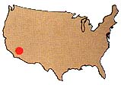
Reading and writing
GEORGE’S DIARY 12TH-14TH JUNE

Slide 3
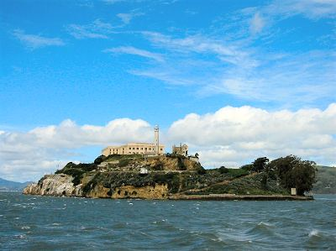
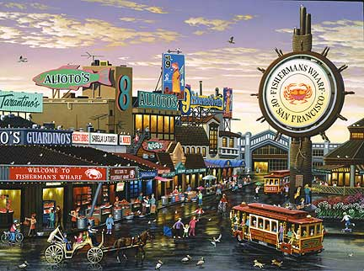
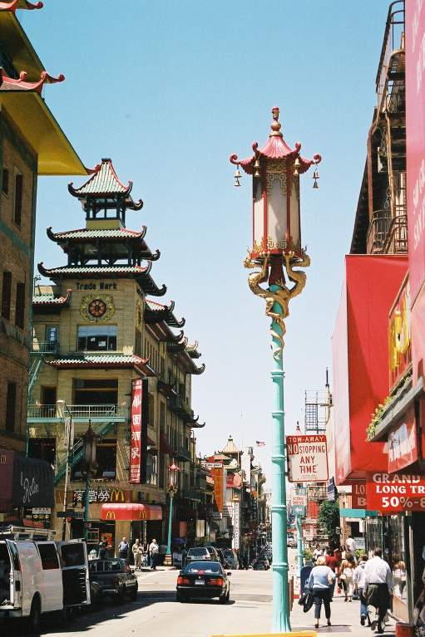
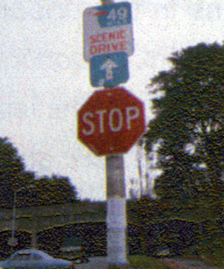
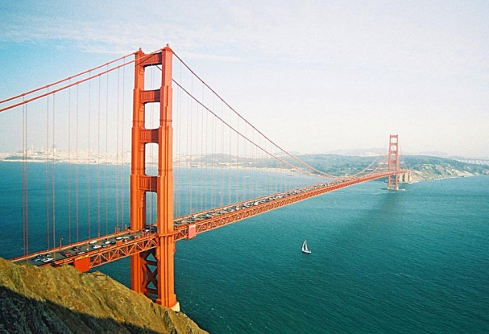
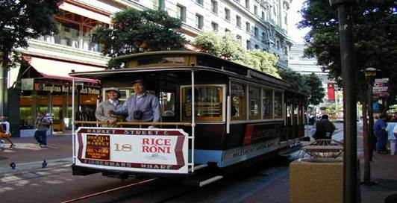
Fast reading:
Look at George’s photos below. Then quickly read George’s diary. He wrote this part of his diary when he was in San Francisco. Write the day he saw these things under the photos.

Slide 4
Write the day he saw these things.
Wednesday 14th, June
Angel Island
Monday 12th, June
Fisherman’s Wharf

Slide 5
Tuesday 13th, June
Chinatown
Tuesday 13th, June
blue and white road signs

Slide 6
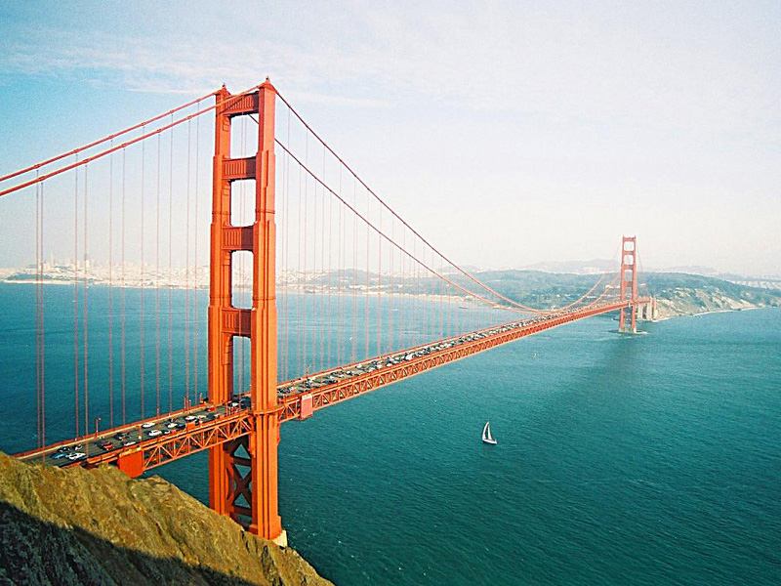
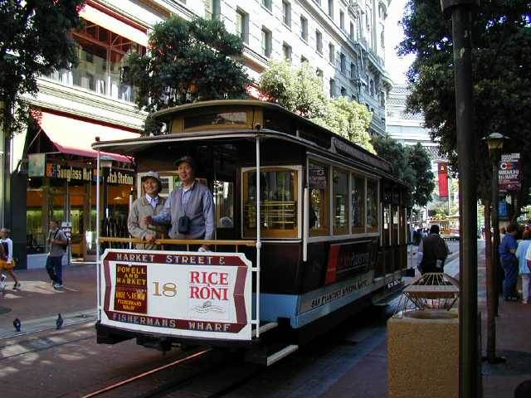
Wednesday 14th, June
Golden Gate Bridge
Monday 12th, June
cable car

Slide 7

Careful reading
Part1
Fill in the blanks with words in the passage.
______ straight to hotel and _________ luggage, then went ________. Rode on ________
Visited ___________________
went
dropped
Monday
exploring
a cable car
Fisherman’s Wharf

Slide 8
Answer the questions:
1. Why did Andrew Hallidie invent the Cable car system?
He invented the cable car system because the horse-drawn trams used before were unsafe.
2.Where did George eat lunch on his First day in San Francisco?
He ate at Fisherman’s Wharf.

Slide 9
Part 2
_________________ a couple from hotel and _______ a car.
Spend all day ________________
In evening, went to __________
Teamed up with
hired
Tuesday
driving around city
Chinatown

Slide 10
Why did George hire a car? Why do you think he joined Terri and Peter?
It was cheaper to hire a car with other people because they could share the cost. Also he probably enjoyed being in the company of other tourists.
2. Name three things that visitors can do in Chinatown.
Eat in Chinese restaurants, go to markets. Visit temples and museums.

Slide 11
part3
Took ferry to ________________
and had a good view of
______________________
Visited the _________
Angel Island
Wednesday
Golden Gate Bridge
cells
What is Angel Island famous for?
The island used to be a place for immigrants to be checked before they could enter California.

Slide 12
Rewrite the diary entry for Tuesday inserting all the missing words.
I teamed up with a couple from my hotel (Peter and Terri) and hired a car. We spent all day driving around the city. There’s a fascinating drive marked out for tourists. It has blue and white signs with seagulls on them to show the way to go.

Slide 13
It’s a 79km round-trip that takes in all the famous tourist spots. We stopped many times to admire the view of the city from different angles and take photographs. Now I have a really good idea of what the city’s like.
In the evening, I went to Chinatown with Peter and Terri. Many / A lot of / Some Chinese immigrants settled in

Slide 14
this area in the 1850s. The fronts of the buildings are decorated to look like old buildings in southern China. We saw some interesting temples, a number of markets and a great many restaurants . There are also art galleries and a museum containing documents,
photographs and all sorts of objects

Slide 15
about the history of Chinese immigration, but it’s closed in the evening. I will have to go back during the day. We had a delicious meal and then walked down the hill to our hotel.

Slide 16
Language points
1. Built in 1873, the cable car system was invented by Andrew Hallidie, who wanted to find a better form of transport than horse-drawn trams.
缆车系统建于1873年，是由安德鲁·海利迪发明的，他试图找到一种比马拉轨道车更好的交通方式。

Slide 17
tram: n.[英](有轨)电车; 有轨电车轨道;
You should take Tram No.52.
你应该坐52路有轨电车。
They are switching the tram.
他们使电车换了轨道。

Slide 18
2. Apparently he’d been shocked when he saw a terrible accident in which a tram slipped down the hill dragging the horses with it.
显然当他看到一场事故中轨道车拖着马匹滑下山坡时大为震惊。

Slide 19
apparently adv.显然地；显而易见地
Apparently, you have done a lot of work.
很明显你们已经做了很多工作。
Apparently, she was trying her best to
save her child from severe illness.
很明显,她在尽力设法挽救她那重病的孩子。
It is apparent that …
It is apparent that all living things need water to keep alive.
很显然，所有生物都需要水才能存活。

Slide 20
(1) slip滑，滑倒，失足
A book slipped off/from her hand.
书本从她的手中滑落。
(2) n. [C] 小错误
It’s normal for a young man to make a slip.
年轻人犯错误很正常。

Slide 21
与slip相关的短语：
slip off 迅速脱去（衣服）
slip on 迅速穿上（衣服）
slip out 被无意说出
slip out of 迅速脱下（衣服）
slip sth. over on sb.
巧妙地捉弄某人，欺骗某人
slip up 犯错误，疏忽

Slide 22
3. It’s also the place to catch the ferry to Angel Island and other places in the Bay.
这也是乘渡船去天使岛和海湾其他地方的渡口。
to catch the ferry to…in the Bay 为不定式作定语, 修饰the place。
不定式做定语时, 与所修饰的词之间有三种关系: 即动宾关系, 主谓关系和同位关系。

Slide 23
4. Teamed up with a couple from my hotel and hired a car.
与我旅店里的一对夫妇结队而行并且合伙租了一辆车。
team up (with)
与……合作或一起工作, 与……结成一队
Let’s team up!
我们联起手来吧！

Slide 24
5. There’s a great drive marked out for
tourist.
有一种专门为旅游者选定的驾车游活动。
mark out v.划线标出….界线
Mr Powel has marked out a general
course of action.
鲍威尔先生已经拟定了一个总的行动计划。

Slide 25
6. It’s a 79 km round-trip that takes
in all the famous tourist spots.
正是这７９公里的往返旅程包括了所有的著名的旅游景点。
take in
(1) 吸收，收留，收容，收养，接待
Our Party branch took in a new
member yesterday.
我们党支部昨天吸收了一名新党员。

Slide 26
(2) 包括
This price takes in the cost of all
the accommodation and food.
这个价格包括了食宿等一切费用。
(3) 理会, 理解, 记住
I wonder if he’s really taking it in.
我想知道他是否真正明白了。

Slide 27
(4) 欺骗，使上当
The salesman finds it easy to take
in old ladies.
这个推销员发现老太太容易上当受骗。
与take相关的短语：
take after 长得像
take apart 拆开，拆卸
take away 拿开，拿走

Slide 28
take back 收回，使回忆起
take off 拿走，取下，去掉；脱去；（使）离开；起跳（飞），（飞）机起飞
take on 承担，呈现，雇用
take over 接管，接替
take to 喜欢，习惯
take up with 和……交往，和……要好

Slide 29
7. Some interesting temples here, a number of markets and a great many restaurants.
这里有一些有趣的寺庙、一些集市和许多饭店。

Slide 30
many
many a/an
a great/good many
a good/large number of
“许多，大量”，
修饰可数名词
much
a good/great deal of
a large amount of
amounts of
修饰不可数名词

Slide 31
a lot of
lots of
a quantity of
quantities of
plenty of
a supply of
supplies of
修饰可数与不可数名词

Slide 32
注意:
(1) amounts of与quantities of后接不可数名词作主语时, 谓语动词用复数。
Large amounts of money are spent on tobacco every year.
每年都要花大量金钱在烟草上。

Slide 33
(2) many a +(单数.) n. 作短语，谓语动词用单数。
Many a student wants to see the film Hero.
很多学生想看电影《英雄》。

Slide 34
8. Also art galleries and a museum containing documents, photographs and all sorts of objects about the history of Chinese immigration, but it’s closed in the evening.
博物馆里有文件，照片和各种各样的有关中国移民史的物品，但是晚上关门了。

Slide 35
immigration: n. 移居,移民
There are strict controls on immigration
into this country.
移民到这个国家有严格的限制。
The immigration officer stamped my
passport.
移民官员在我的护照上盖了戳。

Slide 36
Using Words and Expressions
Answer key for Exercise 1 on Page 48：
a great many, applying for, nephew, ferry, Immigration，Apparently, bakeries，occur, thankful，fascinating

Slide 37

Answer key for Exercise 2 on Page 48:
1. take in
2. reform
3. had marked out
4. team up with
5. back to back
6. applicants
7. customs

Slide 38
Suggested answers to Exercise 3 on Page 48:
1. When he arrived at the hotel, the first thing
he wanted to do was to leave his luggage／
baggage, have a shower and a shave, and
then walk around．
2. My grandpa was a socialist who believed in socialism all his life.
3. Many illegal immigrants felt that their stay in America was like a punishment because only a few of them got justice and were allowed to live there.

Slide 39
4. The civil authorities tried to reduce the noise made by seagulls but failed.
5. Many English farmers mourned their cattle which had to be killed because of “mad COW disease”.
6. My house is nowhere near the center of the city, but it has no air pollution or traffic jams. / Although my house is nowhere near the center of the city, it has no air pollution or traffic jams．

Slide 40


