Slide 1
6.5早读：黄本P105 听力
“作业”小程序拍照上传答案

Slide 2
一、8:00-8:15
维词朗读U2单词
二、8:15-8:45
腾讯课堂 词汇学习

Slide 3

Module 8 Unit2
Vocabulary

Slide 4
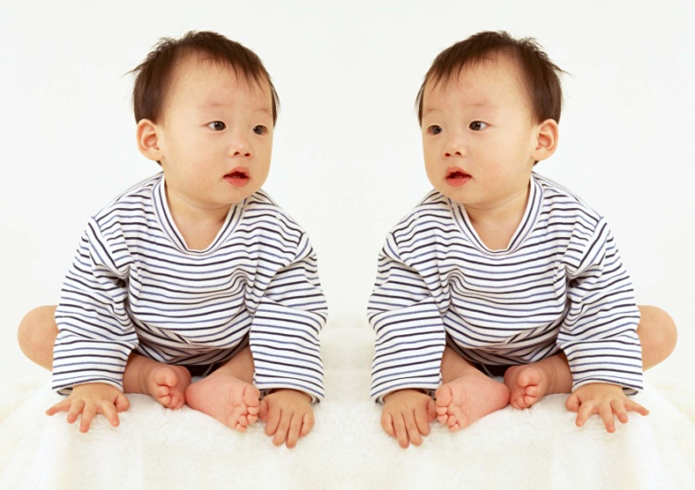
What words can you think of about “cloning”?
Cloning

Slide 5

Pronunciation
Find out the group of which all the letters in red have the same pronunciation.
A.constitution conservative compulsory commercial
B.cast accumulate assumption adore exact
C.regulation decoration retire merely
D.object obtain moral procedure
F.assumption undertake compulsory unable

Slide 6
Word form
v. | n.
differ
 | decoration
resist
strike
 | assumption
retire
object
 | correction

Slide 7
Word form
v. | n.
differ | difference
decorate | decoration
resist | resistance
strike | strike
assume | assumption
retire | retirement
object | objection
correct | correction

Slide 8

adj. | v.
different
conservative
adorable
reasonable
obtainable
owing

Slide 9
adj. | v.
different | differ
conservative | conserve
adorable | adore
reasonable | reason
obtainable | obtain
owing | owe

Slide 10
Chunks
bother undertake cast straightforward resist obtain
to ____________ financial responsibility
the priceless treasure that has been ___________ into the river
to ________ the permission of parking a car
determined to __________ reforms
not complicated but __________
sorry to __________ you

Slide 11
Chunks
bother undertake cast straightforward resist obtain
to undertake financial responsibility
the priceless treasure that has been cast into the river
to obtain the permission of parking a car
determined to resist reforms
not complicated but straightforward
sorry to bother you

Slide 12
Paraphrase
in a good/poor state
to support
without success, useless
to hit
to oppose, not approve
unhappy and sad
not yet paid sb
to finish paying money
to make sb come to life

Slide 13
Paraphrase
in a good/poor state in good/poor condition
to support in favour of
without success, useless in vain
to hit strike
to oppose, not approve object
unhappy and sad cast down
not yet paid sb owe
to finish paying money pay off
to make sb come to life bring sb back to life

Slide 14
Complete the dialogue!
A: What are you ________________ about?
B: I am now heavily in debt. I _________ a large sum of money to Mike.
A: Why? What happened?
B: My wife urged me to buy a new flat.
A: But you do have a flat and it looks ____________________.
B: Yeah. The new one is for her parents!
A: God! I hope you can ____________ the money soon.

Slide 15
Complete the dialogue!
A: What are you cast down/bothering about?
B: I am now heavily in debt. I owe a large sum of money to Mike.
A: Why? What happened?
B: My wife urged me to buy a new flat.
A: But you do have a flat and it looks in good condition.
B: Yeah. So the new one is for her parents!
A: God! I hope you can pay off the money soon.

Slide 16
Complete the dialogue!
A: Did you hear that the workers in our company will ___________?
B: Really? What a surprise! I am totally _______________ it. We deserve a pay rise.
A: I do not ___________ to it, but I am afraid their efforts will be _____________ since the manager fears nothing.

Slide 17
Complete the dialogue!
A: Did you hear that the workers in our company will strike?
B: Really? What a surprise! I am totally in favour of it. We deserve a pay rise.
A: I do not object to it, but I am afraid their efforts will be in vain since the manager fears nothing.

Slide 18

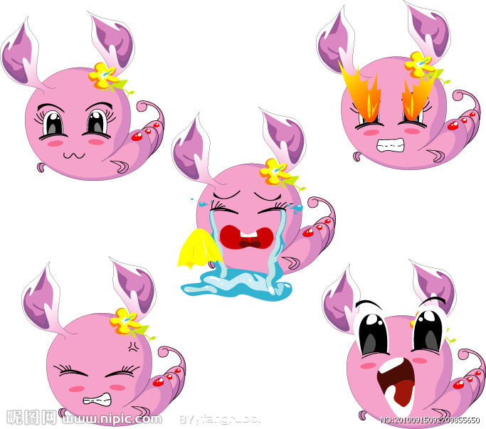
Make sentences!
differ

Slide 19
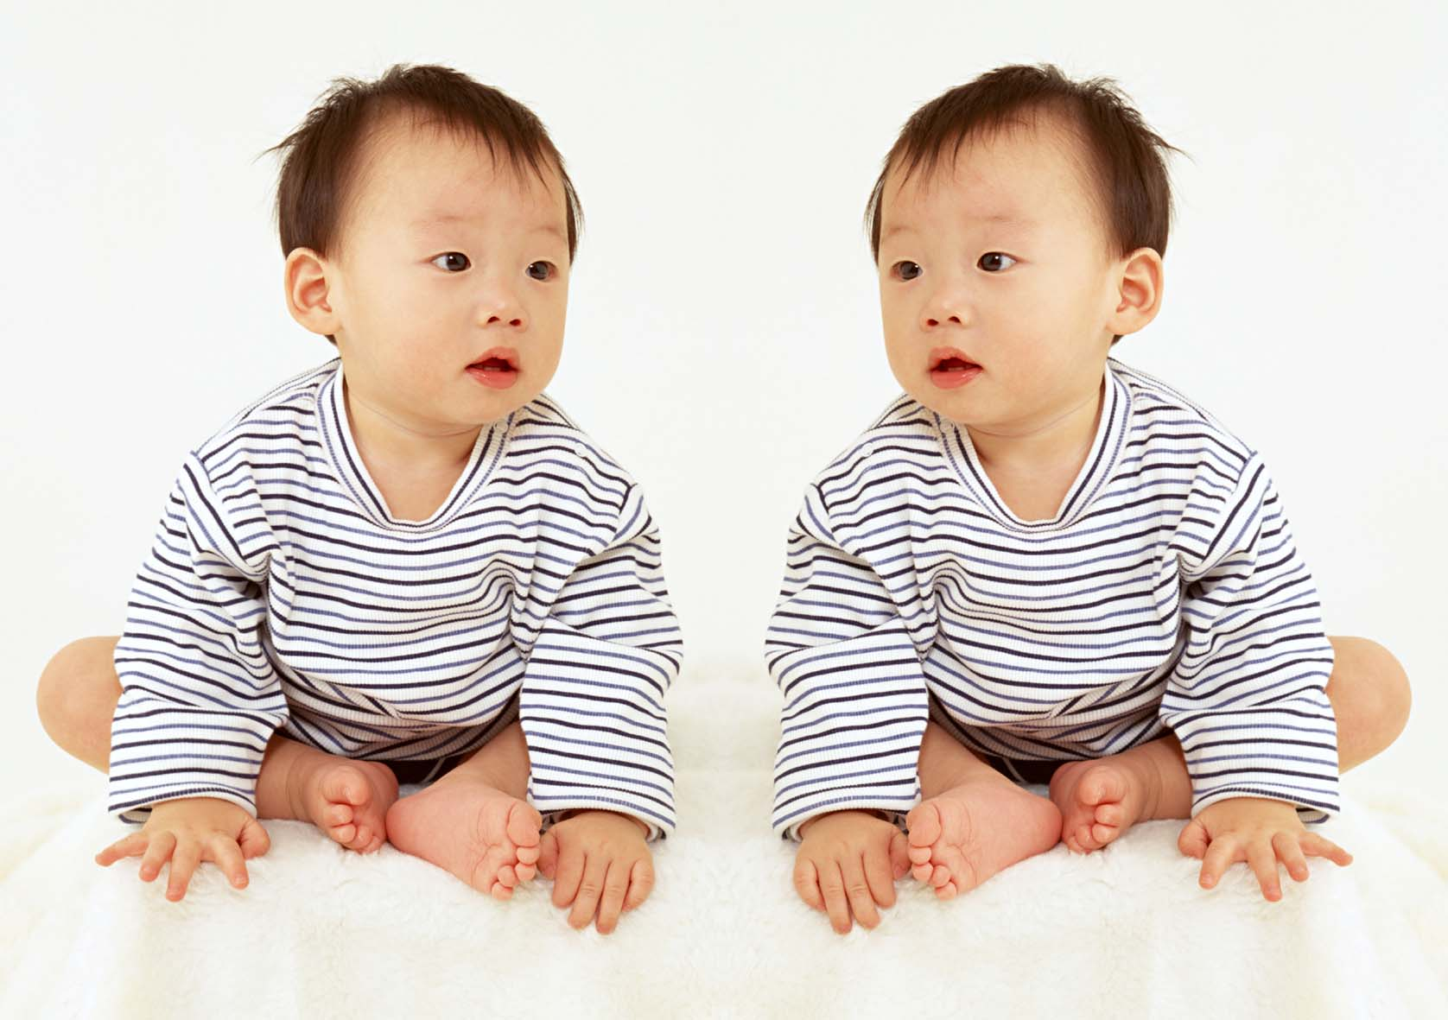
a cloned baby
object to (doing) sth

Slide 20
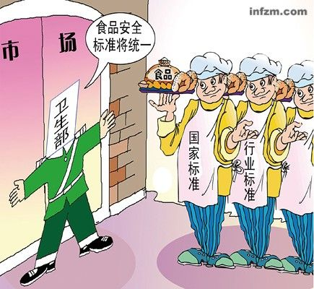
strike fear/terror into one’s heart

Slide 21
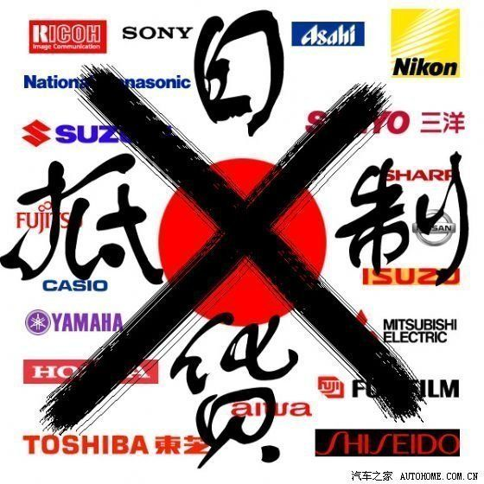
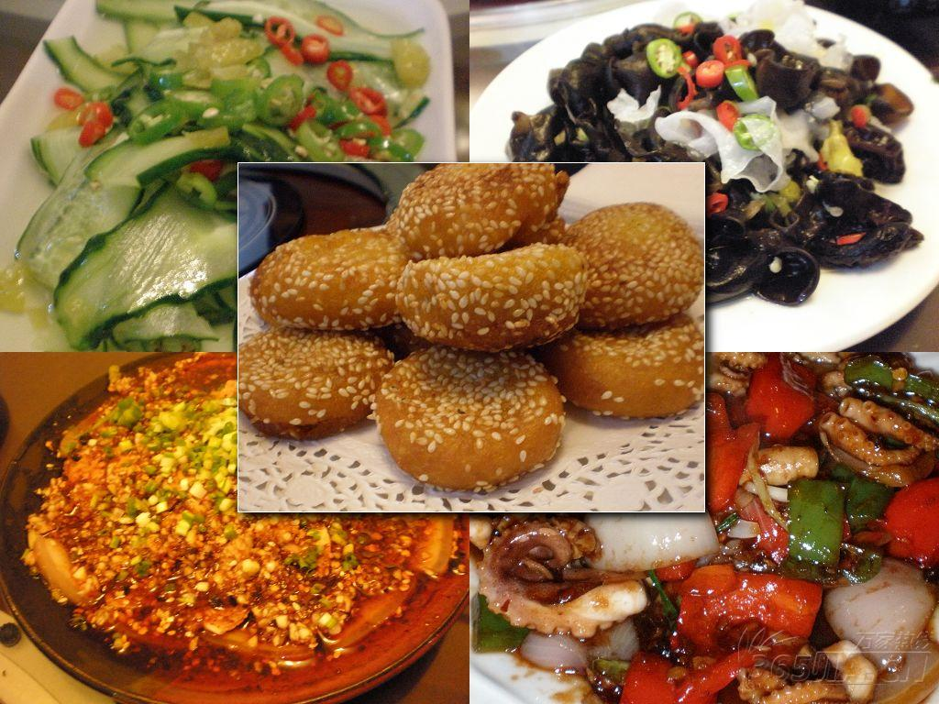
resist (doing) sth

Slide 22

Pay off
They doubt whether their hard work will pay off.
He has guaranteed to pay off all the debt that he own me.
I will pay him off for his treating me like that!

Slide 23
cast
The sun was casting its light on my bed when I woke up.
The elector cast a vote against the proposal.
He cast his friends away after he attained his goal.

Slide 24
Forbid
1. Farmers are forbidden to use chemical fertilizers.
2. She forbade her children sweets.
3. More and more public places in the United States forbid smoking.

Slide 25

vain
“We can’t let him have died in vain. We need to resist!” said the Chairman.
She made several vain attempts. In other words, all her efforts were in vain.
She is vain and spends money like water.

Slide 26
Get one sentence out!
would
their
He
to
to
and
it
be
attempt
was
striking,
in vain.
saying
bound
objected
fail

Slide 27
He objected to striking, saying it was bound to fail and their attempt would be in vain.

Slide 28

Complete the passage.
The opinions on cloning d_________ from people to people. Those who are ____ ________ ______ it think that cloning is likely to _______ the dying _____ ______ _____, which is a breakthrough in history and they believe the scientists’ efforts will _______ ______. However, the others who ________ to cloning, hold the view that it is a risky task to u_____________. They say
iffer
in
favour of
bring
back to life
pay off
object
ndertake

Slide 29
some people hope to clone themselves to o__________ profits and a________ their own ambitions. Anyway, it is still controversial. Some governments begin to f___________ any research into human cloning, because they b____________ about the results that may have negative effects on humans.
btain
ttain
orbid
other

Slide 30
homework
Make a story using at least 8 words or phrases in bold.

