Slide 1
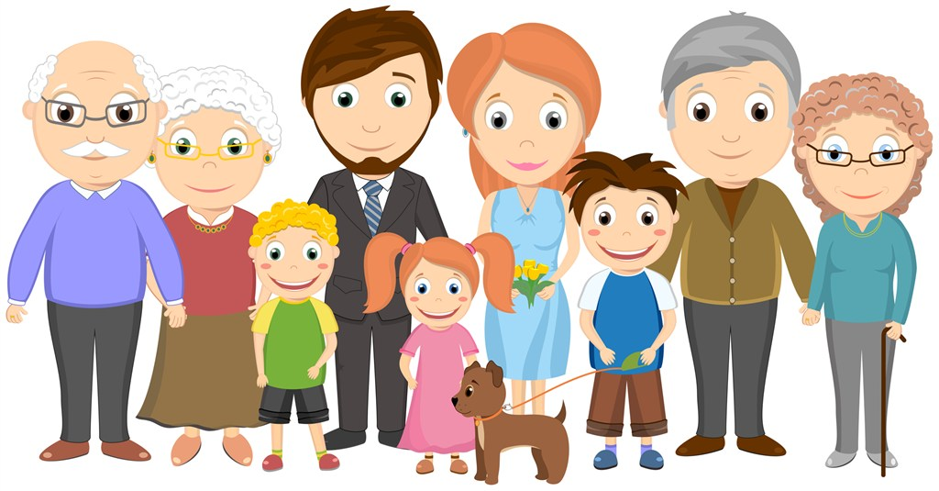
Unit 1 People Around Us
Grammar

Slide 2
目录
Lead-in
1
Pre-Learning
2
3
While-Learning
Post-Learning
4
5
Review

Slide 3
Part I Lead-in

Slide 4

.
1.story 出现了几次？
2.第一次出现前面用了什么冠词？
3.第二次出现前面用了什么冠词？
My mother told me a story yesterday.
The story is about three little pigs.

Slide 5
Part II Pre-Learning

Slide 6
Look at the example and try to make a sentence
man, woman, bus, short, tall
A man and a woman got on a bus.
The man was short but the woman was tall.
1. boy, his mother, train, fat, thin
A boy and his mother got on a train.
The boy was fat but his mother was thin.

Slide 7
2. old woman, young woman, plane, smiling, laughing
An old woman and a young woman got on a plane.
The old woman was smiling and the young woman is laughing.
3. actor, doctor, taxi, talking, listening
An actor and a doctor got into a taxi.
The actor was talking and the doctor was listening.

Slide 8
Part III While-Learning

Slide 9
A. The definite article the
第一次提到
We often use a or an in front of a singular, countable noun when we mention it for the first time. Then we use the before the noun when we mention it again.
Sara found an interesting photo yesterday.
The photo was of her grandpa.
第二次提到
We also use the to talk about something that is the only one of its kind.
世界上独一无二的事物
The Sun is shining brightly.
There were lots of stars in the sky last night.

Slide 10
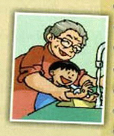
story is about three little pigs.
The
/
A?
√
● The 1ST time:
a/an
the
.
√
● The 2nd time or more:
a/an
the
Sara found an interesting photo yesterday.
The photo was of her grandpa.
the的用法：
1.代替前面出现过的名词
______________________

Slide 11



the Earth
the Sun
the Moon
the的用法：
2.用来形容独一无二的事物
______________________

Slide 12
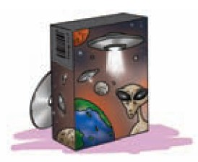
A1. In pairs,S1 talks about what he or she did in the
past few days. S2 asks about it. Follow the example.
1. play/great computer game/yesterday/saving the
Earth from aliens
S1: I played a great computer game
yesterday.
S2: What was the game about?
S1: It was about saving the Earth from aliens.

Slide 13
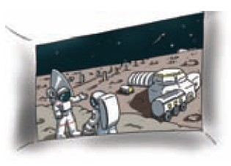
2.see /exciting film / last Saturday / a visit to the Moon
S1: I (do something) (time).
S2: What was...... about?
S1: It was about......
S1: I saw an exciting film last Saturday.
S2: What was the film about?
S1: It was about a visit to the Moon.

Slide 14

3.read / good story / last week / a man on an island
S1: I (do something) (time).
S2: What was...... about?
S1: It was about......
S1: I read a good story last week.
S2: What was the story about?
S1: It was about a man on an island.

Slide 15

4.write / long poem / last Sunday / my pet dog
S1: I (do something) (time).
S2: What was...... about?
S1: It was about......
S1: I wrote a long poem last Sunday.
S2: What was the poem about?
S1: It was about my pet dog.

Slide 16
Let’s talk
What does your desk mate like to play？
Work with your partner.
Ask and answer questions like this:
.
S1: What sport do you like to play in your free time?
S2: I like to play football in my free time. What about you?
S1: I like to play basketball. What musical instrument can you play?
S1: I can play the piano. What about you?
S2: I can play the violin.

Slide 17
B. Using the with the verb play
He plays the guitar / the piano / the violin.
He plays basketball / football / table tennis.
After the verb play, we put the before the names of (musical instruments/sports), but we do not put the before the names of (musical instruments/sports).
the的用法：
3.在乐器名词前面加 the ；
在体育项目前不用加the。
______________________

Slide 18
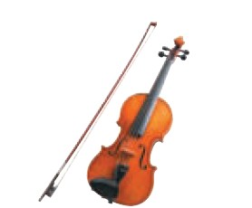

The sentences below are about some students. Complete the sentences. Add the if necessary.
1.Vanessa loves music.
She plays _________.
football
2.Robin plays _______
very well.
the violin

Slide 19
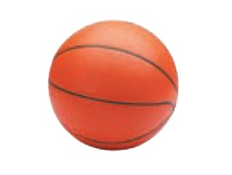
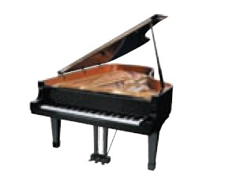
3.James’s dream is to play
_________ in the NBA.
4.Lily is good at playing
________.
basketball
the piano

Slide 20
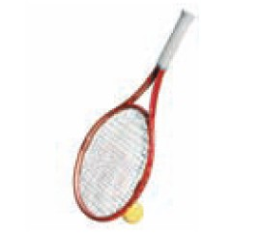
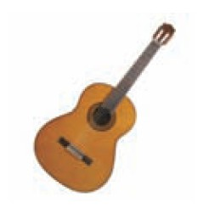
the guitar
5.Linda likes playing
______.
6. Alex plays __________
in the school band.
tennis

Slide 21
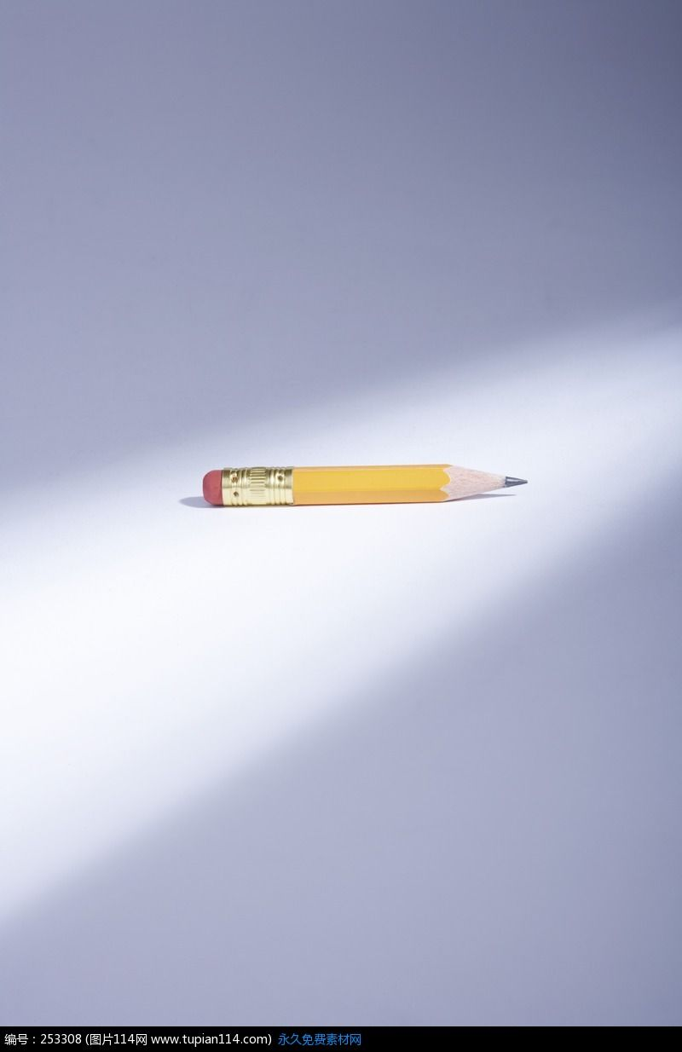


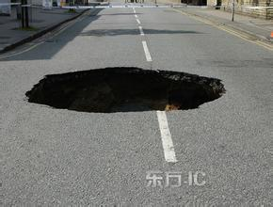
The
pencil on the table
is
(be) short.
The
book about dinosaurs
has
(have) interesting
pictures.
The
boy with short hair
plays
(play) really well.
The
hole in the road
is
(be) dangerous.

Slide 22
C. Using the with a phrase to describe a particular person or thing.
The girl with glasses is Joyce’s best friend.
The man in the black coat is our English teacher.
The woman with long, straight hair is Mrs Zhang.
The factory near my home is very noisy.
the的用法：
4.描述特定的人或事物
______________________

Slide 23
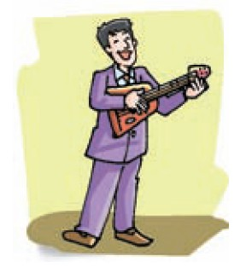
In pairs, talk about the people in the pictures below.
Use the words in brackets to help you. Add the if
necessary. Follow the example.
S1: What’s the man playing?
S2: Which man?
S1: The man in the purple suit.
S2: He’s playing the guitar.
(in the purple suit / guitar)

Slide 24
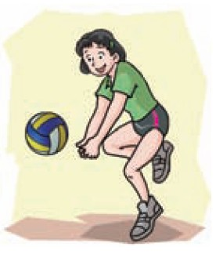
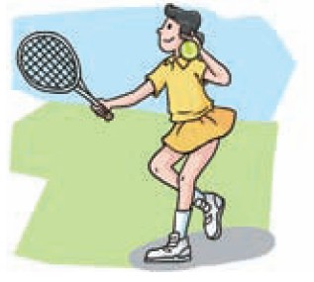
S1: What’s the girl playing?
S2: Which girl?
S1: The girl in the yellow skirt .
S2: She’s playing tennis.
(with short hair / volleyball)
S1: What’s the girl playing?
S2: Which girl?
S1: The girl with short hair.
S2: She’s playing volleyball.
(in the yellow skirt / tennis)

Slide 25
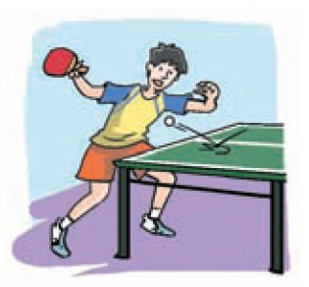
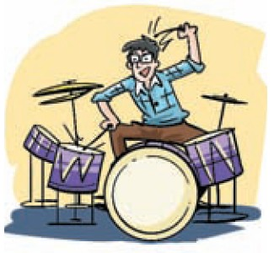
S1: What’s the boy playing?
S2: Which boy?
S1: The man with short, black hair.
S2: He’s playing table tennis.
(with short, black hair/ table tennis)
S1: What’s the man playing?
S2: Which man?
S1: The man with glasses.
S2: He’s playing the drums.
(with glasses / drums)

Slide 26
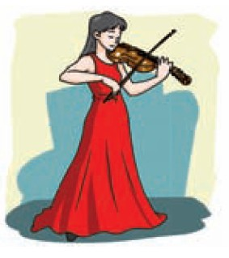
S1: What’s the woman playing?
S2: Which woman?
S1: The woman in the red dress.
S2: He’s playing the violin.
(in the red dress / violin)

Slide 27
Part IV Post-Learning

Slide 28
Summary
1.代替前面出现过的名词。
2.用来形容独一无二的事物。
the的用法：
3.在乐器名词前面加 the ；
在体育项目前不用加the。
4.描述特定的人或事物

Slide 29
the的用法补充：
1.在特定情景中，当对话双方都清楚所指的对象，名词前须用the。
如：Don’t throw the paper on the ground. Put it in the dustbin. 别把纸扔在地上，放到垃圾箱里去。
2.形容词最高级前要加the。
如：the hottest day 最热的一天

Slide 30
the的用法补充：
3.序数词以及表示序列的形容词如last, next等前须用the。
如：the first step 第一步
the last one 最后一个
4.一些惯用语中也含有the。
如：at the moment 此刻 on the other hand 另一方面
in the end 最后 break the ice 打破冷场

Slide 31
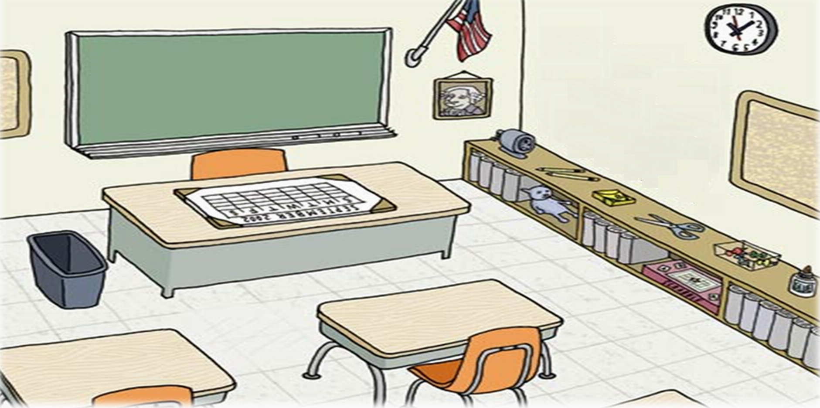

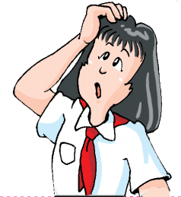
In groups, describe the people and the things in your classroom with “the”.

Slide 32
Part V Review

Slide 33
选择最佳答案填空。
( )1. At the weekend, I often play ____ piano and my
brother usually plays ____ football.
A. the, / B. /, the C. /, / D. the, the
( )2. Lily bought ____new dress and ___dress is beautiful.
A. the, a B. a, a C. the, the D. a, the
( )3. What’s ____ capital of England?
A. a B. / C. the D. an
A
D
C

Slide 34
( )4. Which is bigger, ____Sun or ____ Earth?
A. a, a B. a, the C. the, the D. the, a
( )5. — Do you play ____ violin in your free time?
— No, I like sports. I often play ____football
with my friends.
A. /, the B. the, / C. the, the D. a, a
( )6. ____woman over there is ____English teacher.
A. The, an B. The, the C. An, the D. An, an
( )7. I hope I can fly to ____ Moon one day.
A. the B. a C. an D. /
C
B
A
A

Slide 35
对划线部分提问。
1. Mary plays volleyball every day.
____ ____Mary ____every day?
2. They are talking about a new film.
____ ____ they ______ about?
3. My sister is 1.68 metres tall.
____ ____ is ____ sister?
4. Her skirt is green.
____ ______ ____ her skirt?
5. The girl in green won the game.
______ ____ won the game?
What does play
What are talking
How tall your
What colour is
Which girl

Slide 36
Thank you!

